Slide 1


FOLLOW THE MONEY
A webinar
Understanding California County Budgets
Chris Hoene, Executive Director, California Budget and Policy Center
Ed Harrington, Former Controller, San Francisco
Margaret Brodkin, Director, Funding the Next Generation
July 11, 2017

Slide 2
Dollars and Democracy:
A Guide to the County Budget Process
JULY 2017
Chris Hoene, Executive Director
calbudgetcenter.org

Slide 3
California Budget & Policy Center
The Budget Center was established in 1995 to provide Californians with a source of timely, objective, and accessible expertise on state fiscal and economic policy issues. The Budget Center engages in independent fiscal and policy analysis and public education with the goal of improving the economic and social well-being of low- and middle-income Californians. Support for the Budget Center comes from foundation grants, subscriptions, and individual contributions. Please visit our website at calbudgetcenter.org.
Acknowledgments
The development of this guide was supported by The California Endowment and The Center for Health Program Management at the Sierra Health Foundation. An earlier version was supported by and released in partnership with Californians for Safety and Justice. Scott Graves prepared this guide, which reflects valuable insights provided by the California State Association of Counties.

Slide 4
California’s Counties:
The Basics

Slide 5
California’s Counties Are
Legal Subdivisions of the State
California’s Constitution requires the state to be divided
into counties.
Counties’ powers are provided by the state Constitution or by the Legislature.
  The Legislature may take back any authority or functions that it delegates to the counties.
There are 44 general-law counties and 14 charter counties.
  Unlike general-law counties, charter counties have a limited degree of independent authority over certain rules that pertain to county officers. However, charter counties lack any extra authority with respect to budgets, revenue increases, and local regulations.

Slide 6
Counties Have Multiple Roles in Delivering Public Services
Counties operate health and human services programs as agents of the state.
  These include foster care; child welfare services; Medi-Cal (health care for low-income residents); public health and mental health services; substance use disorder treatment; the CalWORKs welfare-to-work program; and others.
Counties carry out a broad range of countywide functions.
  These include overseeing elections and operating – along with the courts and cities – the criminal justice system.
Counties provide some municipal-type services in unincorporated areas. These include policing, fire protection, libraries, planning, and road repair.

Slide 7
Other Types of Local Agencies Also Deliver Public Services
Counties provide public services alongside other agencies that operate at the local level.
A wide array of local services are delivered by:
  More than 2,000 independent special districts, which provide specialized services such as fire protection, water, or parks.
  More than 900 K-12 school districts, which are responsible for thousands of public schools.
  More than 480 cities, which provide police protection along with other municipal services.
  More than 70 community college districts, which oversee 113 community colleges.

Slide 8
Counties Are Governed by an Elected Board of Supervisors
The Board of Supervisors consists of five members in all but one county.
  The City and County of San Francisco has an 11-member Board and an independently elected mayor.
Because counties do not have an elected chief executive (except for San Francisco), the Board’s role encompasses both executive and legislative functions.
  These include setting priorities, approving the budget, controlling county property, and passing local laws.
Boards also have a quasi-judicial role.
  For example, Boards may settle claims and hear appeals of land-use and tax-related issues.

Slide 9
A Number of Other County Officers
Also Are Elected
Along with an elected Board of Supervisors, the state Constitution requires counties to elect:
  An assessor.
  A district attorney.
  A sheriff.
Although not required by the state Constitution, a few other key county offices are typically filled by election, rather than by Board appointment. These include:
  The auditor-controller.
  The county clerk.
  The treasurer-tax collector.

Slide 10
The County Manager Oversees the Daily Operations of the County Government
The top administrator in each county is appointed by the Board of Supervisors.
  Counties have various titles for this position. This guide uses the generic term “County Manager.”
  San Francisco, with an independently elected mayor, does not a have a county manager position.
The County Manager:
  Prepares the annual budget for the Board’s consideration.
  Coordinates the activities of county departments.
  Provides analyses and recommendations to the Board.
  May hire and fire department heads, if authorized to do so.
  May represent the Board in labor negotiations.

Slide 11
Key Facts About County Revenues and Spending

Slide 12
The County Budget Is More Than
Dollars and Cents
County budgets provide a framework and funding for public services and systems.
  Dollars provided through county budgets can help move policy ideas from concept to reality.
But county budgets are about more than dollars and cents.
  At a fundamental level, a county budget expresses
  our values and priorities, both as residents of a particular county and as Californians.
  County budgets reflect Californians’ collective efforts to help strengthen our communities as well as to ensure the continued vibrancy of our state.

Slide 13
County Budgets Reflect State and Federal Priorities as Well as Local Policy Choices
To a large degree, county budgets reflect state and
federal policy and funding priorities.
  As agents of the state, counties provide an array
  of services that are supported with state and federal dollars and governed by state and federal rules.
  This means that a large share of any county budget will reflect priorities that are set in Sacramento and in Washington, DC.
County budgets also reflect the policy and funding priorities of local residents and policymakers.
  Counties can use a portion of their locally generated revenues to fund key local services and improvements.

Slide 14
County Revenues =
State Funds + Federal Funds + Local Funds
County revenues consist of state and federal dollars along with locally generated funds.
  State and federal revenues pay for health and human services, roads, transit, criminal justice activities, and other services.
  Local revenues, particularly property tax dollars, are important because they are mostly “discretionary” and
  can be spent on various local priorities.
In 2014-15, state and federal revenues comprised nearly half (48.0 percent) of all county revenues across the state.
Property taxes made up almost one-fifth (19.3 percent) of total county revenues in 2014-15.

Slide 15
State and Federal Funds Combined Comprise
Nearly Half of County Revenues, 2014-15
* Reflects a range of smaller revenue sources, including other taxes, fines, licenses, and permits.
Note: Data exclude the City and County of San Francisco. Percentages do not sum to 100 due to rounding.
Source: California State Controller’s Office
Notes:
In 2014-15, state and federal revenues comprised nearly half (48.1%) of all county revenues across the state.
Property taxes made up almost one-fifth (19.3%) of total county revenues in 2014-15.
SF is excluded because SF reports as a city rather than a county.
“Charges for current services”:
The State Controller defines these as “resources obtained by a local government through imposition of fees, charges, and rates for services and facilities. These can include recreation classes, plan-checking fees, safety inspections, etc.” See the “Glossary” to the SCO’s “Counties Annual Report.”

Slide 16
County Budgets Support a Broad Range of Public Services and Systems
In 2014-15, more than half (54.4 percent) of all county spending across the state paid for public protection or public assistance.
  Public protection includes spending on the district attorney, adult and juvenile detention, policing provided by sheriff’s departments, and probation.
  Public assistance includes spending on cash aid for Californians with low incomes, including families with children in the CalWORKs welfare-to-work program.
Large shares of county spending in 2014-15 also supported enterprise activities (15.6 percent) – which includes sewer service and golf courses – and health
and sanitation (15.3 percent).

Slide 17
Public Protection and Public Assistance Combined
Account for Over Half of County Expenditures, 2014-15
* Reflects spending for public facilities, debt service, recreation and cultural activities, and education.
Note: Data exclude the City and County of San Francisco.
Source: California State Controller’s Office
Notes:
In 2014-15, more than half (54.4%) of all county spending across the state paid for public protection and public assistance.
Public protection includes spending on the DA, adult and juvenile detention, policing provided by sheriff’s departments, and probation.
Public assistance includes spending on cash aid for Californians with low-incomes, including families with children in the CW welfare-to-work program.
“Enterprise activities”: The business-like activities of government, such as water delivery and golf courses.
“General” includes costs related to the Board of Supervisors, etc.

Slide 18
State Rules Determining Counties’ Revenue-Raising Authority

Slide 19
State Rules Determine the Authority of Counties to Raise Revenue
Counties can levy a number of taxes and other charges in order to fund public services and systems.
  The rules that allow counties to create, increase, or extend various charges are found in state law – as determined by the Legislature – as well as in the state Constitution.
Statewide ballot measures approved by voters since
the late 1970s have constrained counties’ ability to raise revenues.
  These measures are Proposition 13 (1978), Prop. 62 (1986), Prop. 218 (1996), and Prop. 26 (2010).

Slide 20
Counties Can Increase the Property Tax Rate Solely to Pay for Voter-Approved Debt
Prop. 13 (1978) limits the countywide property tax rate to 1 percent of a property’s assessed value.
  Each county collects revenues raised by this rate and allocates them to the county government, cities, and other local jurisdictions based on complex formulas. Revenues from the 1 percent rate may be used for any purpose.
Local jurisdictions may increase the 1 percent rate to pay for voter-approved debt, but not to increase revenues for services or general operating expenses.
  Most voter-approved debt rates are used to repay bonds issued for local infrastructure projects. At the county level, bonds must be approved by a two-thirds vote of both the Board of Supervisors and the voters.

Slide 21
Counties Can Raise Other Taxes, but Only With Voter Approval
In contrast to counties’ limited authority over property taxes, counties may levy a broad range of other taxes to support local services.
These include taxes on:
  Retail sales.
  Short-term lodgings.
  Businesses.
  Property transfers.
  Parcels of property.
However, county proposals to increase taxes generally must be approved by local voters.
Notes:
I say “generally” in the last bullet because Prop. 13 (1978) allows local governments to increase the property tax rate without voter approval in order to pay for debt approved by voters prior to 1978. See LAO, “A Look at Voter-Approval Requirements for Local Taxes” (March 20, 2014), p. 3.

Slide 22
Counties Can Raise Other Taxes, but Only With Voter Approval (continued)
Voter-approval requirements for local taxes vary depending on whether the proposal is a “general” tax
or a “special” tax.
General (unrestricted) taxes:
  Must be placed on the local ballot and approved by a simple majority of voters.
Special taxes:
  Include both parcel taxes and taxes dedicated to specific purposes.
  Must be placed on the local ballot and approved by at least two-thirds of voters.

Slide 23
Counties Also Can Levy Charges That
Are Not Defined as “Taxes”
In addition to taxes, counties can establish, increase, or extend other charges to support local services. These are:
  Charges for services or benefits that are granted exclusively to the payer, provided that such charges do not exceed the county’s reasonable costs.
  Charges to offset reasonable regulatory costs.
  Charges for the use of government property.
  Charges related to property development.
  Certain property assessments and property-related fees.
  Fines and penalties.
The state Constitution, as amended by Prop. 26 (2010), specifically excludes these charges from the definition of a “tax.”

Slide 24
Counties Also Can Levy Charges That
Are Not Defined as “Taxes” (continued)
Charges that are not defined as “taxes” can be created, increased, or extended by a simple majority vote of the Board of Supervisors. A countywide vote is not required.
However, Prop. 218 (1996) does require the Board to consult property owners regarding two types of charges.
  Property assessments, which pay for specific services or improvements, must be approved by at least half of the ballots cast by affected property owners, with ballots weighted according to each owner’s assessment liability.
  Property-related fees – except for water, sewer, and garbage pick-up fees – must be approved by 1) a majority of affected property owners or 2) at least two-thirds of
  all voters who live in the area.

Slide 25
Key Takeaways

Slide 26
The Bottom Line
County budgets are about more than dollars and cents.
  Crafting the annual spending plan provides an opportunity for county residents to express their values and priorities.
County and state budgets are inherently intertwined because counties are legal subdivisions of California and perform functions as agents of the state.
  To a large degree, county budgets reflect funding and policy choices made by the Governor and legislators as well as by federal policymakers.
  However, county budgets also reflect local choices, as counties allocate their limited “discretionary” dollars to local priorities.

Slide 27
The Bottom Line (continued)
Counties’ ability to raise revenues to support local services is constrained.
  For example, counties cannot increase the property tax rate to boost support for county-provided services.
  Counties may increase other taxes to establish or improve local services, but only with voter approval.
Both state law and local practices shape the county budget process.
  State law establishes minimum guidelines that counties must adhere to in developing their budgets.
  Counties can – and often do – exceed these state guidelines in crafting their budgets and sharing them with the public.

Slide 28
1107 9th Street, Suite 310
Sacramento, California 95814
916.444.0500
choene@calbudgetcenter.org
@CalBudgetCenter
calbudgetcenter.org

Slide 29
Follow the Money
Understanding the numbers

Slide 30
Goals for Session
How to read a County Budget Book for the most important things you want to know?
Where do local revenues come from?
How much is spent on Children and Youth—as much as you can tell from a budget?

Slide 31
Me
Ed Harrington
Controller, City and County of San Francisco
General Manager, SF Public Utilities Commission
Adjunct Professor, University of San Francisco Masters in Urban and Public Affairs
Active in various governmental finance groups

Slide 32
Me
Ed Harrington
Controller, City and County of San Francisco
General Manager, SF Public Utilities Commission
Adjunct Professor, University of San Francisco Masters in Urban and Public Affairs
Active in various governmental finance groups

Slide 33
You
Advocate for Children
Smart—but not a government budget expert
Don’t want to be a government budget expert
Want to know enough to have an intelligent conversation about county money issues and be able to advocate for funding
Willing to learn “enough”

Slide 34
Budget Terminology
Proposed/Recommended Budget
  Before year starts—from CAO/CEA
Adopted Budget/Appropriations Ordinance
  Start of year—From Auditor-Controller
Revenues=Sources; Expenses=Uses
General Fund
Department

Slide 35
Budget Timeline
July to June Fiscal Year
October-December – budget instructions
January-March – Departmental Preparation/Hearings
April-May – CAO Budget Office/Auditor Controller
June – Board of Supervisors

Slide 36
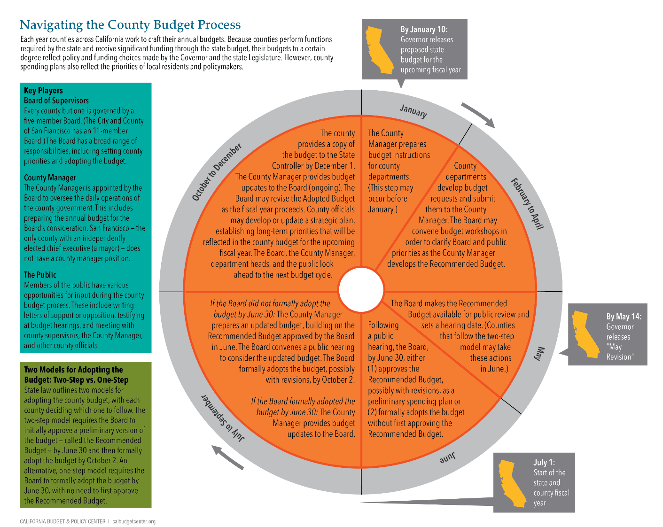
This infographic shows the year-round county budget cycle, illustrating key steps in the process as well as the respective roles of the Board of Supervisors and the County Manager. The infographic is available here:
calbudgetcenter.org/countyprocess

Slide 37
Budget Document
Transmittal Letter from CAO/CEO
  County big picture, Demographics, Strategic Plan
  Often Incremental changes highlighted
Departmental Detail
  Line Item/programmatic
State Controller Schedules

Slide 38
County Budget- Big Picture
Useful General Information/Demographics
What is the total budget?
Where does the money come from?
How is it used?
Where are local tax revenues spent?

Slide 39
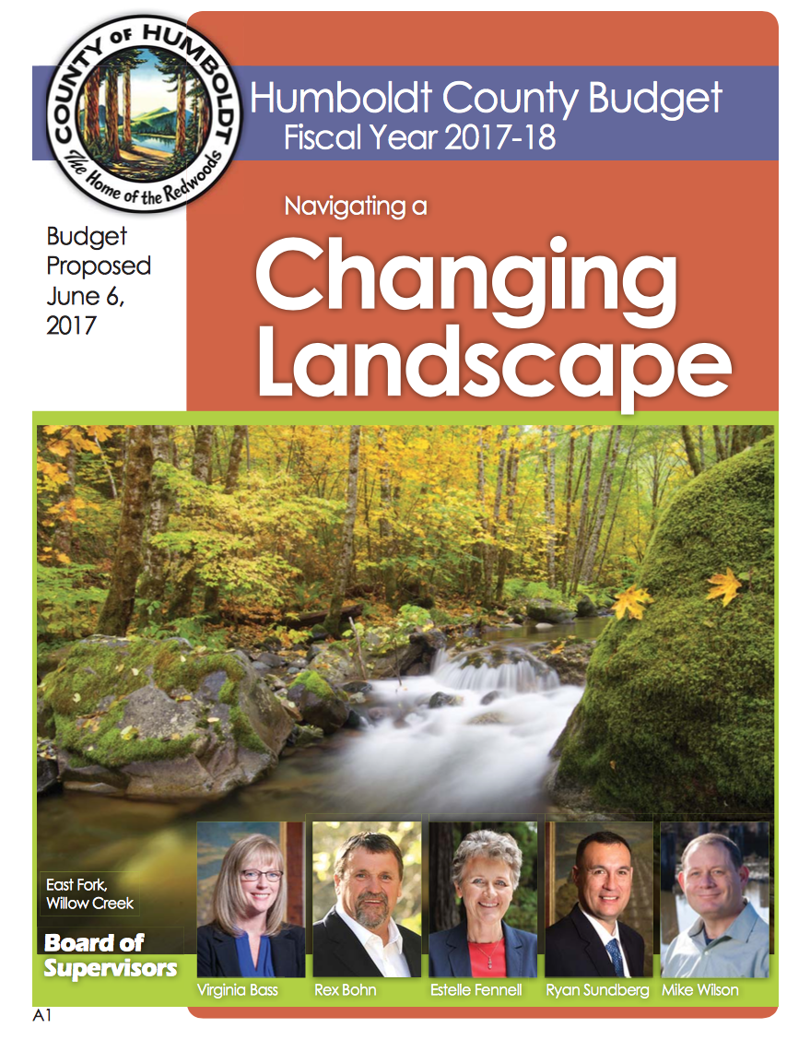
Humboldt

Slide 40
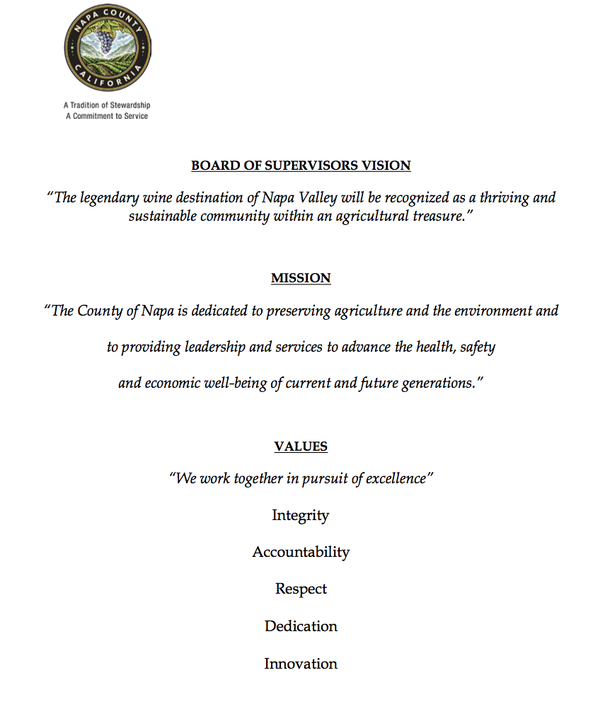
Napa

Slide 41
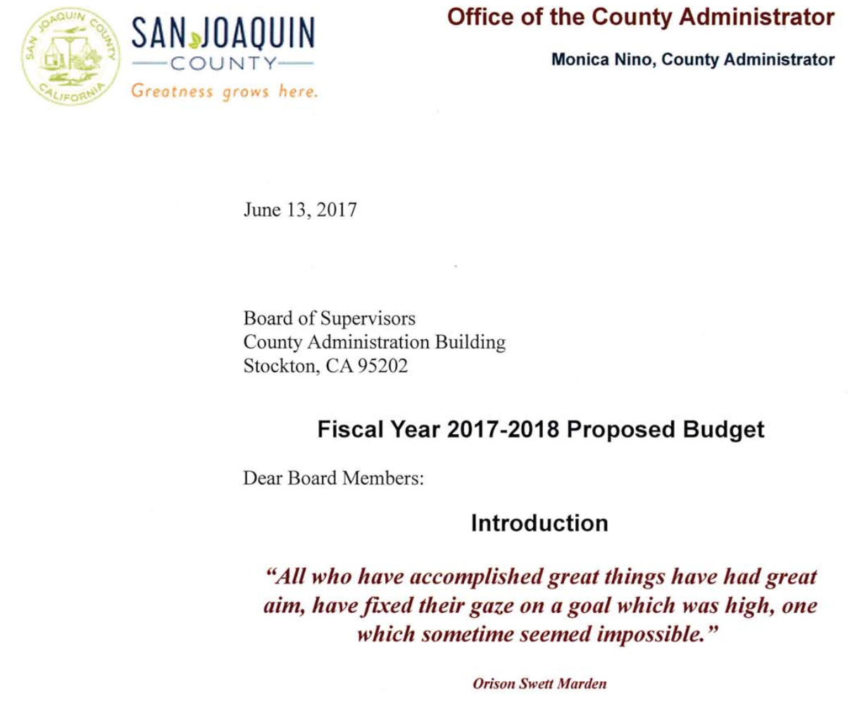
SJ

Slide 42
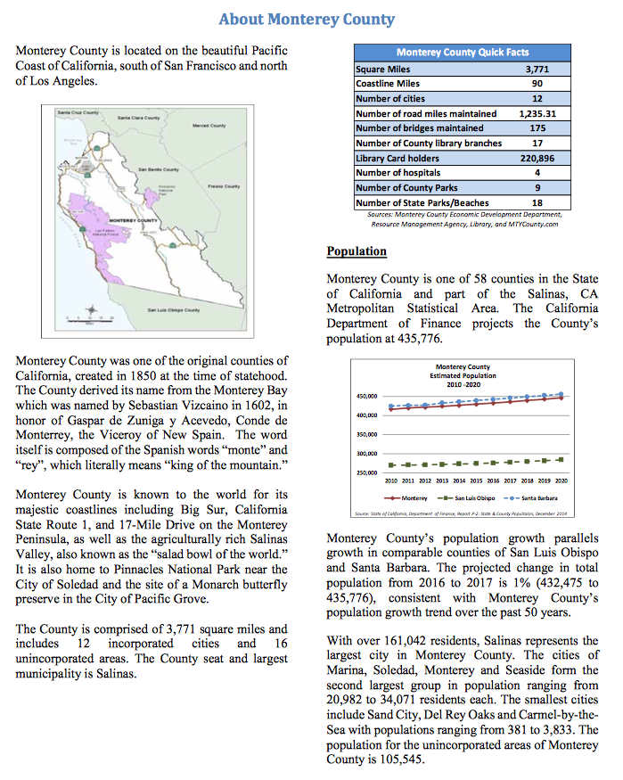
Monterey

Slide 43
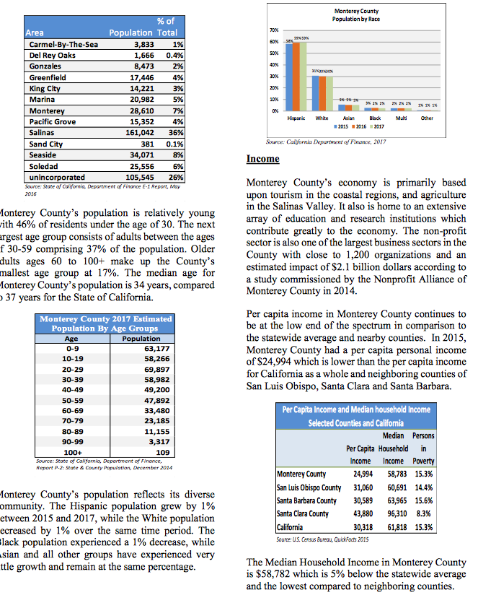
Monterey

Slide 44
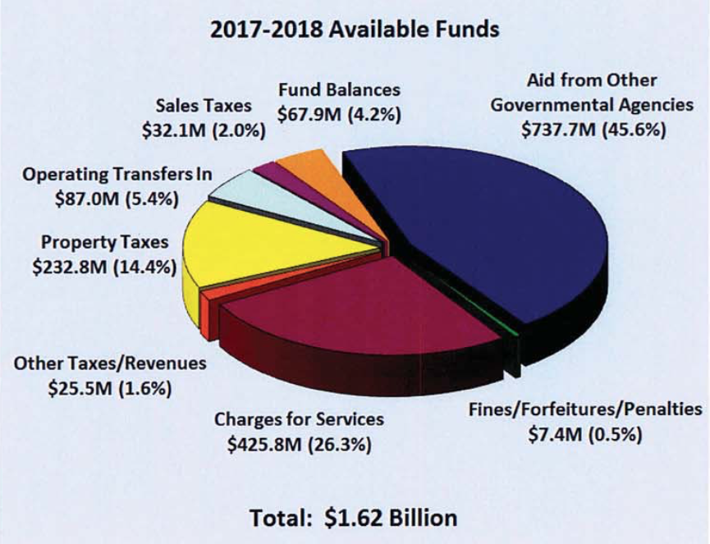
San Joaquin-Total Sources

Slide 45
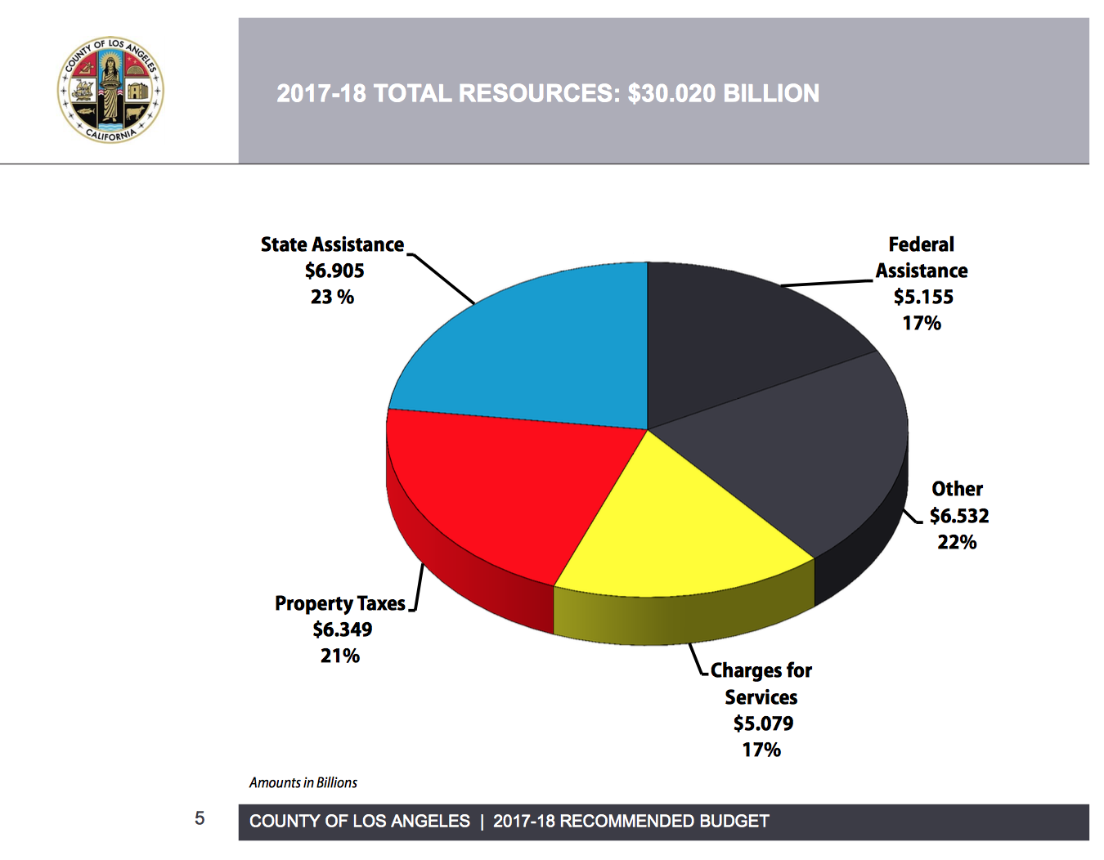
Los Angeles Total Sources

Slide 46
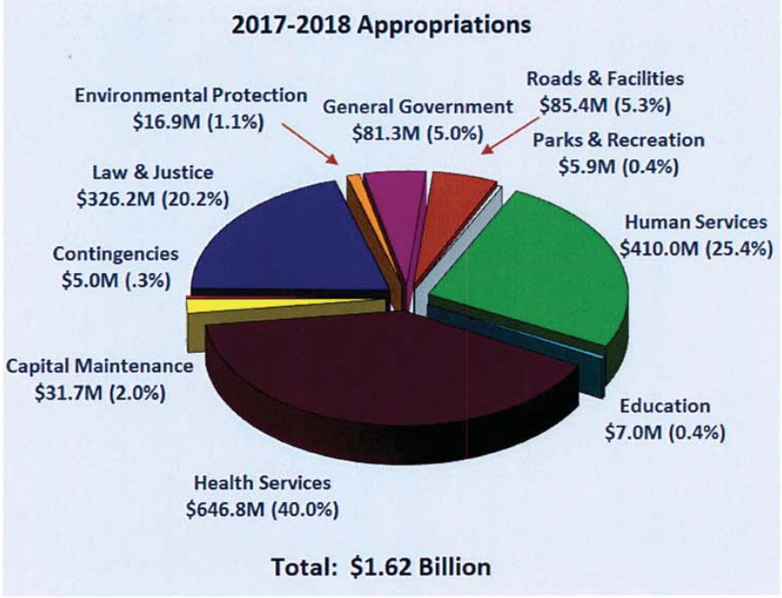
San Joaquin Total Uses

Slide 47
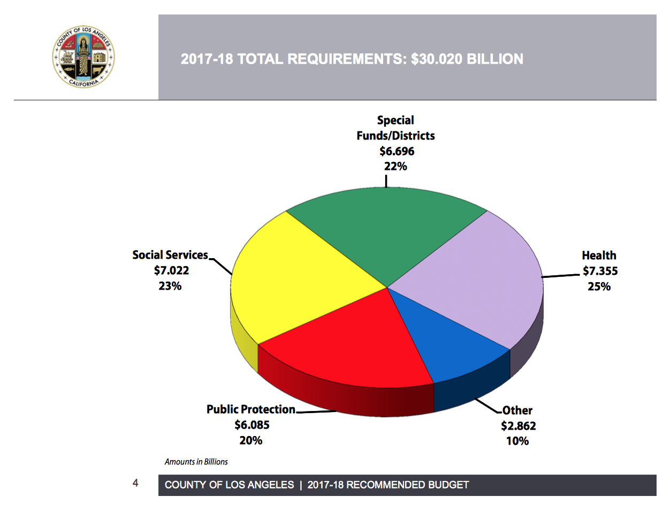
Los Angeles Total Uses

Slide 48
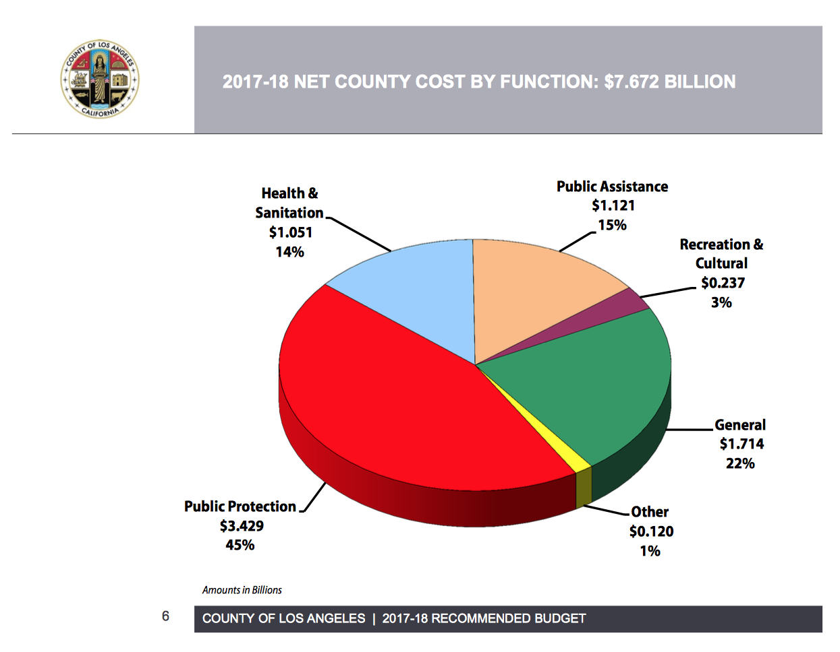
Los Angeles-Use of Local Revenues

Slide 49
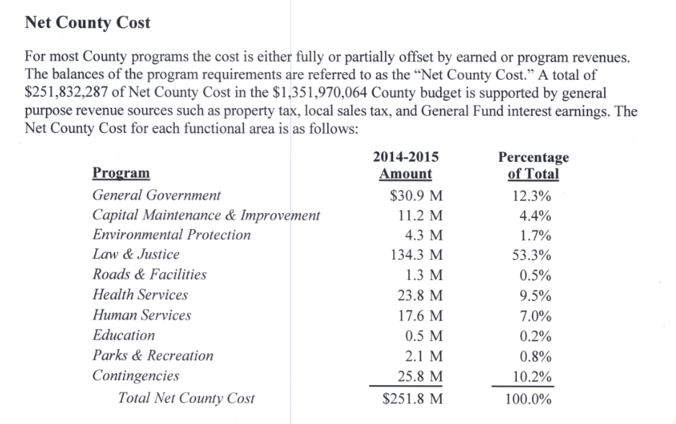
San Joaquin Summary
Discretionary Revenues-Net County Cost

Slide 50
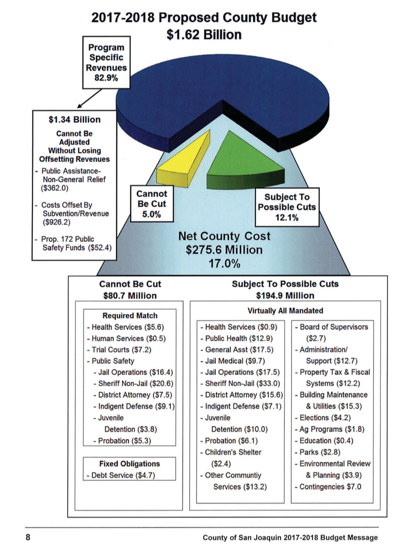
San Joaquin-why you can’t have any

Slide 51
State Controller Schedules
1 – All Funds Summary*
2 – Governmental Funds Summary
3 – Fund Balances of Governmental Funds
4 – Fund Balance Reserves
5 – Sources Summary by Fund*
6 – Sources Detail*
7 – Uses Summary by Function and fund
8 – Uses Summary by Function and Activity
9 – Sources and Uses by Budget Unit*
10-15 Other Funds Detail

Slide 52
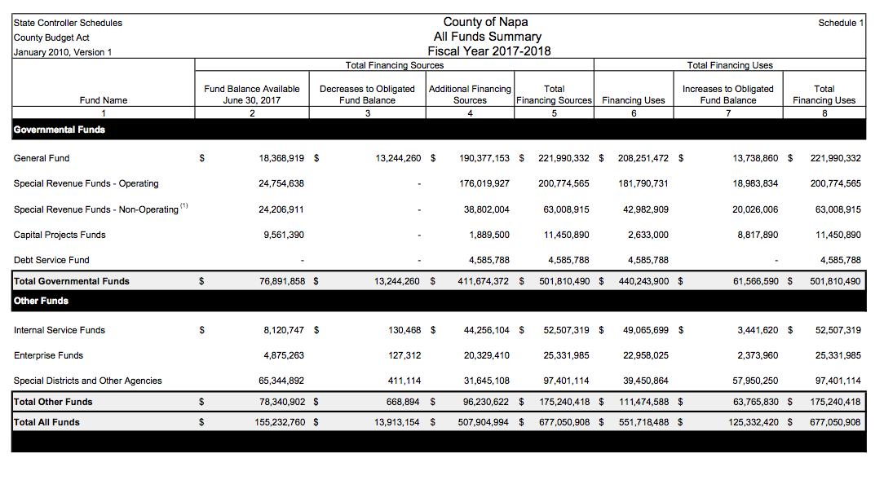
Napa

Slide 53
Sources
Where does local money come from?
  Discretionary money
What are the potential sources of funding for childrens’ services?
Rough guesses of how much might be generated by tax increases?

Slide 54
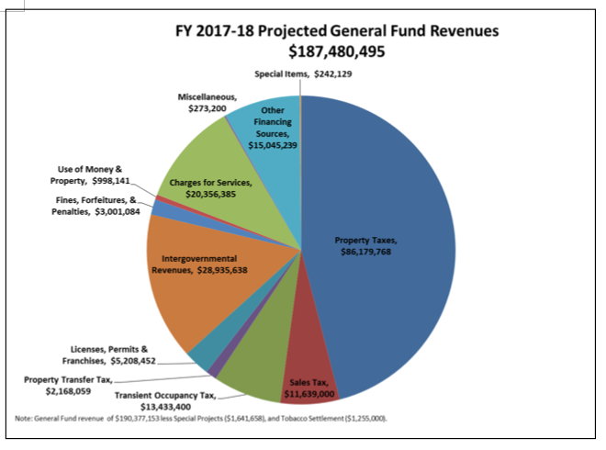
Napa General Fund Revenues

Slide 55
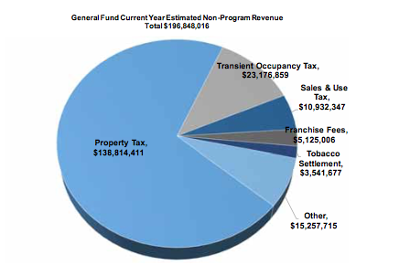
Monterey Non-Program Revenue

Slide 56
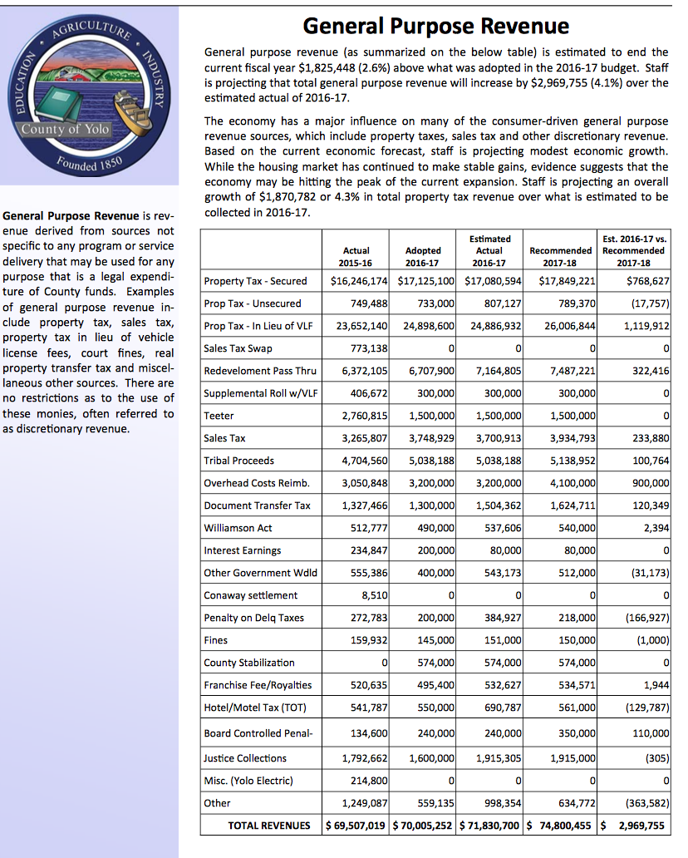
Yolo General Purpose Revenue

Slide 57
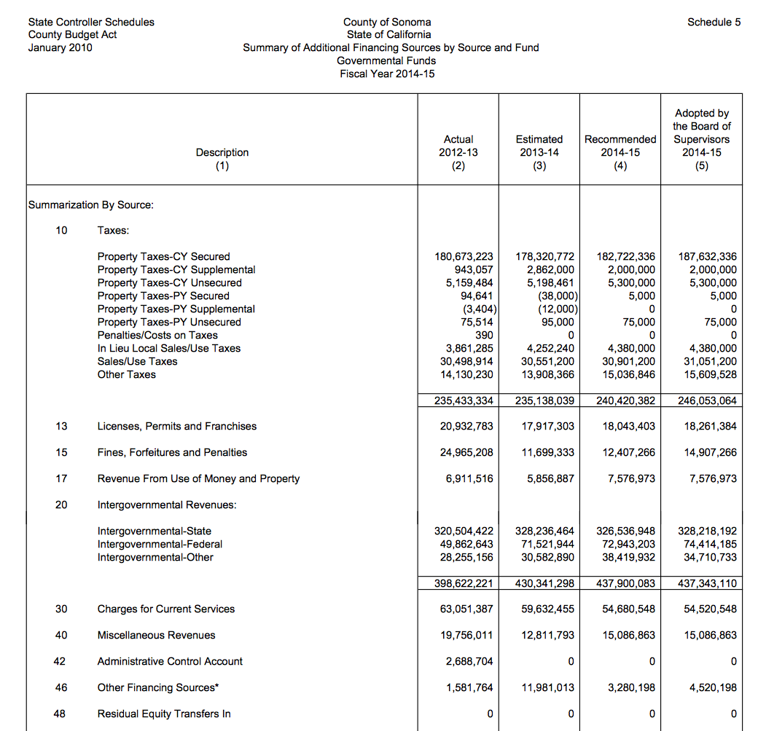
Sonoma County Schedule 5

Slide 58
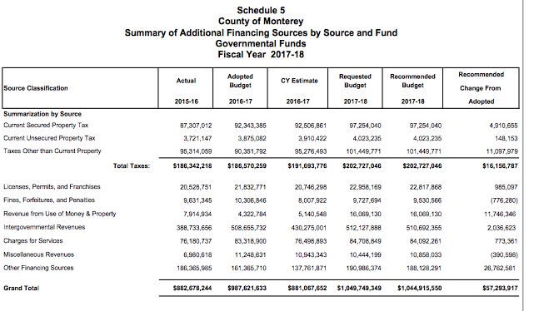
Monterey Total Governmental Fund Revenue

Slide 59
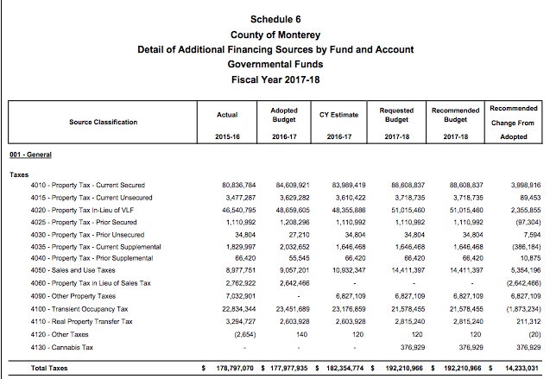
Monterey Local Tax Detail

Slide 60
Spending on Children
Health and Human Services
  Usually required and funded by Fed/State
Juvenile Detention
Other

Slide 61
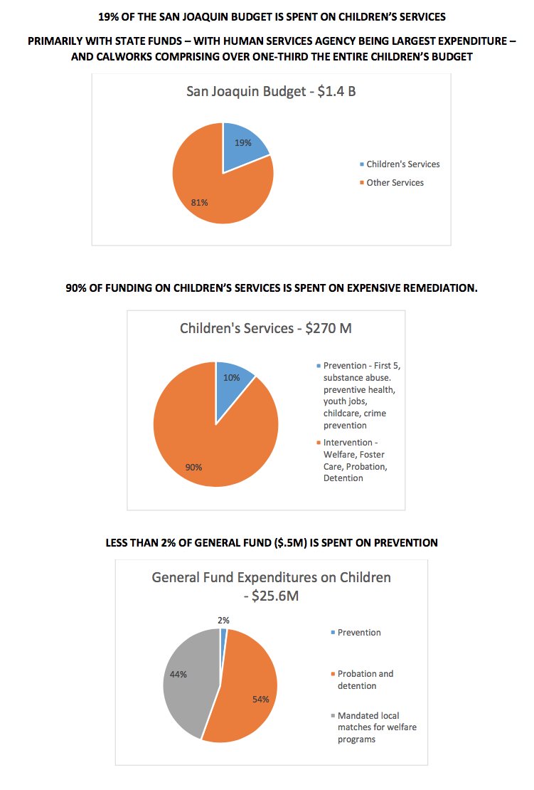
San Joaquin

Slide 62
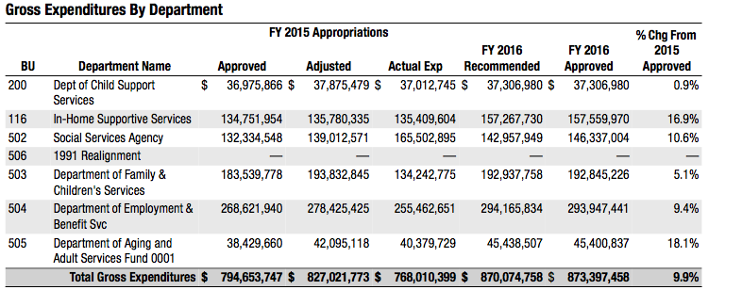
Santa Clara Department of Children, Seniors and Families

Slide 63
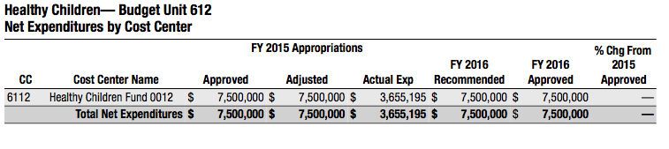
Santa Clara County Children’s Health Initiative

Slide 64
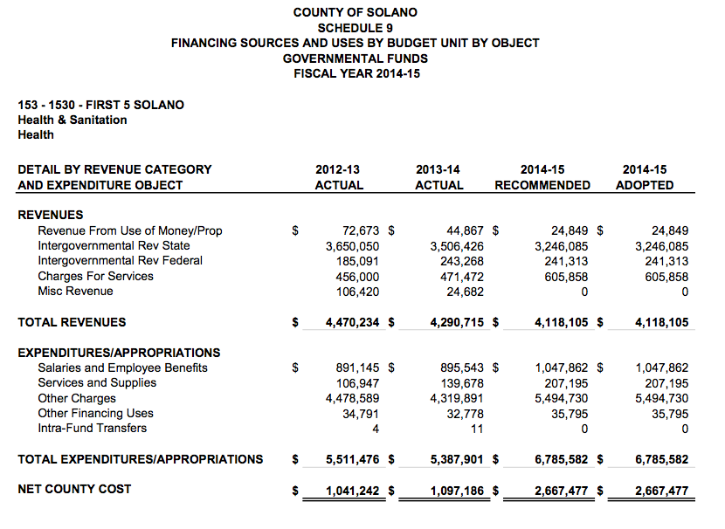
Solano County First 5

Slide 65
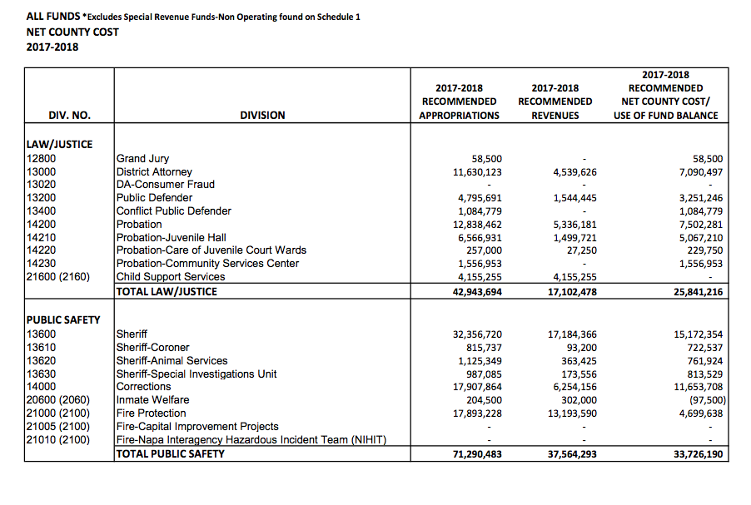
Napa

Slide 66
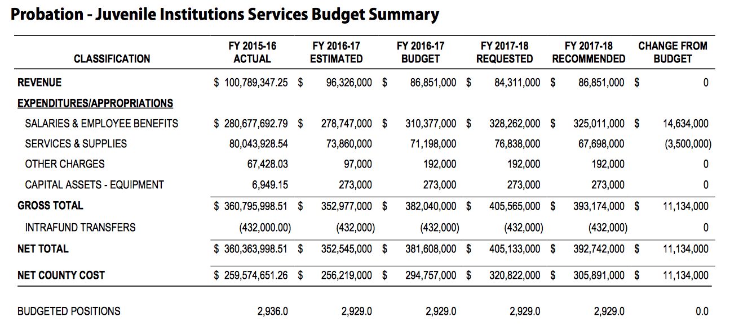
LA

Slide 67
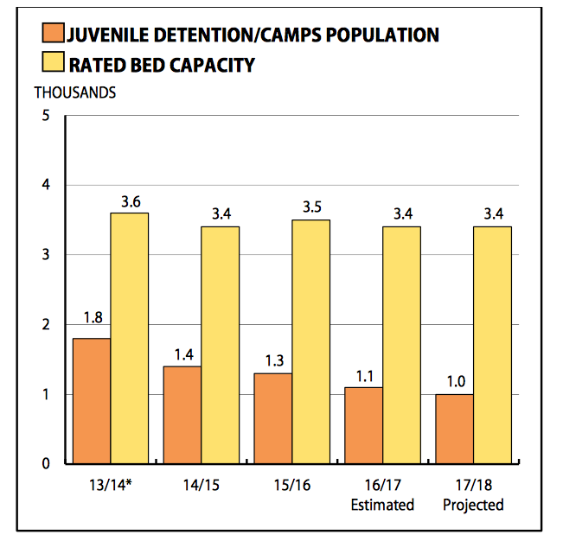
LA

Slide 68
Simple questions to ask about the budget
1. I can’t seem to find anywhere in the budget where it tells me how much we spend on services for children and youth—can you help me?
2. Can you tell me how much you spend on juvenile detention? Can you tell me how much you spend on programs to prevent juvenile detention?
3. I believe we have a waiting list of XXX for _________ service. Is there anything in this budget that would address this?

Slide 69
Not so simple questions about the budget
1. I understand you don’t have a program budget so you can’t tell me what you spend on Children’s Services—or any program, but wouldn’t it be better for you and your taxpayers if the budget showed what we spent our money on in terms of services and programs rather than salaries or how much you spend on paper? How can we help you with this?
2. I realize that pension and retiree health care liabilities are your major concern and priority. But these will be issues for the next 25-30 years. How can we move forward on other issues of community concern while we help you deal with these employee related costs?

Slide 70

CREATING A CHILDREN’S BUDGET
Margaret Brodkin, Director, Funding the Next Generation
Ed Harrington, Former Controller San Francisco, creator of first Children’s Baseline Budget
July 11, 2017

Slide 71



WHAT IS A CHILDREN’S BUDGET?
A Map of Expenditures on Children’s Services
DEFINITION OF CHILDREN’S SERVICES
Services explicitly targeted to children (e.g. child care) and to families when eligibility is dependent on the presence of children in the family (e.g. parenting). NOT services where children benefit as part of a larger class or general public (e.g. fire, clean streets). Can count portion of services explicitly for children when part of a broader service for the general public (e.g. pediatric services in emergency rooms, kids swim classes in public pools).

Slide 72

WHY CREATE A CHILDREN’S BUDGET
Align spending priorities
Improve coordination of services
Identify service gaps
Maximize funding opportunities
Evaluate balance of expenditures
Maintain a children’s baseline budget
ADVOCATE FOR ADDITIONAL RESOURCES

Slide 73

WHAT DO YOU WANT TO KNOW?
Selecting information depends on your purpose.
Expenditure by agency?
Expenditure by function
Expenditure by funding source?
Expenditure by desired outcome or target population
Year to year comparisons
Portion of overall budget
“Front-end” vs. “Back-end” expenditures
Comparative unit costs
Discretionary vs. non-discretionary
Comparisons to other counties

Slide 74

GETTING STARTED
Develop a compelling and non-threatening rationale
Good government, well informed decision-making
Better use of resources
Improved collaboration and coordination
Objectively identify areas for resource development
Resolution by Board of Supervisors – engenders support and cooperation
Establishes purpose of Children’s Budget – goals, guidelines, questions to be answered, areas to be investigated
Creates an Advisory Committee and oversight process
Appoints a leader/lead agency of implementation team
Requires reporting to Board and Public

Slide 75
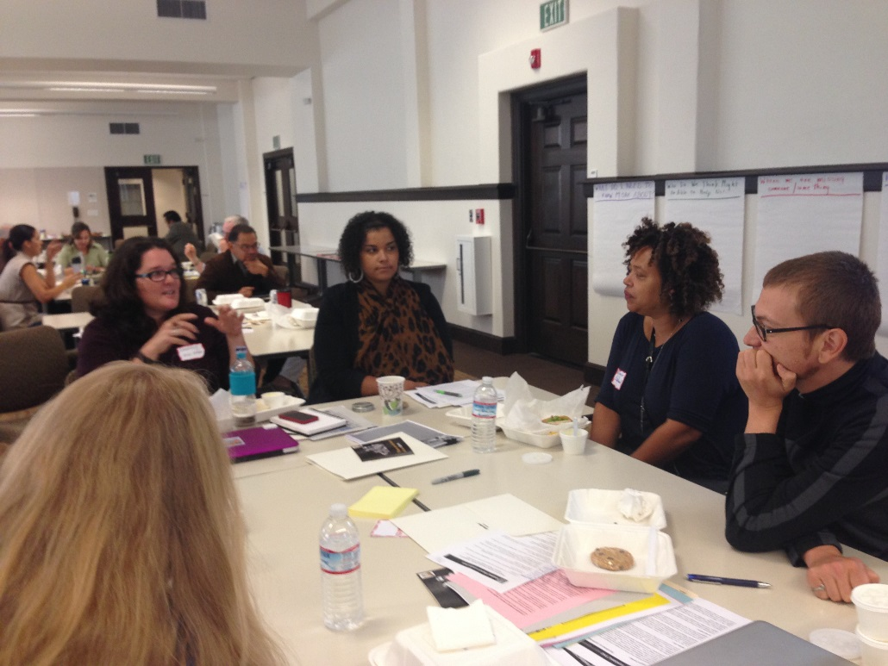
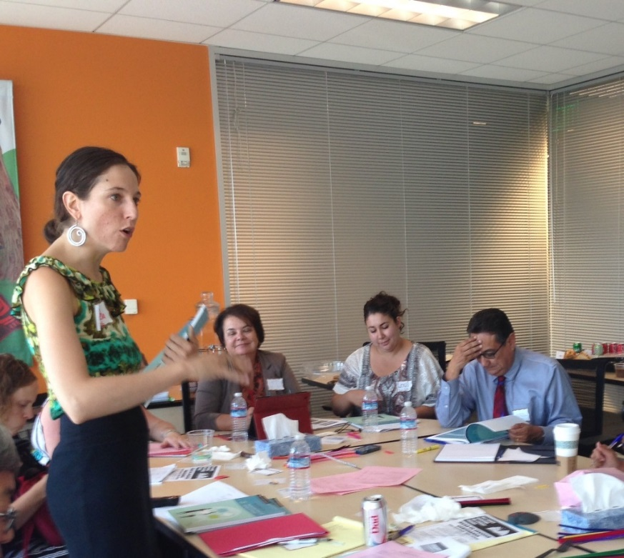
CREATING AN ADVISORY COMMITTEE
BENEFITS
Lends expertise
Builds buy-in of agencies that must provide data
Ensures greater support for conclusions and recommendations
STRUCTURE
Include technical experts, advocates, public agency leadership
Possible leader – head fiscal officer, elected official, county manager, neutral community agency, respected civic leader
Have regular meetings to determine focus, design, ongoing support and guidance

Slide 76

WHERE TO FIND CHILDREN’S SERVICES
At the county level……
Health department – health, mental health, substance abuse
Human services department – child welfare, family support, income supports, economic security, homelessness
Criminal justice – juvenile detention, probation, court
First 5
Recreation, library and cultural institutions
Early care and/or Youth development/employment
Housing

Slide 77

TECHNICAL CHALLENGES
Who will do the work?
Form of data collection – survey, document review, reports by agencies.
Translating budget line items into programmatic and population expenditures
How much detail is enough – agency level, program level, number served.
Ensuring accuracy, consistency and accountability
Presentation of information – Who produces? Who presents?
Institutionalizing the data collection process – Frequently?

Slide 78
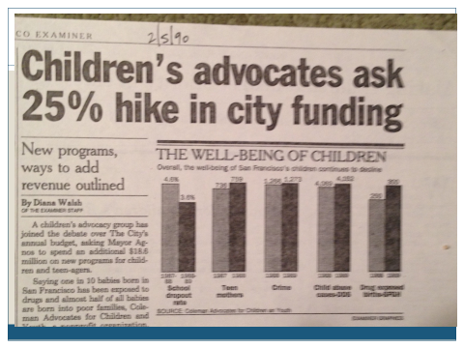
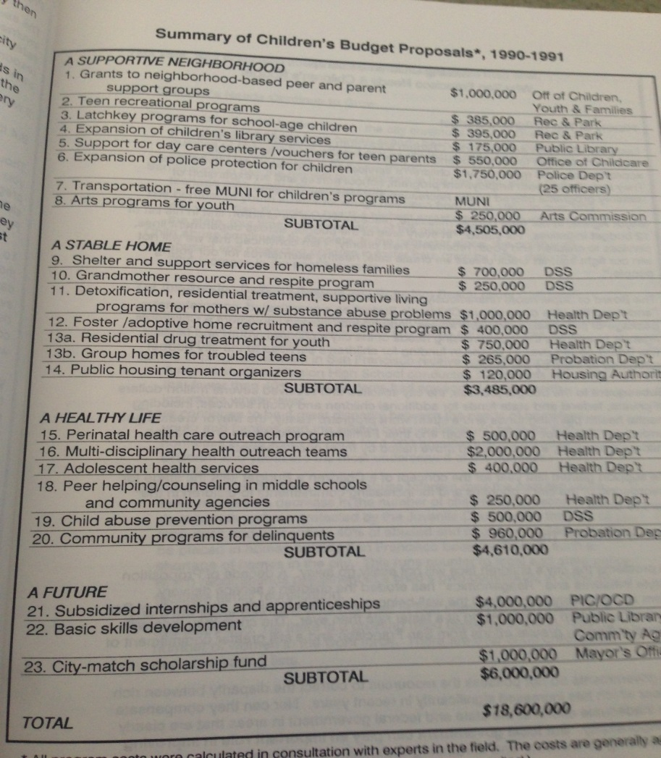
OTHER ELEMENTS CAN ENHANCE EFFECTIVENSS
Profile of community’s children – needs assessment
Data on gaps in services – e.g. waiting lists
Priorities for new services
Cost benefits of new services
Potential sources of funding for new services
CONSIDER CREATING A CHILDREN’S BASELINE BUDGET

Slide 79

ANALYSIS AND RECOMMENDATIONS
MAKING CHANGE WITH CHILDREN’S BUDGETS
Are children getting their fair share?
Do you need more discretionary dollars to meet goals?
Could more lives be saved with greater investment in prevention?
Where are glaring gaps in services? Or skewed funding?
Are there large expenditures with limited accountability?
Have children been losing ground over time?
Do changes in investments match changes in need and demographics?
Are there best practices that should be expanded?

Slide 80

GUIDELINES
GOAL: IMPROVE LIFE FOR CHILDREN
CREATE A CATALYST FOR ACTION
First decide on PURPOSE of your children’s budget.
Stay FOCUSED on purpose – Don’t get lost in weeds.
NO RIGHT WAY – Make whatever “rules” you need to achieve your goals.
BALANCE between collecting to much info and not enough.
It’s a POLICY process, not an accounting one.
PROCESS can be as important as final document.
PARTNERSHIP between government and community advocates is optimal.
INCLUDE ANALYSIS and RECOMMENDATIONS, NOT JUST NUMBERS

Slide 81

FUNDING THE NEXT GENERATION
Provides technical assistance to coalitions working on local funding streams for children and youth
Sponsors learning community and conferences
Site-level support includes speaking, convening, facilitating, trouble-shooting, coaching, and more.
Manual available “Creating Local Dedicated Funding Streams for Kids: A Guide to Planning a Local Initiative to Fund Services for Children, Youth and Their Families”
CONTACT:
Margaret Brodkin, Margaret@fundingthenextgeneration.org
415-794-4963
www.fundingthenextgeneration.org
www.facebook.com/fundingthenextgeneration

