Slide 1

GET MORE MONEY FOR KIDS IN YOUR CITY AND COUNTY 2020 - 2021 BUDGET
Margaret Brodkin, Director Funding the Next Generation
Ed Harrington, Former SF Controller, Expert in Public Finance
Deanna Niebuhr, CA Policy Director, Opportunity Inst.
Dec. 5, 2019
Webinar
Will be posted on funding the next generation website

Slide 2


GOALS OF WEBINAR
START NOW
Inspire and prepare you to do SOMETHING – ANYTHING (ONE THING)– to get money for kids in the 2020-2021 budget

Slide 3
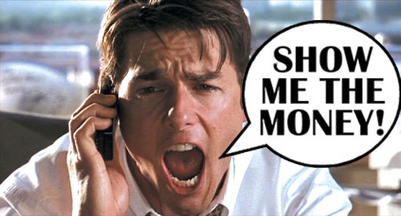
WHAT IS BUDGET ADVOCACY?
GETTING BEYOND THE RHETORIC
Process of working to change public budget priorities for new or expanded programs.

Slide 4

QUESTIONS TO ASK YOURSELF AND PUBLIC OFFICALS AS YOU REVIEW THE BUDGET
Are children getting their fair share?
Do kids need more from your city/county’s discretionary dollars to meet goals?
Should state or federal dollars be more focused on prevention services for kids?
Could more lives be saved with greater investment in prevention?
Where are glaring gaps in services? Or skewed funding?
Are there large expenditures with limited accountability?
Have children been losing ground over time?
Do investments match need and demographics?
Are there best practices that should be expanded?

Slide 5

CHALLENGES
DON’T BE INTIMIDATED!
NO NEW MONEY
SACRED COWS – OTHER PRIORITIES
TURF
NOT THE RIGHT TIME
NOT THE RIGHT APPROACH
PURPOSEFUL MYSTIFICATION

Slide 6
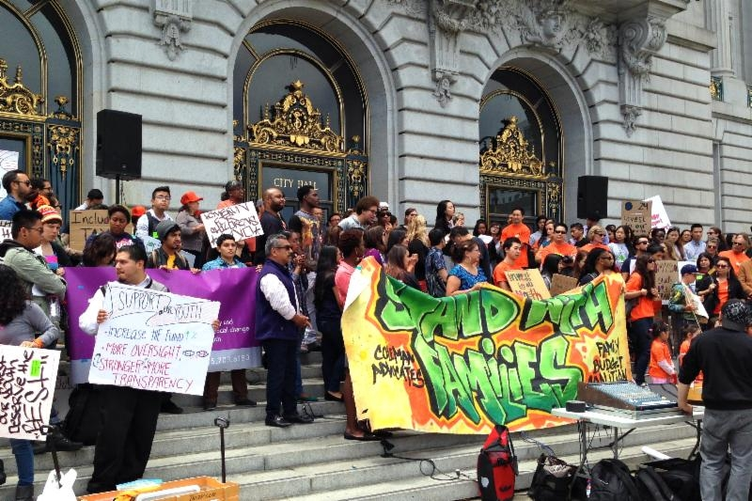
CBO’S AND ADVOCATES FOR CHILDREN CAN WIN BUDGET BATTLES
Budget changes bring long-term solutions.
Showing up is half the battle.
Learn the basics – you will sound smart.
Great potential for collective action to address public budget issues.
Opportunity to build social and political capital and change how resources are allocated.
NON-PROFIT SECTOR CAN RE-INVENT ITS ROLE IN CIVIC LIFE.

Slide 7
UNDERSTANDING
LOCAL BUDGETS
Notes:
1., change LA Co0….to Greater LA Summer Matters Network
2 add 2018 to the date

Slide 8
WHY BUDGETS MATTER?
A budget is a moral document that reflects community values.
Funding inequity is a social justice issue.
It all costs money. Lack of resources is greatest resistance to change

Slide 9
As an advocate, what do I want to know about the budget?
Enough to make your argument—no need to become a budget expert (you pay city/county staff to do that for you.)
Some idea of size of the total budget and where your local taxes go
How much is spent on children services—almost impossible
If you want to add to the budget-- be specific
If they ask you where the money will come from…

Slide 10
Budget Basics
There are no rules for budgeting
Proposed Budget:
  Executive Summary/Transmittal Letter – Prepared by CAO, City Manager, Mayor – policy statement
    Budget summaries, demographics, organization charts, fiscal policies, priorities
  Typically some information by department, goals, performance measures, budget changes
  Some level of State Controller or other detailed accounting schedules
Adopted Budget (by fiscal office)-Annual Appropriation Ordinance:
  Some portion of Transmittal letter
  Budget detail schedules

Slide 11
Topics for Today
Budget Timelines and when/how to get involved
First year start-up budget issues
Pensions

Slide 12
Topics for Today
Budget Timelines and when/how to get involved
First year start-up budget issues
Pensions

Slide 13
Budget Timelines
October- December Budget Instructions
January-March Departmental preparations, hearings
April-May budget Office/Auditor-Controller
June Board of Supervisors

Slide 14
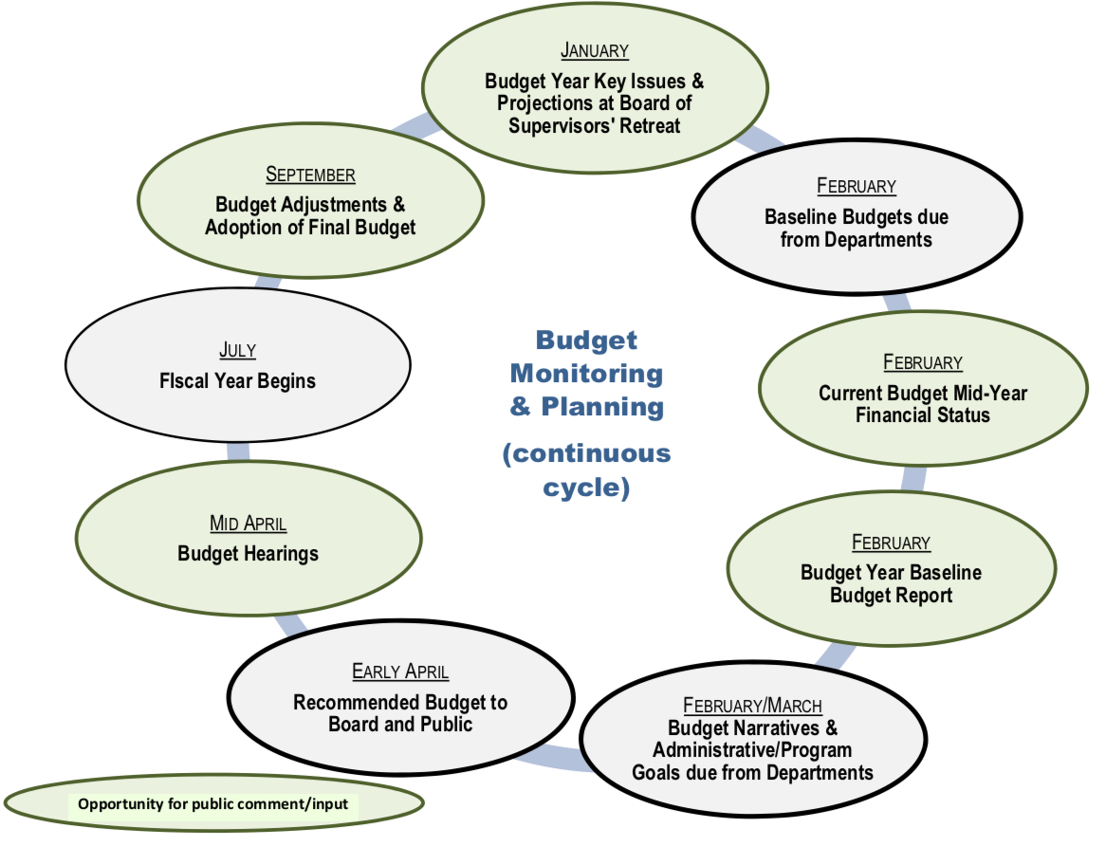
Contra Costa Budget Timing

Slide 15
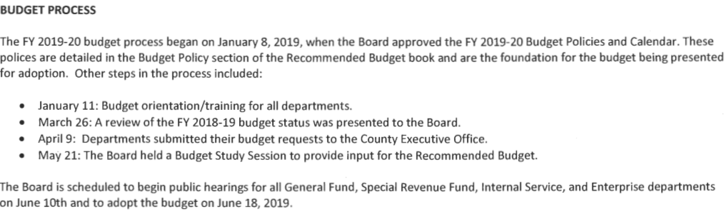
Napa Budget Timing

Slide 16
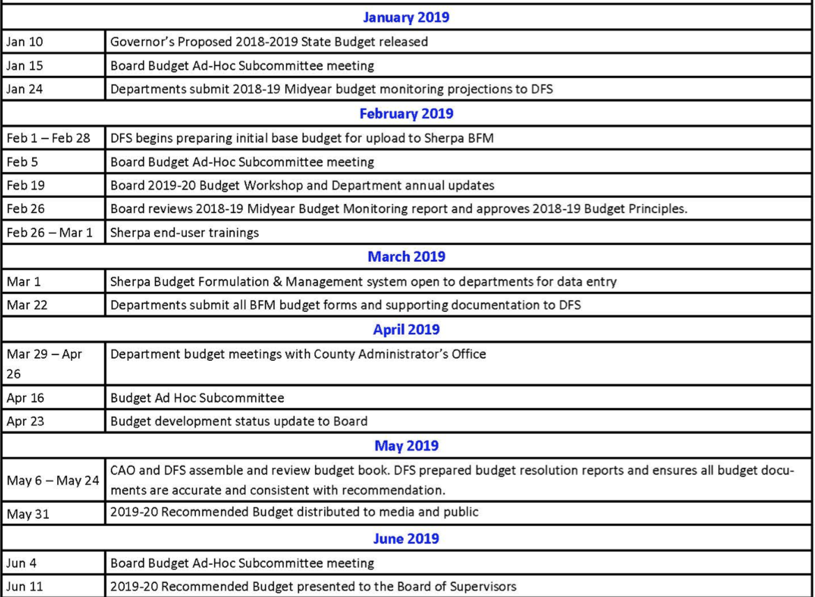
Yolo Budget Timing

Slide 17
When/How to insert yourself?
Budget Instructions to Departments
Board working/study sessions
Departmental Budget Prep
County Administrator Deliberations
Initial Budget Hearings
Final Budget Hearings

Slide 18
First year start-up Budget Issues
  Pilot Projects
    Get in early or you will be too late. Need to show results in time.
  Partial Year budget
      Settle for partial budget as long as it is a full budget for a partial period. Then make sure it is “annualized” in the next budget.

Slide 19
Pension (and Retiree Health Benefits)
  Isn’t the future at least as important as the past?
  We have a legal obligation to our past for retiree pension costs
  We have a moral obligation to our future to take care of our kids

Slide 20
Pension 101
  Pension costs are based on:
    Plan Benefits
    Length of time served and life expectancy
    Rate of Return on Investments
  All of these have changed dramatically in the last 20 years and we will be paying for them forever.

Slide 21
Pension History
  Benefits- Plans were rich in the late 90’s early 00’s so benefits were increased
    Public safety from 2% at 60 3% at 50
  Work/Life expectancy is vastly different
    Work 25-65 now 25-55
    Living as a retiree from 65 – 80 now 55 to 85 and growing
  Investment Return
    Was 8% or more now 7 or 7.5% and that may be high

Slide 22
Pension Future
  Long Term – Change benefits
    “California Rule”
  Short Term- Raise taxes
  This is a very long-term problem and it is not reasonable to
  “just tough it out”

Slide 23
WHAT TO ASK FOR?
Notes:
1., change LA Co0….to Greater LA Summer Matters Network
2 add 2018 to the date

Slide 24
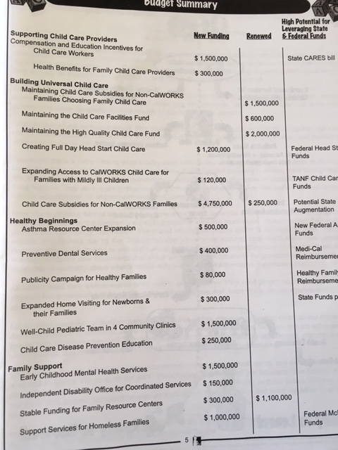
CREATE A PROPOSAL
Can start simple – One item OR Preventing cuts.
Make goal(s) very concrete.
What program? Who will be served? What is cost? Documentation of need? Potential outcomes?
Criteria for setting goal(s):
Possible source of funding, Popular with public, Coalition of supporters, Visible results, Builds power, Rallies parents/youth/constituents,
Big enough to matter --- Small enough to win!

Slide 25
BUILD THE CASE
  Document need
        Report Card/Data on state of kids – some key facts re: problem to be addressed – could be as simple as one key fact
  Build or build-upon a consensus priority or agenda – e.g. Bill of Rights, Stated priority of budget or county
  Demonstrate imbalance of funding – e.g. law enforcement vs prevention
  Communicate the case for investing in children – to public and policymakers – cost benefits
  Create simple one-pagers for decision-makers

Slide 26
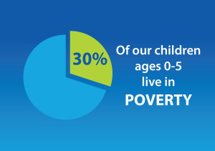
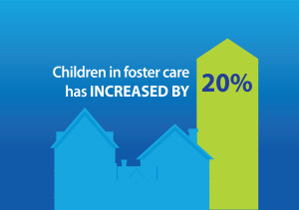
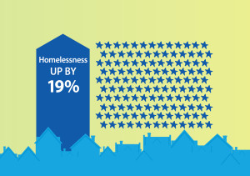
JUST A FEW FACTS
Children in San Joaquin County

Slide 27
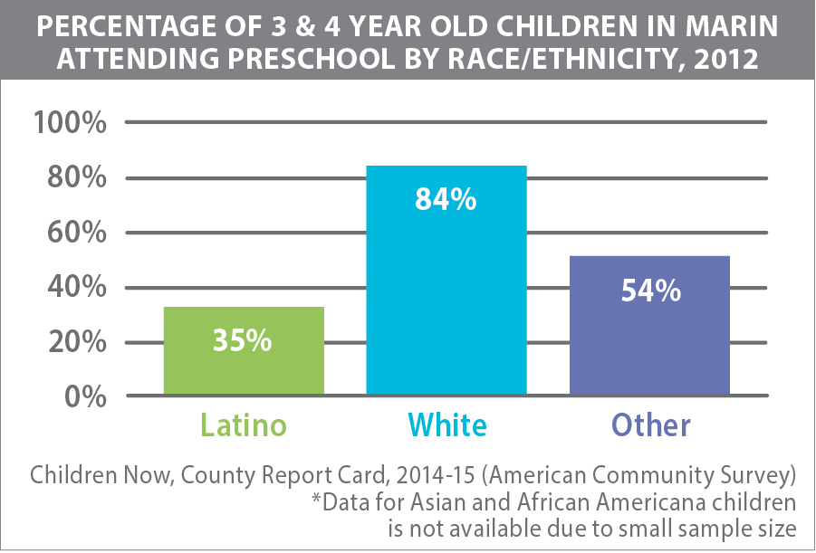

Indications that we are losing ground as rates of attendance have fallen.
Notes:
Access to preschool is markedly different. Preschool - prepares children, especially at-risk children for school. Studies show that poor children are much less likely to be ready for school compared those who are better off with an income-based readiness gap of 27%.

Slide 28
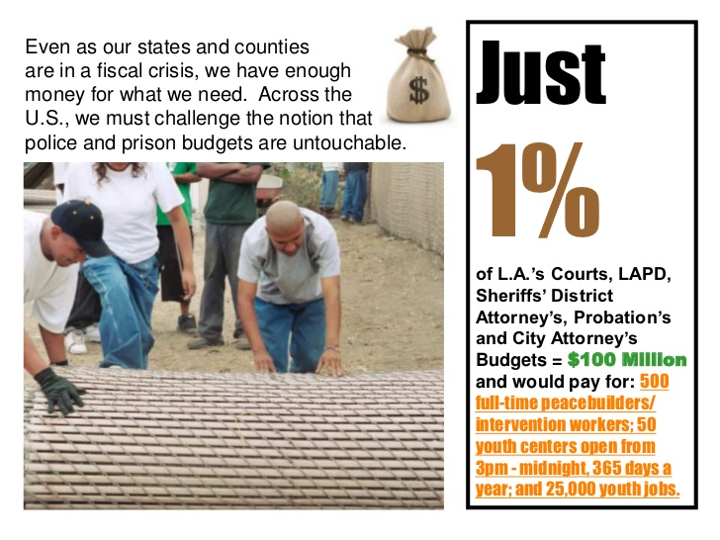
Notes:
1., change LA Co0….to Greater LA Summer Matters Network
2 add 2018 to the date

Slide 29
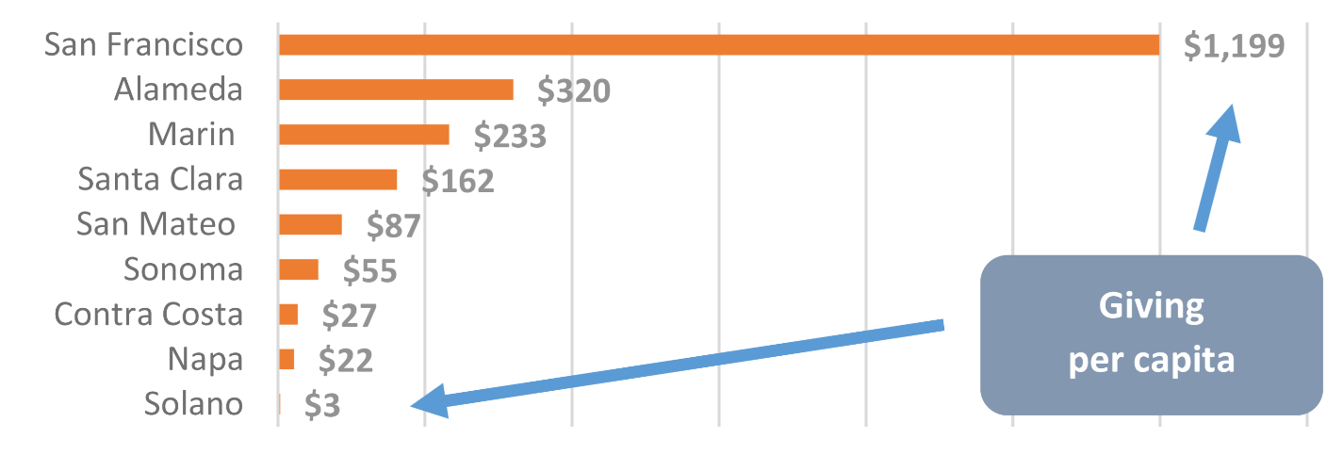
UNDERSTANDING THE CONTEXT
  Foundation giving does not seem directly linked to the level of community needs. For instance, compared to other Bay Area counties, Solano has highest rate of families in poverty (11%), but it has the lowest rate of per capita giving.
  The “giving gap” continues to widen over time. While foundation giving in the Bay Area overall increased 37% between 2006 and 2012, giving in Solano has stagnated, exacerbating the gaps between Solano and its wealthier neighbors.

Slide 30
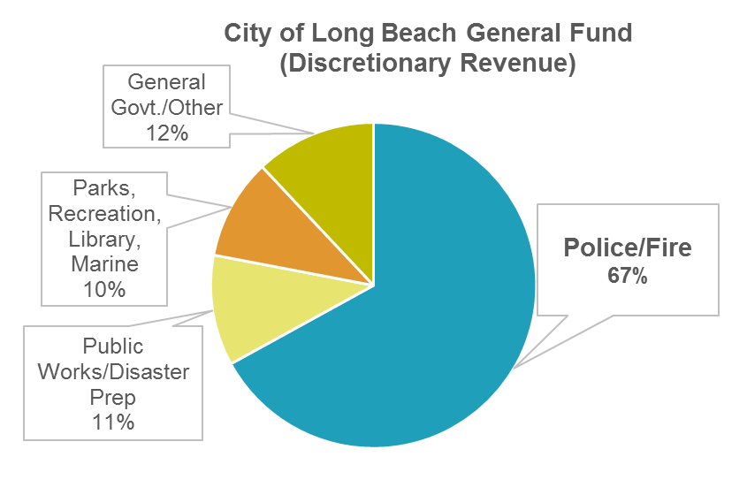
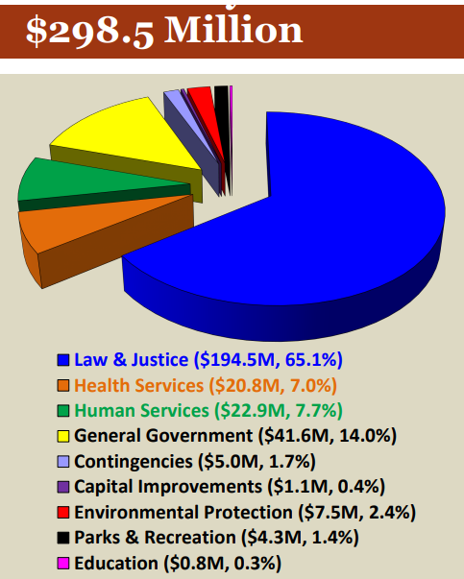
WHAT’S WRONG WITH THIS PICTURE?
San Joaquin County General Fund

Slide 31
WHERE COULD MONEY COME FROM?
Notes:
1., change LA Co0….to Greater LA Summer Matters Network
2 add 2018 to the date

Slide 32

POSSIBLE SOURCES OF FUNDING
**Reallocation of existing dollars – general fund, realigned dollars, specific carve-outs of funding streams (cannabis).
Creating new funding through legislation, e.g. when money changes hands - community benefit agreements, fees i.e. development agreements, agreements with hospitals, PILOT (payment in lieu of taxes)
In-kind resources – facilities, loan funds, free admissions to city/county programs/facilities
Corporations - Social impact “bonds,” tax incentives

Slide 33
POTENTIAL
UNDER UTILIZATION and REDEPLOYMENT
Notes:
1., change LA Co0….to Greater LA Summer Matters Network
2 add 2018 to the date

Slide 34
Funding In Play – Examples
2011 Realignment
Mental Health Services Act
Juvenile Justice Funding (2007)
Family First Prevention Services Act (2018)

Slide 35
What is 2011 Realignment?
  Part of Gov Brown’s package of solutions to multi-year budget deficits
  Enacted through 2011 + 2012 budget trailer bills / made permanent via Prop 30
  Sales Tax and VLF revenue allocated by formula directly to counties (bypasses State General Fund / legislative budgeting process)

Slide 36
What programs were realigned?
(2/3’s to health and human services)
Protective Services
Foster Care
Child Welfare Services
Adoptions / Adoption Services
CAPIT – Child Abuse Prevention Intervention and Treatment
Adult Protective Services
Behavioral Health
EPSDT
Mental Health Managed Care
Drug Medi-Cal
Drug Courts
Perinatal Drug Services
Non-Drug Medi-Cal Services
Residential Treatment

Slide 37
Realignment gives counties new choices
  “Tailor programs to the needs of their communities”
  Reallocate funds among and/or between social services and mental health
  Eliminate optional programs without giving up funds
  Leverage Realignment funds by redirecting funding towards programs with a federal match
  Establish reserves

Slide 38
Realignment Revenue Growth
Revenue growth over multiple years
      Unlike Realignment 1991
Formulas based on poverty / population
      Addresses issues of under investment)
State Controller for annual allocations
      Under ‘subaccounts’

Slide 39
Mental Health Services Act (MHSA)
  Prop 63 (2004)
  1% income tax on individuals earning more than $1m
  In 2015-16, MHSA generated $1.5b / $1.4b allocated to county mental health agencies
  Administered by DHCS + Mental Health Services Oversight and Accountability Commission (MHSOAC)

Slide 40
MHSA - Community-based Approach
Community Services and Supports (CCS)
  Includes MHSA Housing Program
Prevention and Early Intervention (PEI)
Workforce Education and Training (WET)
Capital Facilities and Technology
Innovation

Slide 41
MHSA – Funding Considerations
California State Auditor
  Significant unspent funds … especially in innovation funds
  Reserves
  Interest

Slide 42
State Juvenile Justice Funding
Senate Bill (SB) 81 (2007)
  Counties assume greater responsibility
  New funding streams for counties

Slide 43
State Juvenile Justice Funding
Board of State and Community Corrections (BSCC)
  Juvenile Justice Crime Prevention Act (JJCPA)
  Youth Offender Block Grant (YOBG)
  Others
  http://www.bscc.ca.gov/

Slide 44
Family First Prevention Services Act
Budget Act of 2018 (federal)
  Updated set of prevention programs eligible under Title IV-E
  CA timeline = October 2021

Slide 45
ADVOCACY TIPS
Pick one or two ideas.
Notes:
1., change LA Co0….to Greater LA Summer Matters Network
2 add 2018 to the date

Slide 46
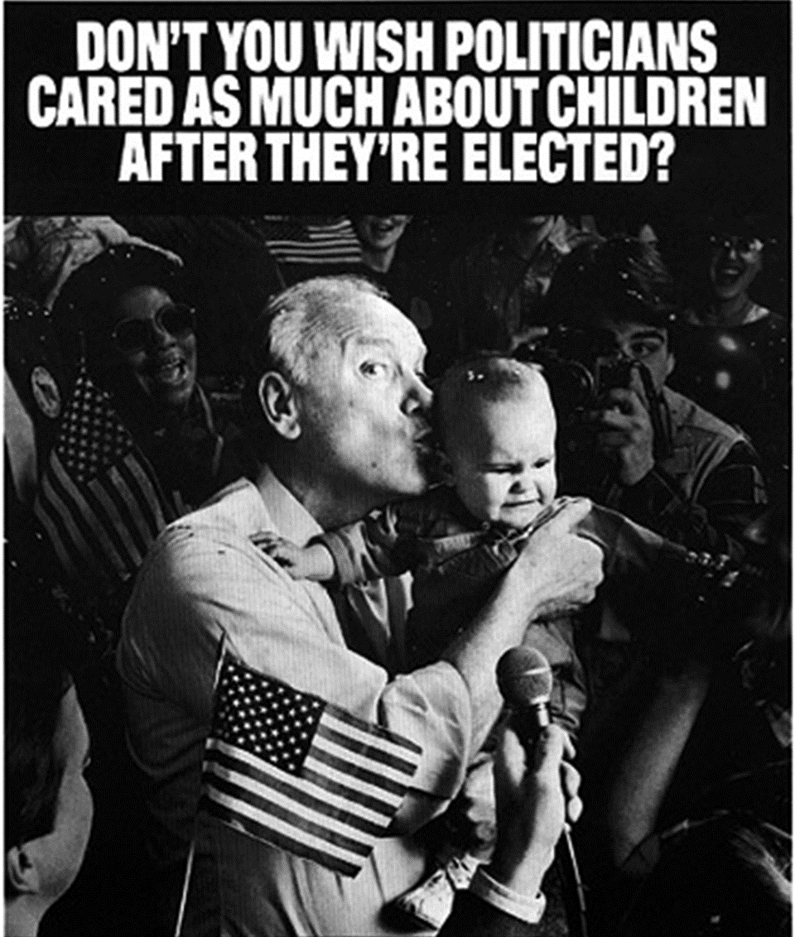
PERSUASION AND PRESSURE
TRADITIONAL TACTICS – reports, meetings, letters, testimony, op-eds, site visits, calls
POLITICAL HARDBALL – demonstrations, sit-ins, petitions, public challenges and direct criticism, guerilla theatre, press events, circumventing the traditional process

Slide 47
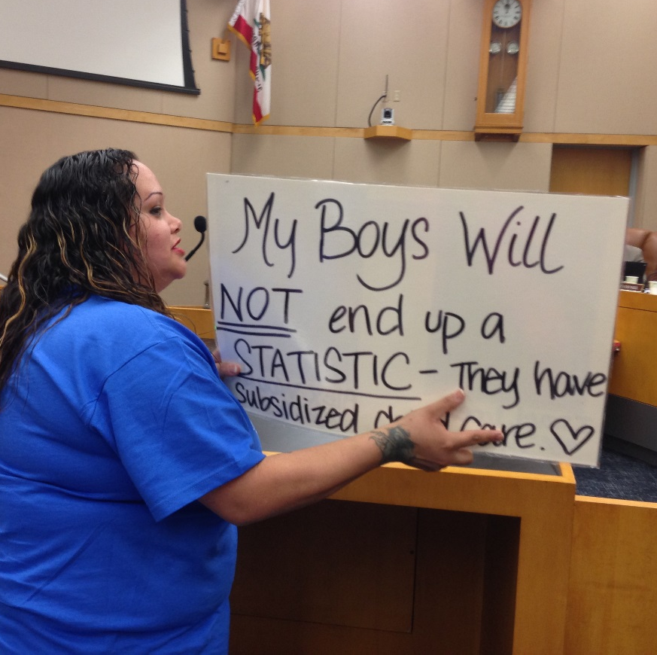
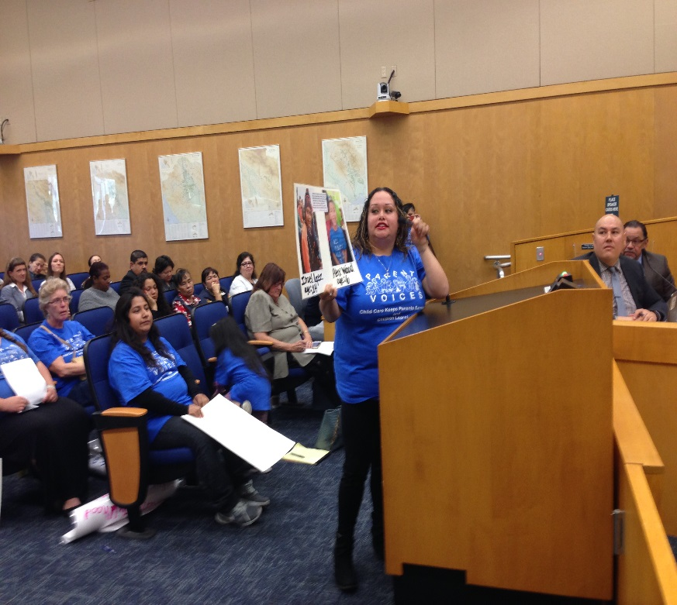
COMMUNICATING THE NEED
USE PUBLIC FORUMS – TESTIFY AT HEARINGS
Reports and facts have an important place, but alone they don’t change budgets.
Decision-makers have short attention spans.
3 minutes is all you get in public testimony.
Avoid jargon and too much data.
Tell stories.
Make it personal.
YOU CAN START BY SHOWING UP FOR OPEN PUBLIC COMMENT.

Slide 48
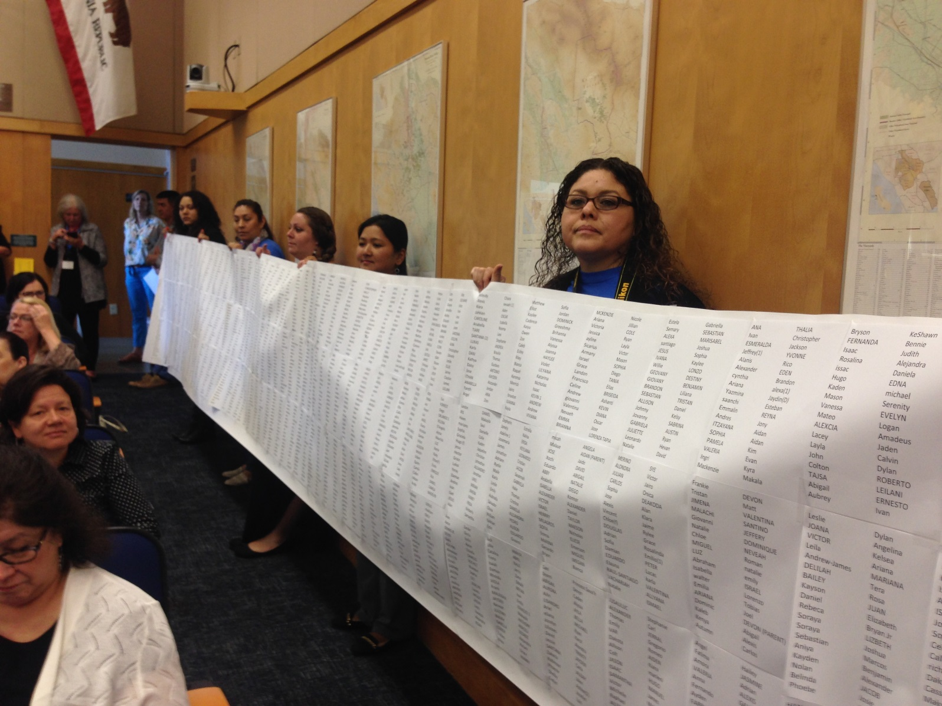
DRAMA HELPS

Slide 49
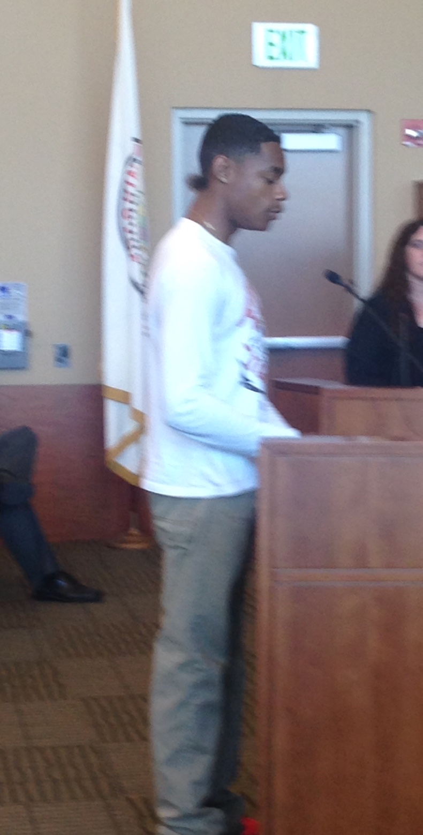
AUTHENTIC VOICES
Elected official to advocate: Whatever you do, stop bringing all those kids.
Advocate: I guess I’ll double the number of kids that we bring.
Hard to say no to kids and parents, and folks telling their real problems.

Slide 50
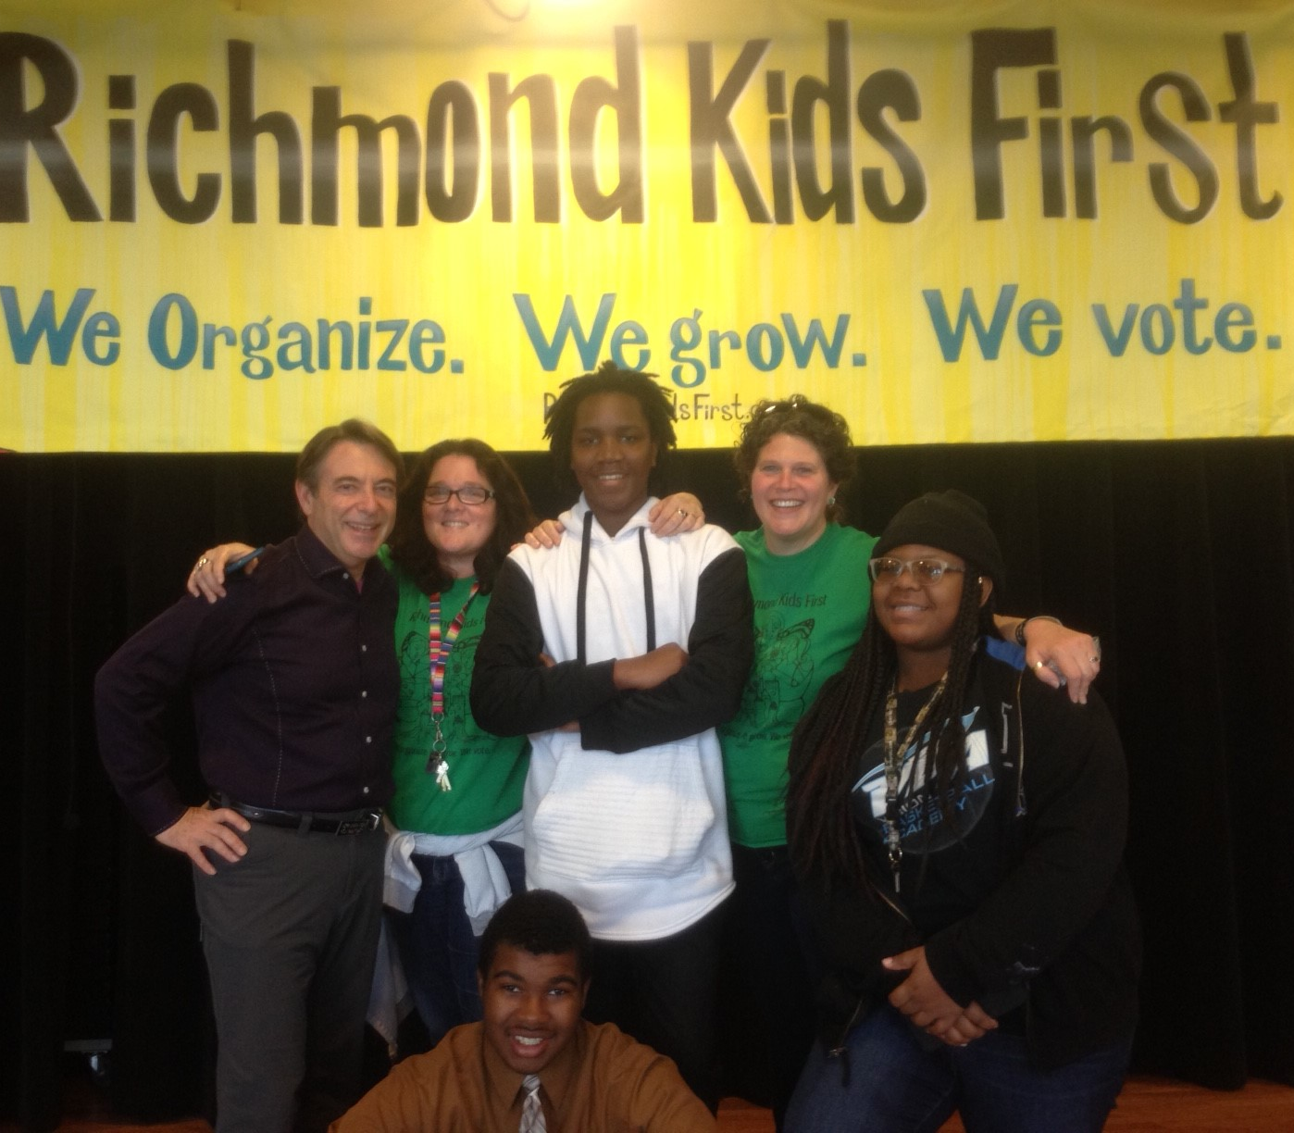
ORGANIZE
DON’T GO IT ALONE
Activities can include:
  Forming a coalition, network – create a letterhead
  Hold rallies and public events - e.g. Baby Brigade
Long term benefits:
  Builds the power of your organization.
  Increases the political and social capital of children, youth and families.

Slide 51
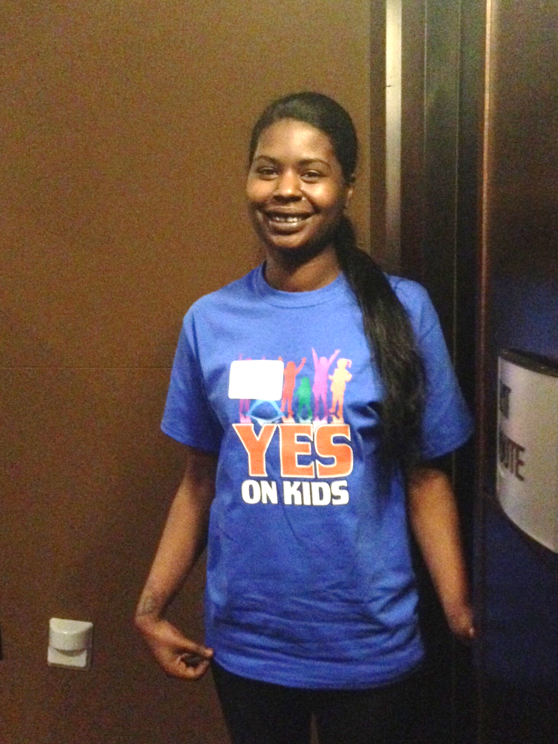
COALITIONS AND ALLIES
San Francisco Budget Justice Coalition
ACCE AFT 2121 AIDS Legal Referral Panel API Council Arts for a Better Bay Area Bay Area Community Resources (BACR) Causa Justa::Just Cause Chinese Progressive Association Coalition of Agencies Serving the Elderly Coalition on Homelessness Coleman Advocates for Children and Youth Community Alliance of Disability Advocates Community Housing Partnership Community Partnership for LGBTQQ Youth (CPQY) Dolores Street Community Services (DSCS) El/La Para TransLatinas Hamilton Families Homeless Emergency Service Providers Association (HESPA) HIV/AIDS Provider Network (HAPN) Hospitality House Jobs With Justice Larkin Street Youth Services LYRIC New Door Ventures NEXT Village SF Parent Voices St. James Infirmary San Francisco Child Care Planning & Advisory Council San Francisco Housing Rights Committee San Francisco Human Services Network San Francisco Immigrant Legal & Education Network (SFILEN) Senior and Disability Action Service Employees International Union, Local 1021 Sheroes Project South of Market Community Action Network (SOMCAN) Supportive Housing Provider Network (SHPN) TGI Justice Project Young Women's Freedom Center

Slide 52
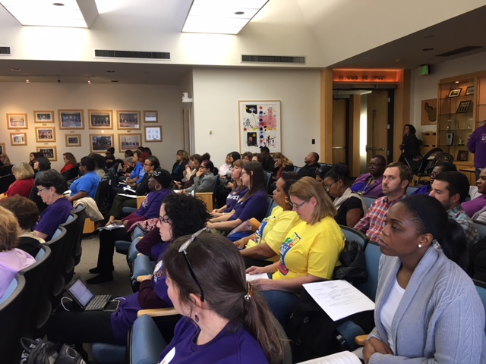
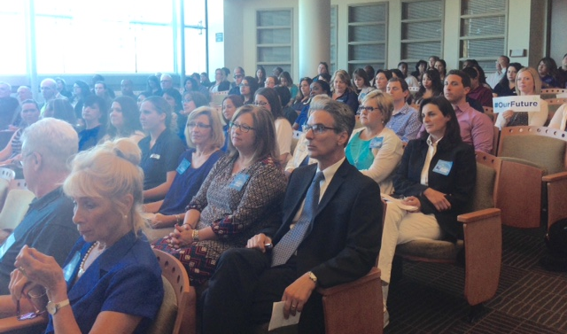
NUMBERS COUNT

Slide 53
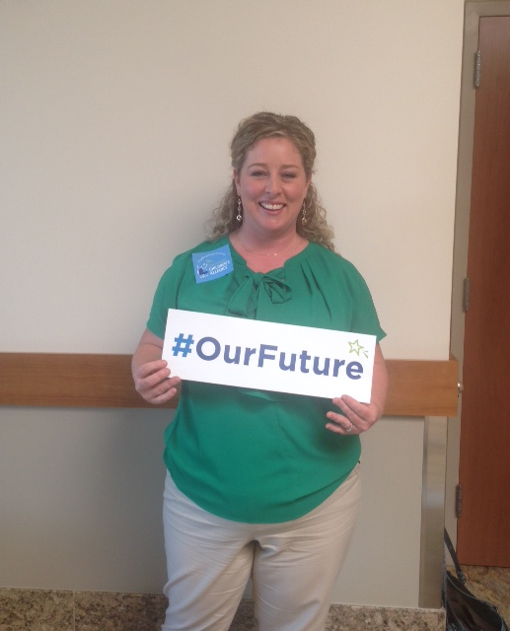
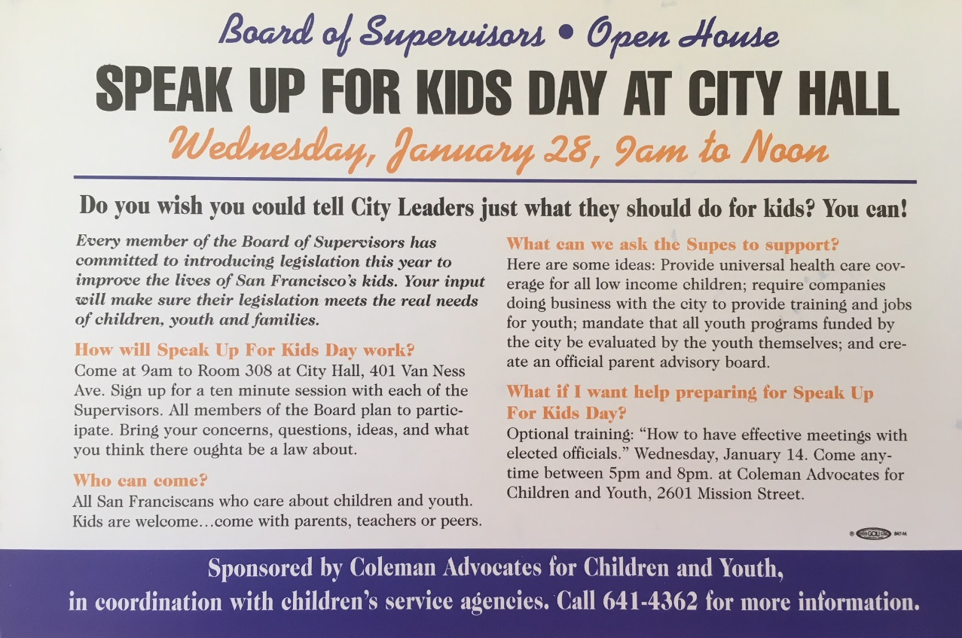
ENLIST PUBLIC SUPPORT
Social media
Outreach to community groups
Conferences and public forums
Mailings and newsletters
Speak out – speak up for kids days

Slide 54
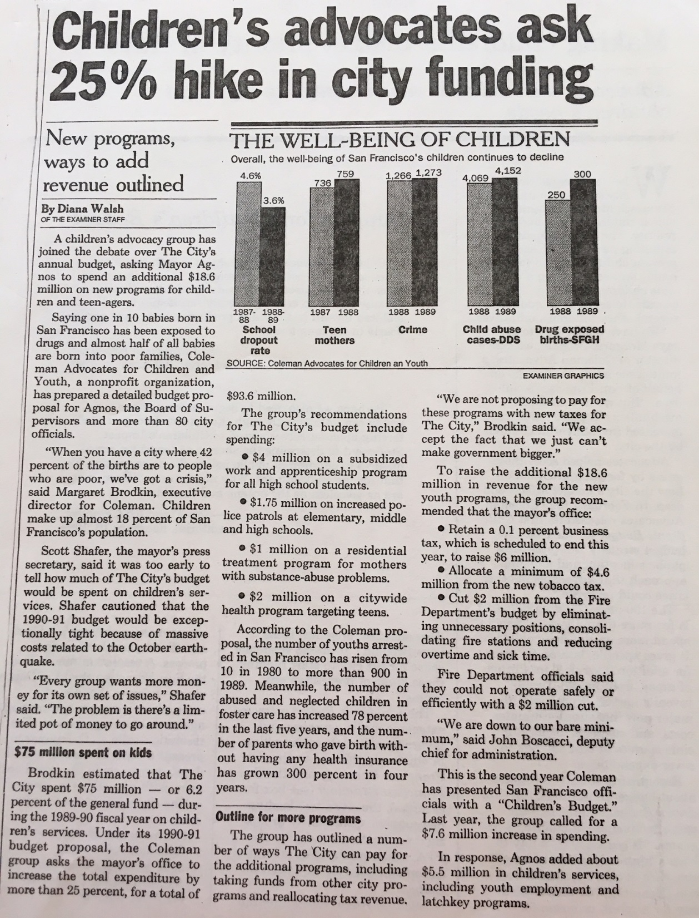
USE THE MEDIA
HAVE A SIMPLE MESSAGE
Press conferences
Op-eds
News releases
Feature stories
Follow the c’s – crisis, conflict, costumes, celebrities
Find a news hook.
OFTEN MORE IMPORTANT TO TALK TO THE MEDIA, THAN DIRECTLY TO DECISION-MAKERS.

Slide 55
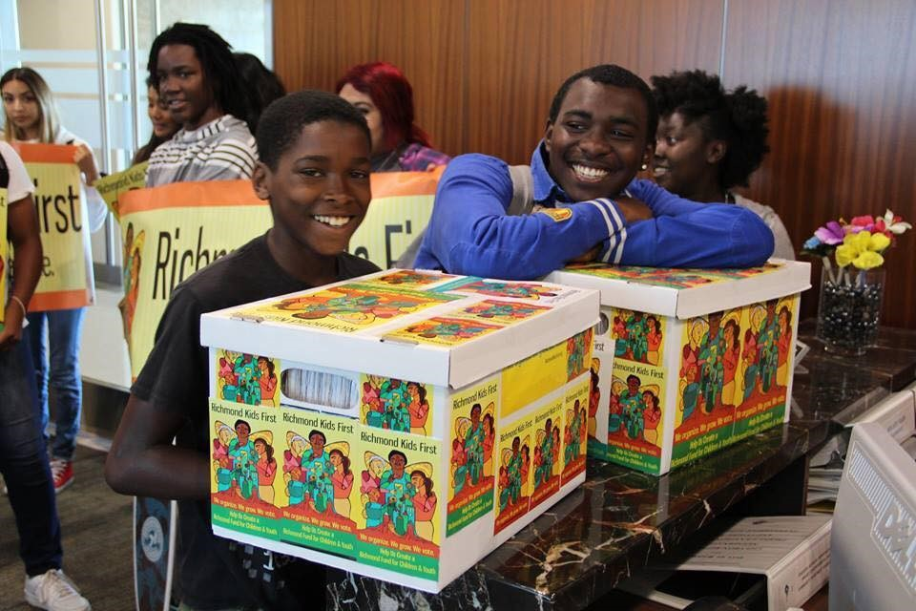

Elections are
Great Opportunities
Candidate forums
Candidate questionnaires
Educating candidates

Slide 56
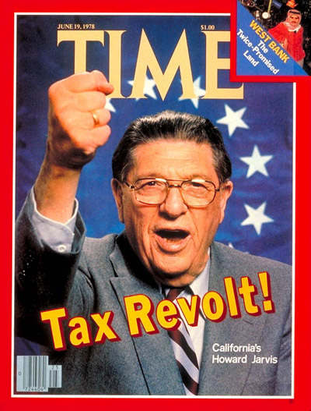

PREPARE FOR OPPOSITION
The Taxpayer revolt is alive and well. New items in the budget threaten increased spending and therefore new taxes.
Policymakers are often leery of funding for new items since it implies an ongoing commitment.
Opposition is often behind the scenes – particularly when status quo and turf is threatened.
BUDGET ADVOCACY IS ONE BATTLE AFTER ANOTHER.
Must be the folks who never go away.

Slide 57
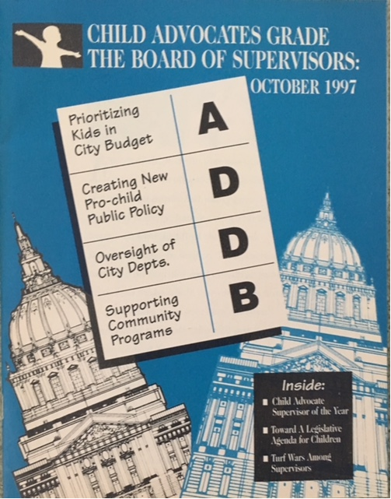
BUILD IN ACCOUNTABILITY
Hold decision-makers accountable after the budget process – for negative AND positive decisions.
  Newsletters
  Report cards
  Follow-up meetings
  Newspaper ads
  Accountability sessions

Slide 58
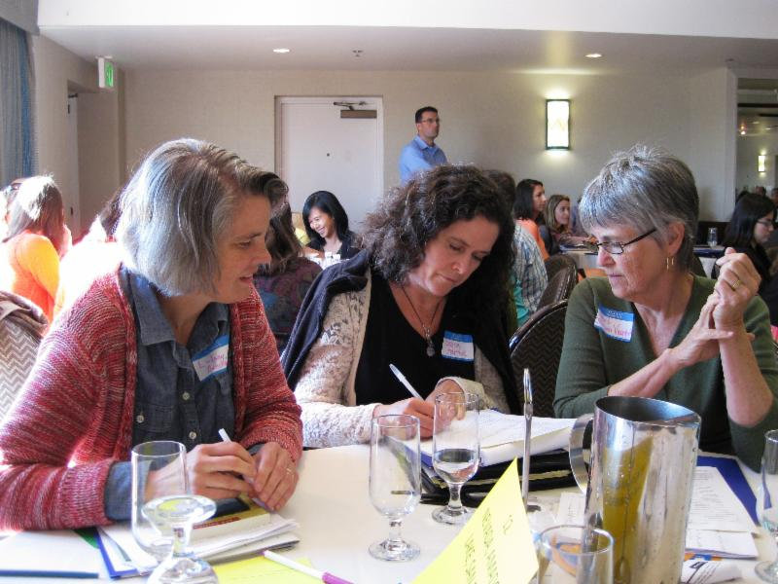
DEVELOPING AN ADVOCACY STRATEGY
What do you want? – your objectives
Who are your allies? – partnerships/coalitions
Who can give you what you want? – your audience/target
What do they need to hear? – your message
Who do they need to hear from? – your messengers
How can we get them to hear it? – your delivery strategy

Slide 59
REFORM THE PROCESS
Notes:
1., change LA Co0….to Greater LA Summer Matters Network
2 add 2018 to the date

Slide 60
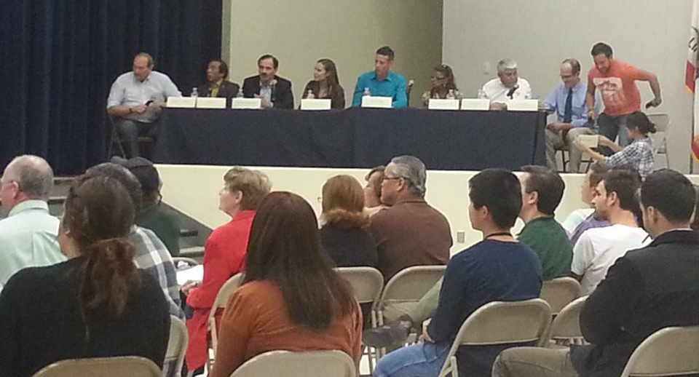
REFORM THE PROCESS
Creating accessible forums for public input at all levels and at all points in the process
Creating access to decision-makers
Making information user-friendly
Enlisting public opinion on priorities.
TRANSPARENCY, TRANSPARENCY, TRANSPARENCY

Slide 61

FUNDING THE NEXT GENERATION
Provides technical assistance to coalitions working on local funding streams for children and youth
Sponsors learning communities and conferences
Support includes speaking, convening, facilitating, trouble-shooting, coaching, and more.
Numerous tools and resources are available.
CONTACT:
Margaret Brodkin, Margaret@fundingthenextgeneration.org
415-794-4963
www.fundingthenextgeneration.org

