Slide 1
Dedicated Funding for Children and Youth in Los Angeles City and County
Los Angeles County Public Opinion Landscape
Adam Sonenshein
Vice President
December 11, 2018

Slide 2
Lesson
1
LA County Voters Want Funding for Early Childhood Programs

Slide 3
In 2015, voters perceived a high level of funding need for public preschool education, nearly equal to parks but lower than for transportation.
(Ranked by Great Need)
Great/Some Need
85%
73%
71%
Q3. Generally speaking, would you say that Los Angeles County has a great need for additional funding, some need, a little need or no real need for additional funding for ___________?

Slide 4
2017: Nearly eight-in-ten Los Angeles County voters saw a need for additional funding to improve access to early childhood education, nearly the same level as some well-known top priorities.
Total Need
77%
81%
80%
77%
Q3. Generally speaking, would you say that California has a great need for additional funding, some need, a little need or no real need for additional funding for ___________ ? Los Angeles County only

Slide 5
In a 2015 survey, voters perceived the most serious problems to be the number of children and number of families living in poverty.
I am going to read you a series of issues some people say are problems in California. Please tell me whether you personally consider it to be an extremely serious problem, very serious problem, somewhat serious problem or really not a problem at all for Californians.
Q3. ^Not Part of Split Sample

Slide 6
Lesson
2
Recent Successful L.A. County Ballot Measures Started with Less than 2/3rds and Won.

Slide 7
LA County Metro (Measure M) Survey & Actual Vote
November 8, 2016: General Election
Survey Votes
Initial
Vote
Vote After Education
**Actual
Vote
Definitely yes
Probably yes
Undecided, lean yes
Undecided, lean no
Probably no
Definitely no
Undecided
Total Yes
64%
Total Yes
71%
71.15%
Total No
30%
Total No
26%
28.85%
**Survey Conducted May/June 2016 with a margin of error of +/-2.5%
Q3/4 Combined, Q10/11 Combined, Q13/14 Combined & Actual Vote. If the election were held today on this measure, do you think you would vote yes in favor or no to oppose it?

Slide 8
LA County Parks (Measure A) Survey & Actual Vote
November 8, 2016: General Election
Survey Votes
Initial
Vote
Vote After Education
**Actual
Vote
Definitely yes
Probably yes
Undecided, lean yes
Undecided, lean no
Probably no
Definitely no
Undecided
Total Yes
69%
Total Yes
75%
74.9%
Total No
19%
Total No
18%
25.1%
**Survey conducted June 2016, with a margin of error of +/-3.0%;
Q3/4 Combined, Q8/9 Combined, Q10/11 Combined & Actual Vote. If the election were held today on this measure, do you think you would vote yes in favor or no to oppose it?

Slide 9
LA County Stormwater (Measure W) Survey & Actual Vote
November 8, 2016: General Election
Survey Votes
Initial Vote
Vote After Education
**Actual
Vote
Definitely yes
Probably yes
Undecided, lean yes
Undecided, lean no
Probably no
Definitely no
Undecided
Total Yes
64%
Total Yes
71%
69.5%
Total No
30%
Total No
26%
30.5%
**Survey Conducted May 2018 with a margin of error of +/-2.5%
Q3 & Q6. If the election were held today, would you vote yes in favor or no to oppose it?

Slide 10
In 2015, support for an LA County preschool funding ballot measure started below two-thirds, but grew after simulating a significant education campaign.
Initial Vote
Vote After Education
Total
Yes
64%
Total
Yes
69%
Total
No
33%
Total
No
28%
**Survey Conducted July 2016 with a margin of error of +/-2.8%
Q4/Q7/Q9. If the election were held today, would you vote yes in favor of the ¼ cent sales tax measure or no to oppose it?

Slide 11
For more information, contact:
Adam Sonenshein
Adam@FM3research.com
12100 Wilshire Blvd., Suite 350
Los Angeles, CA 90025
Phone (310) 828-1183
Fax (310) 453-6562

Slide 12
LA County Survey Methodology
Survey conducted July 27th-August 2nd, 2015
Interviews conducted by telephone with a random sample of 1,298 Los Angeles County registered voters likely to vote in the November 2016 Election
Margin of error for the full sample is ±2.8%; for half the sample is ±3.8%

Slide 13
Hypothetical ¼ cent sales tax ballot measure for preschool education.
LOS ANGELES PRESCHOOL QUALITY, AFFORDABILITY AND CHOICE MEASURE.
To make voluntary, full-day, high-quality preschool available to all three- and four-year-old children in Los Angeles County by training, attracting and retaining qualified preschool teachers; helping parents support their preschool-aged children’s education; offering parental choice of the preschool for their children and priority enrollment for children with special needs, in foster care and military families; and requiring that preschools meet state and local ratings; shall Los Angeles County enact a ¼ cent sales tax, with all funds used locally and annual independent audits?

Slide 14
Measure M Ballot Language
Los Angeles County Metropolitan Transportation Authority
LOS ANGELES COUNTY TRAFFIC IMPROVEMENT PLAN
To improve freeway traffic flow/safety; repair potholes/sidewalks; repave local streets; earthquake retrofit bridges; synchronize signals; keep senior/disabled/student fares affordable; expand rail/subway/bus systems; improve job/school/airport connections; and create jobs; shall voters authorize a Los Angeles County Traffic Improvement Plan through a ½¢ sales tax and continue the existing ½¢ traffic relief tax until voters decide to end it, with independent audits/oversight and funds controlled locally?

Slide 15
Measure A Ballot Language
SAFE, CLEAN NEIGHBORHOOD PARKS, OPEN SPACE, BEACHES, RIVERS PROTECTION, AND WATER CONSERVATION MEASURE
To replace expiring local funding for safe, clean neighborhood/ city/ county parks; increase safe playgrounds, reduce gang activity; keep neighborhood recreation/ senior centers, drinking water safe; protect beaches, rivers, water resources, remaining natural areas/ open space; shall 1.5 cents be levied annually per square foot of improved property in Los Angeles County, with bond authority, requiring citizen oversight, independent audits, and funds used locally?

Slide 16
Measure W Ballot Title and Summary
Los Angeles Region’s Public Health; Safe, Clean Water Program
Shall an ordinance improving/protecting water quality; capturing rain/stormwater to increase safe drinking water supplies and prepare for future drought; protecting public health/marine life by reducing pollution, trash, toxins/plastics entering Los Angeles County waterways/beaches by establishing a parcel tax of 2.5¢ per square foot of impermeable surface, exempting low-income seniors, raising $312,500,000 annually until ended by voters, with audits, oversight and local control be adopted?
Q3. If the election were held today on this measure, do you think you would vote yes in favor or no to oppose it?

Slide 17
Lesson
3
Successful County Measures Often
Have Champions
on the Board of Supervisors.

Slide 18
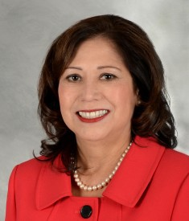
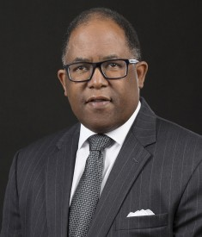
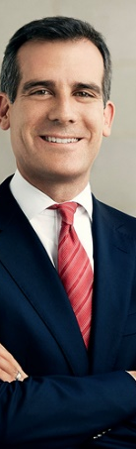
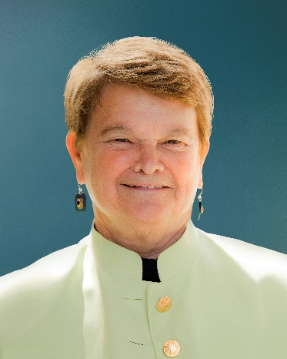
Champions of Recent
LA County Ballot Measures
Measure A (Parks)
Measure H (Homeless)
Measure M (Metro)
Measure W (Stormwater)

