Slide 1
Napa County Budget
March 23, 2020

Slide 2
Napa County Budget Timeline
Fiscal Year July 1 to June 30
Jan 8-10 Budget Training
Feb 14 Preliminary Department budget requests into system
March 20 Department budget requests into system
April 14 Board Budget Study Session
May 22 Budget Book Published
June 15-17 Board Budget Hearing
June 23 Board Budget Adoption

Slide 3
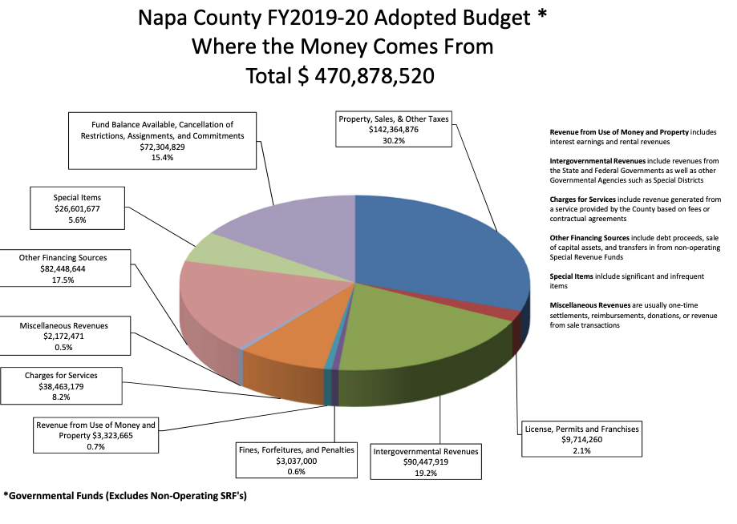

Slide 4
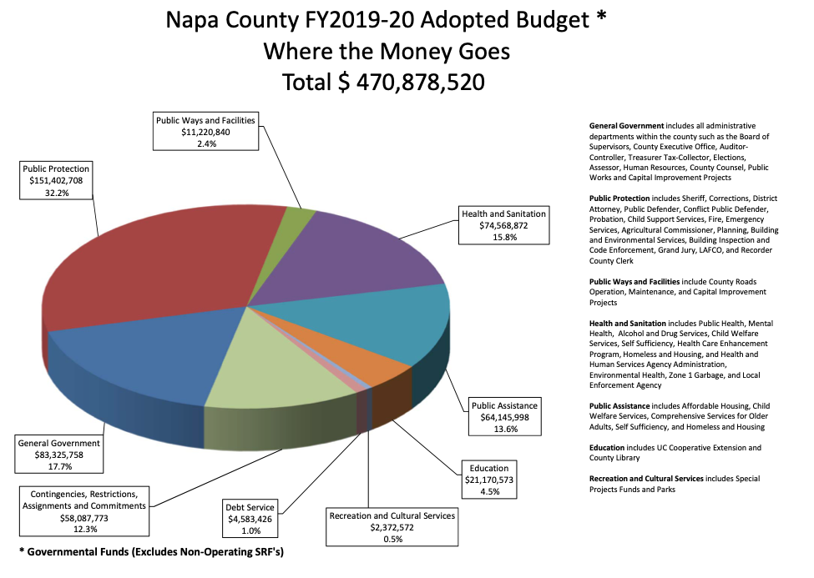

Slide 5
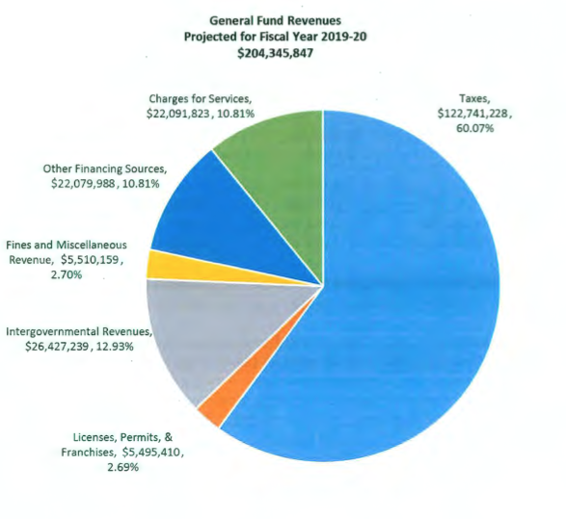
General Fund Revenues

Slide 6
Napa Net County Costs
(Where Discretionary Money is Spent)
Proposed Budget pages 19-21
Public Safety $40
Law/ Justice $29
General Admin $31
Community Resources $16
Human Services $ 0
Not accounted for 7
Total $123
In millions

Slide 7
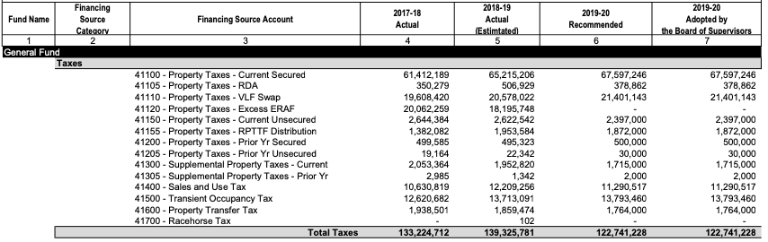
General Fund Revenues

Slide 8
Estimated Revenue Loss- Coronavirus Impact
(Ed Harrington guess)
Tax Budget Estimated Loss
Property Tax $96 $5
Hotel Tax $14 $5
Sales Tax $11 $3
Property Transfer $ 2 $0.5
Excess ERAF $ 0
Totals $123 $13.5 11%
Additional costs????????
In millions

Slide 9
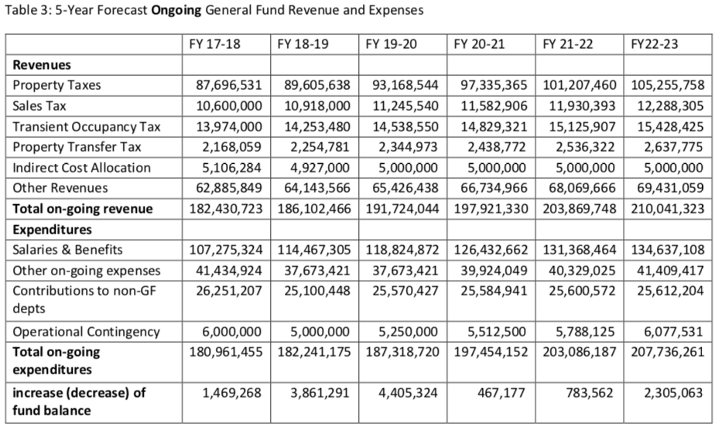
Revenue Projections (from 2018)

Slide 10
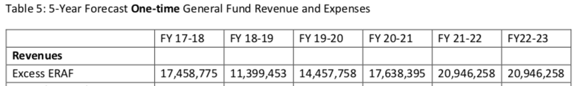
Excess ERAF (from 2018)

