Slide 1
Pomona Budget
September 26, 2018

Slide 2
Budget 101
Budget Rules
Timeline
Understand Terms
Start with Big Picture
Focus on what can be controlled locally
Don’t get lost in the details
Have City staff do the work—but ask nicely and be flexible

Slide 3
Budget Rules
Governmental Accounting—rules clear
  Rules set by GASB
  Implementation by GFOA
  Audited to insure compliance
Governmental Budgeting—no rules
  Reporting requirements by State Controller
    County Budget Guide (sco.ca.gov)
  NACSLB (National Advisory Committee on State and Local Budgeting) best practices
  GFOA/CSMFO Awards programs

Slide 4
Funds (1of2)
Government Accounting is set up in funds
Governmental Funds:
  General Fund-basic government
  Special Revenue- Specific Revenues that are legally restricted for a specific purpose
  Capital Projects
  Debt Service

Slide 5
Funds (2 of 2)
Proprietary Funds
  Enterprise—business type activities
    Airport, water, hospital
  Internal Service
    IT, Risk Management, Motor pool
  Fiduciary Funds—held for others
    Pension, employee benefits

Slide 6
Pomona Budget Timeline
Fiscal Year July 1 to June 30
Dec - Budget Manual, preliminary guidance to departments
Jan-April – Preliminary estimates, budget requests
      Departments submit budgets
May - Budget Printed - Board Study Session
June – Board Budget Hearing
      Board Budget Adoption

Slide 7
Budget Composition
Proposed/Recommended Budget:
  Executive Summary/Transmittal Letter – Prepared by CAO, City Manager, Mayor – policy statement
    Budget summaries, demographics, organization charts, fiscal policies, priorities
  Typically some information by department, goals, performance measures, budget changes
  Some level of State Controller or other detailed accounting schedules
Adopted Budget (by fiscal office)-Annual Appropriation Ordinance:
  Some portion of Transmittal letter
  Budget detail schedules

Slide 8
Budget- Big Picture
Useful General Information/Demographics
What is the total budget?
Where does the money come from?
How is it used?
Where are local tax revenues (discretionary funds) spent?

Slide 9
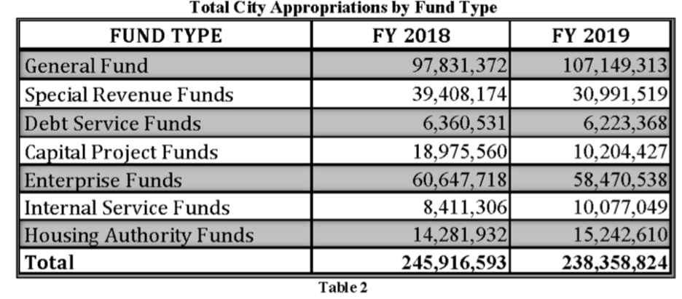
Pomona Total Budget

Slide 10
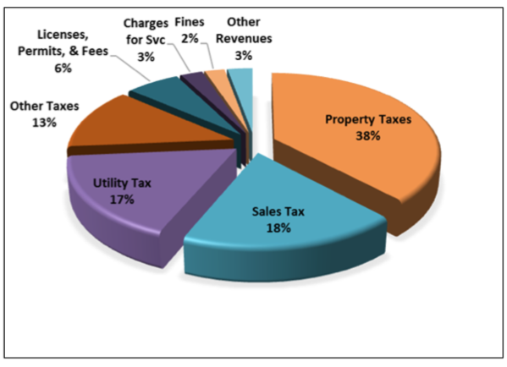
Pomona General Fund Revenues

Slide 11
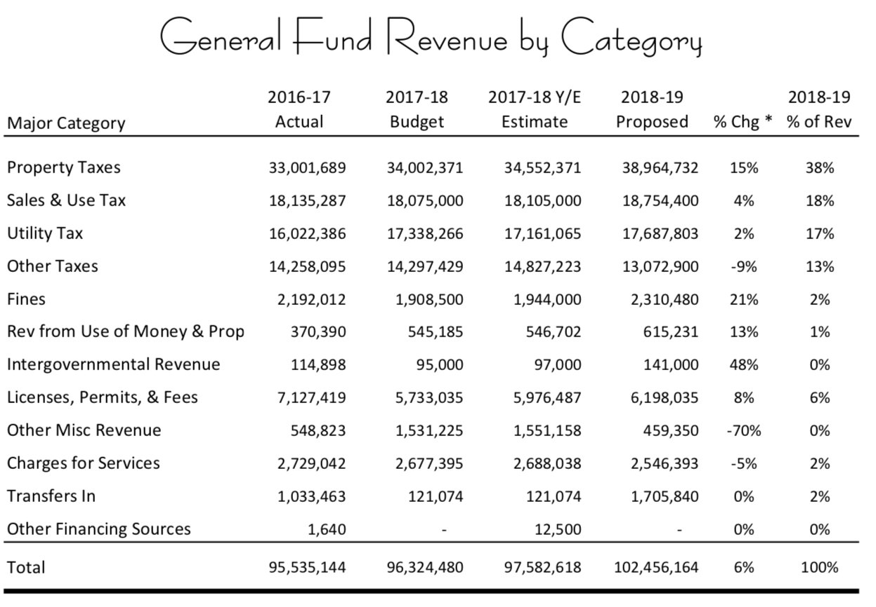
Pomona General Fund Revenues

Slide 12
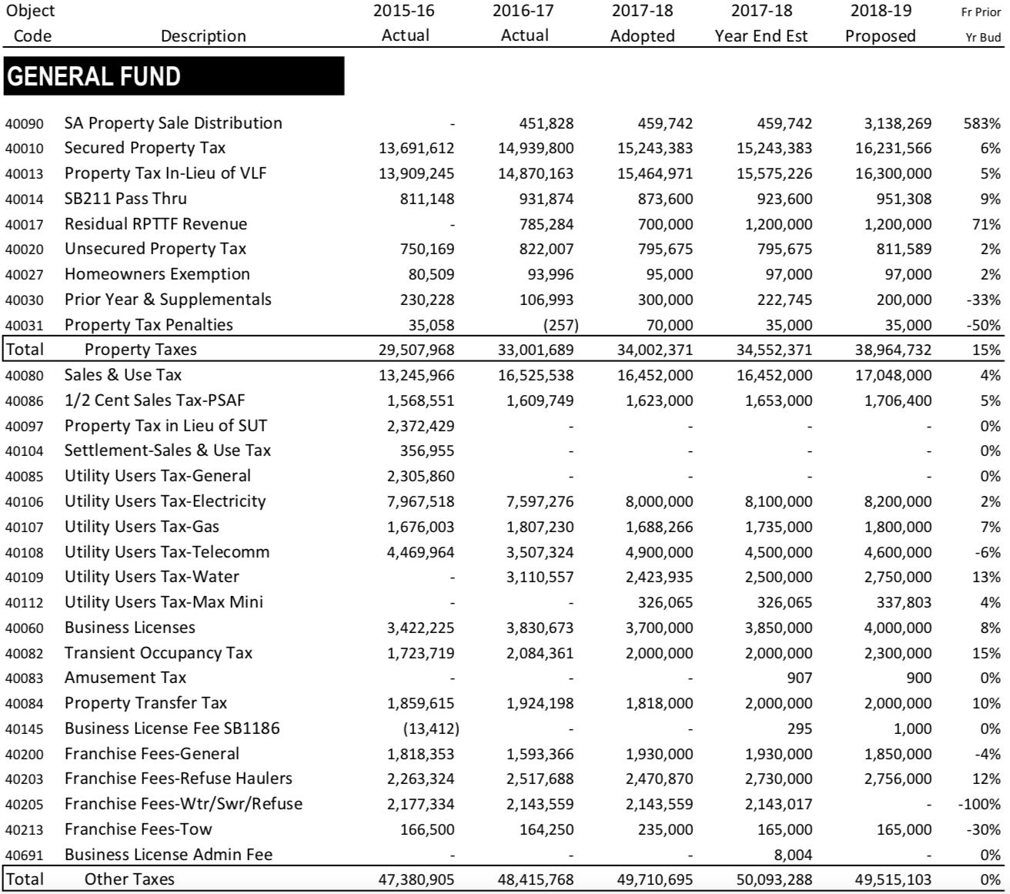
Pomona General Fund Primary Revenues

Slide 13
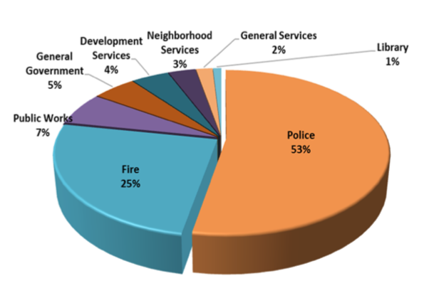
Pomona General Fund Spending

Slide 14
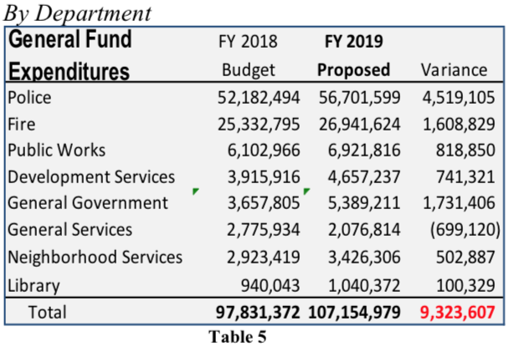
Pomona General fund Spending

Slide 15
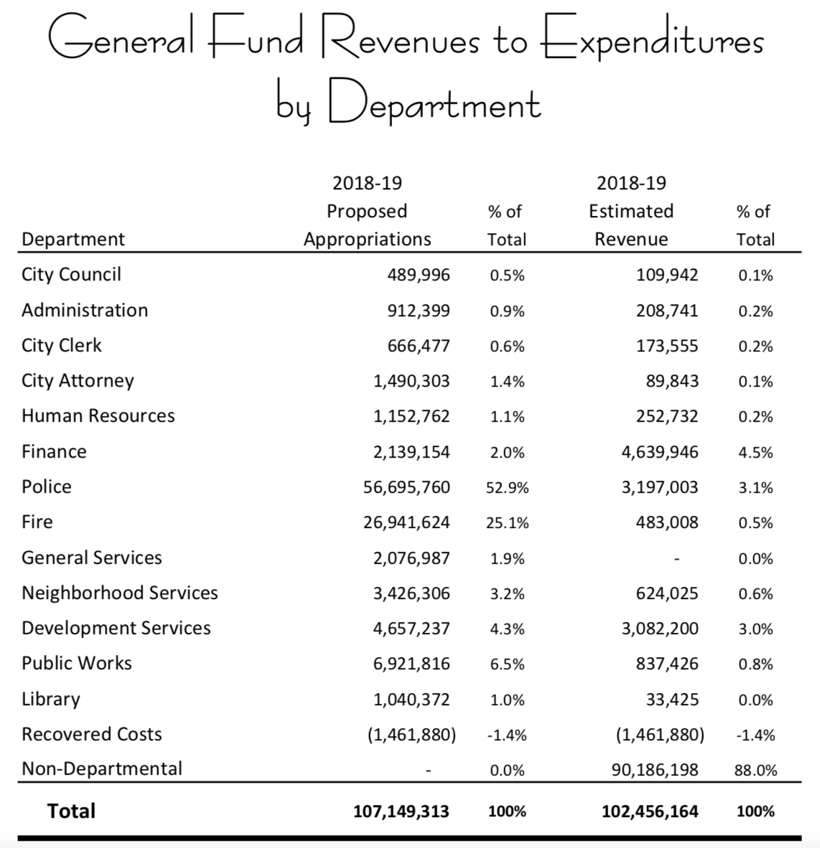
Pomona General Fund Discretionary Spending

Slide 16
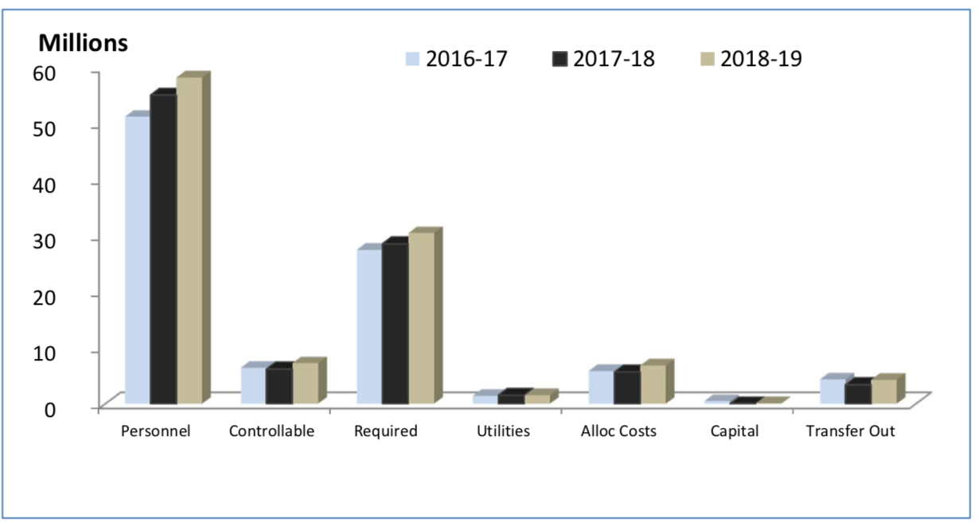
Pomona General Fund Costs

Slide 17
Pomona Financial Health
2018 just slightly over 2008
  5% revenue increase total over 10 years.
  Dropped from $93M in 2008 to $78M in 2011-12,
  up to $98M in 2018
Fund Balance Reserve Policy says goal is 15.5% or $16.6M
  In 2019 reserve projected to be $12.8M
Staffing levels dropped from 777 in 2008 to
565 projected for 2019

Slide 18
Pomona projects deficits forever
$8 to $10 M problem annually
Option 1 – Increase taxes
  Sales Tax
  Parcel Tax
  Utility Users
Option 2 –make cuts/contract out services
Option 3 – combination of taxes and cuts

Slide 19
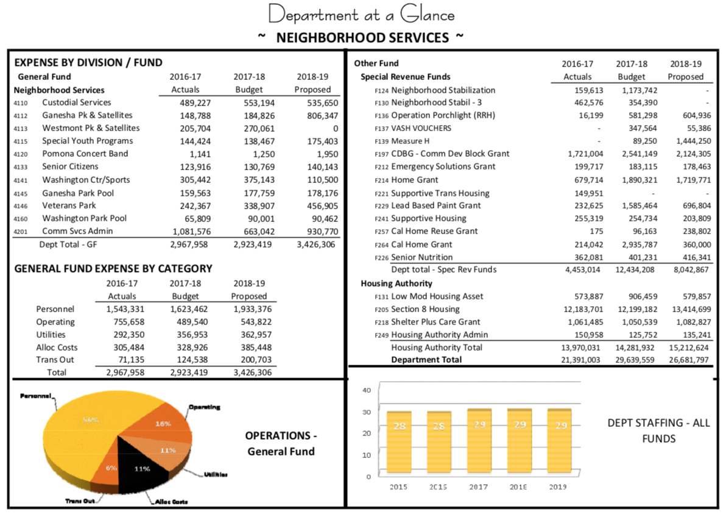
Pomona Youth Programs?

Slide 20
Line-Item Budgets
Detail of salaries, fringes, contracts, supplies, etc.
Len Wood, Local Government Dollars and Sense
“ Many elected officials love line item budgets, and the more detail, the more love. Line items budgets lend themselves to comfortable, yet inconsequential questions such as: why do we need so much for office supplies? Travel has gone up $100 from last year—why?”

Slide 21
Program Budgets
What programs does the city or county operate?
What is the agency trying to accomplish?
How much will it cost to do so?
Programs may cross departmental lines

Slide 22
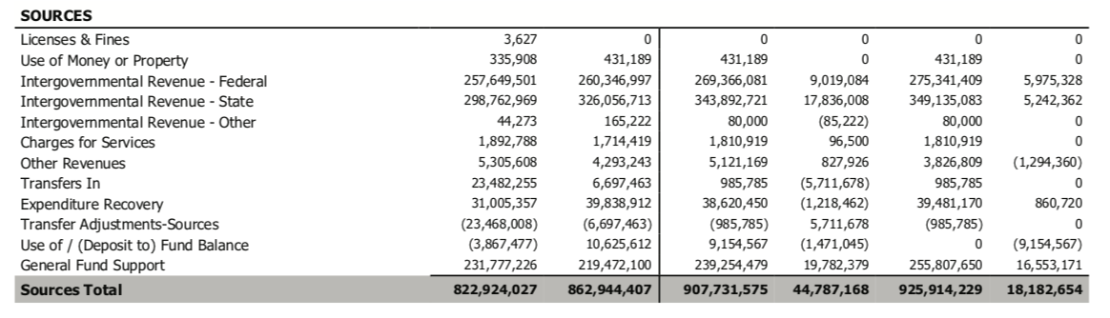
San Francisco HSA Revenue Summary

Slide 23
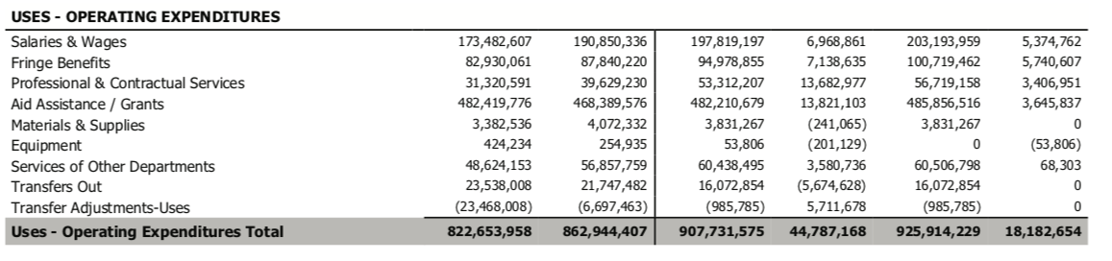
San Francisco HSA Line Item Summary

Slide 24
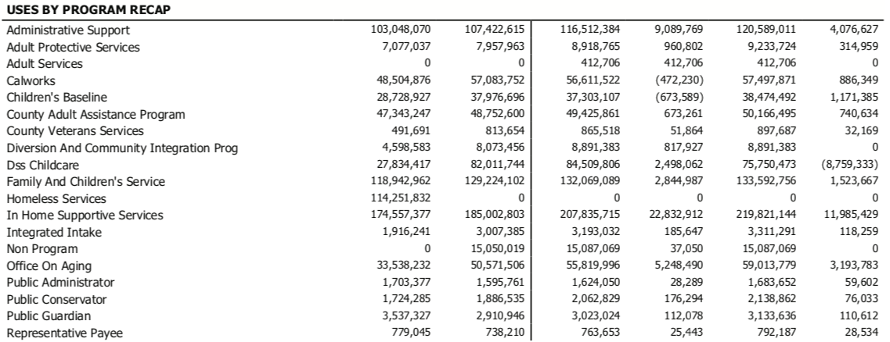
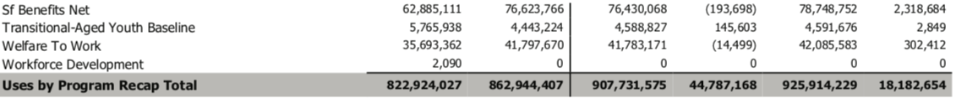
San Francisco HSA Program Summary

Slide 25
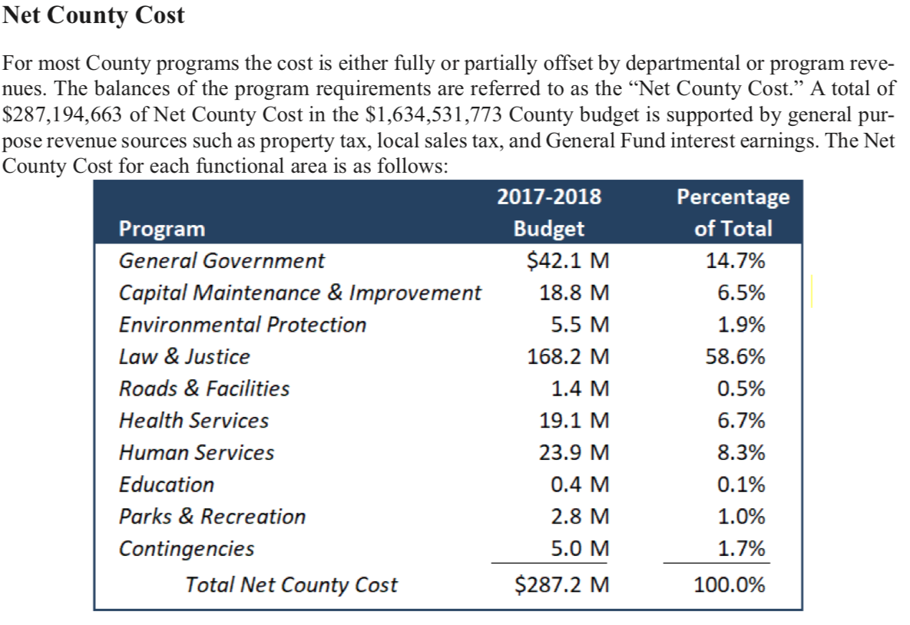
San Joaquin County Budget - Page 3

Slide 26
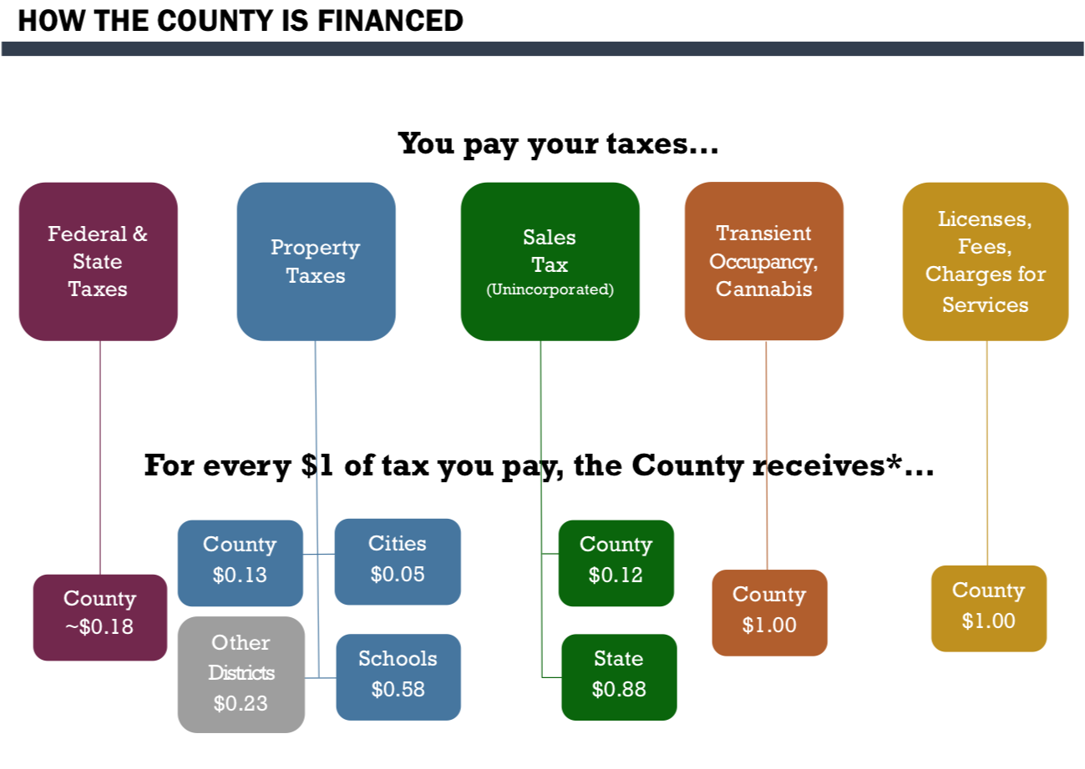
Santa Cruz County

Slide 27
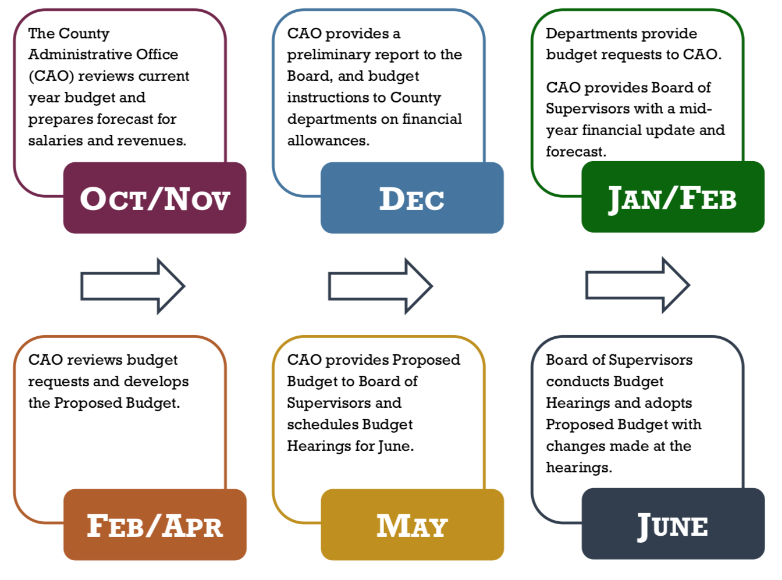
Santa Cruz County Budget Timeline

