Slide 1
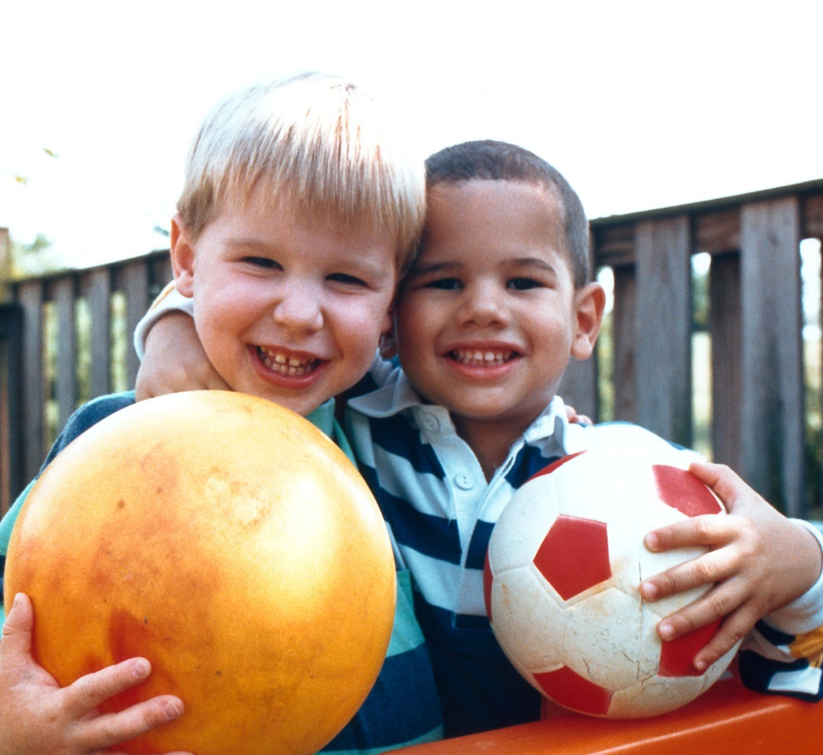


Children and Youth Task Force
Focus on Prevention

Slide 2
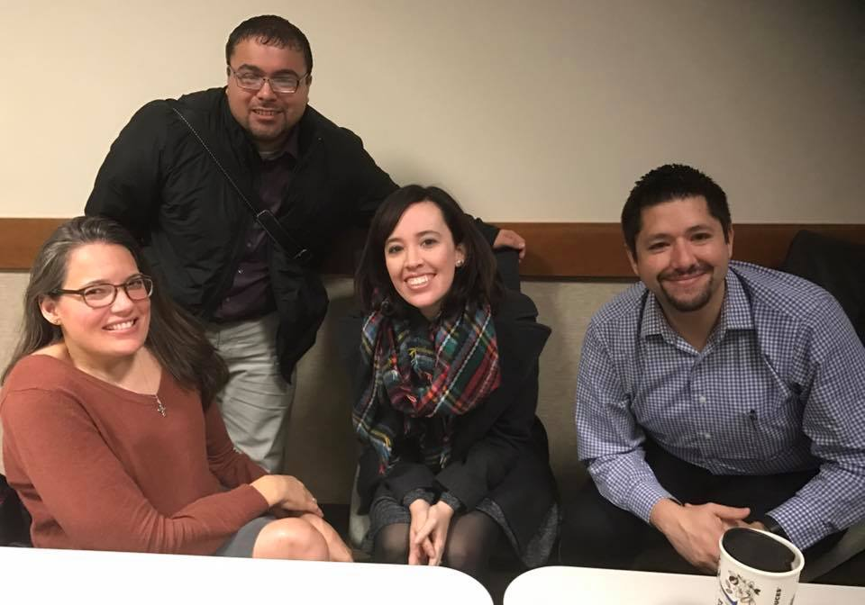

Slide 3
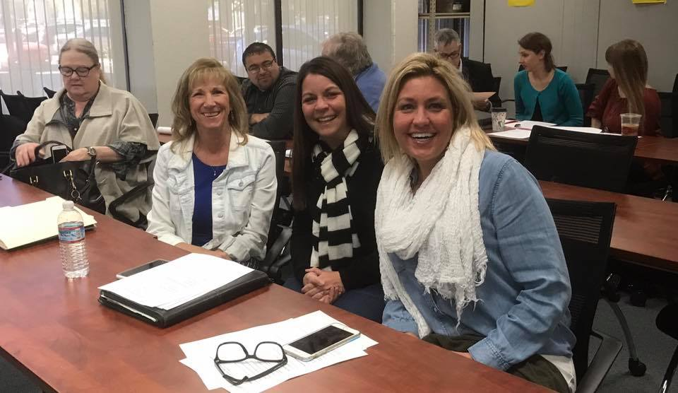

Slide 4
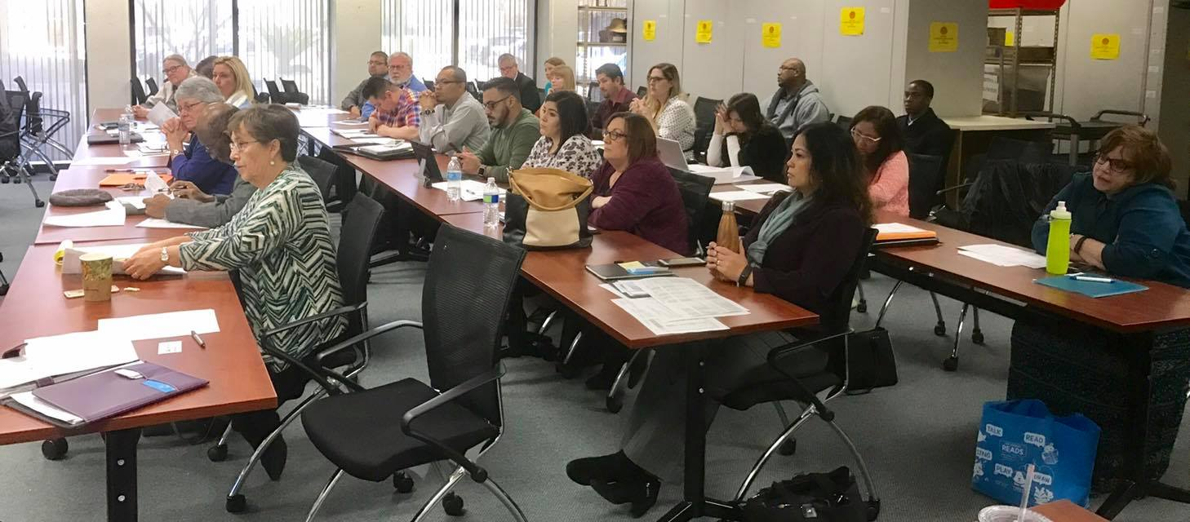

Slide 5
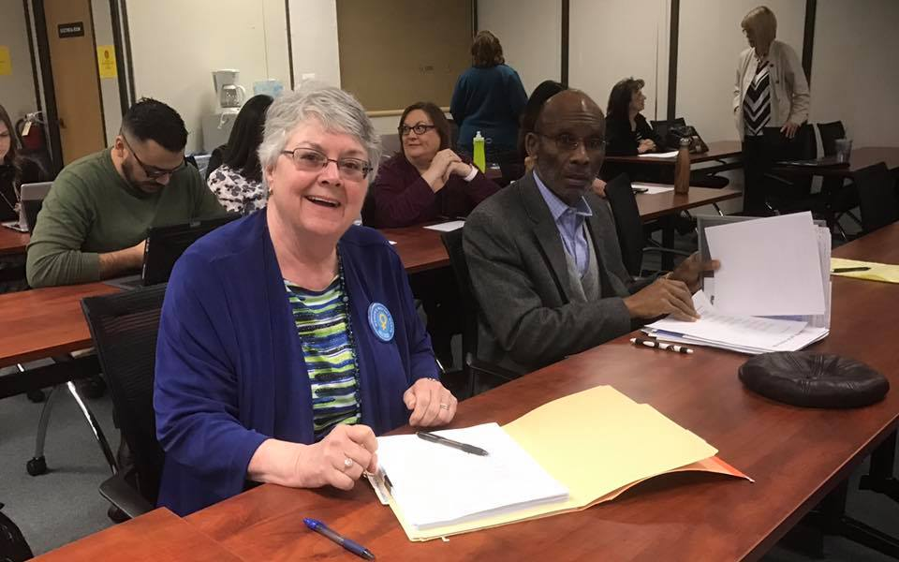

Slide 6
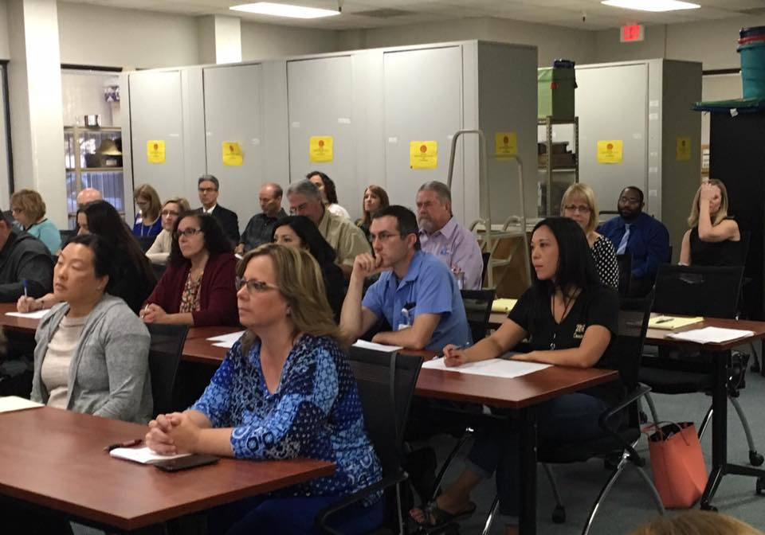
Pictures

Slide 7
Best Practices
Methodology and results

Slide 8
Age group forums
0 – 5 Year Olds | 6-12 Year Olds | 13 – 18 Year Olds
Dr. Maggie Park
CMS Medical Director
Public Heath
Lani Schiff-Ross
Executive Director
First 5 San Joaquin
Lindy Turner-Hardin
Executive Director
Child Abuse Prevention Council
Kay Ruhstaller
Executive Director
Family Resource & Referral
Jamie Baiocchi
Director Early Education & Support
County Office of Education
Jason Messer
Superintendent
Manteca Unified School District
Marc McCool
Director of Operations
Boys & Girls Club Manteca/Lathrop
Dr. Ana Revilla
Pediatric Medical Director
Community Medical Centers
Junior Cueva
Director
Boys and Girls Club – Tracy
Oscar Munguia
Director
Give Every Child A Chance
Doug Silva
Administrator
Youth Build
Dr. Alphonso Apu
Director
Community Medical Centers
Dr. Ward Andrus
Acting Assist. Superintendent
Stockton Unified School District
Brian Muhammed
Participatory Defense
Fathers & Families

Slide 9



Resulting Priorities for 13 – 18 year olds
Prenatal – Age Five
Home Visitation
Case Management
Preschool
Family Strengthening - Wrap Around Services
Case Management
Clinical Services
Parent Education – Coaching
Mentoring and Job Training

Slide 10



Resulting priorities for 6-12 Year olds
Prenatal - Birth
Case Management
Quality Preschool
Afterschool Enrichment Programs

Slide 11
Resulting Priorities for 0-5 Year Olds
Prenatal / Postnatal - Home Visitation
Case Management
Lactation Consulting
From Birth for At-Risk Families
Family Strengthening – Home Visitation
Parent Coaching and Mentoring
Child Development Education
Parenting Strategies
Life Skills
Job Readiness Skills
Quality Childcare / Preschool

Slide 12
Calhepp outcomes
Employment Impact
29%
54%
Before
After

Slide 13

First 5 Preschool Outcomes
Higher attendance and fewer children held back
Better grades in language arts and math
Low income children benefit the most

Slide 14
Best practices
research

Slide 15


Research
WHY START
WITH 0 – 5
YEAR OLDS?

Slide 16
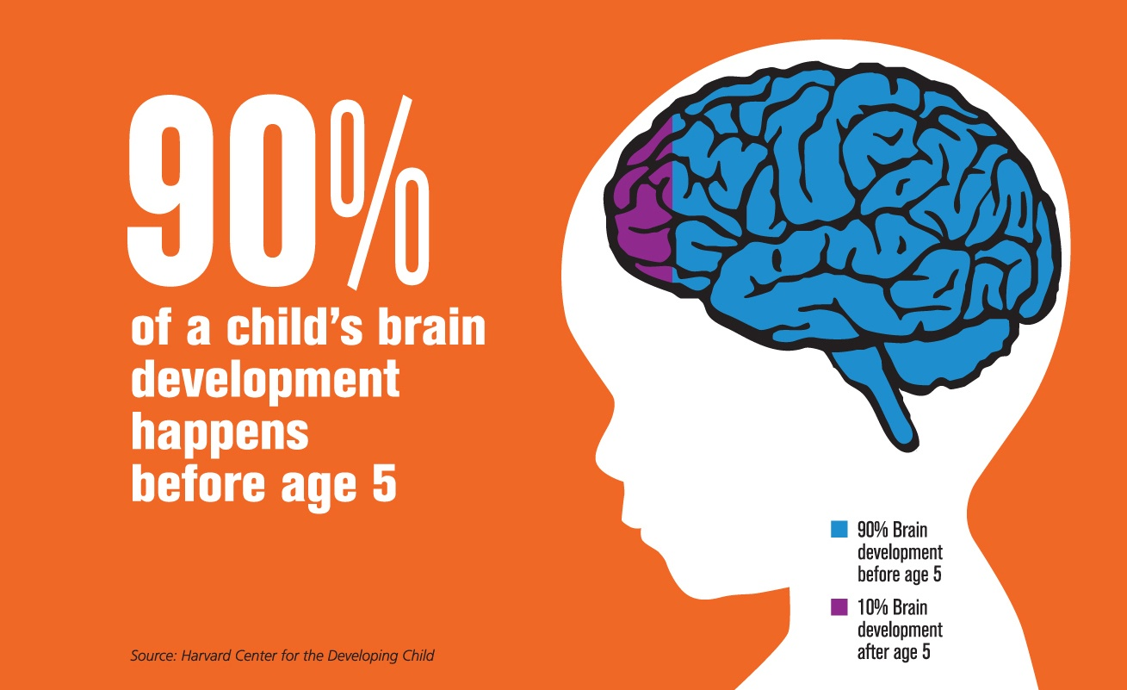

Slide 17

Why prevention?

Slide 18
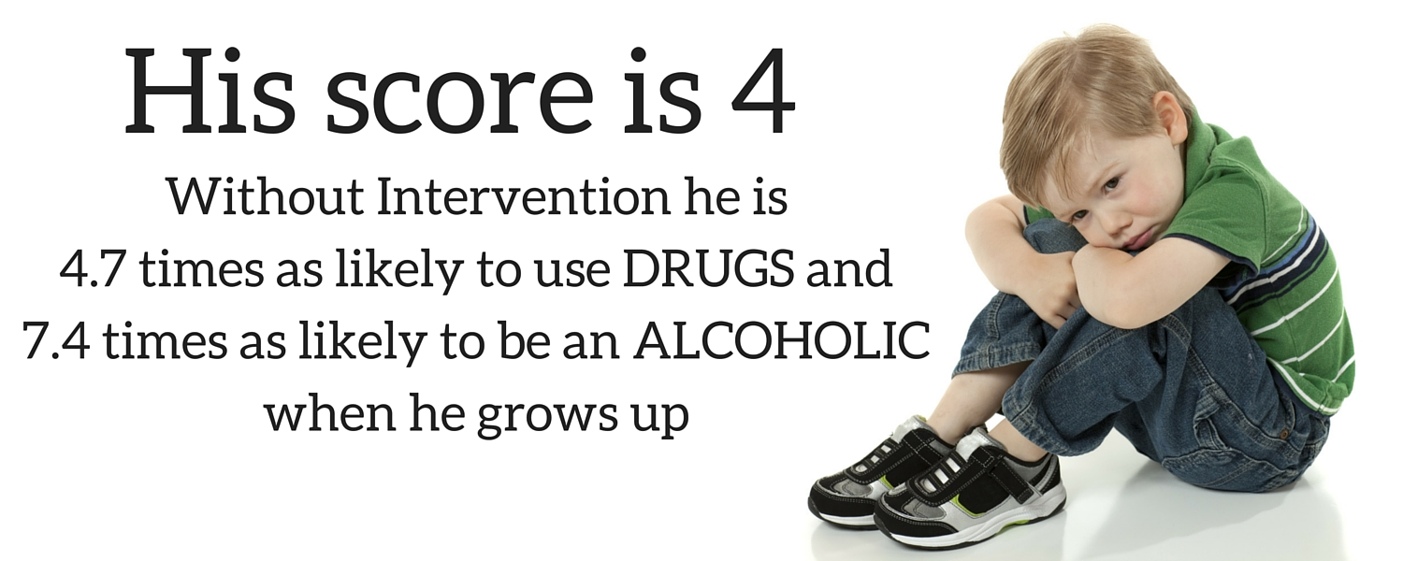
Adverse childhood experiences

Slide 19

Does Prevention have lasting impact?

Slide 20

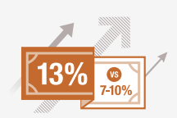
Long term impacts
FADEOUT IS A MYTH. Quality early childhood education provides persistent boosts in socio-emotional skills even if cognitive skills taper in the short-run. Gains in socio-emotional skills ultimately create better education, health and economic achievement.
HIGHER RETURNS. The newest research from Professor Heckman and colleagues finds 13% ROI for comprehensive, high-quality, birth-to-five early education.

Slide 21
Gaps and needs
Methodology and results

Slide 22

Home Visitation with case management
P.A.T
Health Education Program
CalHEPP
Early Head Start
Nurse Home Visiting
1500
Families Served

Slide 23
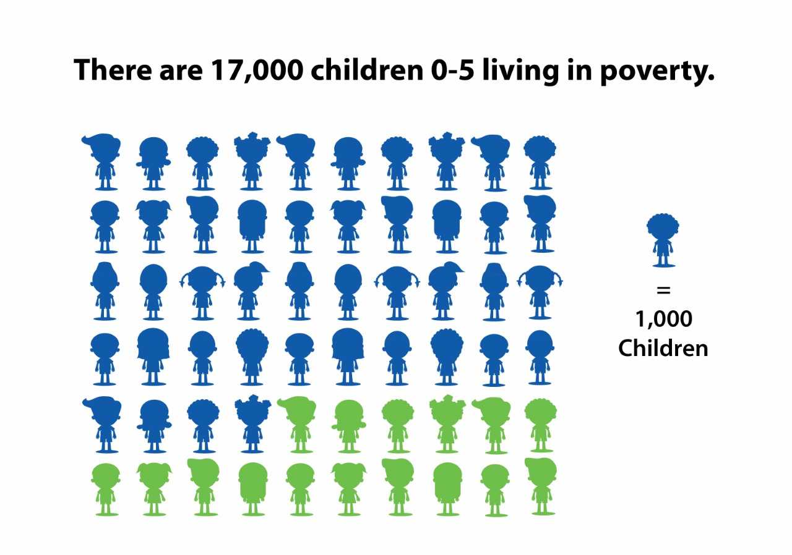

Slide 24
Preschool enrollment
Total # of 3 and 4 year olds enrolled in preschool in San Joaquin County
 | Count | %
San Joaquin County |  | 39%
District 1 | 961/2582 | 37%
District 2 | 1369/4130 | 33%
District 3 | 2500/5992 | 42%
District 4 | 3965/10382 | 38%
District 5 | 2321/5249 | 44%

Slide 25

30 million fewer words

Slide 26
funding
Methodology and results

Slide 27
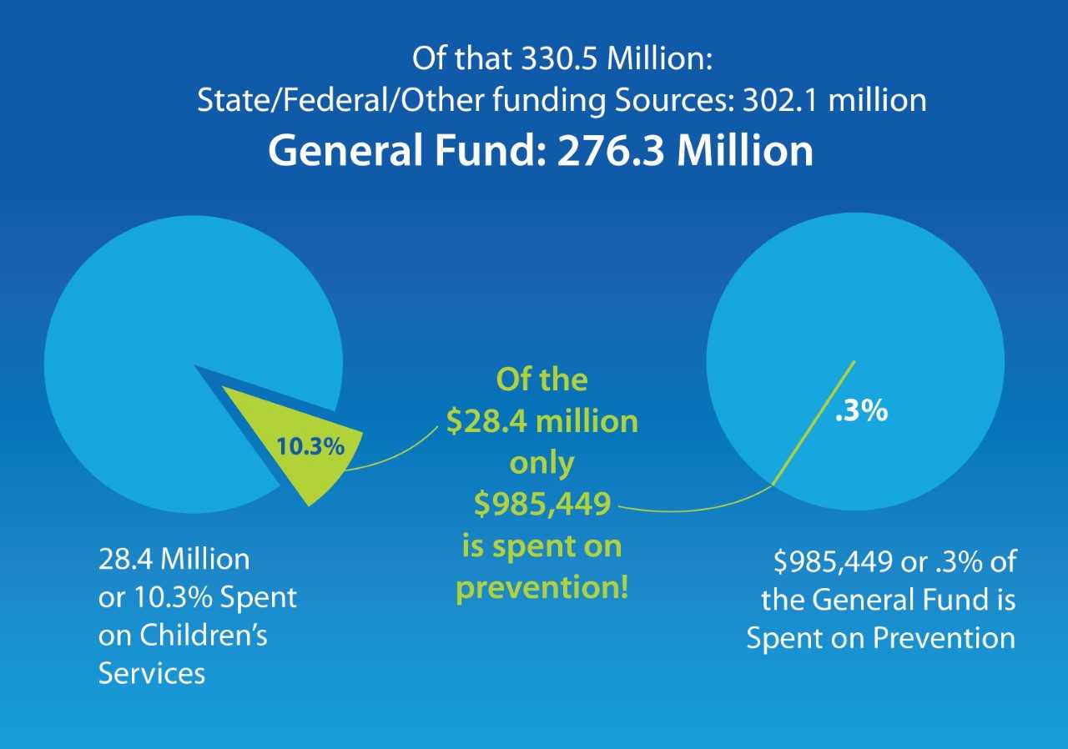

Slide 28
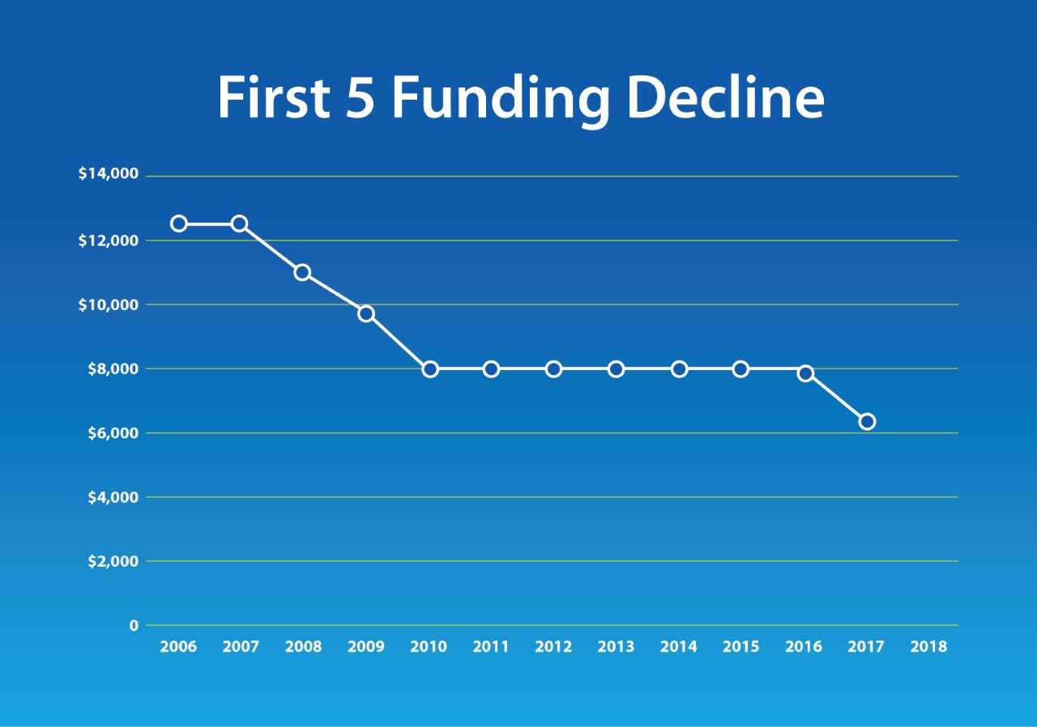

Slide 29
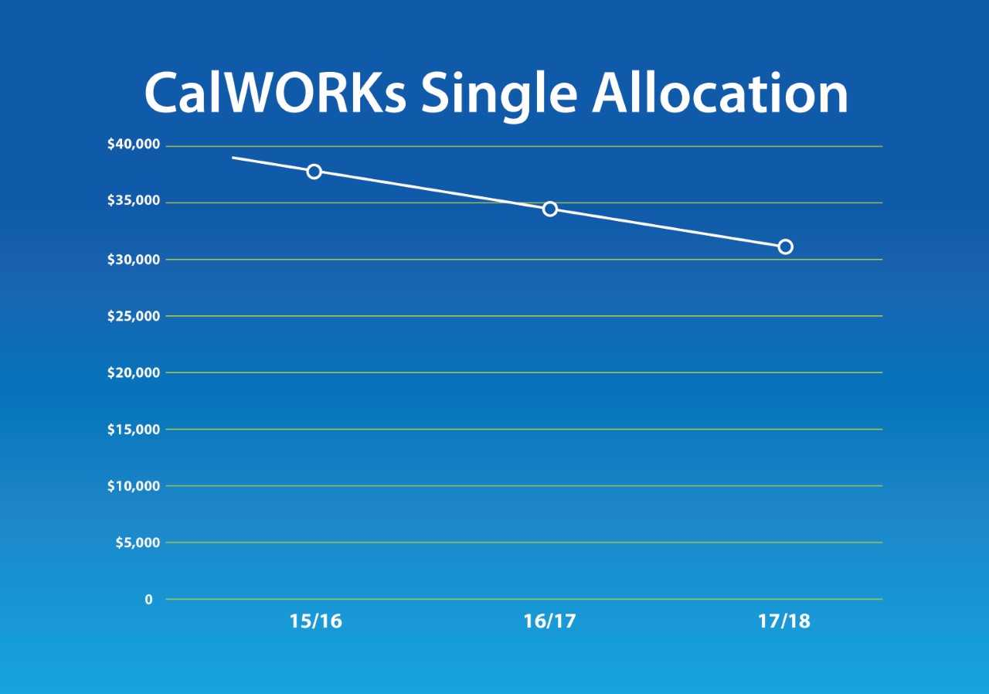

Slide 30
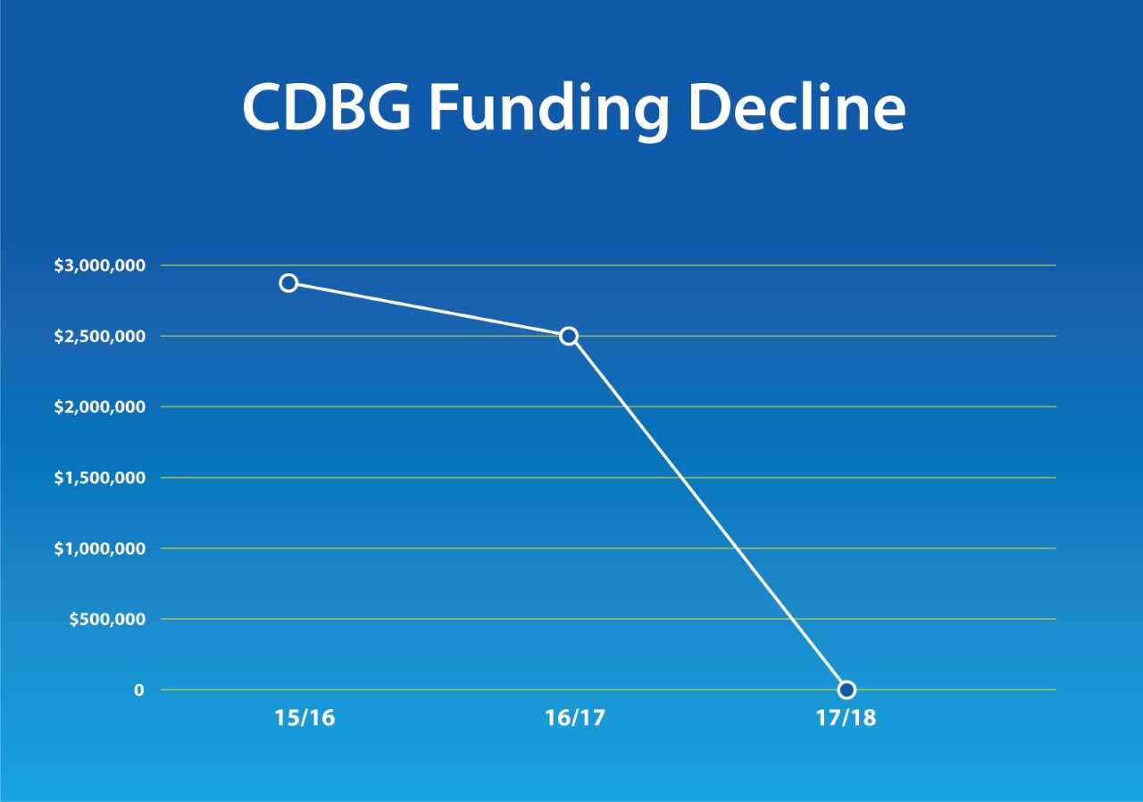

Slide 31
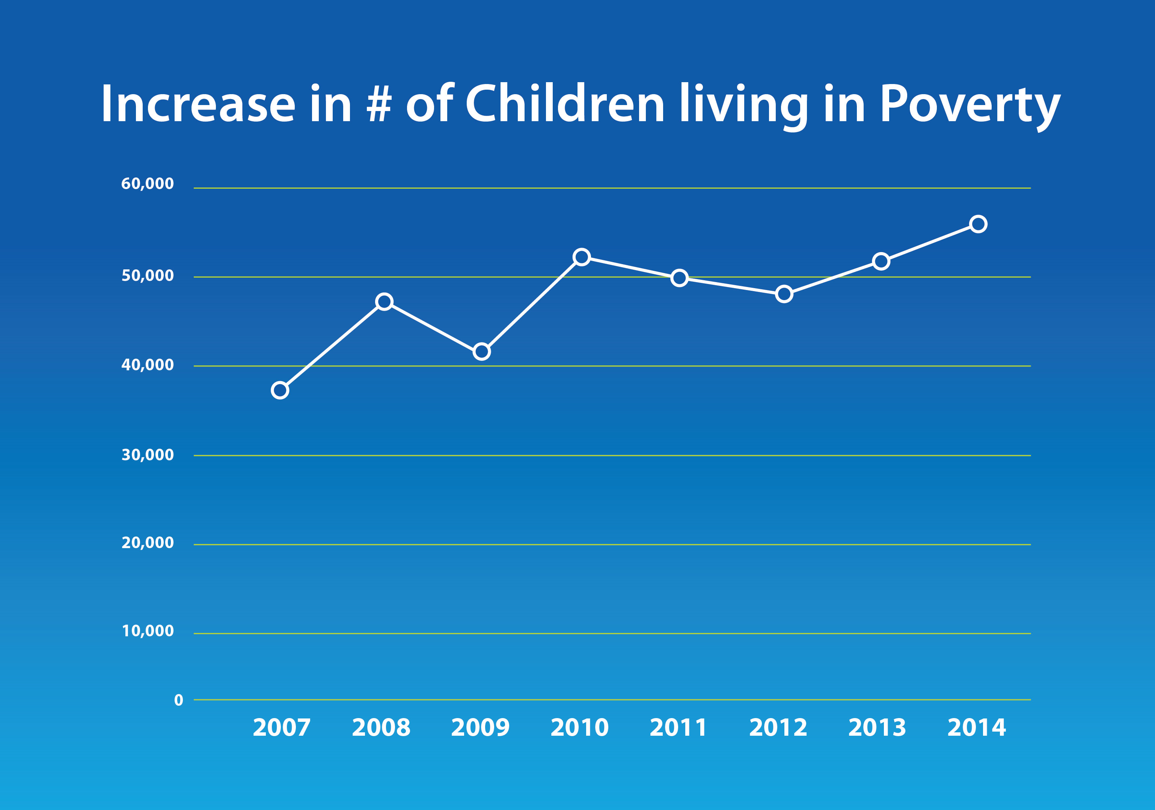

Slide 32
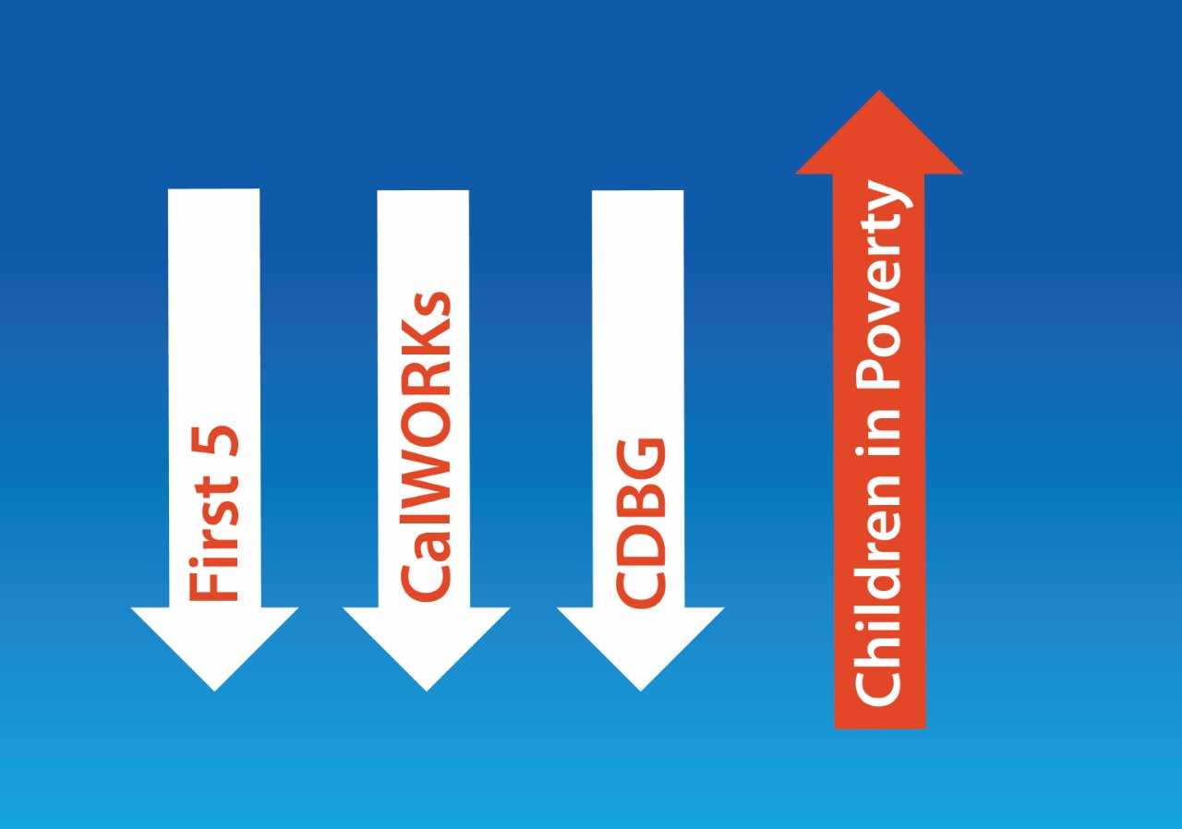

Slide 33

What is the cost of Not investing early?

Slide 34


Slide 35
Cannabis Tax
Fund prevention and early intervention programs for children and youth
New revenue
Prevention works
Local control

Slide 36
Future of the Task Force
Extend sunset of the Children and Youth Task Force to December 2018
Collect additional data
Expand partnerships with criminal justice, education, health, business, faith
Pursue other revenue streams

Slide 37
Children and Youth Task Force
Focus on Prevention

