Slide 1

Richmond Kids First:
Leading with Our Values
Notes:
RYSE youth-serving organization begin by youth organizing effort to combat effects of violence on young people in Richmond.
More than half of the organization’s staff are young people.
This year, we launched a Listening Campaign

Slide 2
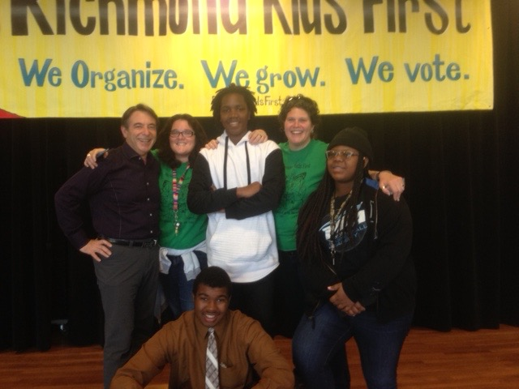
WHAT IS IT?
The Richmond Kids First Initiative seeks to secure 3% of Richmond’s general budget for a dedicated funding stream for children and youth services above and beyond the funds currently allotted for these services for a minimum of 10-years.
The fund will generate roughly 4.3 million dollars a year for 10 years.
There is an Oversight Committee built into the ballot initiative that includes 15 youth and adults appointed by City Council members.
The fund will serve children and youth ages 0-18 years and disconnected Transitional-Aged Youth 18 through 24 years old.
Children, youth and young adults living in Richmond and North Richmond and most impacted by harm, inequity and lack of access to support and services.
Notes:
City is in a deficit. Oakland won at their worst deficit. This is about future-thinking.
Built in contingencies for emergencies
Doesn’t limit cities ability to apply
4.3 million was what the City spent in overtime pay for police. This is about prioritizing prevention over structural interventions that disproportionately target black and brown young people

Slide 3
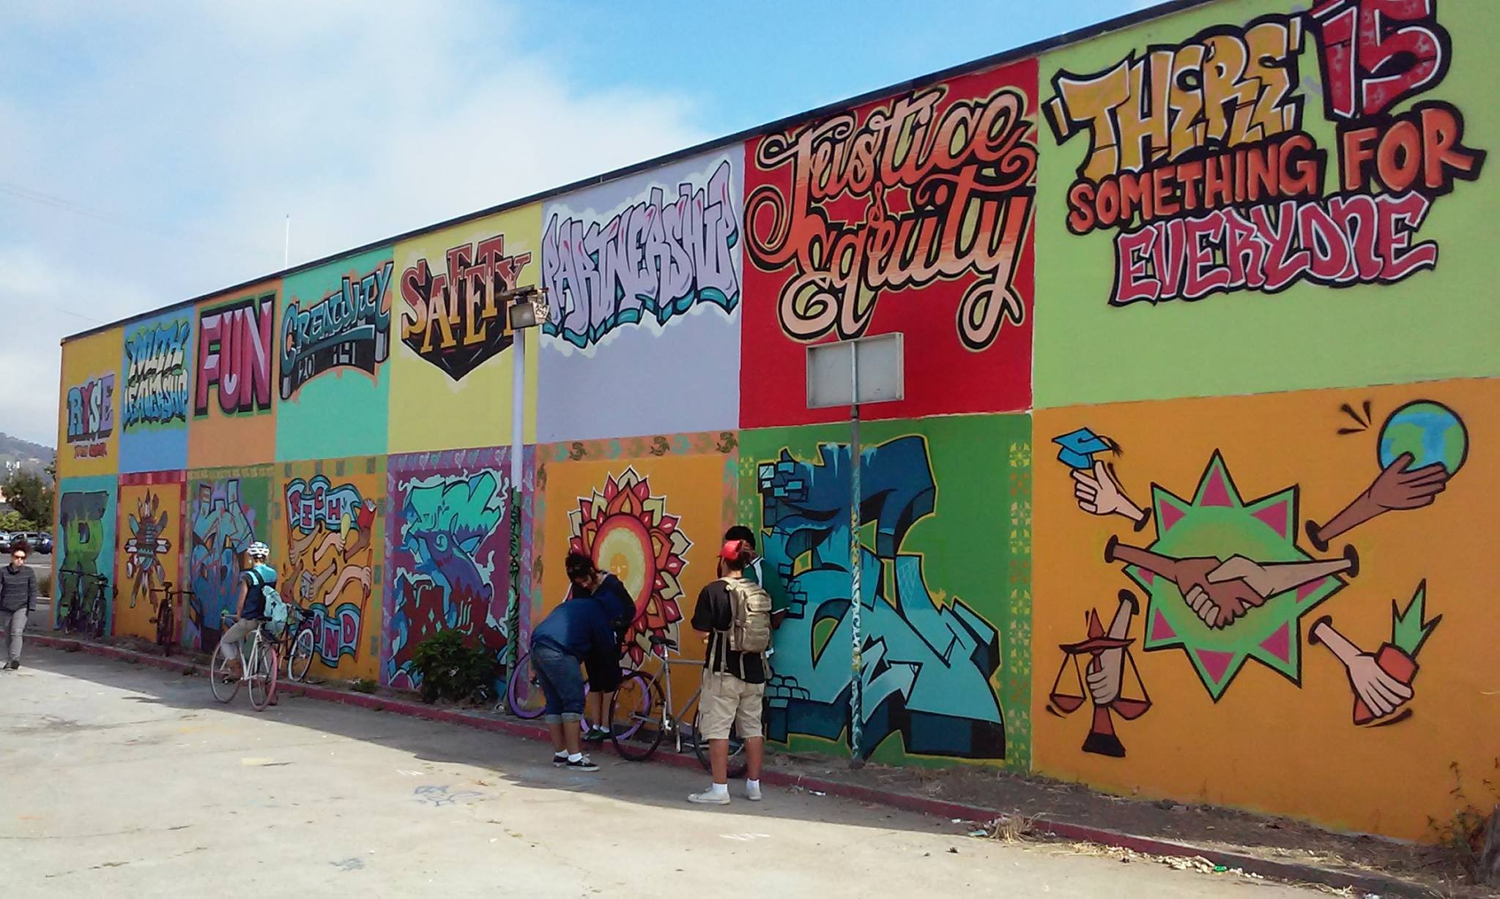

Grounded in Youth Vision
“We envision a community that inspires youth to live with pride and purpose, where the sounds of gunshots have been replaced by the sounds of organizing, song, collaboration, laughter, and learning...”
- From RYSE’s Vision Statement
Notes:
RYSE was started by youth organizers out of an organization called youth together, which was actually funded by OFCY
Youth-led, tired of adults continually dropping the ball. Hadn’t been strong coordinated efforts for organizing in decades
RYSE Opened in 2008, direct service to systems change focus. 13-21
Young people understood that what a city prioritizes is evidenced by where it spends its money. Majority of services to public safety.

Slide 4
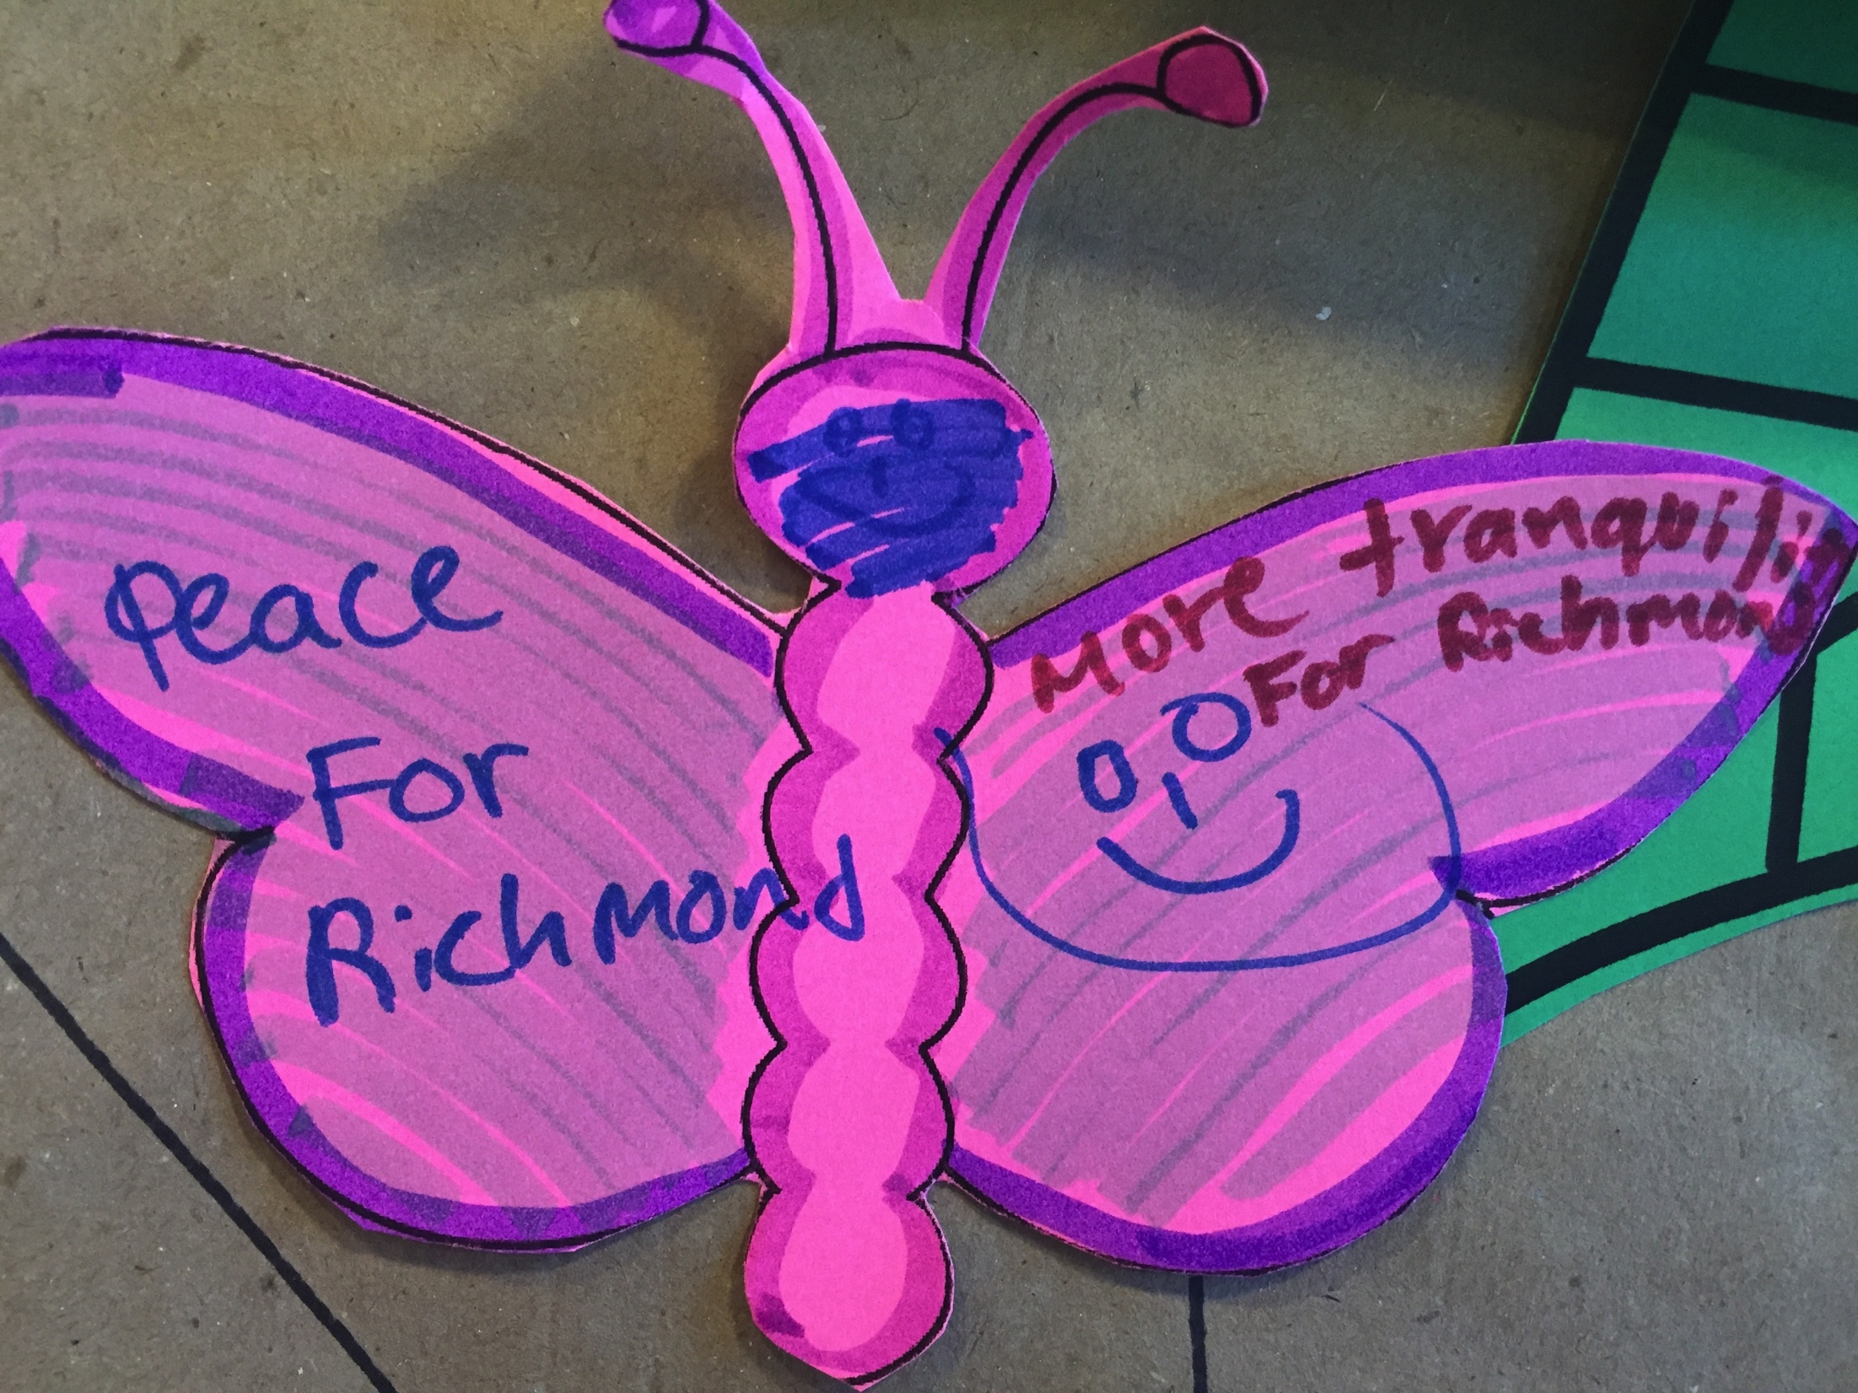
Process
Matters:
Invest in Youth Coalition
Build a shared vision for the needs and priorities of children and youth in Richmond.
Continue to build productive collaborations across community-based services, community institutions and public agencies.
Increase voter registration and turn out for Richmond residents ages 18-30.
Inspire and improve civic engagement skills of young people.
Create more responsiveness and accountability of government to young people.
Engage new funders and funding sources for children, youth and families in Richmond.
Grounded in racial justice and equity.
Notes:
Win or lose. This is about movement building.
We are looking at a potential Trump presidency. This is about igniting the base of young people and their families locally with a keen understanding of the national politic.
Dirty politics
Small community. At the end of the day we are all going to still be here.

Slide 5
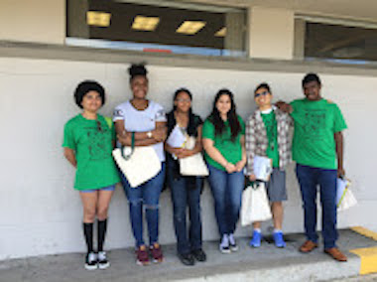
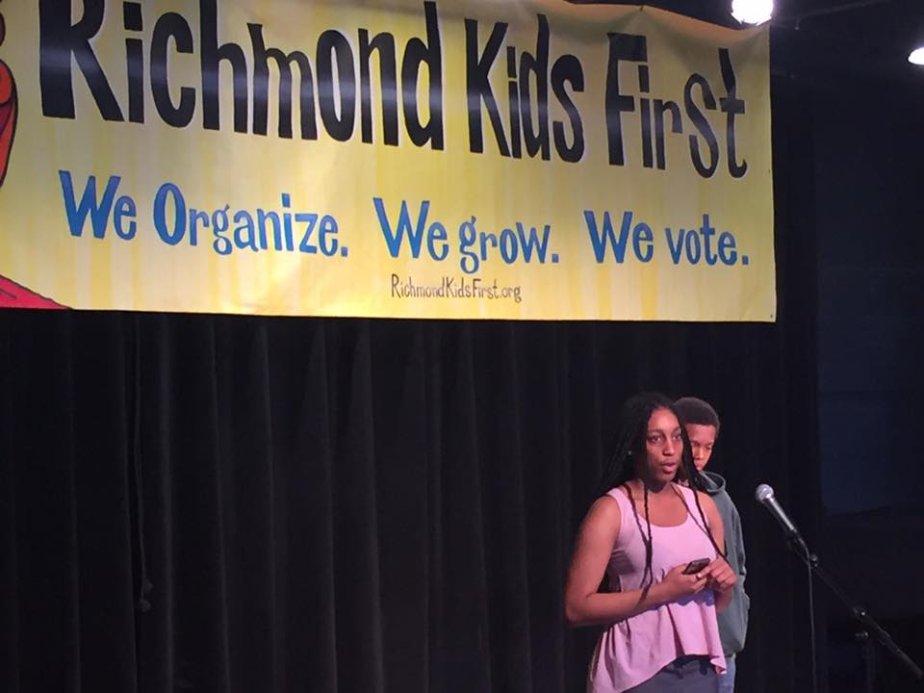
Signatures are key… and it’s hard work
Local residents, youth led process vs. professional firms
Start early
Double check dates
Dedicated staff time to coordinate
On the ballot by signature=community ownership and VOTES!
Notes:
This has been a learning process. Give yourself more time then you think you need for value and coalition, ballot work, fundraising, signature gathering etc.

Slide 6
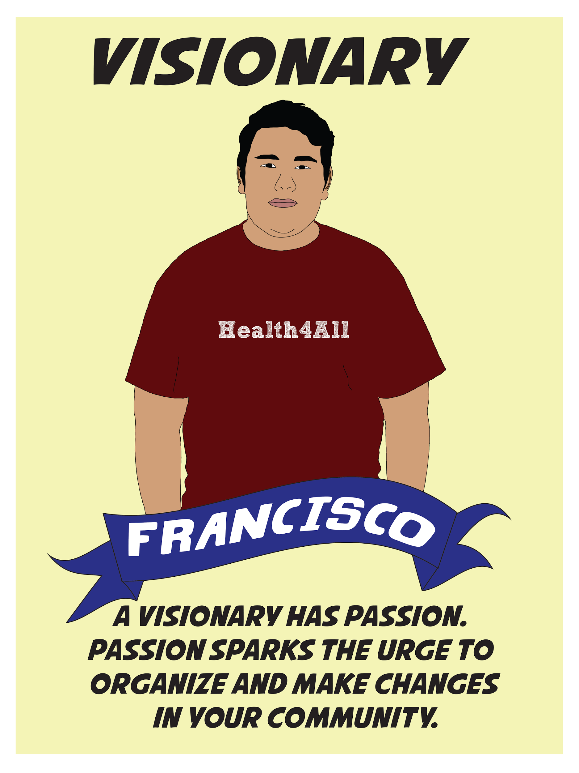
Polling is costly, but ignites the base
Children and Youth Poll High
A local funding partner commissioned the poll prior to the ballot being filed
84% favorable
64% when negative messages get introduced
Democrats/Republicans
All economic brackets
Men/women
Strongest support seniors over 73
Notes:
Polls fund high

Slide 7
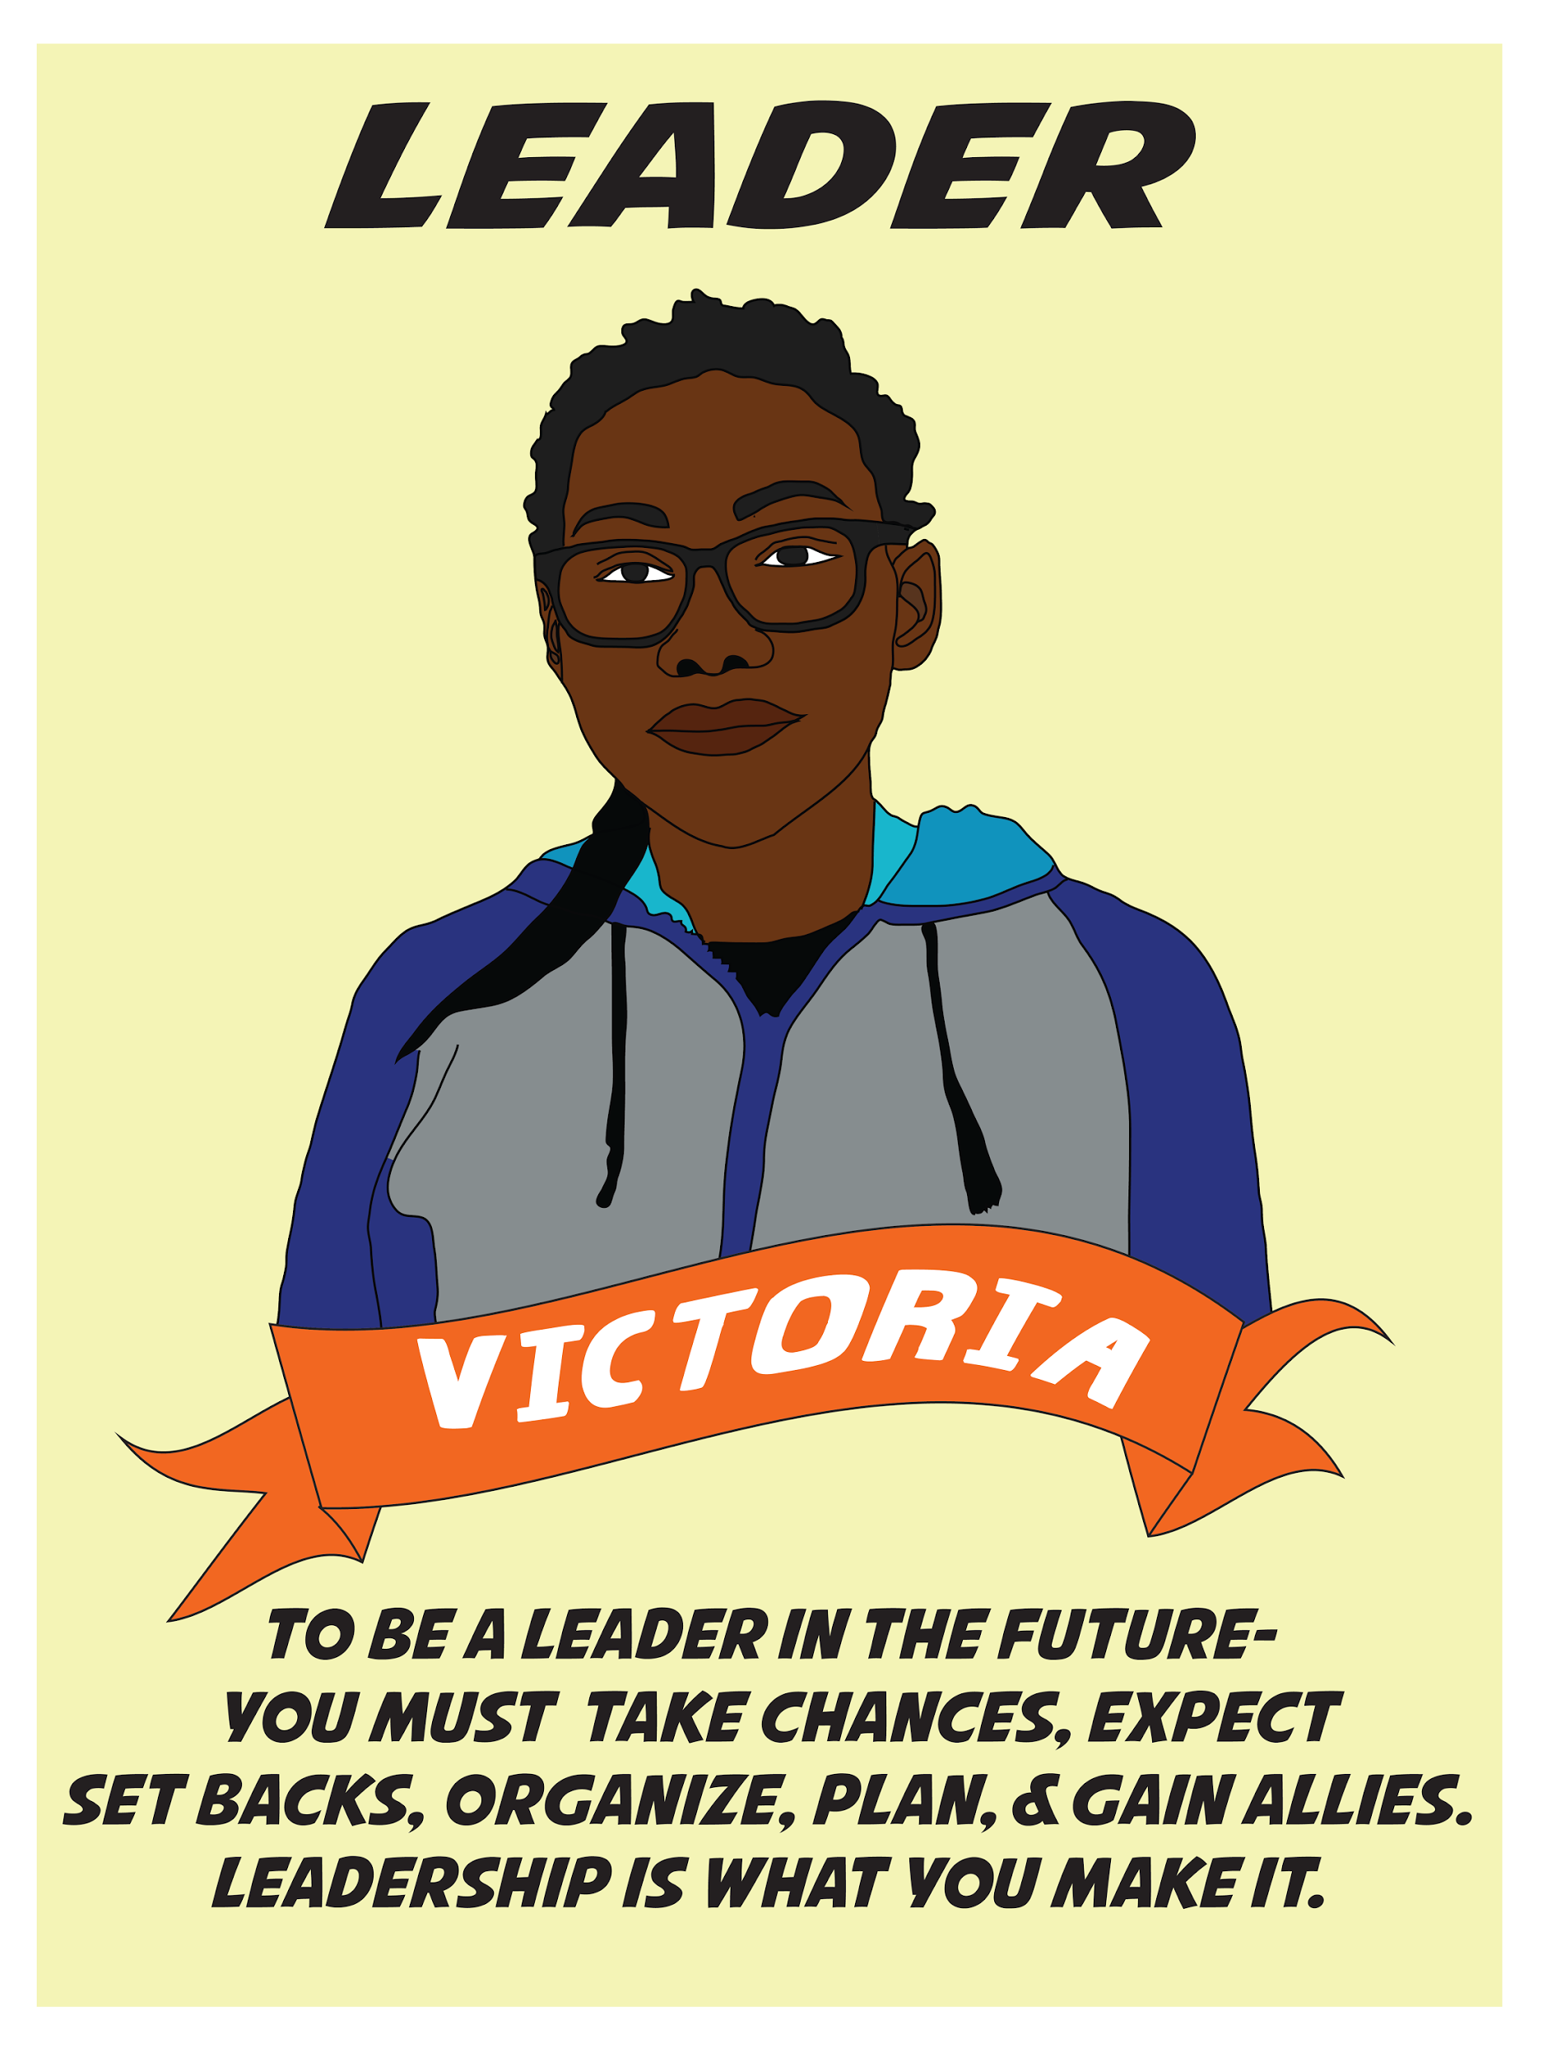
This is a long-term strategy.
Win or Lose.
  Patience is key: a culture of “No” since 2002;
  Unexpected allies and opponents;
  Winning means strategy development, implementation and community initiated accountability;
  Losing means building our base, and building a new strategy to secure resources for children and youth;
  Building an engaged voter base needs to be our collective strategy across communities

Slide 8
For more information or to get involved
(we need signature gatherers STAT)
Sara Kershnar, Invest in Youth Coalition Coordinator: sara@rysecenter.org/510-685-5347
Jamileh Ebrahimi, RYSE Youth Organizing Director: jamileh@rysecenter.org/510-500-7561
Kimberly Aceves, RYSE Founding Executive Director: kimberly@rysecenter.org/510.206.5552

