Slide 1

Becoming a Budget Warrior:
The essential role for non-profits in the local civic arena
Inland Empire Community Collaborative
Margaret Brodkin
San Bernardino, CA

Slide 2
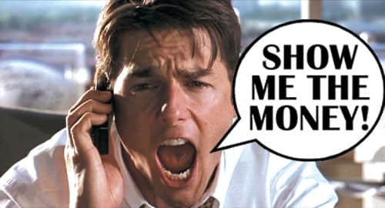
Funding the Next Generation: Values and Mission
Our goal: Empower coalitions to increase local public funding for children and youth – using the ballot.
We believe:
How we spend our money reflects our values. A budget is a moral document.
Achieving good outcomes for kids costs money.
Funding inequity is a social justice issue.
The real money is in the public sector.
Acting locally has great potential.
CHLDREN’S FUNDS IN U.S.
Provide technical assistance to coalitions working on local funding streams for children
Sponsor learning communities and conferences
Support includes speaking, convening, facilitating, trouble-shooting, coaching, providing resources and tools, and more.
FNG team includes – pollster, political consultant, fiscal expert, lawyer
New formalized partnership with Children’s Funding Project.
Notes:
<number>

Slide 3
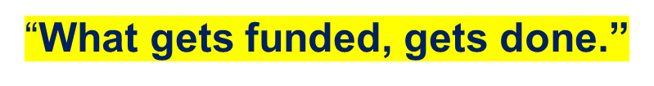
LOCAL DEDICATED FUNDS FOR CHILDREN AND YOUTH
Public dollars created and allocated at local level dedicated to specific services
How we spend our money reflects our values – budgets are moral documents
Children and youth are in crisis. Achieving good outcomes costs money.
Funding inequity is a major social justice issue.
The real money is in the public sector.
Local action is where engagement happens – often untapped for children and youth revenue.

Slide 4
THE TRUTH ABOUT SUSTAINABLE FUNDING
How we spend our money reflects our values.
Achieving good outcomes for kids costs money.
The real money is in the public sector – NOT in grants.
Acting locally has great potential.
CHLDREN’S FUNDS IN U.S.
Notes:
<number>

Slide 5
Why We Need Local Dedicated Children and Youth Funds
CHLDREN’S FUNDS IN U.S.
How we spend our money reflects our values – a budget is a moral document.
Children and youth are in crisis. Achieving good outcomes for kids costs money.
Funding inequity is a major social justice issue.
The real money is in the public sector.
Acting locally has great potential – often untapped.
“What gets funded, gets done.”
Notes:
<number>

Slide 6








STATUS OF FUNDING MOVEMENT IN CA
POLLING CONTINUES TO SUPPORT CHILDREN AND YOUTH FUNDING
Widespread interest in budget advocacy and ballot measures - dozens of city and county coalitions in every part of state are engaged in learning and starting the journey.
Advocates for children and youth are experimenting using the ballot – since 2016 ballot measures in 16 places.
Dedicated funding faced obstacle of 2/3 – legal challenges are winning, and advocates becoming more creative.
Building capacity takes time. Challenges have not deterred interest or optimism.
Pandemic has increased activism and public focus on children and youth.
Notes:
<number>

Slide 7
2020 CA Revenue Strategies for Kids
Location Type of tax To be funded by tax %Vote
Dedicated tax
  San Joaquin County Cannabis tax (Nov) 50% Children and youth 65%
  Alameda County** Sales tax (March) Early care/pediatric hospital 64%
  Sonoma County* Sales tax (Nov) Mental health & homelessness 68%
General tax
  City of Long Beach* Oil tax (Nov) General services – health, youth, climate 57%
Budget set-aside
  Los Angeles County* 10% General Fund (Nov) Community reinvestment – alternatives 57% to incarceration
  City of Sacramento 2.5% General Fund (March) Youth Fund 45%
Budget augmentations….on path to ballot measure
  City of Pomona CDBG, 50% Developer’s fee Youth programs and youth artists $2M
  San Diego City/County CARES Act/COVID $ Childcare vouchers/Provider grants $35M

Slide 8




ELECTIONS 2016 & 2018 & 2020
NAPA
MARIN
SOLANO
SACRAMENTO (2)
RICHMOND
ALAMEDA (2)
SAN FRANCISCO
OAKLAND
SAN JOAQUIN
CAPITOLA
Notes:
delete
<number>

Slide 9

FUNDING THE NEXT GENERATION
Provides technical assistance to coalitions working on local funding streams for children and youth
Sponsors learning communities and conferences
Support includes speaking, convening, facilitating, trouble-shooting, coaching, and more.
Numerous tools and resources are available.
CONTACT:
Margaret Brodkin, Margaret@fundingthenextgeneration.org
415-794-4963
www.fundingthenextgeneration.org

Slide 10
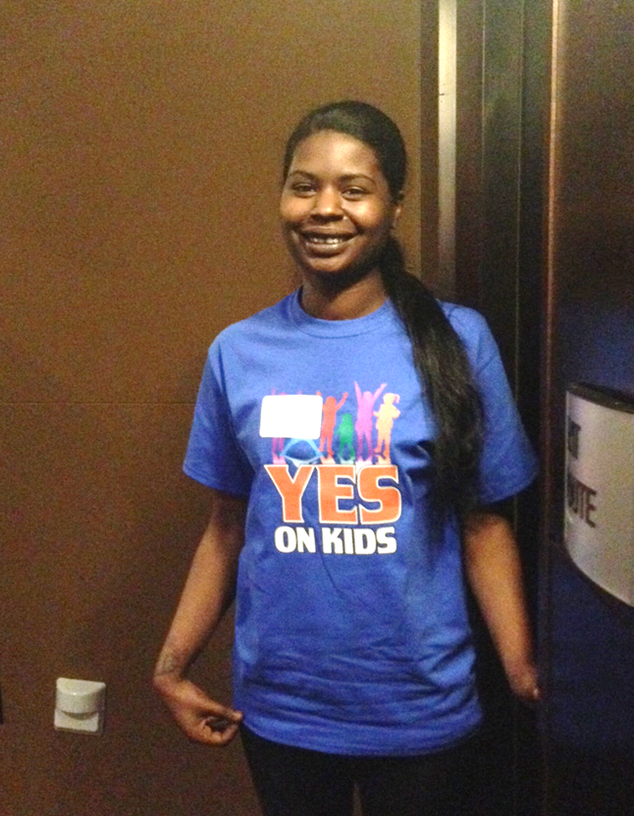
BENEFITS OF LOCAL CAMPAIGNS
FOR FUNDING FOR CHILDREN AND YOUTH
LOCAL GENERAL FUND IS FLEXIBLE
“MAGIC MONEY”
Local level – where engagement happens, foundation of children’s movement
Fills gaps in services
Leverages state, federal, private dollars
Promotes innovation, coordination and systems reform
Focuses on prevention
Facilitates local accountability, leadership and local infrastructure
Generates public support – people see outcomes
Leads to more local funding

Slide 11
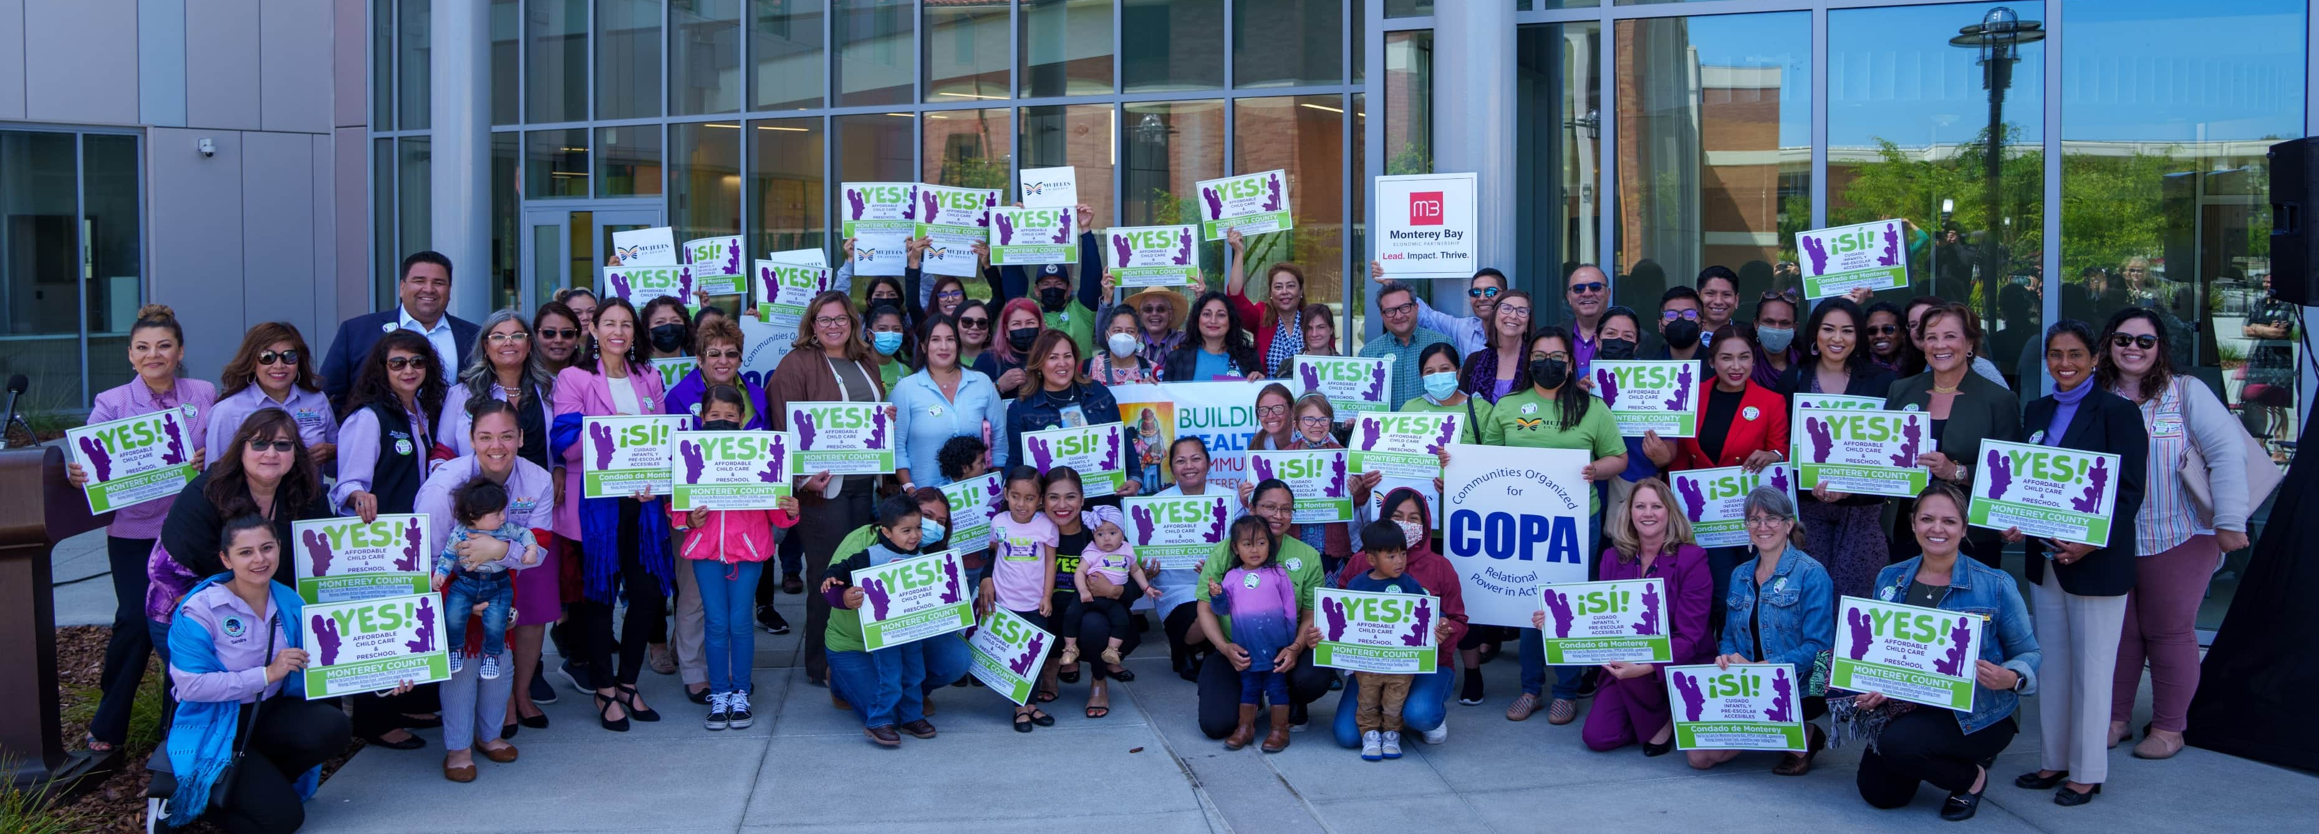
BENEFITS OF BALLOT VS. ANNUAL BUDGETS
Only way to raise NEW money - in most cases More sustainable – not dependent on annual political debate | Builds community visibility, knowledge and support – momentum for future issues Built-in accountability

Slide 12
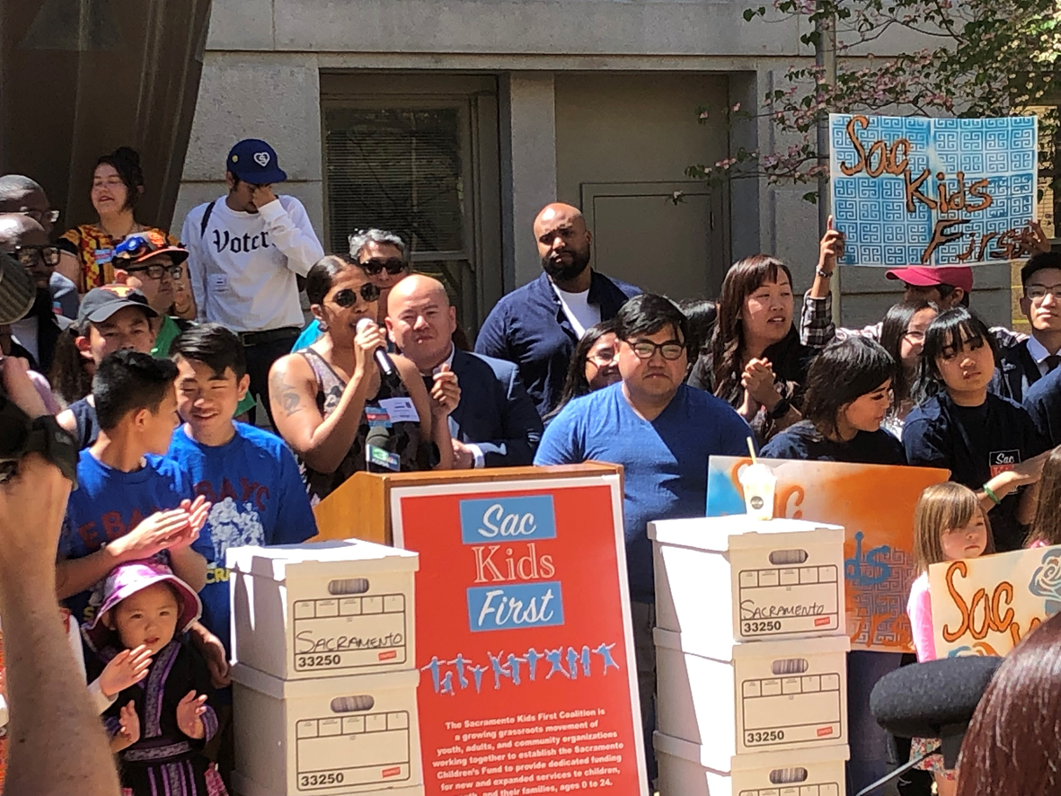
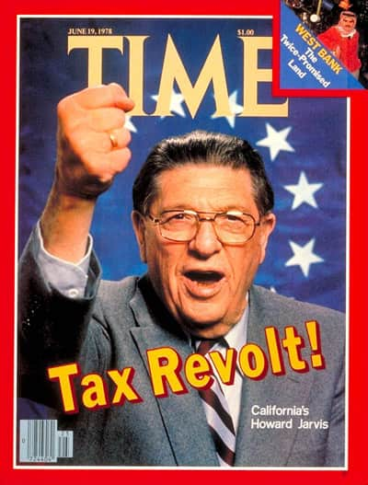
FUTURE POSSIBILITIES
CALIFORNIA ELECTION LAW IS CHANGING.
Voter initiatives only require a majority vote.
Pandemic has raised new public awareness and concerns.
Youth mental health polled as highest public concern regarding children and youth.
Polling provides reason for optimism – public will support dedicated taxes and set-asides.
Maximize Our New Opportunity

Slide 13
FUNDING THE NEXT GENERATION
First organization to promote local children’s funds
2 decades after children’s funds in SF and Oakland
Provides technical assistance to coalitions working on local funding streams for children and youth
  Sponsors learning community and conferences
  Site-level support includes speaking, convening, facilitating, trouble-shooting, coaching, and more.
Develops tools and materials, such as “Creating Local Dedicated Funding Streams for Kids: A Guide to Planning a Local Initiative to Fund Services for Children, Youth and Their Families”
Promotes local dedicated funding ideas in state and national venues
Develops state policy recommendations to facilitate local revenue-raising
TO DATE – 40 communities involved. 15 coalitions in 2017 learning community. 4 measures on ballot.

Slide 14









BASIC THESIS REMAINS THE SAME
Low funding for kids - our field is still motivated to fight for local public dollars and use the ballot.
Public opinion continues to support kids.
New local public funding streams are successful and transformative.
First 5’s have unique assets.
“What gets funded, gets done.”
Notes:
<number>

Slide 15
LESSONS LEARNED FROM BALLOT MEASURE CAMPAIGNS
Notes:
1., change LA Co0….to Greater LA Summer Matters Network
2 add 2018 to the date
<number>

Slide 16
CAUTIONARY LESSONS
2/3 is almost insurmountable – successful campaigns found way around.
Time for groundwork (organizing coalition, building political capital, research on options, finding allies with resources/fundraising) can be years.
City vs County-level measures – county-level has more challenges.
Can start with building local official infrastructure – department, office, coordinating council.
Notes:
<number>

Slide 17



What is a public, local dedicated funding stream?
Public – allocated by government
Local – allocated at the county, city or school district level
Dedicated – can only be spent on services to children, youth and families
Funding – specific amounts of money allocated in a budget process
Stream – ongoing funding, as opposed to year-to-year

Slide 18
CONSIDER BROADER REVENUE STRATEGIES
  Parcel tax on size of parcel
  City/county partnership
  Partner with other interest groups
  Start with narrow issue
  Join a General Tax coalition
  Don’t forget mitigation fees and budget advocacy
CHLDREN’S FUNDS IN U.S.
Notes:
<number>

Slide 19

WHAT NEEDS TO BE IN PLACE?
  Convening organization
  Dedicated staff support
  Diverse network/coalition that can work
together
  CBOs/ALLIES prepared for political engagement
  Baseline information on community needs
  Moderate agreement about priorities
  Passion and willingness to take risks
  Time and motivation to organize the base
  Political champion (if possible)
  Resources to lay groundwork, potential resources for an electoral campaign
Notes:
<number>

Slide 20

BENEFITS OF LOCAL DEDICATED
FUNDING FOR CHILDREN AND YOUTH
LOCAL FUNDING IS FLEXIBLE.
“MAGIC MONEY”
Fills gaps in services not addressed by other funding streams.
Focuses on prevention.
Promotes innovation, coordination and systems reform.
Facilitates local accountability, leadership and local infrastructure.
Generates public support – people see outcomes.
Leverages state, federal, private dollars.
Leads to more local funding.

Slide 21
RATIONALE FOR MEASURE
What are you committing to? (ex. racial equity, prevention, civic participation, best practices, the need for collaboration, leveraging resources, maximizing partnerships, accountability, affordability)
What specific populations will this measure target? (ex. children in poverty, children in all neighborhoods, homeless children, youth impacted by systems)
What models of care will be prioritized? (ex. high quality early care and education, workforce development, evidence-based services, etc.)
What outcomes are anticipated? (ex. all children ready for kindergarten, all youth have opportunities for positive development, all providers make a living wage)
What goals will this measure help the community meet? (Ex. the health, safety, and school success for individual children; gather data on welfare of children; )
ELEMENTS OF A REVENUE MEASURE
Rationale for measure - findings
Title of ordinance – GIVE IT A NAME
Purpose and goals – e.g. prevention
Fund – amount, revenue source, name
Services eligible for funding – ages, types, not eligible
Prevent supplantation – baseline budget
Oversight – power, appointment
Administration – department, contracting, costs
Planning and accountability – public process, evaluation, transparency

Slide 22
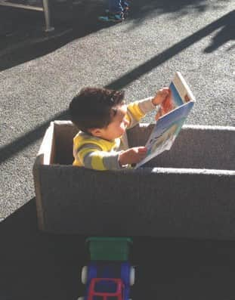
WHAT TO CONSIDER IN MAKING DECISIONS
ABOUT FUNDING STRATEGY?
Be open to unexpected opportunities – and compromises
WHAT DO YOU WANT FUNDED? Gaps in services – priority needs LEGAL CONSIDERATIONS Options and constraints POLITICAL CONSIDERATIONS Political feasibility and public opinion Political champions and allies Strength of opposition Visible outcome Builds political capital | ORGANIZATIONAL CONSIDERATIONS Consensus of sponsoring coalition Potential volunteers Potential to rally parents and constituents Resources of advocates BIG ENOUGH TO MATTER SMALL ENOUGH TO WIN
Notes:
<number>

Slide 23

GETTING READY
  Convening organization
  Dedicated staff support
  Diverse network/coalition that can work
together
  CBO’s prepared for political engagement
  Baseline information on community needs
  Agreement about priorities
  Passion and willingness to take risks
  Time and motivation to organize the base
  Political champion (if possible)
  Resources for an advocacy or electoral
campaign
Notes:
<number>

Slide 24
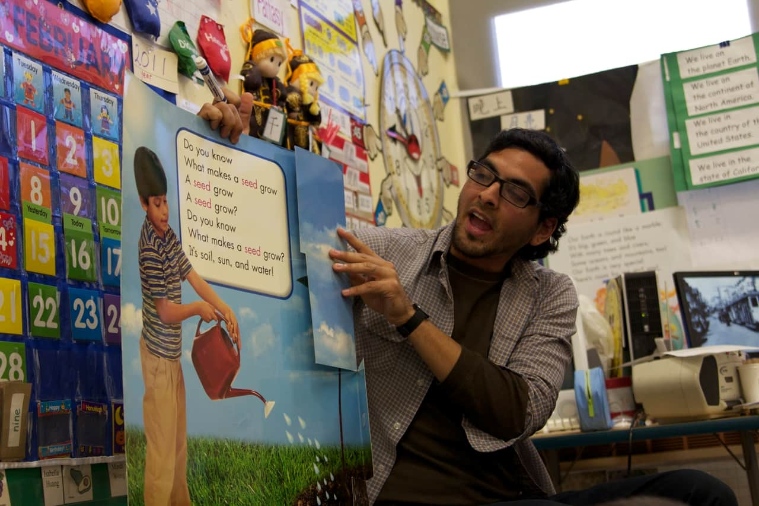
WHAT CAN BE FUNDED IN AN EARLY CARE MEASURE
PROVIDE SUFFICIENT FLEXIBILITY FOR POTENTIAL CHANGES IN FUNDING ENVIRONMENT
e.g., State and/or federal dollars
Scholarships/vouchers for families
Wages for preschool and childcare workers
Facilities and supplies
Support services for families – mental health, developmental screenings, basic needs
Quality enhancement, support for workers – Training
Other as needed to ensure access, equity and quality
Administration and evaluation – Limit %

Slide 25
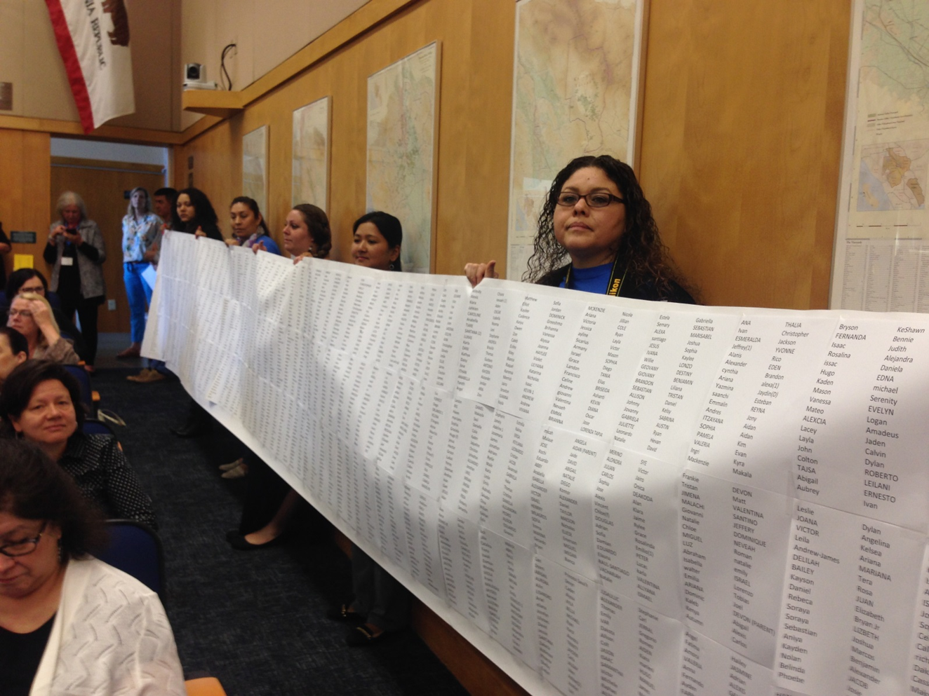
STRATEGIES FOR ADVOCATES IN MOUNTING A CAMPAIGN FOR FUNDING FOR KIDS
PERSUASION AND PRESSURE
Form a coalition – build a network of diverse allies. Organize.
Find elected officials who will be champions.
Cultivate the voices of parents and youth.
Take the initiative – don’t wait for permission or an invitation.
Use the media – social, print, TV, radio.
Never miss a chance to make your case – hearings, community meetings, elections.
Drama helps.
Notes:
Part of what we do is help advocates for kids strategize and learn the skills to become great advocates at the local level for kids whether advocating for changes in local budgets or using the ballot to garner new ways to fund kids. This is my favorite picture – it is the women from Parent Voices in Sonoma County bringing a computer printout of the waiting list for childcare in their county to the Board of Supervisors during a discussion of a potential ballot measure for kids funding.
<number>

Slide 26
WHAT NEEDS TO BE IN PLACE?
    Convening organization
    Dedicated staff support
    Diverse network/coalition that can work
together
    CBO’s prepared for political engagement
    Baseline information on community needs
    Agreement about priorities
    Passion and willingness to take risks
    Time and motivation to organize the base
    Political champion (if possible)
    Resources for an advocacy or electoral
campaign
Notes:
<number>

Slide 27
KEY DECISIONS IN DEVELOPING A MEASURE
BALANCE POLITICAL REALITIES AND NEEDS OF KIDS
1. What do you want to fund?
2. How much money do you need/want?
3. What level of government do you want to target?
4. New Resources vs. Reallocation of Existing Resources
IF NEW REVENUE:
5. Dedicated tax vs. General tax
6. Type of tax – sales, property, business, cannabis, wealth, property transfer, utility, alcohol, soda, etc.
7. Tax rate

Slide 28
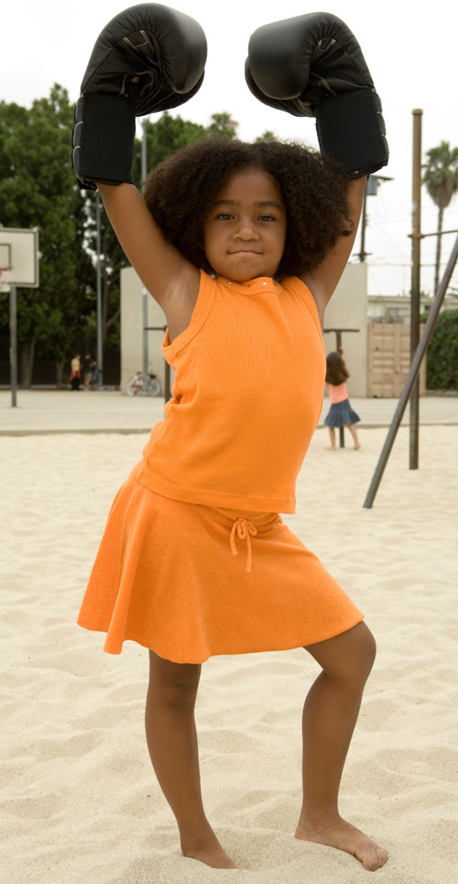
Not yet ready for a single dedicated measure?
CONTINUE TO BUILD THE MOVEMENT.
NO MONEY NO JUSTICE.
Keep eyes open for emerging local measures. Get a seat at the table when new money could become available.
Form alliances with related advocacy and social justice groups – homelessness, mental health, housing.
Consider creating civic infrastructure first – departments, offices, cabinets, councils.
Keep vision of full funding alive. Don’t let anyone think that the problem is solved – until it is.
Build alliances with organizations and people with money for campaigns – public employee unions, hospitals, teachers unions.

Slide 29
Timeline of the Voter-Approved Children’s Fund Movement
1940
1950
1960
1970
1980
1990
2000
2010
2022

Slide 30
Voter-Approved Children’s Funds in California
1991 and 1996
San Francisco pioneered Children’s Fund; Oakland followed
2016
Funding campaigns began in Napa, Marin, Sacramento and Solano. Humboldt successfully prioritized children for marijuana funding.
2018 – 2022
Seven new dedicated funds passed. Five communities put children’s services into larger measures.
DEDICATED FUNDS FOR CHILDREN AND YOUTH
San Francisco (3 funds)
Oakland (2 funds)
Richmond
Santa Cruz
Capitola
Alameda
Sacramento
1940
1950
1960
1970
1980
1990
2000
2010
2022
Notes:
2016 – present – Starting 20 YEARS AFTER OAKLAND – VERY long hiatus
6 funds; 6 other campaigns; 4 revenue campaigns with money going to kids
LESSONS – Expansion requires conscious effort (doesn’t happen naturally – great rationale for CFP and FNG); Won’t win every time – be ready to take chance and try again; Campaigns are also transformative (e.g. great influence on ARP funds); New field emerging - learning to use the ballot – build political capital, engage community, hear parent and youth voices, build broader coalitions, new revenue options. TAKE THE INITIATIVE – ELECTIONS ARE FOR KIDS’ADVOCATES.
<number>

Slide 31
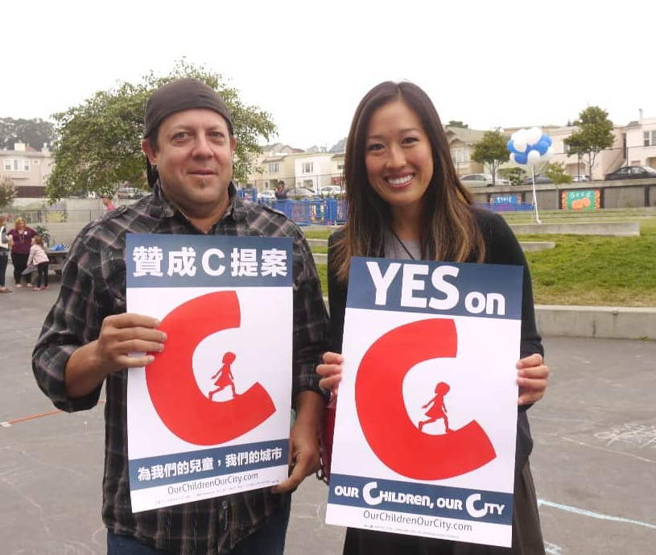
An Emerging Movement
CHILDREN’S FUNDS IN U.S.
All ages – San Francisco, 8 counties in Florida, Seattle, Portland, Oakland, Baltimore, King County
Preschool – Denver, San Antonio, San Francisco, Cincinnati
Violence Prevention – Little Rock, San Bernardino, Oakland, Santa Rosa
Mental health – 8 counties in Missouri, 3 counties in Ohio
Soda – Philadelphia, San Francisco, Oakland, Albany, Berkeley, Boulder
Notes:
1. Just note where King County is Ca?
<number>

Slide 32

ELECTIONS 2016 & 2018 & 2020
NAPA – 45%
MARIN – 63%
SOLANO – 59%/ 45%
SACRAMENTO – 66%,
RICHMOND – 76%, 65%, 63%
ALAMEDA – 66%, 64%
SAN FRANCISCO – 51%
OAKLAND – 62%
SAN JOAQUIN – 63%, 65%
CAPITOLA – 75%
Notes:
delete
<number>

Slide 33
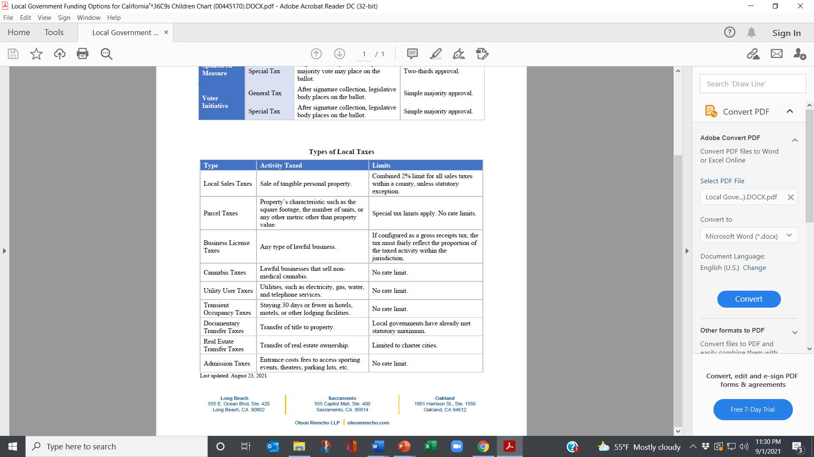
TAXES OR SET-ASIDES – THAT IS THE QUESTION?
TAXES
SET-ASIDES
Dedicated portion of existing revenue to children and youth.
Can be done in charter cities and counties.
No limit on amount – only what is politically feasible.
Generally, require voter initiative.
Kids' needs
Your capacity
Political reality

Slide 34
WHAT REVENUE STREAM IS BEST?
Kids' needs
Your capacity
Political reality
MANY STRATEGIES CAN WORK: FIND THE SWEET SPOT.
Be open to unexpected opportunities.
Know when to compromise.
OPTIONS:
Taxes (sales, soda, property, business, utility, hotel, marijuana)
Fees (admissions, amenities, mitigations, abatement)
Carve-out - reallocation
CONSIDERATIONS:
Polling, Legalities, Support base, Political landscape, Campaign costs
DECISIONS:
New resources vs. reallocation, Which revenue, Legislative vs ballot, Voter initiative vs. Legislators, General vs special, Which election

Slide 35

ONLY 2 WAYS TO GET PUBLIC DOLLARS
Each strategy has built-in resistance.
1. Reallocate existing dollars
2. Generate new dollars
Three arenas
Budget process
Legislative policies
Ballot
.

Slide 36
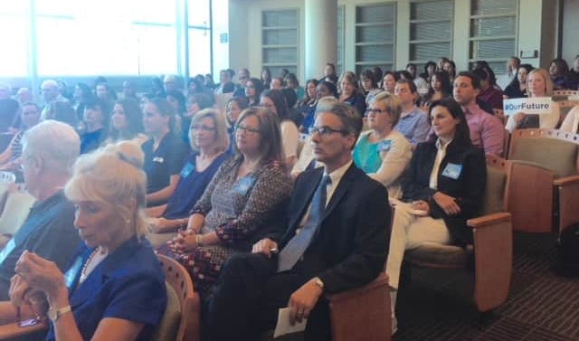
LOCAL BUDGET PROCESS
REALLOCATING EXISTING DOLLARS – WHERE TO GET THE MONEY
General budget request – no specific revenue source identified
Carve-out of new funds – e.g. increases in general fund, cannabis or realignment
Realignment of realignment $ – exploit flexibility in child welfare and behavioral health
Unexpended dollars – e.g. mental health services act
Target low priority items for reallocation
Moving funds from punishment to prevention – e.g. juvenile halls
Pilot projects

Slide 37

LOCAL POLICIES
CAN BE ON THE BALLOT – OR PASSED LEGISLATIVELY
EXISITING OR NEW DOLLARS
Set-asides of existing dollars – e.g. SF PFA, Oakland Fund for Children, Sacramento Fund
Mitigations for making money, saving money or impacting a community – development impact fees, development agreements, community benefit agreements, PILOT (payment in lieu of taxes) i.e. hospitals – Most are city strategies.
In-kind resources – facilities funds, loan funds, free admissions to city/county programs/facilities
Work with community development agencies and housing developers.

Slide 38
CITY AND COUNTY TAXES
MUST BE ON THE BALLOT
Can be General or Special taxes
Sales - combined limit 2% add-on to base of 7.5% - done in 1/8 cent increments
Real estate transfer – can be made progressive by increasing with value of property
Parcel – can be based on size of parcel, and can have many exceptions – always a special tax
Business - gross receipts, car rental, parking
Utility (UUT) – gas, water, sewer, cable, phones
Hotel – Transient Occupancy Tax (TOT) – ranges from 8 – 14%
Marijuana – Cultivation, Manufacturing, Sales – can be passed by a percentage range
Admission – Parks, Sporting events, Concerts, etc.
Some taxes are cities/county unincorporated areas only, i.e. business, UUT, marijuana, admission

Slide 39

LOCAL FUNDING STRATEGIES FOR CHILDREN AND YOUTH SERVICES
Consider community priorities, political opportunities, legal options, new revenue, power of advocates
FIND THE SWEET SPOT.
Annual budget allocation – Reallocation of existing dollars; New federal or state dollars – e.g. CARES for San Bernardino Co. = $380M; Riverside Co. = $431M
Taxes - sales, real estate transfer, parcel, business, utility, hotel, marijuana
Fees - admissions, amenities, mitigations, abatement
Dedicated portion of budget – SF Children’s Fund
NOTE: If it passes, Schools and Communities First (Prop 13 revision on November ballot) would bring approximately $486 M annually to San Bernardino Co. and $362 M to Riverside Co. (40% will go to schools), the rest to county General Fund.
Notes:
Background - Today we will talk primarily about federal funding for COVID 19. We are happy to return to discuss other options for ongoing, long-term discussion. For instance, there may be a possibility of setting aside funds from a potential cannabis tax for kids – which is what they are trying right now in San Joaquin County.
<number>

Slide 40

CHALLENGES TO CHANGING BUDGET PRIORITIES
NO NEW MONEY
COMPETING PRIORITIES
SACRED COWS
TURF
NOT THE RIGHT TIME
NOT THE RIGHT APPROACH
PURPOSEFUL MYSTIFICATION
Notes:
Changing local budget priorities is always hard – whether you are doing it from the inside of government or the outside. Don’t forget most of the people in the room are advocates – and even elected officials who may be in the minority in their communities.
<number>

Slide 41
4. MOUNTING A CAMPAIGN
PERSUASION AND PRESSURE
TRADITIONAL TACTICS – reports, meetings, letters, testimony, op-eds, site visits, calls
POLITICAL HARDBALL – demonstrations, sit-ins, petitions, public challenges and direct criticism, guerilla theatre, press events, withdrawal of political support, circumventing the traditional process

Slide 42
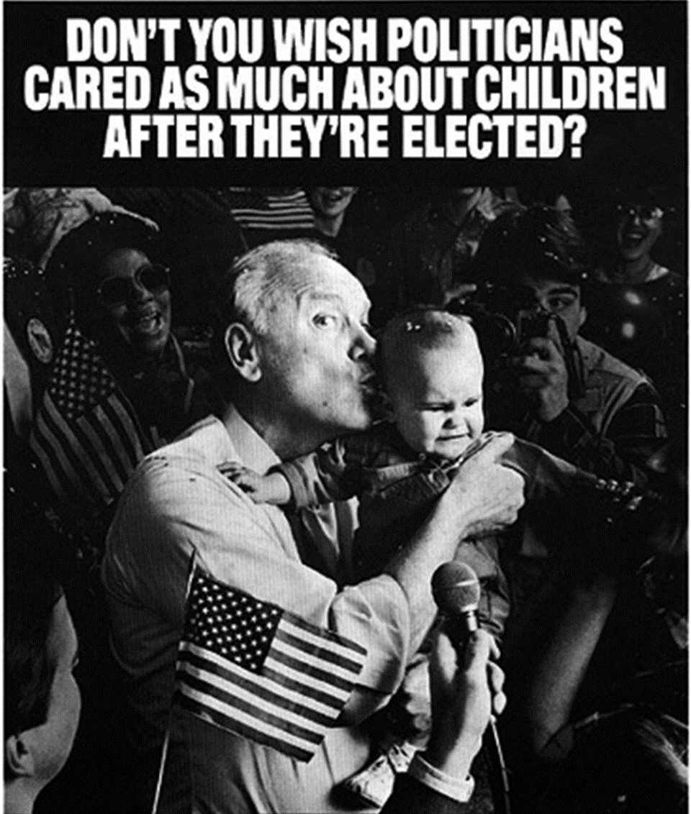
CHALLENGES IN CHANGING BUDGET PRIORITIES
PRESERVING THE STATUS QUO
SACRED COWS
TURF
NEVER THE RIGHT TIME
NEVER THE RIGHT APPROACH
NO NEW MONEY
PENSION COSTS
PURPOSEFUL MYSTIFICATION

Slide 43

ROADMAP FOR CREATING A DEDICATED FUND
THERE ARE KEY ELEMENTS OF WORK,
BUT NO LINEAR PATH
FOUNDATIONAL ELEMENTS Convener, Coalition Community assessment Commitment | KEY STEPS Making the case Building the base Crafting the plan

Slide 44

Roadmap to Influence Local Fiscal Policy
NO LINEAR PATH
1. Making the case
2. Crafting the “ask”/proposal
3. Building the base
4. Mounting the
campaign

Slide 45
Voters believe increased access to early education will have broad benefits for society.
(% Believing Expanded Access to Early Education is Likely to Produce Each Benefit)
FM3/POS National Voter Survey for NAEYC
Notes:
<number>
Can you pick the FM3 slides you think are best. This group is interested in young children.

Slide 46

WHAT NEEDS TO BE IN PLACE?
  Convening organization
  Diverse network/coalition prepared for political engagement
  Baseline information on community needs
  Agreement about what to fund
  Time and motivation to organize the base
  Resources to lay groundwork, e.g., dedicated staff support
  Political champion(s) - desirable, not necessary
  Passion and willingness to take risks
Notes:
<number>

Slide 47
WHAT CAL. DEDICATED LOCAL FUNDS FOR KIDS SUPPORT
FUNDING CAN BE TRANSFORMATIVE – Direct services; Systemic reform; Capacity building; Reallocation of resources; Targeting special needs and underserved populations
EARLY CARE
Scholarships/vouchers for families
Wages for preschool and childcare workers
Facilities and supplies
Support services for families – mental health, developmental screenings, basic needs
Quality enhancement, support for workers – Training
YOUTH DEVELOPMENT
Alternatives to incarceration
Afterschool programs, outdoor education, recreation
Youth leadership and organizing
Violence prevention and response
Media, arts, culture, technology
Educational enrichment
Workforce and career development
Youth Centers
HEALTH AND WELL-BEING
Youth wellness centers
Family support

Slide 48
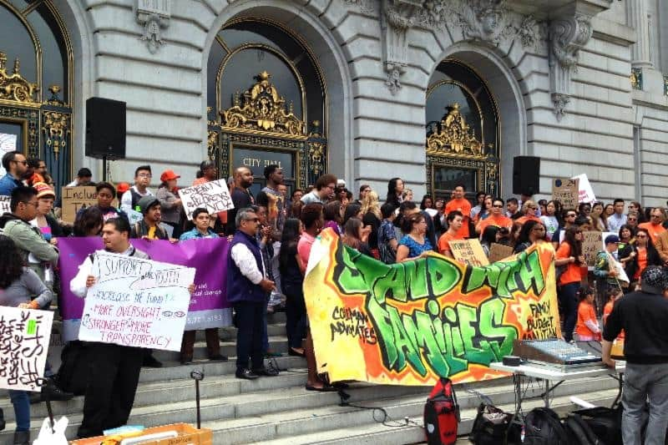
PERSUASION AND PRESSURE
Soft traditional tactics – reports, meetings, letters, testimony, op-eds, site visits, calls
POLITICAL HARDBALL – demonstrations, sit-ins, petitions, public challenges and direct criticism, guerilla theatre, press events, withdrawl of political support, circumventing the traditional process

Slide 49
THE ALAMEDA WINNING FORMULA
PARTNERSHIPS
FIRST CAMPAIGN Public policy experts Strong “provider” involvement Parent Voices Labor Community foundation Political champion | SECOND CAMPAIGN Added: Signature drive – potential for majority voter threshold Coalition with Children’s hospital Greater grassroots leadership
Join pediatric health care experts, nurses, kindergarten and preschool teachers, childcare providers, parents, and community leaders across the county in voting YES on Measure C!
Notes:
delete
<number>

Slide 50

Maximize Our New Opportunity
CHILDREN’S FUNDS IN U.S.
Notes:
1. Just note where King County is Ca?
<number>

Slide 51
WHY PUBLIC BUDGETS MATTER?
State of our children is a crisis.
A budget is a moral document that reflects community priorities.
Funding inequity is a social justice issue.
Lack of resources is greatest resistance to change

Slide 52
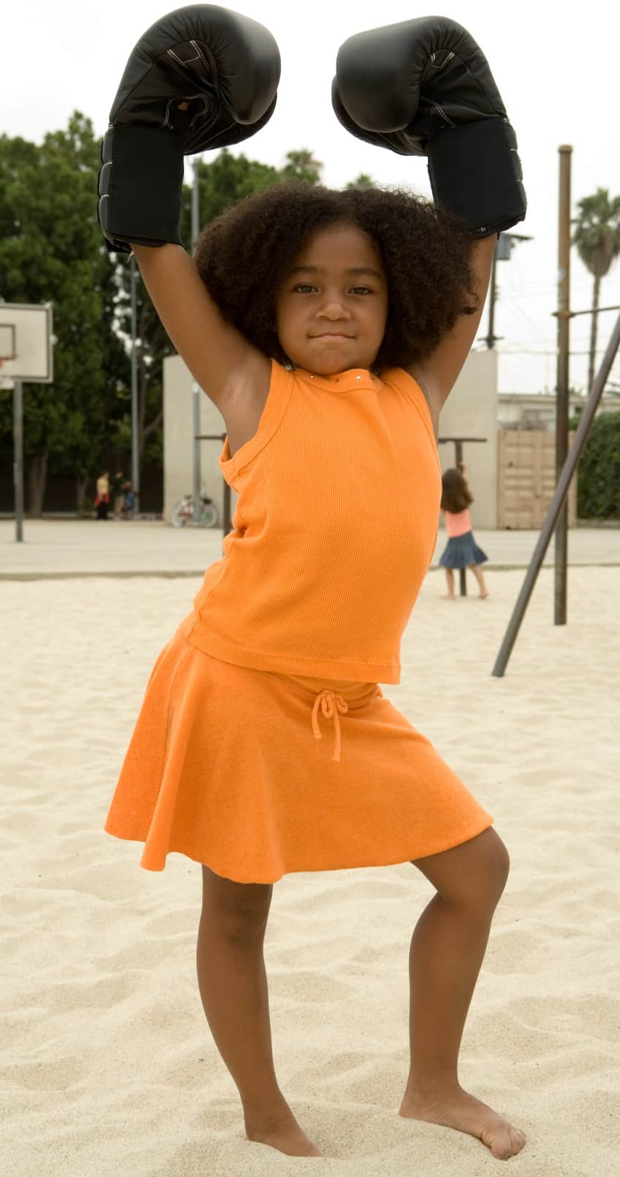
TRAINING, COACHING, CONSULTATION BY FNG
Learning community, Presentations to individual communities, Consultation with campaign leaders, National conference
Assessing political feasibility Revenue options Legal issues Prioritizing needs Assessing your local budget Drafting a measure Timelines | Political strategy Campaign budgets Coalition partners Fundraising Communication strategies, including digital Messaging Determining public opinion

Slide 53
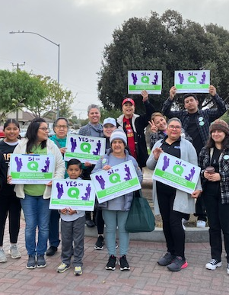
ASSESSING FEASIBILITY – ART NOT SCIENCE
.
WHAT TO ASSESS Revenue options Legal constraints History of ballot revenue measures Political leaders Opinions of major influencers – civic groups, labor, grassroots, business, groups representing segments of population Public opinion CONSIDER: | Potential partners and coalition members Opposition – potential for neutralizing Demographic changes that can help your cause Barriers to overcome Greatest assets

Slide 54
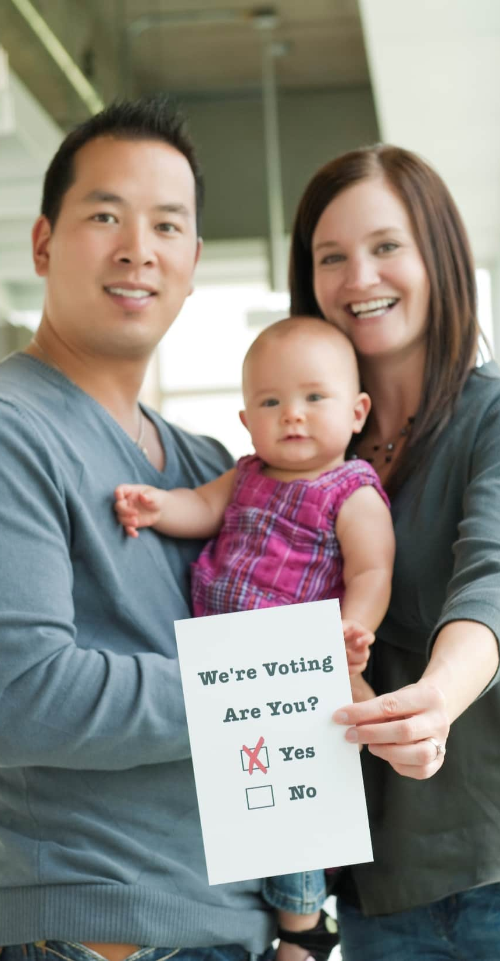
DO WE NEED TO
GO TO THE BALLOT?
ELECTIONS ARE POWERFUL
Institutionalizes the funding
Platform for telling the story and broadening the base
Pre-election budget advocacy can be important
NOTE: Timelines are a challenge.

Slide 55
CBO’S AND ADVOCATES FOR CHILDREN NOT PREPARED FOR BUDGET BATTLES
Reliance on short-term solutions to single agency budget needs
Lack of knowledge about public budgets
Lack of participation in local budget processes
Lack of collective action to address public budget issues
Missed opportunities to build social and political capital and change how resources are allocated.
WE MUST RE-INVENT OUR ROLE IN CIVIC LIFE.

Slide 56
WHAT ARE THE REVENUE OPTIONS?
Kids' needs
Your capacity
Political reality
MANY STRATEGIES CAN WORK.
FIND THE SWEET SPOT.
Taxes - sales, soda, parcel, business, utility, hotel, marijuana
Fees - admissions, amenities, mitigations, abatement
Carve-out – reallocation
Annual budget allocation

Slide 57
WHAT REVENUE STREAM IS BEST?
Kids' needs
Your capacity
Political reality
MANY STRATEGIES CAN WORK: FIND THE SWEET SPOT.
Be open to unexpected opportunities.
Know when to compromise.
OPTIONS:
Taxes (sales, soda, property, business, utility, hotel, marijuana)
Fees (admissions, amenities, mitigations, abatement)
Carve-out - reallocation
CONSIDERATIONS:
Polling, Legalities, Support base, Political landscape, Campaign costs
DECISIONS:
New resources vs. reallocation, Which revenue, Legislative vs ballot, Voter initiative vs. Legislators, General vs special, Which election

Slide 58
The San Francisco Story
Notes:
1., change LA Co0….to Greater LA Summer Matters Network
2 add 2018 to the date
<number>

Slide 59
TWO WAYS TO GET PUBLIC DOLLARS
REALLOCATE EXISTING DOLLARS
      Budget process – childcare funding
      Ballot – San Francisco, Oakland
GENERATE NEW DOLLARS
      Budget process – Santa Cruz
      Ballot – Alameda, San Joaquin, San Francisco
.

Slide 60
Roadmap For Creating Dedicated Funding
THERE ARE KEY ELEMENTS OF WORK, BUT NO LINEAR PATH
Making the case
Building the base
Crafting the plan
Mounting the
campaign

Slide 61
ROADMAP FOR CREATING A DEDICATED FUND
THERE ARE KEY ELEMENTS OF WORK,
BUT NO LINEAR PATH
FOUNDATIONAL ELEMENTS Convener, Coalition Community assessment Commitment | KEY STEPS Making the case Building the base Crafting the plan

Slide 62

WHAT TO CONSIDER IN MAKING DECISIONS ABOUT FUNDING STRATEGY?
Be open to unexpected opportunities. Know when to compromise.
  Gaps in services – priority needs
  Legal realities – e.g. voter threshold
  Public opinion
  Consensus of sponsoring coalition
  Political champions
  Strength of opposition
  Potential volunteers
  Resources of advocates

Slide 63
CBO’S AND ADVOCATES FOR CHILDREN NOT PREPARED FOR BUDGET BATTLES
Reliance on short-term solutions to single agency budget needs
Lack of knowledge about public budgets
Lack of participation in local budget processes
Lack of collective action to address public budget issues
Missed opportunities to build social and political capital and change how resources are allocated.
WE MUST RE-INVENT OUR ROLE IN CIVIC LIFE.

Slide 64

DRAMA HELPS

Slide 65
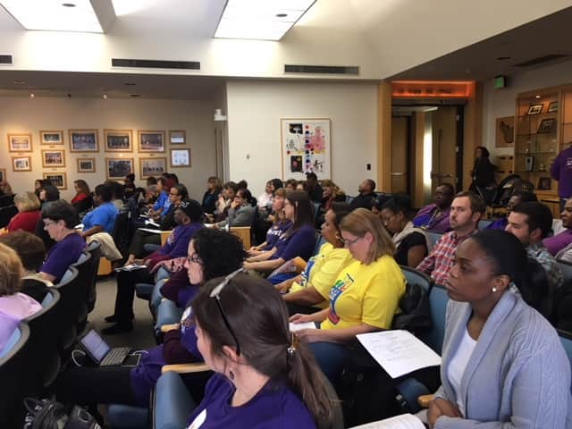
NUMBERS COUNT

Slide 66
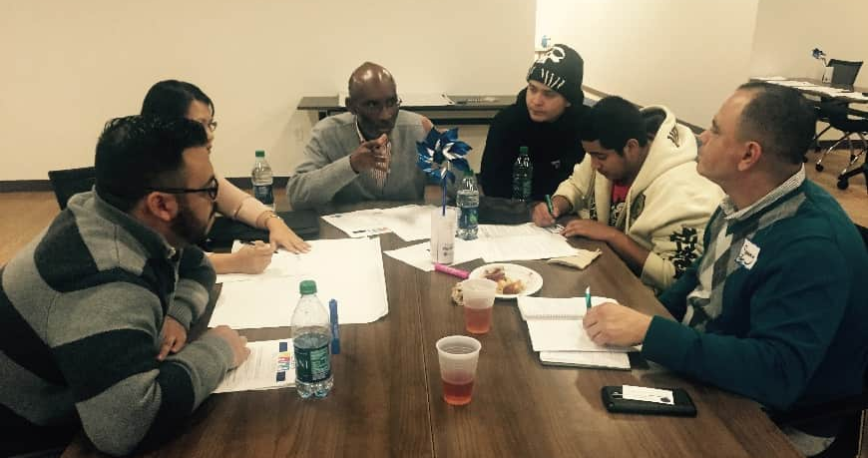
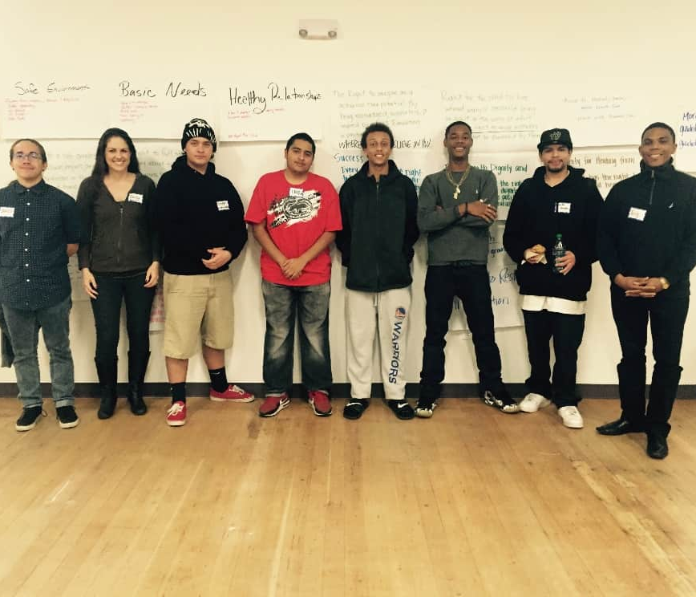
NON-PROFIT PROVIDERS ARE CORE
Assets – Tradition of social justice, Understand problems close-up, Connected to program participants.
Challenges – Financial conflicts, Political inexperience, Not knowing regulations
Youth and Parents – The most Powerful voices

Slide 67
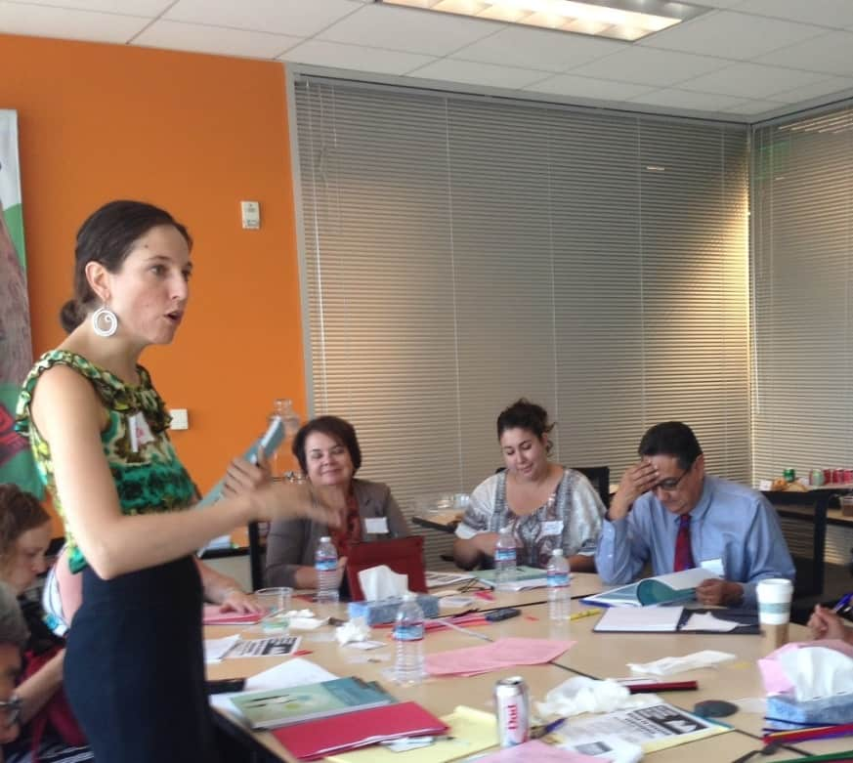
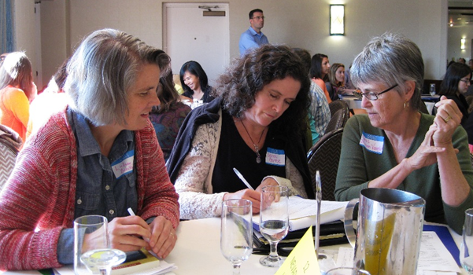
WHO COORDINATES THE WORK?
STAFF IS ESSENTIAL.
Lack of staff is biggest barrier to moving forward.
Staff work can be foundation funded – most work happens before a measure reaches the ballot.
CAVEAT: IF YOU WANT DEDICATED FUNDING, YOU NEED DEDICATED STAFF.

Slide 68

PREPARE FOR OPPOSITION
Anti-tax, Anti-government
Protecting turf and status quo
Competing priorities – roads and cops
Not the right time
Not the right approach

Slide 69
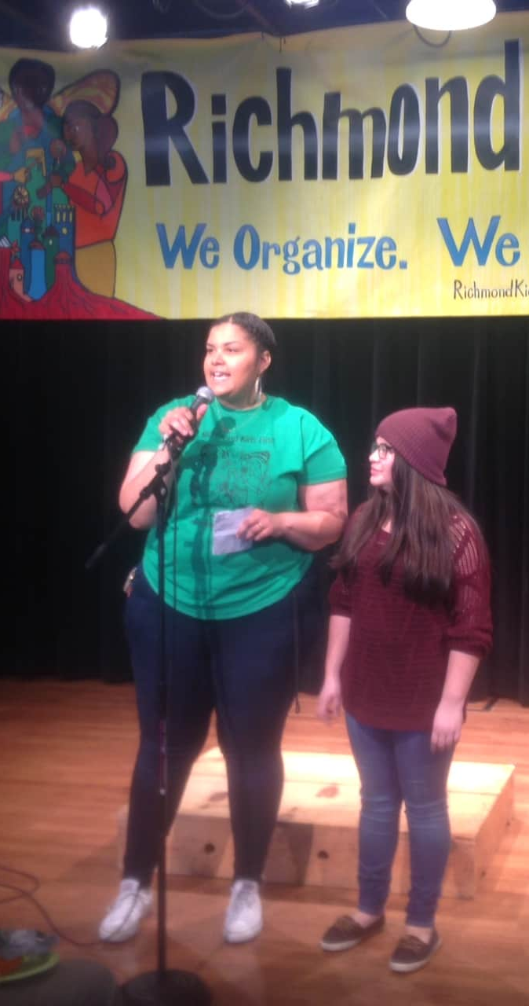
WHAT IS THE MOST
IMPORTANT STRATEGY?
IT’S ABOUT ORGANIZING.
Increasing the political and social capital of children, youth and families.
Activities can include coalition building, public education, door-to-door outreach, community meetings, house parties, rallies.
Build a powerful organization driven by community.
BEWARE: Always expect opposition – Competition for $, Protecting turf and control, Anti-government, Anti-taxes

Slide 70
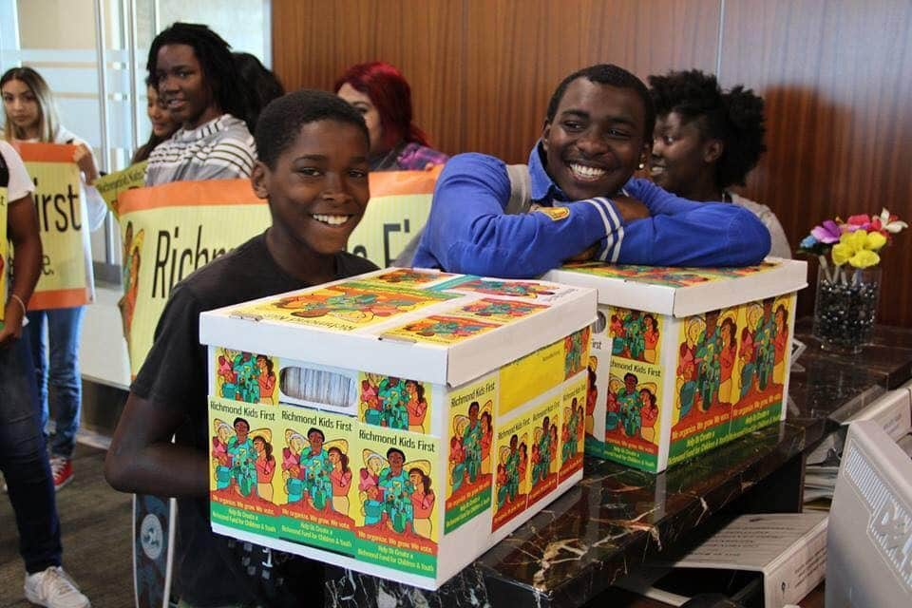

Elections are
Great Opportunities
Candidate forums
Candidate questionnaires
Educating candidates
Placing measures on ballot

Slide 71
PREPARE FOR OPPOSITION
Anti-tax, Anti-government
Protecting turf and status quo
Competing priorities – roads and cops
“Sacred cows” – political heavyweights
No more money
BEWARE QUIET OPPOSITION
Not the right time
Not the right approach
BUDGET ADVOCACY IS ONE BATTLE AFTER ANOTHER.
Must be the folks who never go away.

Slide 72

WE HAVE WHAT IT TAKES
The Potential Power of IECC
We can make the case.
We have energy.
There are a lot of us – 69 organizations
We have allies.
Now is the time for local politics.
We can build on the lessons of our pioneering colleagues
We have great leadership.
Notes:
delete
<number>

Slide 73

STRATEGIES TO CONSIDER
    Parcel tax on size of parcel
    City/County partnership
    Partner with other interest groups
    Start with narrow issue
    Join a General Tax coalition
    Don’t forget mitigation fees
and budget advocacy
Must consider broader strategies
Notes:
<number>

Slide 74
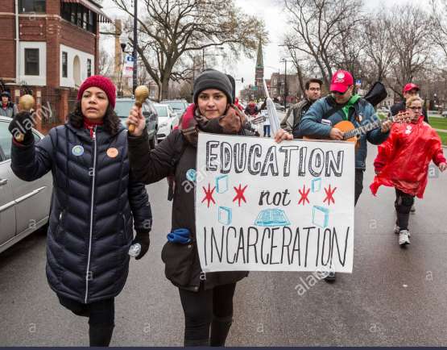
LESSONS – WHAT GETS BUDGETED GETS DONE
  Budgets and elections are unique
  organizing and communication opportunities to create sustainable funding.
  Non-profit providers have untapped power.
  It takes a village – collective action.
  It entails persuasion and hardball politics.
  Youth and parents have influential voices.
  Take the initiative – don’t wait for politicians.
  Drama helps make the case. Media amplifies the case.
  Expect opposition.
  Power builds power.
  It is complex, frustrating, unpredictable, but ultimately exhilarating and empowering.
Notes:
Delete unless these are lessons learned from tax and revenue work then keep
<number>

Slide 75
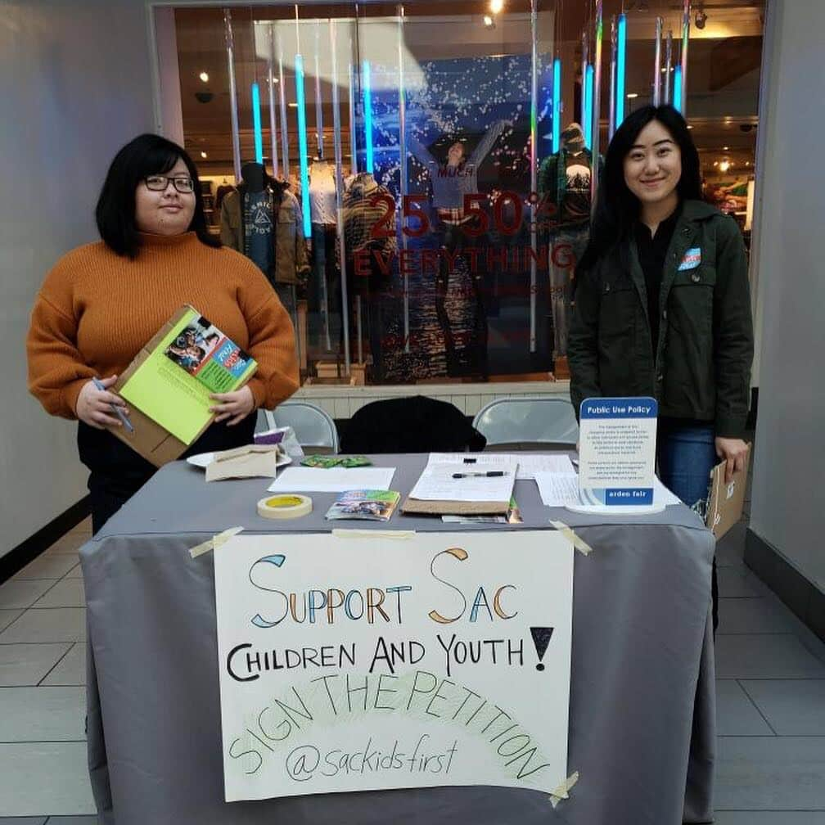
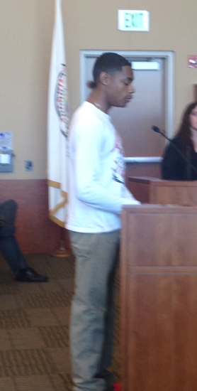
CHALLENGES TO YOUTH FUNDING MOVEMENT
WE MUST RE-INVENT ROLE IN POLITICAL LIFE
Advocates lack money and time – no paid lobbyists or funds for political donations
Competition with more politically influential interests – e.g., law enforcement
Mindset of policymakers – not as important as roads
Lack of knowledge and involvement in local budget process
Missed opportunities to build social and political capital and change how resources are allocated.
NEEDED: Collective action - broad intersectional, intergenerational, cross-cultural coalitions

Slide 76

REFORM THE PROCESS
Creating accessible forums for public input at all levels and at all points in the process
Creating access to decision-makers
Empowering the legislative body
Strengthen budget policy support
TRANSPARENCY, TRANSPARENCY, TRANSPARENCY

Slide 77

Lessons Learned from Organizing for Kids
  Budgets and elections are unique organizing and communication opportunities to create sustainable local funding.
  The early care community has untapped power. Must develop new skills and role in civic life. (Staff support is needed.)
  It takes a village – collective action. Work in coalition with others. Organize!
  Success requires persuasion and hardball politics.
  Parents have influential voices. Children are irresistible.
  Advocates must take the initiative and take risks.
  Drama helps make the case. Media amplifies the case.
  PROPOSING SOLUTIONS IS EFFECTIVE AND POWERFUL
Local organizing is exhilarating and empowering.
Notes:
Delete unless these are lessons learned from tax and revenue work then keep
<number>

Slide 78
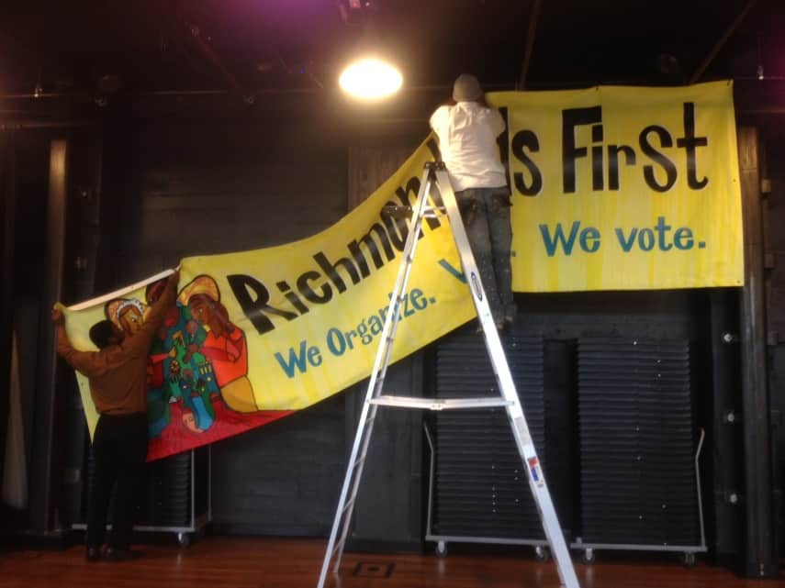
LESSONS LEARNED
  Take the initiative – There is always a place to start.
  Have a realistic timeline.
  Propose concrete solutions.
  Being political is essential – people power
makes it happen.
  Elections are powerful – campaigns are magic.
  Requires persuasion AND pressure.
  No one panacea – all communities differ.
  Marathon, not a sprint.
  Expect opposition.
  Youth and parents can change the process.
  Harder than anticipated, but……
  Exhilarating - success leads to success.

Slide 79
FUNDING THE NEXT GENERATION
Provides technical assistance to coalitions working on local funding streams for children and youth
Sponsors learning communities and conferences
Support includes speaking, convening, facilitating, trouble-shooting, coaching, and more.
Numerous tools and resources are available.
CONTACT:
Margaret Brodkin, Margaret@fundingthenextgeneration.org
415-794-4963
www.fundingthenextgeneration.org

