Slide 2
A majority of Californians thinks the state is on the wrong track.
Would you say things in California are headed in the right direction, or do you feel they are off on the wrong track?
Q1.

Slide 3
When asked to describe California, many responses express general negativity or affordability concerns.
If you had to pick two or three words to sum up how things are going in California today,
which ones would you choose?
(Open-ended)
Q3. Split Sample

Slide 4
While a majority say they are living comfortably, fewer than one in five are increasing savings.
Which of the following best describes your current financial situation:
Total Living Comfortably
53%
Q6.

Slide 5
Broad majorities are lack confidence that their children will be able to afford to live in the same California community, or end up better off financially.
How confident are you that your children and grandchildren will be able to afford to live in the same California community that you do today?
How confident are you that your children and grandchildren will be financially better off than you are today?
Very confident
Somewhat confident
Not too confident
Not at all confident
Don’t know
Total Confident
21%
Total Confident
25%
Total Not Confident
74%
Total Not Confident
69%
Notably, these concerns cut across income lines
Total Not Confident | $0-$75K | $75K-$150K | $150K+
Afford Same Community | 78% | 71% | 75%
Better Off | 67% | 67% | 70%
Q7 & Q8.

Slide 6









Californians remain “concerned” and “frustrated” about the state – and fewer are “hopeful” than in 2018.
2012
2018
2024
Difference (2018-2024)
Concerned
Hopeful
Frustrated
Alarmed
Helpless
Angry
Content
Indifferent
Happy
Other/Don't know
-9%
-22%
-3%
+2%
0%
-1%
-6%
+1%
-4%
-2%
QFM6. (Total)

Slide 7
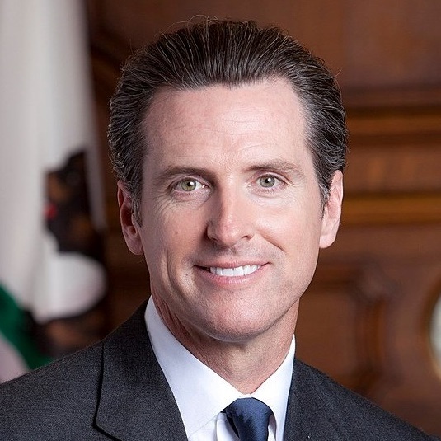

Voters are split in their views of state and local government.
Here are some names of people and organizations active in public life. Please indicate whether you have a favorable or unfavorable opinion of that person or organization. You can also indicate if you have never heard of the person or organization—or have heard of them, but do not have enough information to offer an opinion.
Total Fav. | Total Unfav.
47% | 50%
38% | 44%
33% | 34%
Q2.

Slide 8









The California Ballot Propositions
Measure | Prospects
Prop 2 | State school bond: Won 58% to 42%
Prop 3 | Marriage equality: Won 63% to 37%
Prop 4 | State climate bond: Won 60% to 40%
Prop 5 | Vote threshold for infra. bonds: Lost 45% to 55%
Prop 6 | Ending involuntary servitude: Lost 47% to 53%
Prop 32 | $18 minimum wage: Lost 49% to 51%
Prop 33 | Rent control….again: Lost 40% to 60%
Prop 34 | Non-profit pharmacy regulation: Won 51% to 49%
Prop 35 | MCO tax: Won 68% to 32%
Prop 36 | Prop 47 repeal: Won 68% to 32%

Slide 9
These results happened in the face of ongoing (and growing) skepticism about the initiative process.
Which of the following statements about the initiative process in California comes closest to your view:
+6
OR
-6
*Slightly Different Wording in Previous Survey

Slide 10
That skepticism exists more on the right than the left.
Which of the following statements about the initiative process in California comes closest to your view:
California’s initiative system is not working well. Too many ballot measures are confusing, have unintended consequences, and benefit special interests rather than all Californians. | OR | California’s initiative system generally works. It gives the public a chance to have a greater say and address issues that our broken state government cannot or will not.
QFM1.

Slide 11
In Sonoma County, childcare was a broadly-shared concern.
I’m going to read you some issues that some people say may be problems in Sonoma County. Please tell me whether you think each is a problem or not.
Ext./Very Ser. Prob.
88%
82%
81%
58%
53%
53%
52%
Q5. Split Sample

Slide 12
Messages in Favor of Sonoma County Measure I
Ranked by Very Convincing
41% | *(SCHOOL READINESS) By increasing access to quality early learning programs, Measure I strengthens K-12 education. Currently, nearly four in five Sonoma County kids enter kindergarten unprepared and are reading below grade level in third grade. Studies show that kids who go to high-quality pre-school and other early learning programs are more likely to read proficiently by the third grade, and more likely to graduate and go on to college.
40% | (BRAIN DEVELOPMENT) Research shows that 90% of a child's brain development occurs before age five. These critical years lay the foundation for the rest of a child's life. By expanding access to early childhood care and quality pre-school for children, as well as access to family services for parents, Measure I will help ensure that every child in Sonoma County gets off to a strong start.
38% | (PANDEMIC) In 2020, Sonoma County lost over 40% of its available early childhood education and care. Inadequate funding, catastrophic wildfires, and the Coronavirus pandemic forced providers to close their doors, making childcare scarce and driving huge cost increases for working families. Now, every year, 10,000 Sonoma County kids miss out on early learning opportunities. Our fragile child care system is at a breaking point, but by voting yes on Measure I we can turn it around.
37% | *(ESSENTIAL WORKERS) Essential workers that have been on the frontline of the pandemic — like nurses, grocery store employees, and first responders — often can't access the childcare they need because of the limited options. Measure I will make childcare available in more places and at more hours of the day so essential workers can get the support they need while they take care of all of us.
Q7. I would like to read you some statements from supporters of Measure I. Please tell me whether you find it very convincing, somewhat convincing,
or not convincing as a reason to vote yes. *Split Sample

Slide 13
Messages in Favor of Measure I (Continued)
Ranked by Very Convincing
37% | (EQUITY) Pre-school should not be a luxury only available to a few families. In Sonoma County, the cost of sending a child to pre-school is nearly $13,000 per year — that's 39% of the median annual income for Sonoma County women. Measure I will provide scholarships to make early education available and affordable to families of all incomes, including middle-class families.
37% | (LONG TERM COSTS) Investing in early childhood education and children's health is a commitment that is worth every penny. Measure I will help ensure that children grow up healthy and have the opportunity to thrive. It allows parents to work — lifting families out of poverty and enabling our local economy to grow. And, by improving outcomes for our children, Measure I reduces future societal costs on social services and incarceration.
36% | (WAGES) Early childhood educators who serve infants and toddlers have one of the most important jobs: caring for young children and helping them learn, grow and be prepared to succeed. But it is hard to recruit and retain qualified educators because the average wage for a childcare provider is only $14 per hour. Measure I increases that wage, investing in local early childhood educators working with our young children at a crucial time in their lives.
36% | (QUALITY/SAFETY) No parent should have to worry about the care their child is receiving while they are at work. Measure I will help ensure that Sonoma County has quality childcare programs that meet safety standards, so parents can to go to work with the peace of mind knowing their kids are safe and well cared for.
Q7. I would like to read you some statements from supporters of Measure I. Please tell me whether you find it very convincing, somewhat convincing,
or not convincing as a reason to vote yes. Not Part of Split Sample

Slide 14
Beyond this top tier, there were a wide range of other effective messages as well.
Q7. I would like to read you some statements from supporters of Measure I. Please tell me whether you find it very convincing, somewhat convincing,
or not convincing as a reason to vote yes. *Split Sample

