Slide 1

BALLOT 2024 FORWARD
  REVENUE OPTIONS FOR CHILDREN AND YOUTH FUNDS IN CALIFORNIA
  Importance of identifying revenue stream for ballot measure
  Overview of options – decisions and considerations
  What makes a good tax
  California taxes – pros and cons
  Opportunities with cannabis taxes
  Questions – what can work in your city or county?
Margaret Brodkin, Director Funding the Next Generation; Ed Harrington, Expert in public finance; Jim Keddy, ED Youth Forward; Ben Gercever, Olson Remcho law firm
MARCH 24 – NOON TO 1:30PM
Webinar for funding the next generation

Slide 2

WHAT NEEDS TO BE IN PLACE?
  Convening organization
  Dedicated staff support
  Diverse network/coalition
  CBOs/Allies prepared for political engagement
  Authentic voices and engagement – i.e.,parents
  Baseline information on community needs
  Moderate agreement about priorities
  Passion and willingness to take risks
  Time and motivation to organize the base
  Political champion (if possible)
  Resources to lay groundwork, potential resources for an electoral campaign

Slide 3

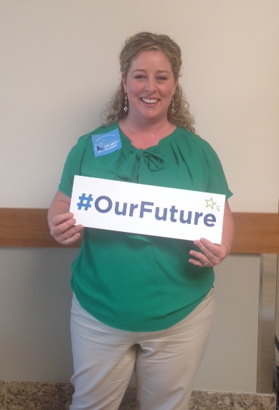
WHAT TO CONSIDER IN MAKING DECISIONS
ABOUT REVENUE STRATEGY?
Be open to unexpected opportunities – and compromises
  WHAT DO YOU WANT FUNDED?
  Gaps in services – priority needs
  LEGAL CONSIDERATIONS
  Options and constraints
  POLITICAL CONSIDERATIONS
    Political feasibility and public opinion
    Political champions and allies
    Strength of opposition
    Visible outcome
    Builds political capital
  ORGANIZATIONAL CONSIDERATIONS
  Consensus of sponsoring coalition
  Potential volunteers
  Potential to rally parents and constituents
  Resources of advocates
  BIG ENOUGH TO MATTER
  SMALL ENOUGH TO WIN

Slide 4
STEPS FOR DETERMINING REVENUE STRATEGY
.
WHAT TO ASSESS
Legal options
Economic health of city/county
City/County discretionary budget – opportunities for set-asides or expanded revenue
Opportunities with school district
Public opinion about revenue options
HOW TO GET INFO
Meeting with administrative, legal and fiscal staff of city/county
Mtg. w election authorities
Previous campaign consultants, sponsors, opponents for revenue measures
Have elected allies on City Council or Bd of Supes ask questions.
CONSIDERATIONS
Unique economic opportunities – e.g., cannabis
Competition for dollars
Other revenue ballot measures – opportunities for collaboration

Slide 5

3 WAYS TO GET LOCAL PUBLIC DOLLARS
ALL PATHS MEET RESISTANCE.
  1. Reallocate existing dollars
  2. Allocate new dollars
  3. Generate new dollars
  Three arenas
      Budget process
      Legislative policies
      Ballot
.

Slide 6
FINDING THE RIGHT FUNDING STRATEGY
Kids' needs
Your capacity
Political reality
MANY STRATEGIES CAN WORK.
FIND THE SWEET SPOT.
Annual budget allocation
Taxes
Carve-out/Set-aside – reallocation of General Fund or of a specific funding stream (e.g. cannabis)
  Note – potential new funding from Schools and Communities First Act 2020: LA -$3.6B
Charges, Assessments, Fees – cannot exceed reasonable cost

Slide 7
FINDING THE RIGHT FUNDING STRATEGY
Kids' needs
Your capacity
Political reality
MANY STRATEGIES CAN WORK.
FIND THE SWEET SPOT.
Annual budget allocation
Taxes - sales, real estate transfer, parcel, business, utility, hotel, marijuana
Fees - admissions, amenities, mitigations, abatement
Carve-out – reallocation
Note – potential new funding from Schools and Communities First Act: Monterey - $66M; San Beneto - $6.2M; Santa Cruz - $46M

Slide 8
FINDING THE RIGHT FUNDING STRATEGY
Kids' needs
Your capacity
Political reality
MANY STRATEGIES CAN WORK.
FIND THE SWEET SPOT.
Annual budget allocation
Taxes - sales, real estate transfer, parcel, business, utility, hotel, marijuana
Carve-out – reallocation/set-asides
Fees - admissions, amenities, mitigations, abatement, tax credits/exemptions, community benefit agreements
In-kind facilities
Note – ARP funding for Riverside County - $480M ; San Bernardino County $423

Slide 9
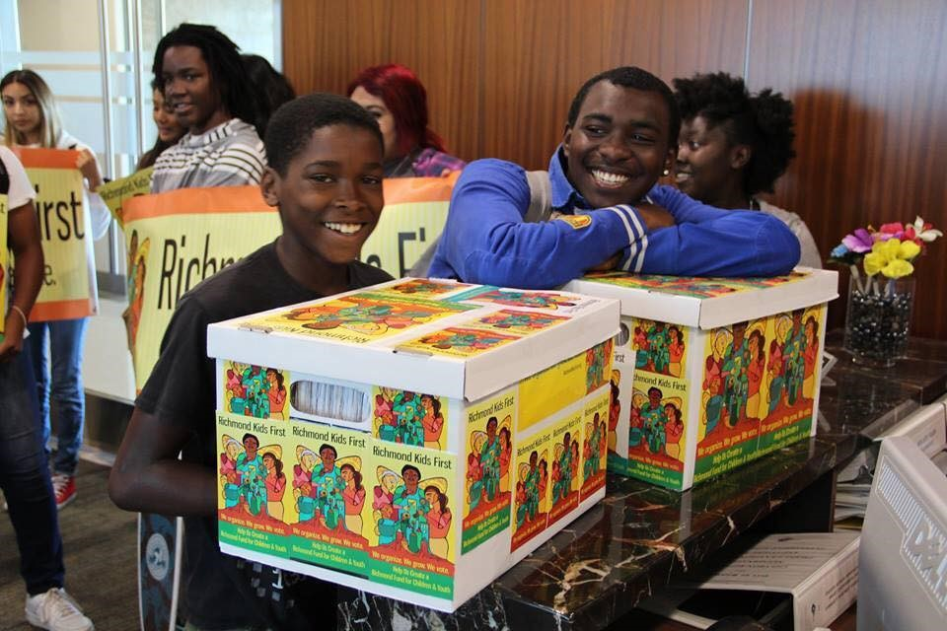
Getting on ballot? Votes needed by electorate & legislators?
VOTER INITIATIVE VS LEGISLATIVE INITIATIVE
Getting on ballot:
Special tax requires majority of legislature.
General tax requires 2/3 legislative vote.
Charter amendments require 2/3 vote of legislature.
VOTER THRESHOLD
Special taxes require a 2/3 vote, unless put on the ballot by voter initiative, when they require only a majority.
General taxes require only a majority vote.
Charter amendments (set-asides) need a majority.
SPECIAL TAX VS GENERAL TAX
Special goes specifically to your targeted service, population, etc. – harder to pass
General goes to city or county General Fund – there are some ways to get money to targeted services.

Slide 10
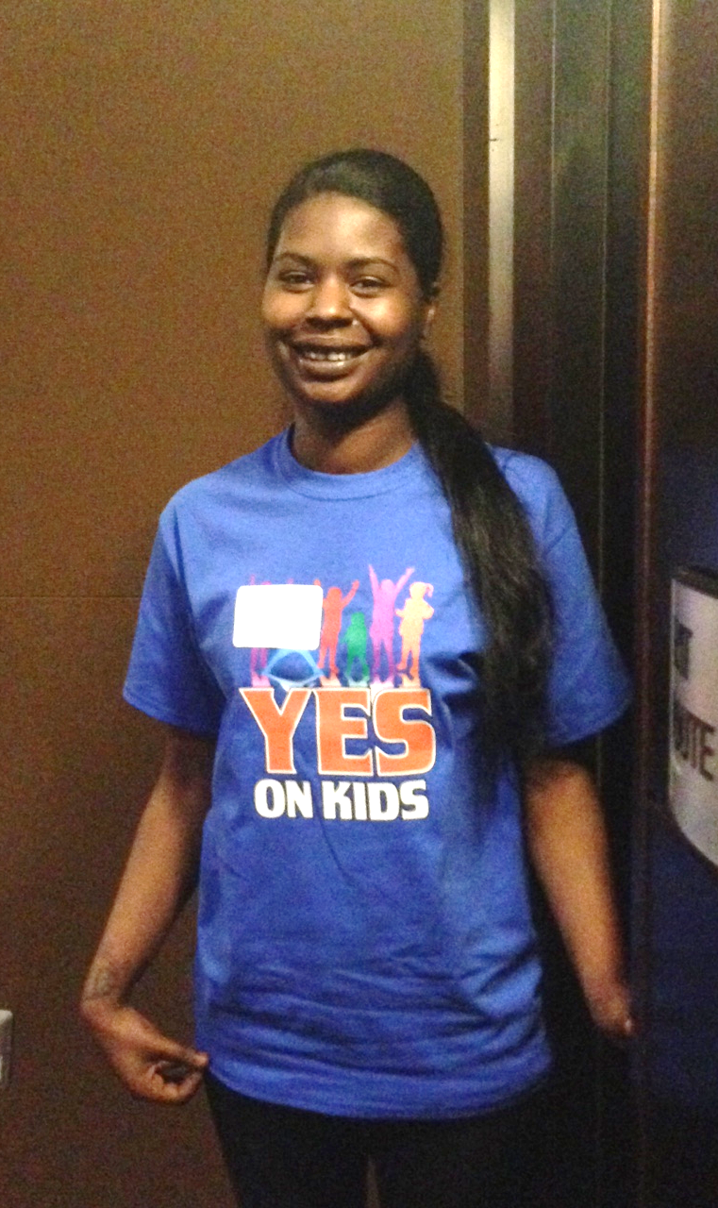
TAXES OR SET-ASIDES
    TAXES
    Sales
    Parcel
    Business
    Cannabis
    Utility
    Transient Occupancy
    Documentary Transfer
    Real Estate Transfer
    Admission taxes
    BONDS
    Only for capital, e.g., youth centers, childcare centers
    SET ASIDES
    Dedicated portion of existing revenue – requires only majority vote as charter amendments
    Can be done in charter cities or counties
    No limit on amount
    Generally, requires voter initiative
Taxes less popular with voters;
more popular with electeds and
labor. Set-asides more popular
with public; electeds and fiscal
people hate it.

Slide 11

POSSIBLE SOURCES OF FUNDING
**Reallocation of existing dollars – general fund, realigned dollars, specific carve-outs of funding streams (cannabis).
Creating new funding through legislation, e.g. when money changes hands - community benefit agreements, fees i.e. development agreements, agreements with hospitals, PILOT (payment in lieu of taxes)
In-kind resources – facilities, loan funds, free admissions to city/county programs/facilities
Corporations - Social impact “bonds,” tax incentives

Slide 12
POSSIBLE SOURCES OF FUNDING
Reallocation of existing dollars – general fund, realigned dollars, specific carve-outs of funding streams.
Creating new funding by raising taxes through legislation or voters. Whenever money changes hands, try to get some.

Slide 13
SOURCES OF REVENUE
Each strategy has built-in resistance.
    1. Reallocate existing dollars
    2. Generate new dollars
    Three arenas
      Budget process
      Legislative policies
      Ballot
.
Kids' needs
Your capacity
Political reality

Slide 14
WHAT ARE THE REVENUE OPTIONS?
Kids' needs
Your capacity
Political reality
MANY STRATEGIES CAN WORK.
FIND THE SWEET SPOT.
Taxes - sales, soda, parcel, business, utility, hotel, marijuana
Fees - admissions, amenities, mitigations, abatement
Carve-out – reallocation
Annual budget allocation

Slide 15
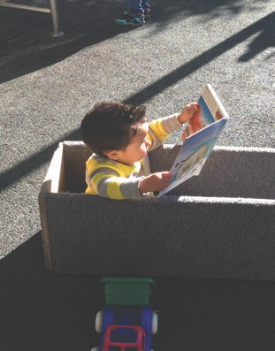

WHAT TO CONSIDER IN MAKING DECISIONS ABOUT FUNDING STRATEGY?
Be open to unexpected opportunities. Know when to compromise.
  Gaps in services – priority needs
  Legal realities – e.g. voter threshold
  Public opinion
  Consensus of sponsoring coalition
  Political champions
  Strength of opposition
  Potential volunteers
  Resources of advocates

Slide 16
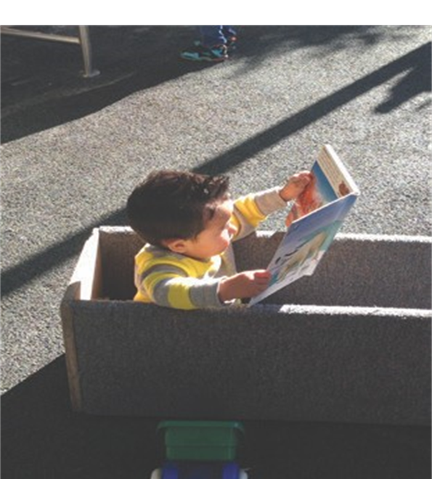
TAXES OR SET-ASIDES – GETTING ON THE BALLOT
TAXES
Sales
Parcel
Business
Cannabis
Utility
Transient Occupancy
Documentary Transfer
Real Estate Transfer
Admission taxes
Taxes less popular with voters;
more popular with electeds and
labor. Set-asides more popular
with public; electeds and fiscal
people hate it.
BONDS
Only for capital
SET-ASIDES
Dedicated portion of existing revenue to children and youth.
Can be done in charter cities and counties.
No limit on amount – only what is politically feasible.
Generally, require voter initiative.
SPECIAL TAX VS GENERAL TAX
Special goes specifically to your targeted service, population, etc. – harder to pass
General goes into the city or county General Fund – there are some ways to get money to targeted services
VOTER INITIATIVE VS LEGISLATIVE INITIATIVE
Charter amendments require a 2/3 vote by legislature to get on ballot.
Special tax requires majority of legislature to place on ballot
General tax requires 2/3 legislative vote to get on ballot
VOTER THRESHOLD
General taxes require only a majority vote.
Special taxes require a 2/3 vote, unless put on the ballot by voter initiative, when they require only a majority.

Slide 17

Decisions Decisions Decisions
    New resources vs. reallocation?
    Which revenue source?
    Legislation vs. ballot ?
    Placement on ballot - Voter initiative vs. elected officials?
    General vs. special tax?
    Which election?
.

Slide 18
How much do you need?
How much can you expect to raise?
What are your unmet needs?
How much money can different revenue streams produce?
Can you ramp up over time?
Will it ever be enough?

Slide 19
WHAT TO CONSIDER IN MAKING DECISIONS ABOUT FUNDING STREAM?
Be open to unexpected opportunities. Know when to compromise.
  Gaps in services – priority needs
  Legal realities – e.g. voter threshold
  Polling results
  Consensus of sponsoring coalition
  Political champions
  Strength of opposition
  Potential volunteers
  Campaign costs – fundraising potential

Slide 20
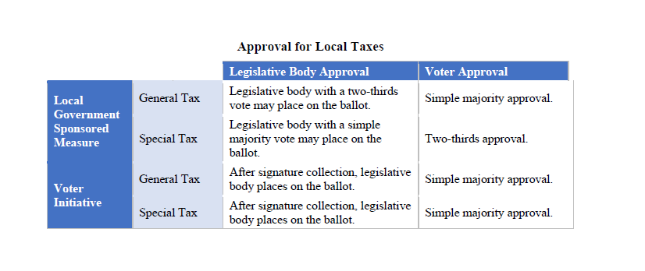
After signature collection, legislative
body places on the ballot.
Simple majority approval
Set-asides
Require amendment of charter – two-thirds of Legislative body to place on ballot.
Simple majority of voters with voter initiative.

Slide 21
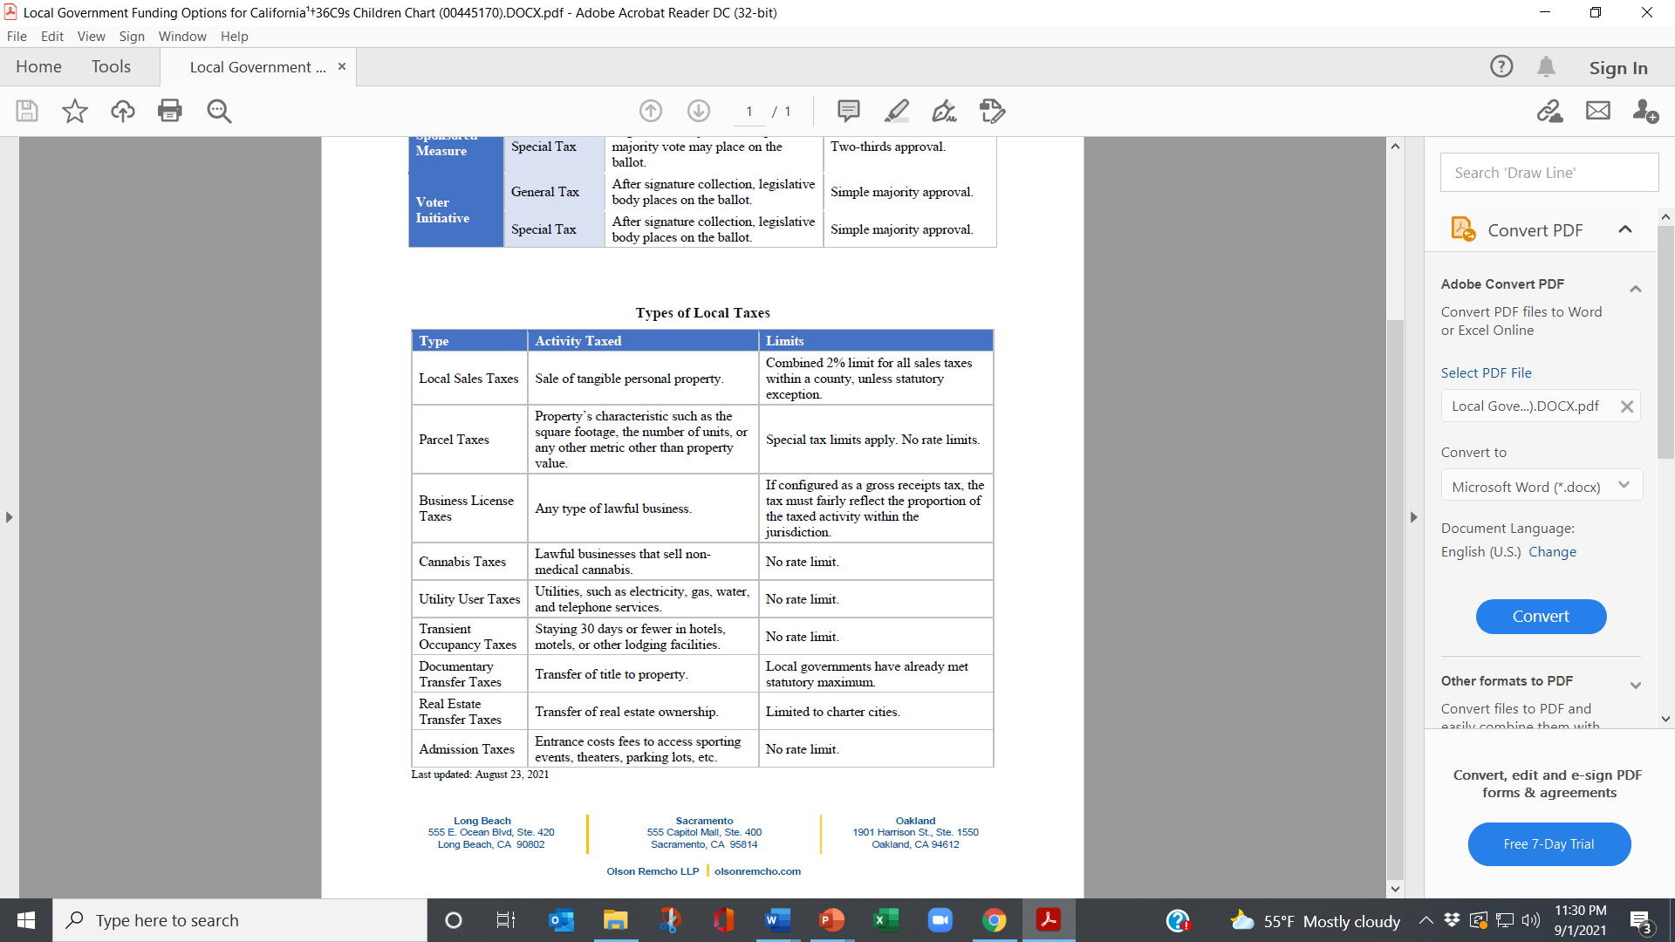
REVENUE OPTIONS: TAXES AND SET-ASIDES
TAXES
SET-ASIDES
Dedicated portion of existing revenue to children and youth.
Can be done in charter cities and counties.
No limit on amount – only what is politically feasible.
Generally, require voter initiative.
Kids' needs
Your capacity
Political reality

Slide 22
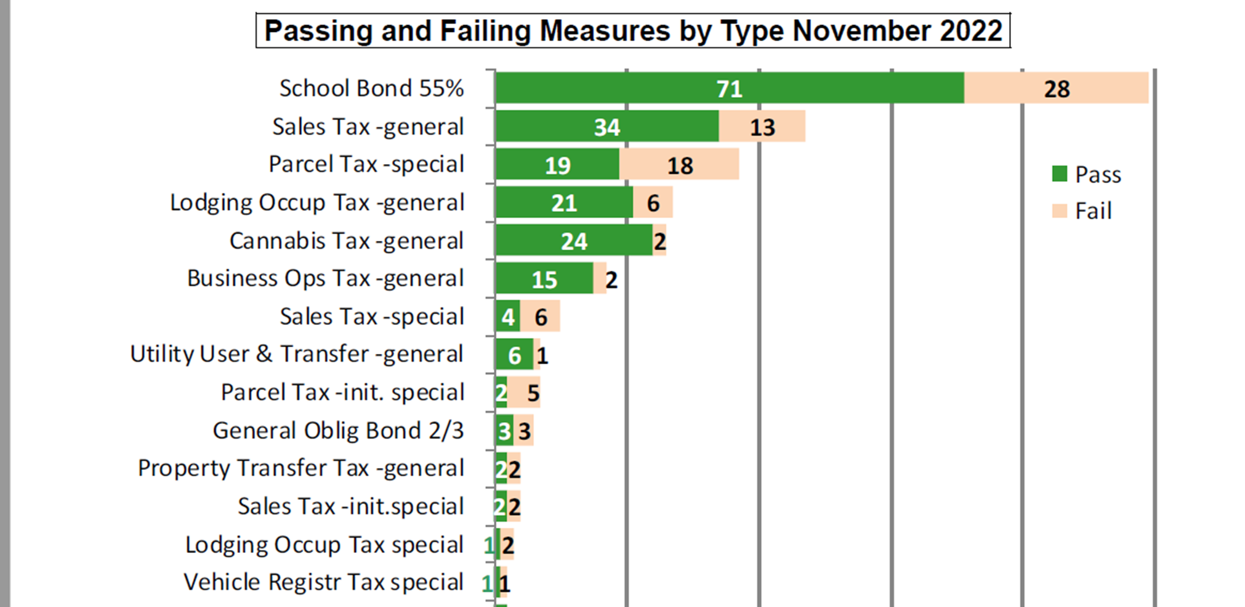
Passing and Failing Measures by Type, Nov. 2022
  Convening organization
  Dedicated staff support
  Diverse network/coalition
  CBOs/Allies prepared for political engagement
  Authentic voices and engagement – i.e.,parents
  Baseline information on community needs
  Moderate agreement about priorities
  Passion and willingness to take risks
  Time and motivation to organize the base
  Political champion (if possible)
  Resources to lay groundwork, potential resources for an electoral campaign

Slide 23
Passing and Failing Measures by Type, Nov. 2022
  Convening organization
  Dedicated staff support
  Diverse network/coalition
  CBOs/Allies prepared for political engagement
  Authentic voices and engagement – i.e.,parents
  Baseline information on community needs
  Moderate agreement about priorities
  Passion and willingness to take risks
  Time and motivation to organize the base
  Political champion (if possible)
  Resources to lay groundwork, potential resources for an electoral campaign

Slide 24

A good tax
Easy to administer/collect/audit
Viewed as equitable and fair
Developed through a broad and effective process
Only changes behavior if desired
Tax revenue is not volatile
Doesn’t cause economic flight
Easy to comply with/calculate
Raises money

Slide 25

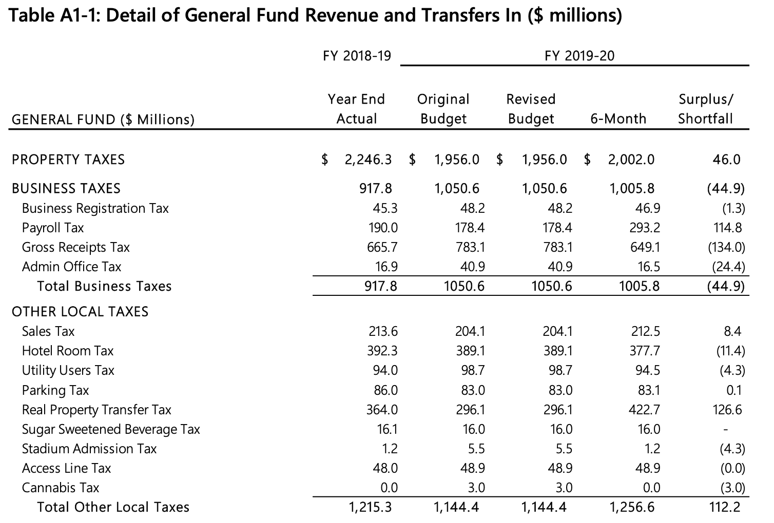

Slide 26
Sales Tax Rates in large US cities
Chicago 10.25%
Seattle 10.10%
Los Angeles 9.50%
Oakland 9.25%
New York 8.875%
San Francisco 8.50%
Houston 8.25%
Boston 6.25%
Portland OR 0.00%

Slide 27
CITY AND COUNTY TAXES
THEY CAN BE GENERAL OR SPECIAL TAXES.
Sales - combined limit 2% add-on to base of 7.5% - done in 1/8 cent increments – City of LA = 9.5 tax; Long Beach = 10.5
Real estate transfer – can be made progressive by increasing with value of property – LA = $5.6 – most other cities %1.10*
Parcel – can be based on size of parcel (not the value), and can have many exceptions (such as low income, seniors) – always a special tax – Flood control parcel tax just passed in LA County
Business - gross receipts, car rental, parking*
Utility (UUT) – gas, water, sewer, cable, phones*
Hotel – Transient Occupancy Tax (TOT) – ranges from 8 – 14% - LA City TOT = 14%
Marijuana – Cultivation, Manufacturing, Sales – can be passed by a percentage range
Admission – Parks, Sporting events, Concerts, etc.*
*Cities only, or unincorporated areas of county

Slide 28
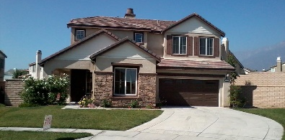
Property Taxes
Pros | Cons
Strong support from renters | Greater voter sensitivity to tax rates
Ad valorem taxes allow for progressivity | Equity concerns for flat parcel taxes
Existing nexus to education | Seniors are high-propensity voters, concerned about property taxes, and don’t have kids at home
Inclusion of commercial properties a plus – reduces burden on residential | Inclusion of commercial properties a negative – mobilizes opposition

Slide 29
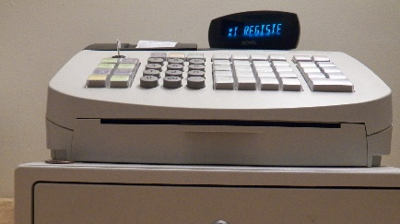
Sales Taxes
Pros | Cons
Broad voter acceptance | Broad affordability concerns
Low familiarity with sales tax rate | Lots of competition for the revenue source
Ability to tax visitors, workers and tourists | Regressivity

Slide 30

Marijuana Taxes
Pros | Cons
Very popular with voters | Not available in states without legalization
Few voters would pay the tax directly | Some concerns about a marijuana/kids nexus
Higher taxes can provide some deterrent to youth use | Significant competition for funding source

Slide 31

Budget Set-Asides
Pros | Cons
Does not entail a tax increase | Likely to inspire funded opposition
Percentage underscores modest nature of request | Can split progressive community
Provides increased revenue as budget grows | Elected officials may oppose on principle

Slide 32
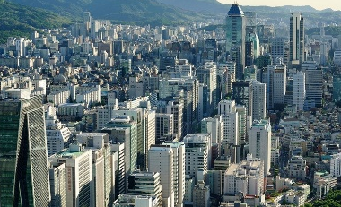
Business Taxes
Pros | Cons
Appealing in a strong economy | Can potentially inspire funded opposition
Leverages political energy around addressing income inequality | Claimed impacts on small business/ job loss
Does not directly tax most voters | Opposition arguments about tax being passed on are intuitive

Slide 33
Voters’ favorite taxes are the ones they do not have to pay.
Total Supp. | Total Opp.
75% | 23%
64% | 34%
60% | 36%
45% | 53%
38% | 57%
2015 Santa Clara County Survey

Slide 34
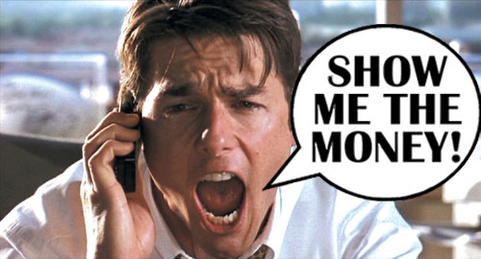
AGrowing Moveent
CHLDREN’S FUNDS IN U.S.
All ages – San Francisco, 8 counties in Florida, Seattle, Portland, Oakland, Baltimore, King County
Preschool – Denver, San Antonio, San Francisco, Cincinnati
Violence Prevention – Little Rock, San Bernardino, Oakland, Santa Rosa
Mental health – 8 counties in Missouri, 3 counties in Ohio
Soda – Philadelphia, San Francisco, Oakland, Albany, Berkeley, Boulder

Slide 35

FUNDING THE NEXT GENERATION
Provides technical assistance to coalitions working on local funding streams for children and youth
Sponsors learning communities and conferences
Support includes speaking, convening, facilitating, trouble-shooting, coaching, and more.
Numerous tools and resources are available.
CONTACT:
Margaret Brodkin, Margaret@fundingthenextgeneration.org
415-794-4963
www.fundingthenextgeneration.org

Slide 36
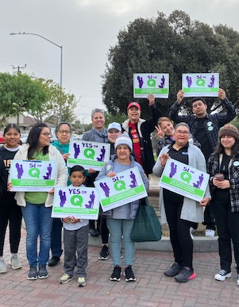
ASSESSING FEASIBILITY – ART NOT SCIENCE
.
WHAT TO ASSESS
Revenue options
Legal constraints
History of ballot revenue measures
Political leaders
Opinions of major influencers – civic groups, labor, grassroots, business, groups representing segments of population
Public opinion
CONSIDER:
Potential partners and coalition members
Opposition – potential for neutralizing
Demographic changes that can help your cause
Barriers to overcome
Greatest assets

Slide 37
CITY AND COUNTY TAXES
THEY CAN BE GENERAL OR SPECIAL TAXES.
Sales - combined limit 2% add-on to base of 7.5% - done in 1/8 cent increments
Real estate transfer – can be made progressive by increasing with value of property
Parcel – can be based on size of parcel, and can have many exceptions – always a special tax
Business - gross receipts, car rental, parking
Utility (UUT) – gas, water, sewer, cable, phones
Hotel – Transient Occupancy Tax (TOT) – ranges from 8 – 14%
Marijuana – Cultivation, Manufacturing, Sales – can be passed by a percentage range
Admission – Parks, Sporting events, Concerts, etc.
Some taxes are cities/county unincorporated areas only, i.e. business, UUT, marijuana, admission

Slide 38
Set-asides/Carve-outs
Dedicated portion of existing revenue to children and youth.
Can be done in charter cities and counties.
No limit on amount – only what is politically feasible.
Generally require voter initiative.
Kids' needs
Your capacity
Political reality
SWEET
SPOT

Slide 40


The New Funding Frontier:
Pros and Cons

Slide 41
Sales taxes, parcel taxes, and cannabis taxes were particularly popular.
From Michael Coleman, CaliforniaCityFinance.com

Slide 42
Voters are much more likely to support a funding measure with accountability mechanisms.
I am going to read you some other possible provisions of this measure. Please tell me whether you would be more likely or less likely to vote for the measure if that provision were included.
Difference
+50%
+46%
+38%
+38%
Napa County 2015 Voter Survey

Slide 43
