Slide 1
Invest in Youth
Long Beach
Mike Russo, Manager of Equity in Public Funds
Jacky Guerrero, Budget Analyst

Slide 2

Advancement Project CA

Slide 3
Agenda
Framework and Context
Long Beach Analysis
Los Angeles County Analysis
Questions and wrap-up

Slide 4
Framework and Context
Notes:
PIA

Slide 5
Government Jurisdictions
Federal
Immigration
State
MediCal (with some federal $)
Prisons
County
Health Services (much with state $)
Social Services (much with state $)
School District
City
Social Security
Medicare
Education
Sheriff and Jails
Police & Fire
K-12 education (with state dollars)
Street maintenance
City Planning
Water

Slide 6
Advocacy Calendar
* * Long Beach Fiscal Year is October 1 – September 30 * *
Date | Event
Dec-March | City Manager makes budget projections and issues instructions to departments Meet with City Manager, Department Managers and Mayor; budget research
April | Departments finalize their budget requests
May-June | City Manager works with departments to finalize requests Continue meeting with Department heads and Councilmembers
By July 3 | City Manager submits proposed budget to Mayor
By Aug. 2 | Mayor releases proposed budget and recommendations to City Council and public Analyze proposal, meet with Councilmembers and the Mayor
Aug-Sept. | Council holds budget hearings Attend hearings, mobilize, meet with Councilmembers and Mayor
Sept. 15 | Deadline for Council adoption of budget; Mayor can concur or make line-item vetoes Victory! (Hopefully)
Sept.30 | Deadline to overturn line-item vetoes; adopted budget finalized

Slide 7
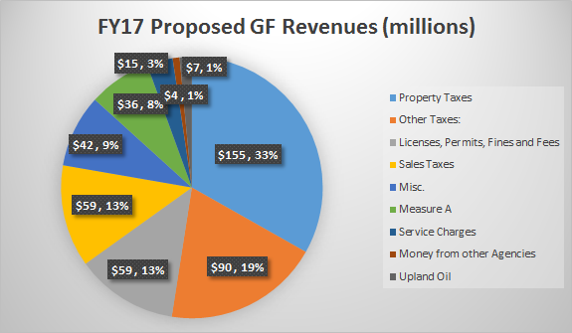
FY17 GF Revenue
FY17 General Fund Revenues – By Source
Total $470.2 Million

Slide 8
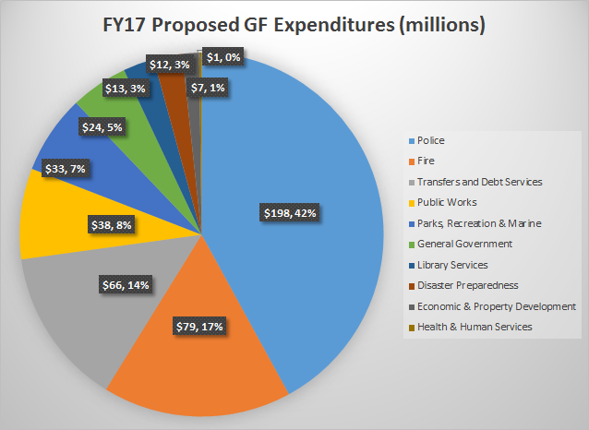
FY17 GF Expenditures
FY17 General Fund Expenditures
Total $470.1 Million

Slide 9
What is youth development?
Age range: 10-24 (10-19 for arrests)
Focus on youth gaining something that’s of use later, vs. just an experience
Mentorship and ongoing engagement
Safe spaces for youth
Supporting positive development rather than responding to youth as problems

Slide 10
What we looked at (and what we didn’t)
Suppression (erred on the side of underestimating):
Arrests – estimated budget via share of youth arrests (19 and under)
Incarceration – reported youth-specific spending (county only)
Where possible, youth-focused legal system costs (DA, PD, City Attorney)
Youth Development (erred on the side of overestimating):
Workforce and job skills programs – specific allocations
Recreation and library programs – sometimes specific allocations, sometimes estimated from youth share of programs or population

Slide 11
Long Beach

Slide 12
Long Beach City
Suppression
Youth Arrests and SROs | $22 M
Youth Prosecution | $353 K
Total | $22.3 M
Positive Youth Spending
Parks Programs (including afterschool) | $19 M
Library Programs | $1.8M
Workforce Programs | $2.0 M
Development Svcs Programs (inc. MBK) | $910 K
Total | $23.7 M

Slide 13
Suppression Spending

Slide 14
Long Beach City - All Arrests
30%
Reduction
Arrests include felonies and misdemeanors for all ages
Source: CA Dept. of Justice Office of the Attorney General

Slide 15
Arrests Adults vs. Youth
In 2014, 13% arrests made were of youth – down drastically from 22% in 2005
Source: CA Dept. of Justice Office of the Attorney General

Slide 16
Demographic Breakdown of Youth Arrests
2,386 Youth Arrested in 2014
Source: CA Dept. of Justice Office of the Attorney General

Slide 17
Long Beach Crime Rates
Source: FBI Crime in the United States

Slide 18
Police Department
Police Department
Patrol
Investigations
Administrative Distribution
(executive office, administration and financial bureau)
General Fund 97%, Prop H Funds 2%, Tidelands Operation Fund 1%
100% General Fund
Majority General Fund
Police Dept. Youth-Arrest Suppression Spending:
$21.9 Million
Notes:
Support – operating LB Jail, Port Police Division, Training and Administration and Management

Slide 19
City Prosecutor
City Prosecutor
Gang Injunctions & Diversion Programs
Assistant City Prosecutor
* General Fund
Prosecutor Suppression Spending:
$353K
Notes:
No line item spending was listed for their work overseeing gang injunctions injunctions, and the PACT program. Our figure takes into account their salary and benefits.

Slide 20
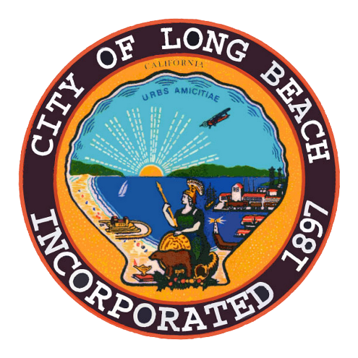

Youth Suppression Per Capita Spending
$9,362 Youth
2,386 Youth
Arrested
(0-19)
$22.3 Million

Slide 21
LBPD Per Capita Spending Comparison
 | Police Department FY17 Budgets | City Population | Per Capita Spending
Oakland | $ 242.5 M | 402,339 | $ 603
Long Beach | $ 216.5 M | 468,594 | $ 462
Sacramento | $132.2 M | 476,075 | $ 278
Los Angeles | $ 2.6 B | 3,862,210 | $ 669
Population Source: 2010 – 2014 ACS 5-Year Estimates

Slide 22
Youth Development Spending

Slide 23
Parks, Recreation & Marine Department
Community Resources Bureau
Community Parks Programs
Community Outreach & Youth Services
General Fund 79%, Tidelands Operations Fund 13%, General Grants Fund
7%, Special Advertising and Promotions Fund 1%
Youth Development Park Spending:
$19 Million
Notes:
We arrived at this figure by analyzing the departments position titles – specifically recreation leader positions – we then added their salaries and benefits to arrive at $12.5 million

Slide 24
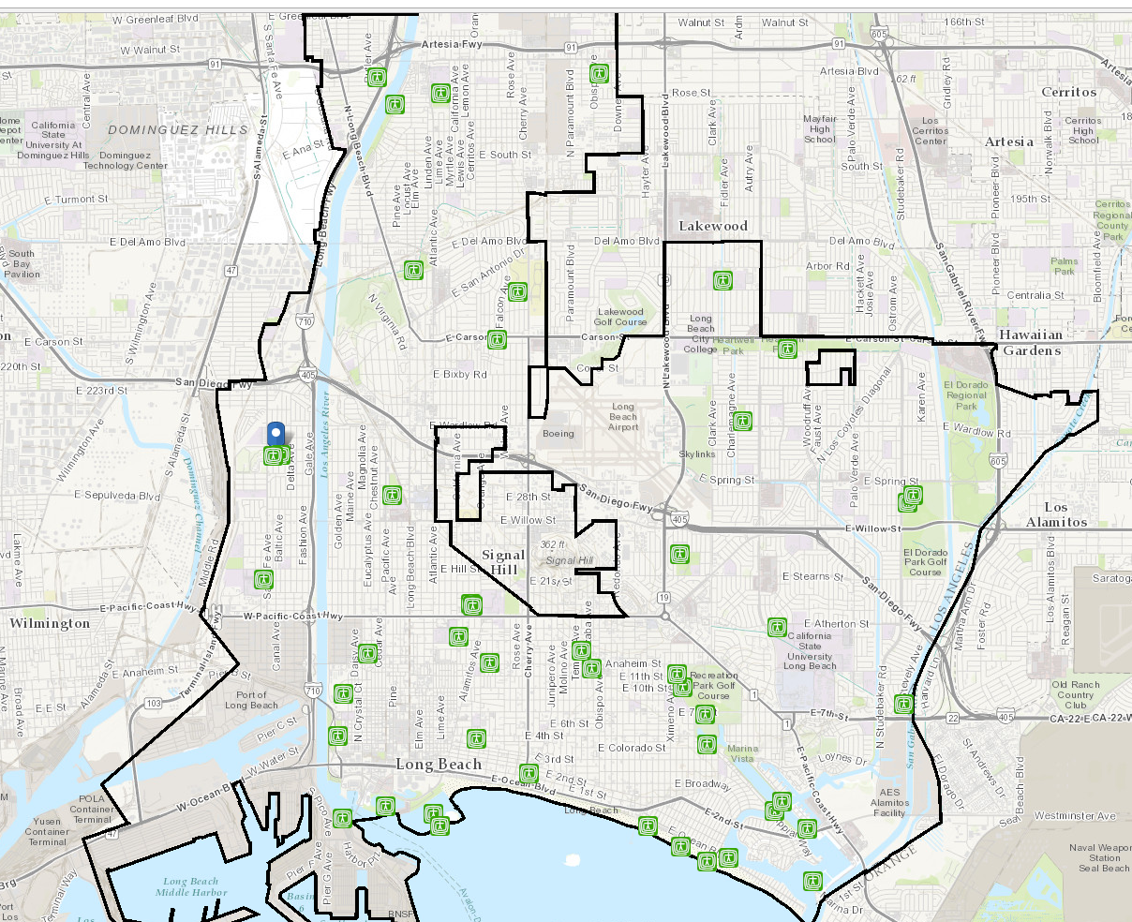
Teen Center Locations
Operating Hours
Houghton Park Teen Center
Monday – Friday
3 – 7 p.m.
Ages Served
13 - 18
Programs Offered
Silverado Teen Center
Arts & Crafts
Board/Video Games
Homework Assistance
Free Food
California Recreation Teen Center
Freeman Community Center
Personnel
Cesar Chavez “The Zone”
1 Full-Time Supervisor
2 Part-Time Seasonal Staff

Slide 25
Economic & Property Dev. Department
Workforce Development Bureau
Services for Youth
100% Federal Grants – Workforce Innovation and Opportunity Act
Youth Development Workforce Spending:
$2M

Slide 26
Library Department
Main Library
Services Bureau
Youth Services Division
Branch Library
Services Bureau
Coordination with Youth Services Programs
General Fund 95%, General Grants 5%
General Fund 92%, Civic Center 4%, General Grants 3%
Youth Development Library Spending:
$1.8M
Notes:
We arrived at this figure by reviewing the youth services officers position and job description – they oversee the coordination of youth services programs across the library systems

Slide 27
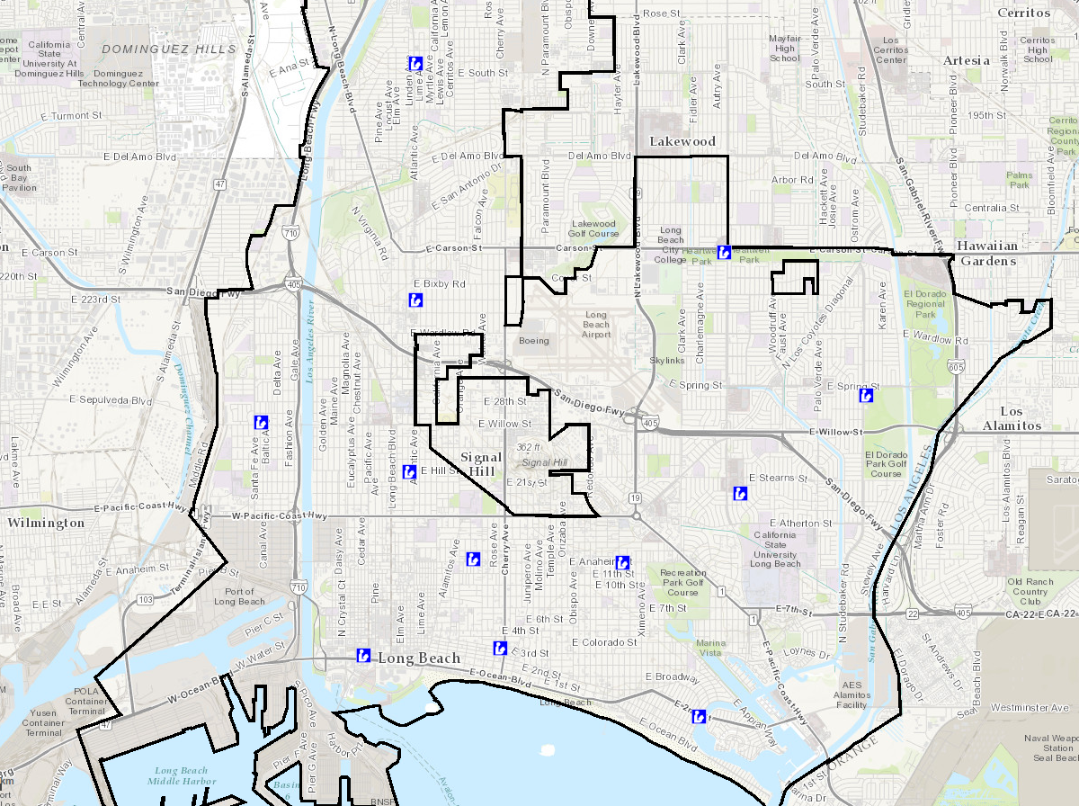
Library Youth Programs
Operating Hours
M: Closed
T: 12 – 7 pm
(Main Library till 8 p.m.)
W: 12 – 6 p.m.
Th: 12 – 7 p.m.
(Main Library till 8 p.m.)
F: 10 – 5 p.m.
Sa: 10 – 5 p.m.
Su: 12 – 4 p.m.
(Bay Shore, Burnett, El Dorado & Michelle Obama)
Programs Offered
Storytime
Bilingual Conversations
Arts & Crafts
Animal Petting
Computer & Technology Classes
Khmer Language Classes
Video Games

Slide 28
Development Services Department
Housing & Neighborhood Services Bureau
Neighborhood Relations
Successor Agency Fund 76%, Housing Development Fund 14%, Community Development Grants Fund 9%, Others 1%
Youth Development Neighborhood Relations Spending:
$910K

Slide 29
Youth Development Spending
$187
Youth
$23.7 Million
126,964
Youth in LB City
(0-19)
2010 – 2014 ACS 5-Year Estimates

Slide 30
How does Long Beach compare?
Youth Development Spending
(in Millions)
Per Capita Spending on Youth

Slide 31
Los Angeles County Analysis
Notes:
PIA

Slide 32
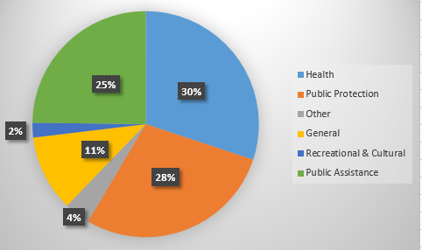
FY17 Recommended Budget
Total:
$28.4 billion

Slide 33
LA County
Suppression
Youth Arrests | $127M
Youth Defense (Public Defender) | $20M
Youth Incarceration | $453.6M
Youth Supervision | $192.8M
Total | $793M
Positive Youth Spending
Workforce Programs | $12.9 M
Arts Commission | $2.9M
(Library Programs) | ($1.8 M)
(Parks Programs) | ($17 M)
Total | $15.8 M

Slide 34
Suppression Spending

Slide 35
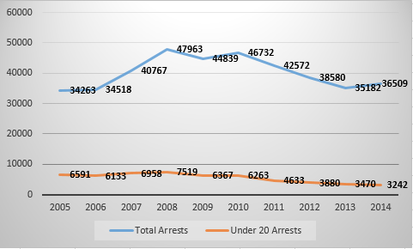
Arrest Data - Adults vs. Youth
Overall there has been a 50% reduction in youth arrests from 2005-2014
In 2014, youth made up 9% of all arrests – a 10% decrease from 2005
Arrests include felony and misdemeanors for all ages
Source: State of California Department of Justice Office of the Attorney General

Slide 36
Sherriff Department
Patrol
$91.7M
Detective
10.7M
Administrative Distribution
$24.6M
Sherriff Department
$127M
Direct Contact
Supportive Role
Sherriff Dept. Youth Suppression Spending:
$127 Million

Slide 37
Public Defender
Juvenile Services
$19M
Public Defender
$20M
Administrative Distribution
$686K
Public Defender Youth Suppression Spending:
$20 Million

Slide 38
Probation (Incarceration)
Probation Department
$453.6M
Juvenile Institutions Services
$377.9M
Care of Juvenile Court Wards
$2.89M
Support Services for Institutions
$72.3M
Support Services for Court Wards
$554K
Probation Dept. Youth Incarceration Spending:
$453.6 Million

Slide 39
Probation (Supervision)
Probation Department
$192.8M
Juvenile Services
$128.5M
Juvenile Suitable Placement
$33.1M
Admin Distribution for Juvenile Services
$24.7M
Admin Distribution for Juvenile Placement
$6.3M
Probation Dept. Youth Supervision Spending:
$192.8 Million

Slide 40


Youth Suppression Per Capita Spending
Sherriff Spending:
$39,000/ Youth
$127 M
~3242 Youth Arrested
Public Defender Spending:
$500/
Youth
$20 M
~40,000 Children Represented

Slide 41
Youth Suppression Per Capita Spending
Probation Spending (Incarceration):
$378K/
Youth
$453.6 M
~1200 Youth in halls/camps
Probation Spending (Supervision):
NA
$192.8 M
Supervision data not available

Slide 42
Youth Development Spending

Slide 43
Workforce Innovation and Opportunity Act
Youth Jobs
$12.9M
Community and Senior Services
Workforce Development Spending:
$12.9 Million

Slide 44
Arts Commission
Arts Commission
Arts Internship
$704K
Arts Education
$2.2M
Arts Commission Spending:
$2.9 Million

Slide 45
Public Library
Public Library
$164.2M
Public Services
$83M
Library Material
$14.4M
Information Systems
$11.4M
Administration
$55M
Youth Development Library Spending:
17 youth positions makeup 1.5% of total positions housed within Public Services
1.5% of $83M = $1.2 Million
$1.2M + 626K (Admin)
=
$1.8 Million

Slide 46
Parks & Recreation
Parks and Rec
$180.9M
Community Services
$66M
Regional Services
$30.9M
Environmental Stewardship
$7.65M
Asset Presentation & Development
$42.2M
Administrative Services
$34.1M
Youth Development Park Spending:
21% of Community Services Budget ($13.8M) + Admin ($3.2M)
=
$17 Million

Slide 47
Youth Development Spending
$7.52
Youth
$12.9M Youth Jobs
$2.9M Arts
($1.8M Library)
($17M Parks)
$15.8M Total
2.1 million
Youth in Los Angeles County
(ages 10-24)

Slide 48
Questions?

