Slide 1
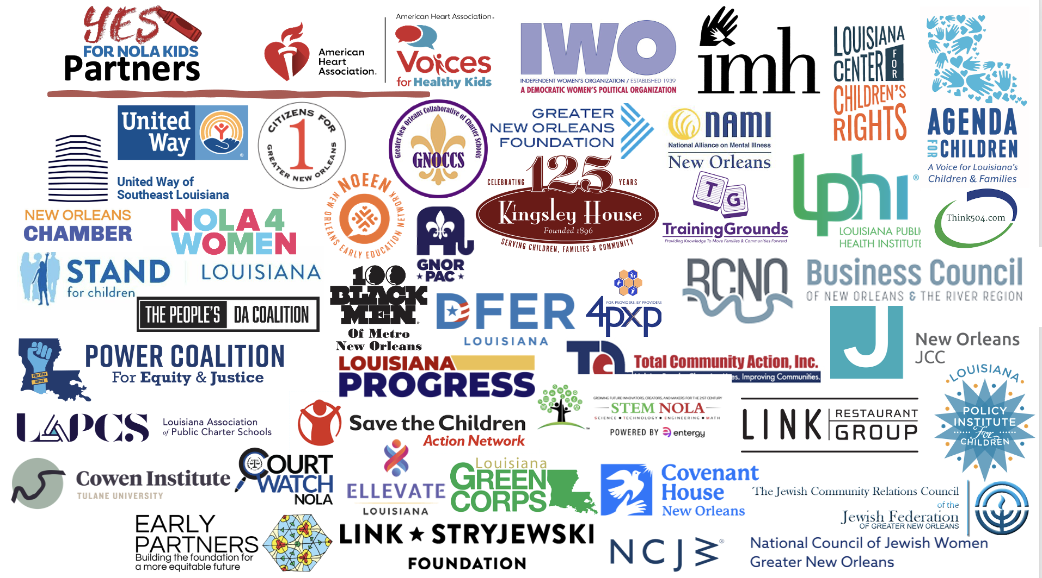


Coalition Building to Secure Dedicated Funding for Children
Children’s Funding Project Toolkit
2023-2024 Cohort Presentation
January 27, 2023
Prepared by Hamilton Simons-Jones, ResourceFull Consulting
Notes:
1 minute

Slide 2
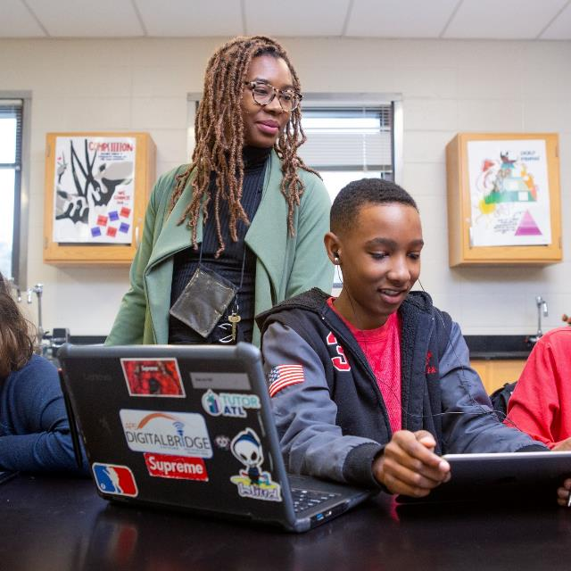
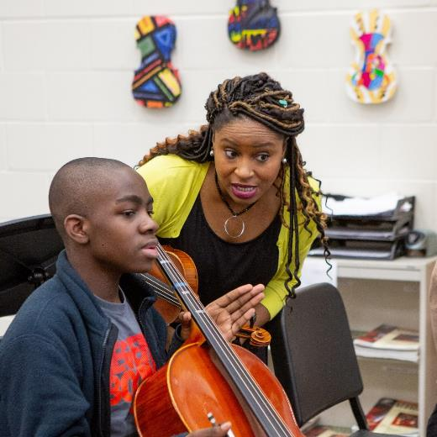
Objective
To support communities working to advance successful efforts to secure dedicated funding for children in thinking through and building a strong, diverse, and effective coalition to support their success.
Your Title Here
Photos by Allison Shelley for EDUimages
Notes:
1 minute: This is version 1, so we also welcome feedback on this. (Should we create a survey to capture said feedback?)

Slide 3
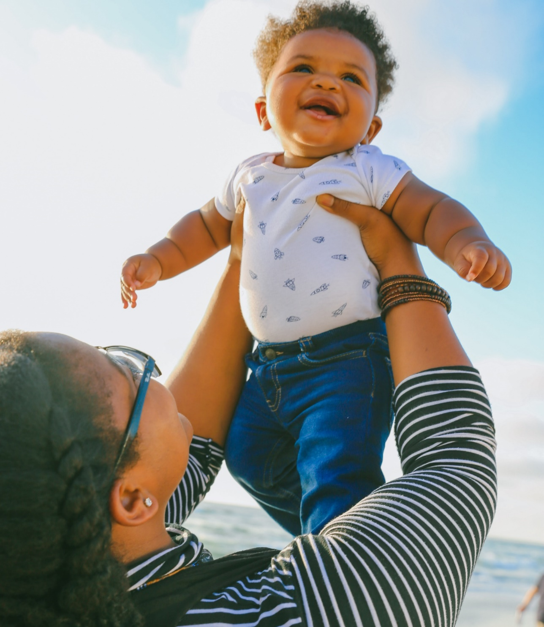

Why Do You Need A Coalition?
Power
/ˈpou(ə)r/ (noun)
The capacity or ability to direct or influence the behavior of others or the course of events.
(Oxford)
A strong, diverse, and effective coalition gives you the power you need to achieve your goals.
The stronger your coalition, the more power you have (i.e., the quicker and more effective your influence is to achieve your desired results).
Notes:
3 minutes: Open the floor in a large group to answer this question. Once we get a few responses, offer the frame of power….

Slide 4

Strong and Effective Coalitions
Strong: Individual members prioritize the coalition.
Effective: The coalition achieves its goals.
Share from your experience:
What is a strong and effective coalition you’re familiar with?
Why do you feel it was strong and effective?
OPTIONAL: What practices or approaches did this coalition use to be so strong and effective?
Photo by Allison Shelley for EDUimages
Notes:
15 minutes: Share in random/mixed community small groups of 2-3 people each (~8 mins) then share out in large group…
Key ideas: sharing credit, regular communication, clear expectations, internal transparency, etc.

Slide 5
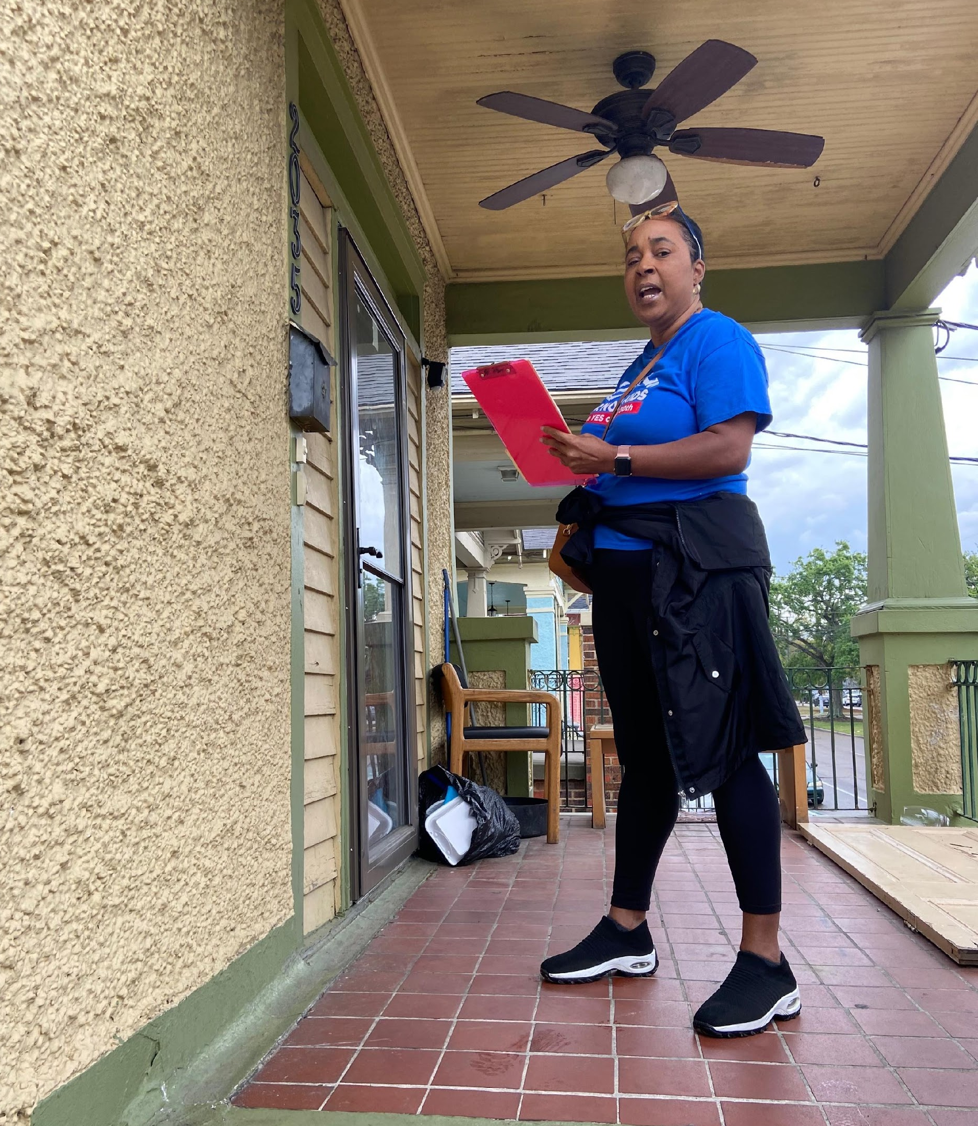
A 5-Step Process
For building and strengthening effective coalitions to secure dedicated funding for children that can be repeated regularly.
1
Establish Your Goals
2
Analyze Power & Influence
3
Prioritize Coalition Engagement
4
Develop Engagement Plan
5
Implement & Refine Engagement Plan
Kristi Givens, Co-Founder of For Providers by Providers canvassing for Yes for NOLA KIds
Notes:
1 min: Introduce the process

Slide 6
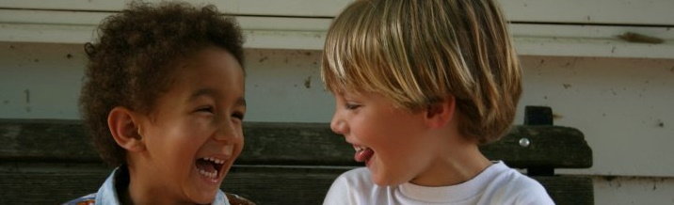
1
Establish Your Goals
Your goals should be…
Examples
Short-Term
While your long-term goal is likely to win dedicated funding for children, it requires the achievement of several shorter-term goals first.
Coalition Focused
While you have many goals, pick a goal that requires a coalition to ensure you have the power and influence to accomplish.
SMART
Set goals that are Specific, Measurable, Action-oriented, Realistic, and Time-bound
Getting on the Ballot: Securing # signatures by X date or Ensuring the majority of Council members vote for an ordinance to place our measure on the ballot by Y date.
Fundraising: Raising $XXX,XXX dollars by Y date for our campaign fund.
Media Support: Securing the endorsements of the major local newspapers for our ballot measure by the time early voting starts or Earning favorable feature stories about the issue to help educate voters about its importance in at least one major media outlet by X date.
Designing the Measure: Completing the language for the ballot measure by X date to best position it for success.
Minimizing Opposition: Ensuring anti-tax, business, or other groups don’t mount an organized opposition campaign before early voting starts.
Securing Endorsements: Securing key endorsements (elected officials labor, law enforcement, political organizations, civic groups, etc.) by one month before the election.
Children’s Funding Project is a nonprofit social impact organization that helps communities and states expand equitable opportunities for children and youth through strategic public financing. childrensfundingproject.org
Select photos by Allison Shelley for EDUimages
Notes:
5 mins: Walk them through slides and examples and then open it up for others in a large group format to share examples of goals that are specific to their efforts.
Introduce steps 1 and 2 in large group and then send them into small groups in teams to create at least one goal and begin the power analysis.

Slide 7

2
Analyze Power & Influence
A. Who do you need to influence to achieve your goal? B. Which individuals and groups can help you accomplish this goal? C. Which individuals and groups might stand in the way of your success?
Key Stakeholders to Consider:
Goal: [INSERT HERE]
Business: Chambers of commerce, major companies/businesses, economic development organizations, business coalitions, young professional groups
Civic Engagement: Rotary, advocacy coalitions, leadership development orgs, organizers, Urban League, NAACP
Education: Early childhood providers, teachers, principals, education organizations, school collaboratives, etc.
Elected Officials (current and past): Mayor/President, Council, School Board, Sheriff/DA/Police Chief, State reps, other State elected officials (i.e., Lt. Governor, Governor, Treasurer, Attorney General, etc.), U.S. Senators or Representatives
Faith: Major churches, synagogues, mosques, temples, interfaith groups, faith-based civic and policy groups
Media: Print, radio, TV, social media influencers, including mainstream, niche and ethnic media
Neighborhood: Homeowners associations, neighborhood-based civic & political groups
Nonprofit: Senior centers, youth-serving, museums, health, policy orgs, social justice, universities
Parent: PTOs, parent organizing and information groups, influential parents
Philanthropy: Local, regional, and national foundations, community foundations, United Way, wealthy individuals
Political Action: Active 501c4 orgs., party-affiliated groups, other local political organizations
Professional Associations: Family/education/ child-related, financial (CPAs, etc.), real estate, etc.
Public Officials (non-elected): CAO, education, child and family services, health department staff
Labor: Major local labor unions, teachers’ unions, etc.
Other Influencers: Celebrities, athletes, musicians, entertainers, community elders, etc.
High Influence
Strongly Oppose
Strongly Support
Neutral
Low Influence
Notes:
5 mins: Walk them through an example with Yes for NOLA Kids and the school board’s support, which led to the CEA.
20 mins: In site teams in breakout rooms, work through #1 and #2.
10 mins: Share out from each small group

Slide 8
Goal: Prevent organized opposition from business or anti-tax groups
Potential influencers to consider:
High Influence
Business: Example
Business: NOLA Business Council
Civic Engagement: Example
Education: Example
Civic Engagement: Bureau of Governmental Responsibility
Elected officials: City Council Chair
Elected officials: Example
Neighborhood: Lakeview N’hood Association
Political Action: GNO Republicans
Nonprofit: United Way
Philanthropy: Baptist Community Ministries
Faith: Example
Media: Example
Business:
NOLA Chamber
Strongly Support
Neutral
Neighborhood: Example
Education: GNO Collaborative of Charter Schools
Nonprofit: Example
Parent: Example
Professional Assoc.: NOLA Metro Association of Realtors
Elected Officials: District Attorney
Philanthropy: Example
Political Action: Example
Professional Assoc.: Example
Public officials: Example
Labor: United Teachers of New Orleans
Labor: Example
Other influencers: Example
Low Influence
Notes:
INSTRUCTIONS:
Select one SMART goal your team is trying to achieve in the near future (see slide 6 for examples) and write it at the top of the slide.
In as many categories as possible (yellow boxes on the right) identify potential people in your community that could influence your ability to achieve this goal.
Move the yellow boxes containing potential influencers onto the chart at right based on A) how much influence they could have over your ability to achieve your goal, and B) how likely they are to support or oppose your pursuit of this goal.

Slide 9
Austin Goal: Identify the scope of funding goal (age range; target groups; $ required)
Potential influencers to consider:
High Influence
Elected officials: City of Austin (Mayor, council)
Civic Engagement: Example
Business: Chamber AARO Leaders
Education: School Districts, ACC
Elected officials: County Judge
Labor: Central Labor Council, Worker’s Defense
Faith: Example
Media: Example
Strongly Oppose
Neighborhood: Western Edge of Travis County
Business: TRA
Nonprofit: UWATX
Strongly Support
Neutral
Philanthropy: SX6 Coalition
Political Action: Example
Parent: PTAs
Professional Assoc.: Example
Public officials: Example
Other influencers: Example
Low Influence
Notes:
INSTRUCTIONS:
Select one SMART goal your team is trying to achieve in the near future (see slide 6 for examples) and write it at the top of the slide.
In as many categories as possible (yellow boxes on the right) identify potential people in your community that could influence your ability to achieve this goal.
Move the yellow boxes containing potential influencers onto the chart at right based on A) how much influence they could have over your ability to achieve your goal, and B) how likely they are to support or oppose your pursuit of this goal.

Slide 10
Baltimore Goal: Get on the Ballot by November 2024
Potential influencers to consider:
High Influence
Business: TRowe, GBC
Civic Engagement: Example
Public officials: Mayor; City Council; Senators; Governor
Faith: Pastor King
Political Action: Pam K
Elected officials: Example
Philanthropy: AECF, CareFirst, Abell; Baltimore’s Promise
Media: Fox News
Nonprofit: Academic Medical Centers, Mercy Hospital
Strongly Oppose
Strongly Support
Neutral
Neighborhood: Example
Education: CIty Schools
Parent: Mothers with infant loss
Professional Assoc.: Example
Labor: Example
Other influencers: Example
Low Influence
Notes:
INSTRUCTIONS:
Select one SMART goal your team is trying to achieve in the near future (see slide 6 for examples) and write it at the top of the slide.
In as many categories as possible (yellow boxes on the right) identify potential people in your community that could influence your ability to achieve this goal.
Move the yellow boxes containing potential influencers onto the chart at right based on A) how much influence they could have over your ability to achieve your goal, and B) how likely they are to support or oppose your pursuit of this goal.

Slide 11
Birmingham Goal: Get final answer on path to ballot.
Potential influencers to consider:
High Influence
Civic Engagement: Rotary
Business: Alabama Power
Education: Example
Elected officials: Mayor, Council
Philanthropy: Goodrich
Media: AL.com
Faith: Sixth Avenue Baptist
Strongly Oppose
Strongly Support
Neutral
Neighborhood: Example
Parent: Example
Nonprofit: Childcare Resources
Political Action: Example
Professional Assoc.: Example
Public officials: Example
Labor: Example
Other influencers: Example
Low Influence
Notes:
INSTRUCTIONS:
Select one SMART goal your team is trying to achieve in the near future (see slide 6 for examples) and write it at the top of the slide.
In as many categories as possible (yellow boxes on the right) identify potential people in your community that could influence your ability to achieve this goal.
Move the yellow boxes containing potential influencers onto the chart at right based on A) how much influence they could have over your ability to achieve your goal, and B) how likely they are to support or oppose your pursuit of this goal.

Slide 12
Cleveland Goal: Build coalition to secure out-of-school time funding
Potential influencers to consider:
High Influence
Business: Greater Cleveland Partnership
Philanthropy: The Cleveland Foundation
Public officials: City and County Agency Staff
Elected officials: City and County Councils
Labor: Teachers Union
Parent:Parent Ambassadors
Faith: Greater Cleveland Congregations/ GC Interfaith Alliance
Strongly Support
Media: Example
Strongly Oppose
Nonprofit: Art OrganizationEarly Childhood
Education: School Districts
Neutral
Civic Engagement: Cleveland Votes/NAACP
Neighborhood: NPI, Settlement Houses
Political Action: Example
Professional Assoc.: Example
Other influencers: Example
Low Influence
Notes:
INSTRUCTIONS:
Select one SMART goal your team is trying to achieve in the near future (see slide 6 for examples) and write it at the top of the slide.
In as many categories as possible (yellow boxes on the right) identify potential people in your community that could influence your ability to achieve this goal.
Move the yellow boxes containing potential influencers onto the chart at right based on A) how much influence they could have over your ability to achieve your goal, and B) how likely they are to support or oppose your pursuit of this goal.

Slide 13
Columbus Goal: write measure/Get on the ballot
Potential influencers to consider:
High Influence
Elected officials: County commissioner Erica Crawley
Other influencers: Columbus Partnership
Public officials: city council
Nonprofit: Action for Children
Business: chamber of commerce
Philanthropy: Columbus Foundation
Future Ready Columbus
Education: CCS
Democratic party
Political Action: Ohio Republican party
Faith: BREAD
Strongly Oppose
Labor: CEA and other unions
Strongly Support
Neutral
Civic Engagement: Ohio Organizing Collaborative
Media: Example
Professional Assoc.: NAEYC
Neighborhood: homeowners- against tax increase
Parent: Motherful
Low Influence
Notes:
INSTRUCTIONS:
Select one SMART goal your team is trying to achieve in the near future (see slide 6 for examples) and write it at the top of the slide.
In as many categories as possible (yellow boxes on the right) identify potential people in your community that could influence your ability to achieve this goal.
Move the yellow boxes containing potential influencers onto the chart at right based on A) how much influence they could have over your ability to achieve your goal, and B) how likely they are to support or oppose your pursuit of this goal.

Slide 14
EBR Goal: Develop a Timeline for Ballot Initiative
Potential influencers to consider:
High Influence
Nonprofit:United Way & New Schools Baton Rouge, Louisiana Policy Institute
Business: Example
Faith: Example
Elected officials: Example
Philanthropy: Baton Rouge Area Foundation
Political Action: Example
Strongly Oppose
Public officials: DA’s office
Strongly Support
Neutral
Media: Example
Civic Engagement: Example
Education: Example
Neighborhood: Southeast
Professional Assoc.: Example
Labor: Early Childhood
Parent: Example
Other influencers: Example
Low Influence
Notes:
INSTRUCTIONS:
Select one SMART goal your team is trying to achieve in the near future (see slide 6 for examples) and write it at the top of the slide.
In as many categories as possible (yellow boxes on the right) identify potential people in your community that could influence your ability to achieve this goal.
Move the yellow boxes containing potential influencers onto the chart at right based on A) how much influence they could have over your ability to achieve your goal, and B) how likely they are to support or oppose your pursuit of this goal.

Slide 15
Jefferson Parish Goal: timeline and power analysis
Potential influencers to consider:
High Influence
Business: parish biz council
Public officials: DA,
Civic Engagement: Ready start network
Elected officials: city council (scott walker)
Philanthropy: Example
Faith: Example
Nonprofit: UWSELA
Strongly Oppose
Media: Example
Strongly Support
Neutral
Political Action: JP Republican Party/ Women’s asso’c of repub
Parent: Parent associations
Education: school district, ECE directors/owners
Neighborhood: Example
Labor: labor unions, worker rights grassroots orgs
Professional Assoc.: teacher unions
Other influencers: Example
Low Influence
Notes:
INSTRUCTIONS:
Select one SMART goal your team is trying to achieve in the near future (see slide 6 for examples) and write it at the top of the slide.
In as many categories as possible (yellow boxes on the right) identify potential people in your community that could influence your ability to achieve this goal.
Move the yellow boxes containing potential influencers onto the chart at right based on A) how much influence they could have over your ability to achieve your goal, and B) how likely they are to support or oppose your pursuit of this goal.

Slide 16
Longmont Goal: Insert goal here
Potential influencers to consider:
High Influence
Business: Example
Civic Engagement: Example
Education: Example
Elected officials: Example
Faith: Example
Media: Example
Strongly Oppose
Strongly Support
Neutral
Neighborhood: Example
Nonprofit: Example
Parent: Example
Philanthropy: Example
Political Action: Example
Professional Assoc.: Example
Public officials: Example
Labor: Example
Other influencers: Example
Low Influence
Notes:
INSTRUCTIONS:
Select one SMART goal your team is trying to achieve in the near future (see slide 6 for examples) and write it at the top of the slide.
In as many categories as possible (yellow boxes on the right) identify potential people in your community that could influence your ability to achieve this goal.
Move the yellow boxes containing potential influencers onto the chart at right based on A) how much influence they could have over your ability to achieve your goal, and B) how likely they are to support or oppose your pursuit of this goal.

Slide 17
Northfield Goal: Build the coalition
Potential influencers to consider:
High Influence
Other influencers: Rice County Ready for K
Philanthropy: SMIF
Public officials: City Administrator and Police Chief
Philanthropy: Northfield Shares, WINGS
Education: Example
Nonprofit: Three Rivers
Business: Faribault Chamber of Commerce
Elected officials: Mayor Pownell
Faith: Example
Media: Example
Strongly Oppose
Strongly Support
Neutral
Neighborhood: Growing Up Healthy
Business: Northfield Chamber of Commerce
Parent: Example
Civic Engagement: Boards and Commissions
Philanthropy: Faribault Foundation, RCAUW
Political Action: Example
Professional Assoc.: Example
Labor: Example
Low Influence
Notes:
INSTRUCTIONS:
Select one SMART goal your team is trying to achieve in the near future (see slide 6 for examples) and write it at the top of the slide.
In as many categories as possible (yellow boxes on the right) identify potential people in your community that could influence your ability to achieve this goal.
Move the yellow boxes containing potential influencers onto the chart at right based on A) how much influence they could have over your ability to achieve your goal, and B) how likely they are to support or oppose your pursuit of this goal.

Slide 18

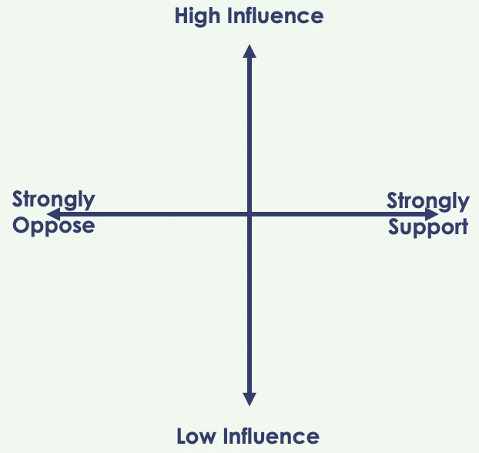
3
Prioritize Coalition Engagement
A
Who will you prioritize?
B
How will you engage them?
Kitchen Cabinet
Steering Committee
Subcommittee / Working Group
Speaker’s Bureau
Endorser
Financial Contributor
Prioritize those who are here
Children’s Funding Project is a nonprofit social impact organization that helps communities and states expand equitable opportunities for children and youth through strategic public financing. childrensfundingproject.org
Select photos by Allison Shelley for EDUimages
Notes:
5 mins: Walk through the prioritization and engagement, then open up for large group discussion around other ways you can engage individuals and organizations in your coalition.
Ask each person on the call to identify one person or group they want to add to their coalition and what role they would like them to play in the coalition and write it down (for the next part of the activity).

Slide 19
Goal: Prevent organized opposition from business or anti-tax groups
High Influence
1
Secure “Full Throated” Support from Key Business Influencers
Business: NOLA Business Council
Civic Engagement: Bureau of Governmental Responsibility
Educate & Engage Potential Opposition
Elected officials: City Council President
2
Neighborhood: Lakeview N’hood Association
Political Action: GNO Republicans
Nonprofit: United Way
Philanthropy: Baptist Community Ministries
Strongly Oppose
Business:
NOLA Chamber
Strongly Support
Neutral
Education: GNO Collaborative of Charter Schools
Professional Assoc.: NOLA Metro Association of Realtors
Elected Officials: District Attorney
Labor: United Teachers of New Orleans
Low Influence
Notes:
INSTRUCTIONS:
Select one SMART goal your team is trying to achieve in the near future (see slide 6 for examples) and write it at the top of the slide.
In as many categories as possible (yellow boxes on the right) identify potential people in your community that could influence your ability to achieve this goal.
Move the yellow boxes containing potential influencers onto the chart at right based on A) how much influence they could have over your ability to achieve your goal, and B) how likely they are to support or oppose your pursuit of this goal.

Slide 20
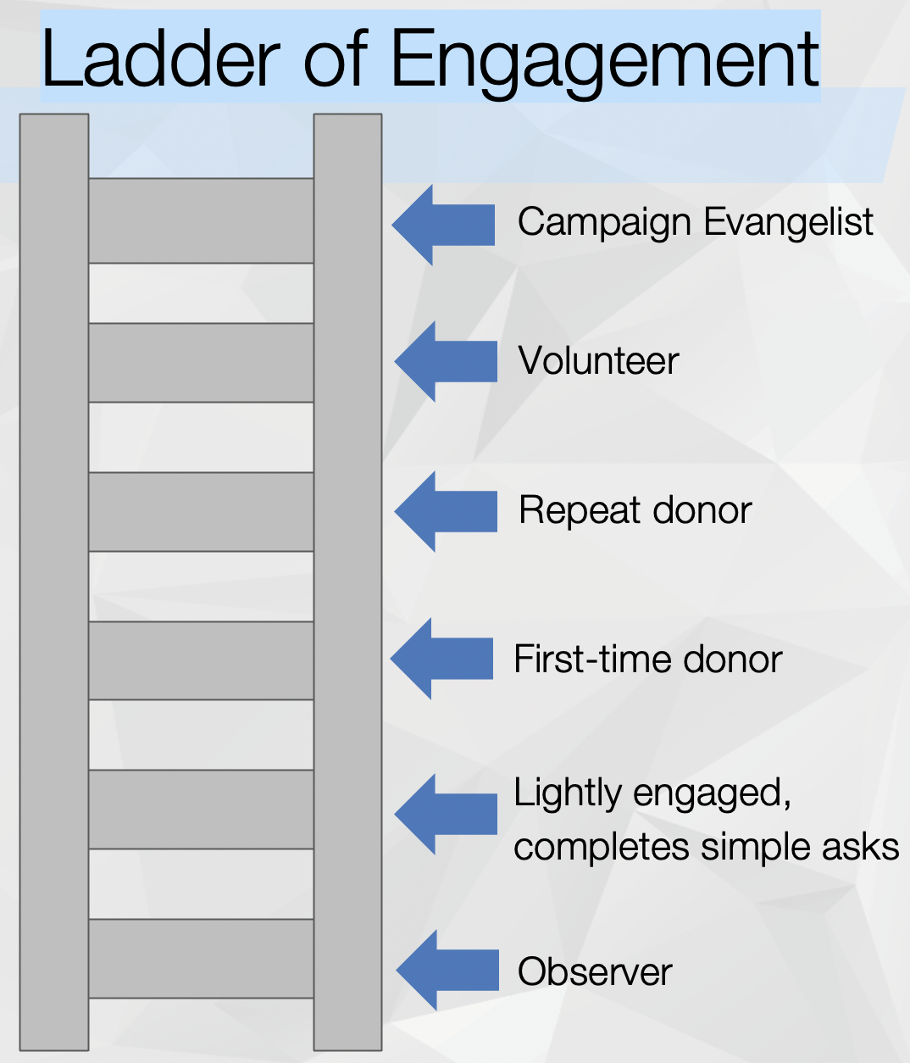


Develop Engagement plan
4
Once you have prioritized the gaps in your coalition you want to fill or shore up, outline a plan to engage each prospective coalition partner.
A
Who should engage them?
Consider:
Their relationship to this person/organization,
Their understanding of and commitment to your issue and campaign, and
Their ability to influence the prospective coalition member(s).
B
What is your case for their support?
Address:
Why they should partner
How their goals align with the goals of your campaign/coalition
Who else is involved whom they trust
C
What is your ask of them?
Identify a clear and specific ask:
Public endorsement or speaker’s bureau
Serve on campaign leadership or subcommittee
Financial support
Host educational activities with constituents
Standard Asks
Vote
Endorse
Volunteer
Donate
Promote
Notes:
10 mins: Walk through each of these, asking people to map this out for the person they identified in the following slide. Coach a volunteer through this from the large group.
Introduce the ladder of engagement to help people think about the cascade and types of asks (offering Yes for NOLA Kids as an example).

Slide 21
Goal: Prevent organized opposition from business or anti-tax groups
Potential influencer | Who should engage them? | What’s your case for their support? | What’s the immediate ask? | What’s the long-term potential ask?
 | Bill Hammack (Influential member and campaign co-chair) | This is a natural extension of their education agenda. Child care is impacting workforce availability. We have a sound plan with a track record to ensure good use of tax dollars. | Endorse & Membership Presentation | Contribute funds through PAC. Secure member donations. Provide surrogates.
 | Charmaine Caccioppi (EVP at United Way) | United Way has been a leader on this and it aligns with your Women United and long-term policy agenda for access to early care & education. | Presentation & Endorsement | Promote with other business leaders. Contribute funds. Support PR.
 | Hamilton | Child care is impacting workforce availability. We have a sound plan with a track record to ensure good use of tax dollars. | Endorsement | Funding. Source of donors and surrogates.
 | Charmaine Caccioppi (EVP at United Way) | There is widespread voter support for this (polling). We have a strong coalition and a sound plan with a track record to ensure good use of tax dollars. | Identify and address potential opposition | Continue to be a surrogate and champion.
Business: NOLA Business Council
Nonprofit: United Way Board & Public Policy Committee
Business: NOLA Chamber of Commerce
Elected Officials: City Council President

Slide 22
Goal: Austin
Potential influencer | Who should engage them? | What’s your case for their support? | What’s the immediate ask? | What’s the long-term potential ask?
Example | Example | Example | Example | Example
Example: Example

Slide 23
Goal: Baltimore
Potential influencer | Who should engage them? | What’s your case for their support? | What’s the immediate ask? | What’s the long-term potential ask?
Example | Example | Example | Example | Example
Example: Example

Slide 24
Goal: Birmingham
Potential influencer | Who should engage them? | What’s your case for their support? | What’s the immediate ask? | What’s the long-term potential ask?
Example | Example | Example | Example | Example
Example: Example

Slide 25
Goal: Cleveland
Potential influencer | Who should engage them? | What’s your case for their support? | What’s the immediate ask? | What’s the long-term potential ask?
Example | Example | Example | Example | Example
Example: Example

Slide 26
Goal: Columbus
Potential influencer | Who should engage them? | What’s your case for their support? | What’s the immediate ask? | What’s the long-term potential ask?
Example | Example | Example | Example | Example
Example: Example

Slide 27
Goal: East Baton Rouge
Potential influencer | Who should engage them? | What’s your case for their support? | What’s the immediate ask? | What’s the long-term potential ask?
Example | Example | Example | Example | Example
Example: Example

Slide 28
Goal: Jefferson Parish
Potential influencer | Who should engage them? | What’s your case for their support? | What’s the immediate ask? | What’s the long-term potential ask?
Example | Example | Example | Example | Example
Example: Example

Slide 29
Goal: Longmont
Potential influencer | Who should engage them? | What’s your case for their support? | What’s the immediate ask? | What’s the long-term potential ask?
Example | Example | Example | Example | Example
Example: Example

Slide 30
Goal: Northfield
Potential influencer | Who should engage them? | What’s your case for their support? | What’s the immediate ask? | What’s the long-term potential ask?
Example | Example | Example | Example | Example
Example: Example

Slide 31
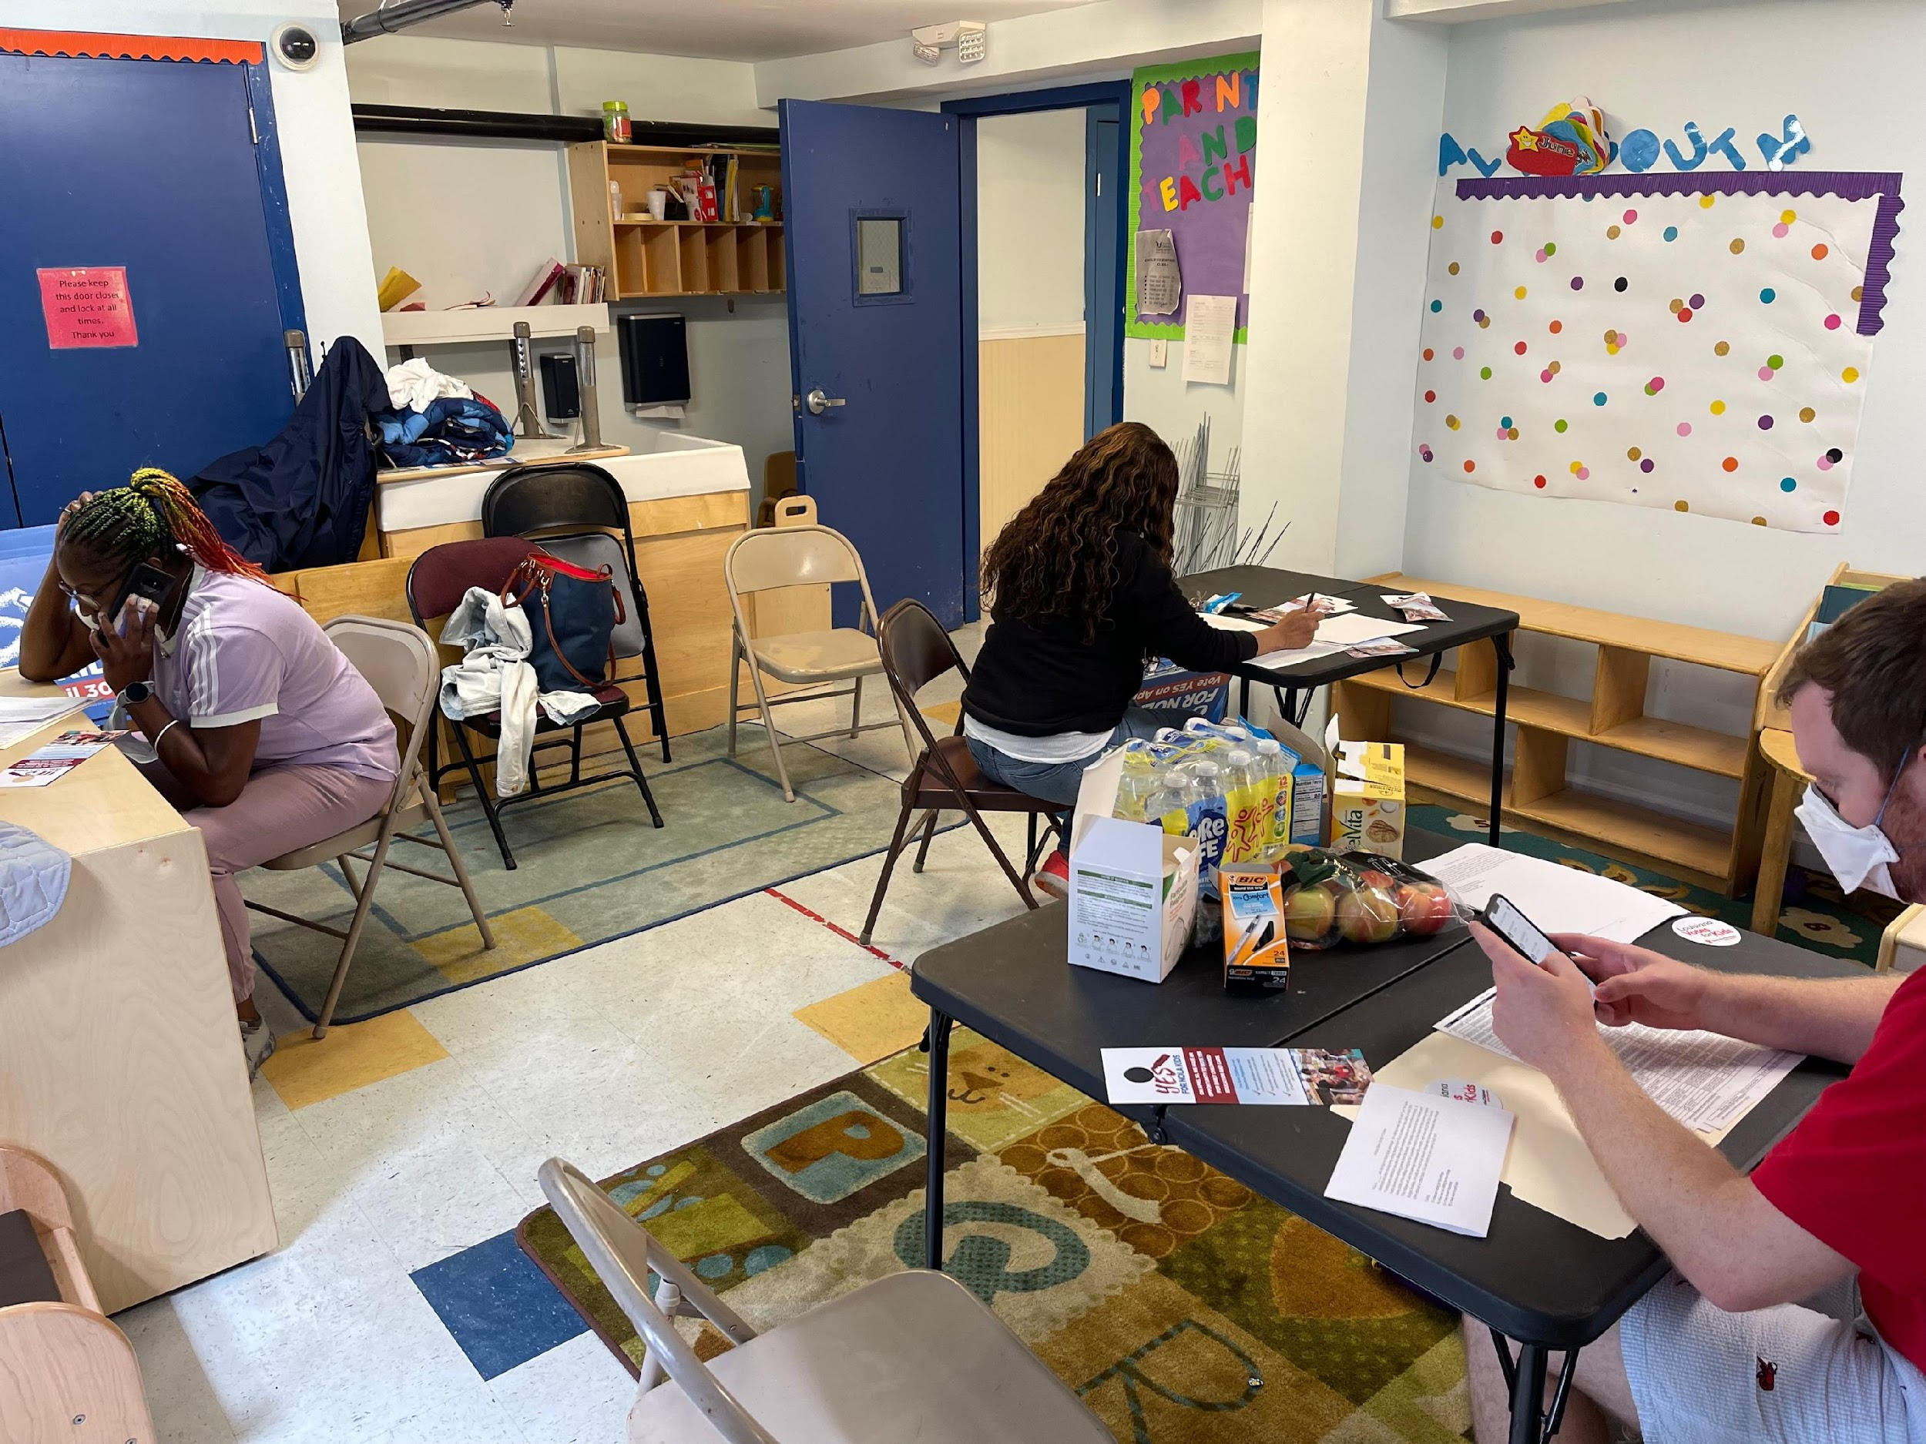

What worked and what didn’t?
A
B
Why?
Implement & Refine Engagement Plan
5
How should we change our coalition-building strategy?
C
Yes for NOLA Kids Volunteers Phone Banking
Notes:
3 mins: Go out and do it and listen carefully and learn from folks to understand what is working and what isn’t!

Slide 32


Thanks
Hamilton Simons-Jones
Hamilton@ResourceFullConsulting.com
Notes:
2 mins: Contact info. Evaluation form/feedback survey?
Sources for Stock Images, Icons, and Other Visuals for PowerPoint Presentations
Photos
Children’s Funding Project Stock Images Library: (file path: G:/CFP/Communications/Presentations/Stock Images) Consult this folder first to find photos used and approved by the Communications team. The subfolders are organized by the age of the children featured in the photos. https://drive.google.com/drive/folders/1FHffttD-QBhIf3FIQ9NYCAM1NUWZwTNz?usp=sharing
EDUimages: This free online collection features more than 700 photos of real children and educators in real schools; after-school, career preparation, and community-based programs; and preschools. NOTE: All photos in this collection have a photo credit that you must include with the image if you use it in your slide presentation. https://images.all4ed.org/
Unsplash: Free photos from a variety of genres. https://unsplash.com/
Pexels: Free stock photos from various genres. https://www.pexels.com/
Nappy: Beautiful, free high-resolution photos of Black and Brown people. https://nappy.co/
Also check out this list of Diverse and Inclusive Stock Photography and Illustration websites. NOTE: Most of these websites charge fees, but some do offer images for free or free with attribution/photo credit. https://www.linkedin.com/pulse/diverse-inclusive-stock-photography-lidia-varesco-racoma/
Icons/Illustrations
PowerPoint Icon Library: Open PowerPoint and start a new presentation. At the top in the tool bar, click the “Icons” tab to launch the icon library.
Flaticons: This website offers 8.0M+ free icons, stickers, and logos in PNG format. You can create a free account to access the icon library. NOTE: With the free account, you must include a credit/author attribution with any images you use in your presentation. https://www.flaticon.com/

