Slide 2
The Votes

Slide 3



Time and again, we see that the deepest divisions on funding for early childhood programs come on partisan and ideological lines.

Slide 4
  In Santa Clara County, voters support the concept of tax for early childhood by two to one…
Some people have suggested that Santa Clara County should improve and expand access to early childhood education programs to better prepare children for kindergarten. Would you support or oppose increasing local taxes to improve and expand early childhood education programs in Santa Clara County?
Total Support
64%
Total
Oppose
31%
Q15.

Slide 5
…but a majority of Republicans oppose it.
(% of Sample)
(47%)
(30%)
(23%)
15 Among Voters. Would you support or oppose increasing local taxes to improve and expand early childhood education programs in Santa Clara County?

Slide 6
Similarly, in 2012 San Antonio voted on a ballot measure to fund pre-K…
SALES AND USE TAX FOR THE PRE-K FOR S.A. EARLY CHILDHOOD EDUCATION PROGRAM. Adoption of a sales and use tax at the rate of one-eighth of one percent for the purpose of financing authorized programs of the San Antonio early childhood education municipal development corporation for a maximum period of eight years.

Slide 7
…and only passed it over the strong objections of Republicans.
(% of Sample)
(41%)
(30%)
(30%)
4. If the election on this measure were held today, would you vote for it or against it?

Slide 8
And when Prop 82 was on the ballot in 2006 here in California…
PRESCHOOL EDUCATION. TAX ON PERSONAL INCOMES ABOVE $800,000 FOR COUPLES, $400,000 FOR INDIVIDUALS. INITIATIVE CONSTITUTIONAL AMENDMENT AND STATUTE. Provides voluntary preschool education for all four-year olds, expands teacher training, requires annual audits. Funded by dedicated 1.7% tax on personal income above $800,000 for couples, $400,000 for individuals. Fiscal Impact: Additional state revenues of about $2.4 billion annually by 2010 through 2011, with comparable annual increases in total state and county expenditures for preschool programs.

Slide 9
…GOP voters were key opponents of the measure.
% of Sample
(45%)
(16%)
(39%)

Slide 10
The Values

Slide 11
Overwhelmingly, voters nationally say we should be doing more to ensure children start kindergarten ready to do their best – virtually no one says do less.
And when it comes to ensuring that children begin kindergarten with the knowledge and skills they need to do their best in school, do you think we should be... doing more, doing less, or are doing enough?
PUBLIC OPINION STRATEGIES • HART RESEARCH ASSOCIATES

Slide 12
Republicans share this belief, though with somewhat less intensity.
Start Kindergarten with Skills/Knowledge To Succeed By Party
PUBLIC OPINION STRATEGIES • HART RESEARCH ASSOCIATES
12

Slide 13
In California, voters – including conservatives – think pre-school has broad benefits.
Pre-school programs benefit everyone, by leading to better-educated kids, lower crime rates, and a stronger economy
Pre-school programs primarily benefit the children who are enrolled in them, and their parents and families
Both/Neither/NS/DK
OR
47% to 33% among conservatives

Slide 14
California voters across the ideological spectrum also say pre-school strengthens K-12 education.
Pre-school programs strengthen K through 12 education. Studies show that kids who go to pre-school learn to read faster, are less likely to fall behind their classmates, and are less likely to drop out of school.
Pre-school programs weaken K through 12 education. They take money and qualified teachers away from elementary and secondary school classrooms, where investments in education are more likely to help our kids.
Both/Neither/NS/DK
OR
53% to 27% among conservatives

Slide 15
On the issue of money, we see strong perceptions that more is needed...
In your personal opinion, do you think preschool programs in Hawaii have a great need, some need, a little need, or no real need for additional funds?
Great/
Some
Need
81%
Little/
No Need
13%
Q8.

Slide 16
…a perception which is broadly shared by Democrats, independents and Republicans.
Democrats
Independents
Republicans
(% of Sample)
(14%)
(26%)
(12%)
(25%)
(8%)
(11%)
8. In your personal opinion, do you think preschool programs in Hawaii have a great need, some need, a little need, or no real need for additional funds?

Slide 17
And in national polling, when the subject is federal investment…
“Congress is considering a plan that helps states and local communities provide better early childhood education programs to parents of children from birth to five. It provides ten billion dollars per year for ten years in grants to states to provide all low and moderate income four year olds with voluntary access to high‐quality preschool programs. It also makes available voluntary programs in high‐quality early education and child care for infants and toddlers, as well as home visiting and parent education.”
PUBLIC OPINION STRATEGIES • HART RESEARCH ASSOCIATES

Slide 18
…seven-in-ten American voters are supportive…
Total Support | 71%
Total Oppose | 23%
Would you support or oppose this plan to help states and local communities provide better early childhood education?
PUBLIC OPINION STRATEGIES • HART RESEARCH ASSOCIATES

Slide 19
…and the concept gets support from three-in-five GOP voters.
PUBLIC OPINION STRATEGIES • HART RESEARCH ASSOCIATES
19

Slide 20
Core elements of the plan receive broad support…
Ranked By % Total Important
Making early education and child care more affordable for working families to give children a strong start.
Very Important
Funding would only be provided to programs that meet specific standards that have been proven to work for educating young children and keeping them healthy.
Helping states and local communities build better preschool services for parents and making them more accessible to children from low and middle income families.
Making available high quality early learning programs for infants and toddlers to give them a strong start on developing school ready knowledge and social skills.
Providing voluntary home visiting and parent education programs that help first‐time parents support their child's early learning, health and emotional development.
There are a few different parts to this plan. Please tell me if you think each of the following is very important, somewhat important, not that important, or not important at all.
PUBLIC OPINION STRATEGIES • HART RESEARCH ASSOCIATES

Slide 21
…and there is little variation in response by partisan affiliation.
 | GOP | IND | DEM
Making early education and child care more affordable for working families to give children a strong start. | 87% | 89% | 97%
Funding would only be provided to programs that meet specific standards that have been proven to work for educating young children and keeping them healthy. | 83% | 83% | 93%
Helping states and local communities build better preschool services for parents and making them more accessible to children from low and middle income families. | 78% | 83% | 93%
Making available high quality early learning programs for infants and toddlers to give them a strong start on developing school ready knowledge and social skills. | 71% | 76% | 89%
Providing voluntary home visiting and parent education programs that help first‐time parents support their child's early learning, health and emotional development. | 70% | 73% | 89%
Plan Items By Party (% Total Important)
PUBLIC OPINION STRATEGIES • HART RESEARCH ASSOCIATES

Slide 22
The Barriers… and the Responses

Slide 23
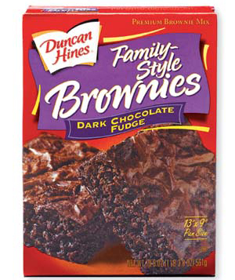
Stay on the
Front of the
Brownie Box
Notes:
23

Slide 24
Messages That Work – with Everyone
Helping kids at a critical period for brain development
Strengthening K-12 education by investing in pre-K
Return on investment from helping young children
Benefits for the economy and workforce
The value of prevention

Slide 25

Barrier #1: Taxes
As long as the debate focuses on increased taxes, conservative voters will be resistant. Even voters who agree that it is worth investing in early childhood do not necessarily believe that government needs additional dollars to make those investments – thinking instead that they should rely on what they have.

Slide 26
Key Responses: Taxes
It can be possible to split conservative voters on certain tax mechanisms – young versus old, women versus men, and moderate versus conservative.
Sunset provisions can give voters more comfort taking a “leap of faith” with a new tax.
Certain taxes – notably sin taxes – are capable of drawing significant Republican support.
Messengers with credibility as tax skeptics – like GOP officials or business leaders – can have great credibility.

Slide 27
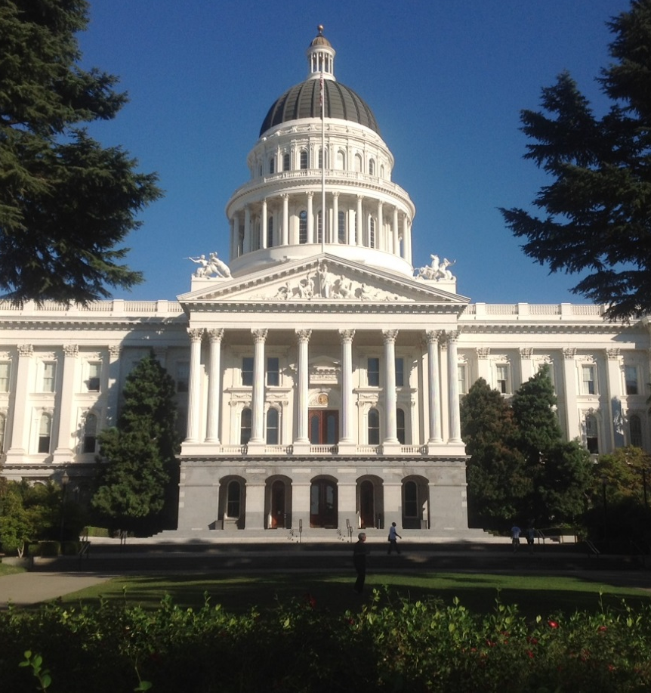
Barrier #2: Government
Conservative voters lack confidence in government – particularly at the state and federal levels – to create broad and positive social change.

Slide 28
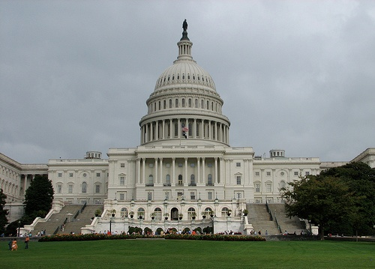
Forty years after Watergate, distrust in government has hit a record low.
Proportion Believing Government Can be Trusted to Do What is Right “All or Most of the Time”
1972
1974
August 2014
53%
36%
13%
University of Michigan Surveys
Notes:
28
28

Slide 29
Key Responses: Government
Most important are accountability mechanisms – audits, citizen oversight, public disclosure – which give voters more feeling of control.
Avoid creating new layers of government wherever possible – take advantage of expanding existing programs.
Devolve authority and control to the lowest level of government possible – community-level governance is best.
Build on and DOCUMENT existing successes.

Slide 30
Audits, oversight, and measurement are compelling.
Total More Likely | Total Less Likely
79% | 20%
77% | 22%
75% | 22%
74% | 23%
All spending would be subject to independent annual financial audits
The measure would include specific standards for measuring the pre-school programs’ effectiveness every year
All spending would be reviewed by a citizens’ governing board
All spending would be reviewed by a citizens’ oversight board
San Antonio, 2012

Slide 31
As we saw in Arizona, showing a record of success is highly important.
Total % Ext./ Very Important
74%
73%
70%
70%
65%
61%
66,000 children benefit from healthier, safer learning environments
The parents of 80,000 newborns can leave the hospital with information about healthy parenting practices
69,000 food boxes have been distributed, including 2 million pounds of food and 76,000 other items, such as diapers and formula
33,000 children are receiving higher quality child care
3,000 more children will have access to specialized therapists in their communities
10,000 children have received child care scholarships that allowed their parent to work or look for work

Slide 32

Barrier #3: Competing Priorities
Given a perception of scarce and constrained resources, conservative voters assign higher funding priorities to other services like K-12 education, public safety, and roads.

Slide 33
Key Responses: Competing Priorities
Highlight the silver lining of a tax increase – it does not take a penny from existing services.
Emphasize that pre-K strengthens K-12 education; voters believe it.
Highlight the preventive power of early childhood investments – the ways that they free up education, public safety, and public health resources.
Use teachers, public health nurses, police, and other service providers as messengers advocating for investment in kids.

Slide 34

Barrier #4:
The “Nanny State”
Conservative voters are skeptical of government programs that appear to intrude into private lives or absolve parents of responsibility for caring for their children – or worse, provide incentives for them to do less.

Slide 35
Key Responses: The Nanny State
Encourage, incent, and require parent involvement at any opportunity.
Always frame the issue as helping children – not helping parents.
Highlight instances where money is not being spent or directed by government – as grants to non-profits, for example.

Slide 36
As we saw in San Antonio, requiring a role for parents helps.
Total Ext./ Very Imp.
86%
69%
73%
76%
74%
72%
Encouraging parent involvement in pre-school
Providing dedicated funding that can only be spent on preschool education
Offering pre-school spaces to military families that do not currently have access to them
Requiring parent involvement in pre-school
Aiming to improve third grade math and reading scores
Focusing pre-school programs on reading, math, and lifelong learning skills

Slide 37

Barrier #5:
The Undocumented
Here in California, conservatives are highly attuned to any perception that expanded social services will benefit undocumented immigrants. This is particularly true in rural and southern California communities.

Slide 38
Key Responses: The Undocumented
In some cases, policies may explicitly include funding for the undocumented – a fact which can be clarified.
Draw clear distinctions between undocumented adults and undocumented children – who played no role in immigration decisions and may have significant needs.
Explain that denying early health and education services to undocumented children yields higher costs over the long term – for education, health, and public safety.
Highlight the fact that the undocumented pay taxes into the system without receiving benefits in return.

Slide 39

Questions

