Slide 2
The Big Picture

Slide 3
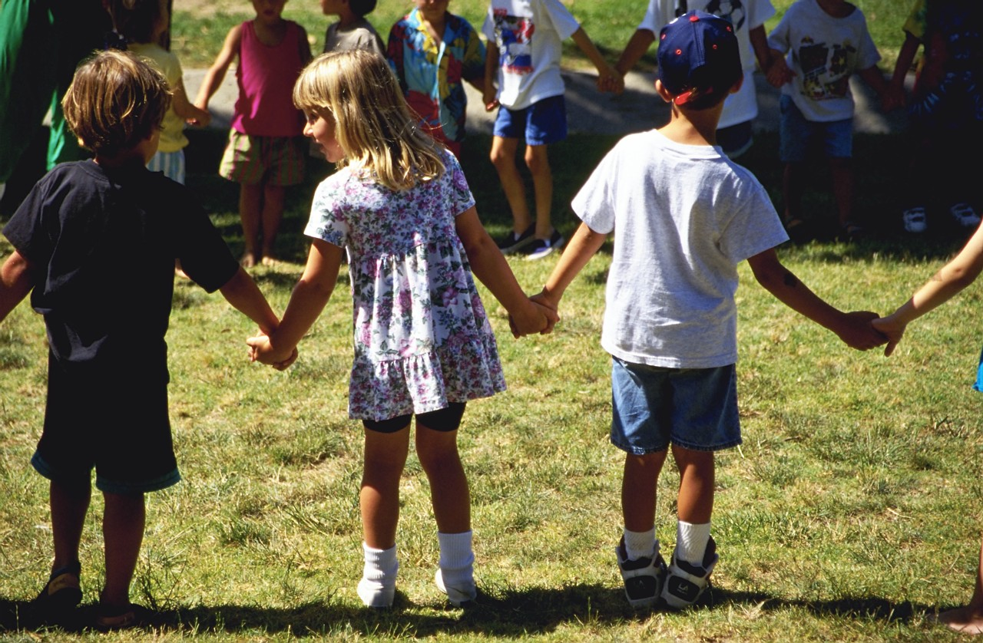
Even in tough economic times, our research continually shows that voters are willing to vote to increase funding for services that benefit kids. Why?

Slide 4
Voters rank helping kids as a more urgent priority than many other national issues.
#1:

Slide 5
Voters place children getting a strong start in life as one of the highest national priorities.
Now I'm going to read you some goals that people might have for our country right now, and I'd like you to rate how important you personally consider each goal to be ‐ is it extremely important, very important, somewhat important or not that important to you.
Ranked By % Extremely/Very Important
Extremely
Important
Making sure that our children get a strong start in life so they will perform better in school and succeed in their careers
Making sure that working parents can find quality, affordable child care for their young children
Improving access to quality health care for low‐income families
Improving roads, highways, and other infrastructure
2013 National Survey by Public Opinion Strategies/Hart Research Associates

Slide 6
Voters appreciate the critical and lasting importance of helping kids while they are very young.
#2:

Slide 7
A plurality of voters views one to three as the most critical ages in a child’s development.
What do you think is the most important age for developing a child’s capacity to learn? Is it…
2004 Arizona Voter Survey

Slide 8
Voters see addressing root problems early as the best way to keep kids out of trouble.
I am going to read you two statements that describe different approaches to addressing youth related problems. Please tell me which one you think is the best way to prevent kids from falling behind and dropping out of school or turning to gang violence and drug abuse.
Addressing root problems before they start by providing support services for kids and their families, like after-school and community based programs that keep kids out of trouble, encourage parent involvement, and teach non-violent conflict resolution.
Setting up stronger consequences for criminal and unacceptable behavior, which means putting more cops on the street, getting tough on juvenile crime and truancy, and ending social promotion.
Both/Neither/DK/NA
OR
2008 City of Oakland Survey

Slide 9
Voters don’t believe that we, as a society, are doing enough to help kids.
#3:

Slide 10
Overwhelmingly, voters say we should be doing more to ensure children start kindergarten ready to do their best – virtually no one says do less.
And when it comes to ensuring that children begin kindergarten with the knowledge and skills they need to do their best in school, do you think we should be doing more, doing less, or are doing enough?
2013 National Survey by Public Opinion Strategies/Hart Research Associates

Slide 11
In our hyper-partisan time, kids are one issue that is non-partisan.
#4:

Slide 12
Voters across the political spectrum say that we should be doing more.
Start Kindergarten with Skills/Knowledge To Succeed By Party
2013 National Survey by Public Opinion Strategies/Hart Research Associates

Slide 13
Voters see investments in kids as helping everyone – not just individual kids and their families.
#5:

Slide 14
And three in five voters say these programs benefit everyone, not just the children who are enrolled and their families.
Pre-school programs benefit everyone, by leading to better-educated kids, lower crime rates, and a stronger economy.
Pre-school programs primarily benefit the children who are enrolled in them, and their parents and families.
Both/Neither/Not sure/Don't know
OR
2012 San Antonio Voter Survey

Slide 15
Key Findings in Solano County

Slide 16

Methodology
600 telephone interviews with Solano County voters likely to cast ballots in November 2016
  Interviews conducted September 23-28, 2014
  Interviews on both landlines and cell phones
Margin of sampling error of +/- 4.0%
Some percentages may not sum to 100% due to rounding

Slide 17


Attitudes toward local public agencies that help children and youth are favorable.
I am going to read you a list of names of some local institutions that are often in the public eye. Please tell me if your overall impression of that institution is favorable or unfavorable. If you don’t recognize any of them, just say so.
Total Fav. | Total Unfav.
58% | 26%
65% | 24%
60% | 20%
27% | 4%
Q1.

Slide 18
Only ten percent believe the County’s children are “very well-prepared” for Kindergarten.
In general, how prepared do you think Solano County’s children are for learning when they enter kindergarten: are they…
Total
Prepared
58%
Total Not Prepared
18%
Q6.

Slide 19
Solano County voters feel a strong sense of collective responsibility for helping kids.
I am going to read you a series of statements.
Please tell me whether you agree or disagree.
Total Agree | Total Disag.
86% | 12%
87% | 9%
81% | 18%
Q7.

Slide 20
Voters see a substantial need for funding programs that benefit children and youth.
I am going to read a short list of public services in Solano County. Please tell me if you think there a great need for additional funding, some need, a little need or no real need for additional funding.
Great/ Some
81%
79%
77%
78%
67%
77%
Q2. Split Sample

Slide 21
The tipping point for support seems to be right around $50 per year.
Regardless of how the money were raised, would your household be
willing to pay ______ in additional taxes to improve and expand
access to children’s services throughout Solano County?
Total Will. | Total Unwill.
39% | 58%
51% | 48%
59% | 39%
69% | 29%
Q10.

Slide 22
Voters offer the strongest support for helping homeless youth and child abuse prevention.
Ranking the Importance of Children’s Services to be Funded
Ext./Very Impt.
81%
76%
69%
67%
68%
Q8. Split Sample

Slide 23
Majorities rate many other services as “very important.”
Ext./Very Impt.
65%
65%
62%
65%
65%
61%
65%
61%
57%
54%
8. I am going to read you a list of some of the specific items that might be funded by this measure. Please tell me how important it is to you that money from the measure be used to pay for that particular project—is it extremely important, very important, somewhat important or not too important? Split Sample

Slide 24
A message about supporting parental responsibility tests most strongly.
(PARENTS) The most important factor in helping kids succeed in school is getting their parents involved. That’s why this measure requires parents to actively participate in their kids’ education, from pre-school through graduation – by bringing kids to school on-time and ensuring they have excellent attendance; participating in school activities; and reading to kids at home.
^(BRAIN DEVELOPMENT) Research shows that a child’s brain develops most dramatically during the first five years of life. This critical period is a window of opportunity to lay the foundation for all of the years that follow. By voting for this measure, we can help ensure that every child in Solano County has the health and education support they need to get off to a strong start.
(SCHOOL READINESS) Voting “yes” on this measure will help to strengthen local schools. Increasing access to quality pre-school programs will help strengthen K-12 education. Studies show that kids who go to pre-school are better prepared to learn, more likely to read by the fourth grade and more likely to graduate and go on to college.
80%
75%
77%
12. Here are some statements from people who support the measure. Please tell me whether you find it very convincing, somewhat convincing, or not convincing as a reason to vote yes on this measure. ^Not Part of Split Sample

Slide 25
Messages about the broader benefits of the measure also score highly.
(BETTER FOR EVERYONE) It will be better for all of us who live in Solano County if we can support programs to make sure that every parent can meet their children’s basic needs for food and shelter and that every child has the opportunity to succeed.
(CRIME) Studies show that quality preschool cuts crime by helping kids stay in school and stay out of trouble with crime, drugs and gangs. By helping Solano County kids get the right start in life, this measure helps keep kids on the right track and out of the criminal justice system.
(INCREASING NEED) Since the recession in 2008, more Solano County children are living in poverty. In Solano County, nearly one in three households with children now qualifies for food stamps, and over 2,000 children are homeless. This measure will help to ensure that we can meet the needs of our most vulnerable residents.
75%
67%
64%
12. Here are some statements from people who support the measure. Please tell me whether you find it very convincing, somewhat convincing, or not convincing as a reason to vote yes on this measure. ^Not Part of Split Sample

Slide 26
A message focused on economic benefits is generally the least compelling.
(HAND UP NOT HAND OUT) The programs for children that this measure will support – whether they are quality preschool, after-school programs, or efforts to help at-risk kids – provide the support children need to succeed so they can be self-reliant as adults. They provide a hand UP, not a hand out.
(ACCOUNTABILITY) This measure has strict accountability provisions, including citizens’ oversight, annual independent audits and public reporting of all expenditures, to ensure that funds are spent efficiently and as promised to voters.
(JOBS/ECONOMY) Our local economy depends on having skilled, educated workers, and being a place where companies and workers want to locate. This measure will help us make the investments now to ensure that our economy will be strong into the future.
76%
69%
64%
12. Here are some statements from people who support the measure. Please tell me whether you find it very convincing, somewhat convincing, or not convincing as a reason to vote yes on this measure. ^Not Part of Split Sample

Slide 27
Demographic Profiles of Groups Disproportionately Likely to Support, Oppose, or be Swing Voters on Additional Investments in Kids
Consistent Supporters | Swing Voters | Consistent Opponents
Latinos | Ages 75+ | Republican Men
Liberal Democrats | Republicans Ages 18-49 | Republicans Ages 50+
Independents Ages 18-49 | Use All/Mostly Landline | Conservative Republicans
Liberal | Conservative | Liberal/Moderate Republicans
Democratic Women | Conservative Republicans | Republicans
Liberal/Moderate Independents | Children Attend Public School | Conservative
African-Americans | Republican Men | Republicans Ages 18-49
Independent Women | Republicans | Conservative Independents
Women Ages 18-49 | Moderate/Conservative Democrats | Men Ages 50+
BOS District 1 | Ages 40-49 | Republican Women
Ages 18-29 | HH Income $0-$30,000 | Have Adult Children
Ages 30-39 | Children's Ages 5-10 | Independents Ages 50+
Children Do Not Attend Pre-School/Pre-K | African-Americans | Ages 65-74
Voters of Color | Permanent Absentee Voters | HH Income $120,000+
Interviewed on Cell Phone | All Other Cities | Men

