Slide 1


DRAFTING A BALLOT MEASURE
Margaret Brodkin, Founder/Director Funding the Next Generation
With Meredith Hayes, Whatcom County, WA, Children’s Fund Campaign
March 23, 2022, Children’s Funding Institute

Slide 2

Key elements of a successful children’s funding measure
Title of ordinance
Rationale for Measure
Purpose and goals
Services eligible for funding
Excluded services
Oversight body
Administering entity
Spending plan & accountability
Source, amount, duration
Preventing supplantation

Slide 3
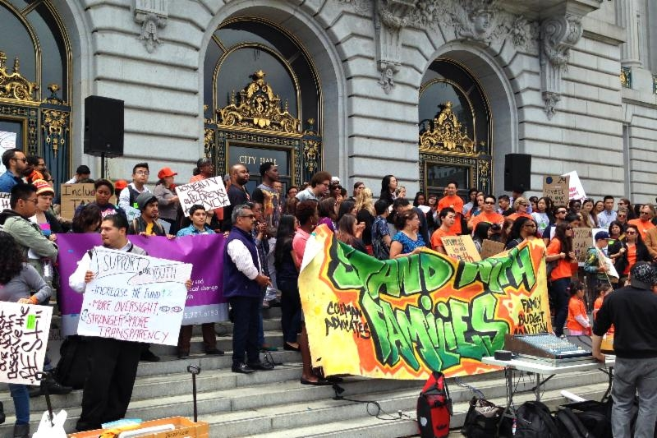

Building power with a shared vision
Establishing a children’s fund is an opportunity to build a movement for children in your community.
No matter who is doing the final drafting, use the drafting process to build a shared vision by:
Engaging more people in the civic process
Build productive collaborations across diverse community institutions to arrive at a consensus.
Ensure that the coalition goes through all elements of the measure and grapples with decision points together.
Reaching a consensus with your allies about the basic elements of the measure takes time, but ultimately it brings you together and prepared you for the challenges of a campaign.
Notes:
Get down to specifics
Engage the network

Slide 4
Process
Your measure might be placed on the ballot by signature petition or by local legislative action. The method by which it is placed on the ballot will impact the drafting process:
If your measure is being placed on the ballot by a city or county official body, the final and official draft of the measure will be done by the attorney for your city or county. You must negotiate with the officials placing the measure on the ballot.
Placing the measure on the ballot by signature/petition allows your coalition to get exactly what you want in the measure, but also requires your campaign to hire a lawyer with sufficient expertise in local election and finance law.
or
Tips:
The drafting process could take anywhere from 6 weeks to 6 months, so start early, and leave plenty of time to draft edit and finalize your measure.
Throughout this process, your measure will continue to evolve. Creating the perfect measure is impossible and drafting a measure with sufficient political and public support requires compromise.
Consider the appropriate level of detail you want in the ordinance – a balance between flexibility and accountability.

Slide 5


Title of Ordinance
If you don’t carefully title your measure, someone else will, and that name will show up everywhere, from the ballot, to yard signs (both pro and anti!), and all over the media. Most people will only know the name of the ballot measure, so
use it to establish your brand and convey key messages, &
cement it by including it in the measure itself!
Include some version of the world “child” and/or “youth”
Include the name of your city or county, so people understand this local measure will benefit their community directly
Title | Rationale | Purpose | Eligible | Excluded | Oversight | Administration | Accountability | Source | Supplantation

Slide 6

Examples
CAUTIONARY TALES
San Francisco, CA advocates wanted their measure to be called “The Children’s Amendment,” but never officially named it in the measure. So, the media would only refer to it as “Proposition J.”
In 2016, Fairfax County, VA advocates for a tax that would reduce reliance on real estate taxes and increase school funding was rejected. The name? “Fairfax County Meals Tax.” This focused voters on what they’d be paying, rather than what they’d gain, and the measure failed.
Establishment of Children's Services Council of Leon County
(Leon County, FL, 2020)
Children’s Health and Child Care Initiative for Alameda County
(Alameda County, CA, 2019)
Families, Education, Preschool, and Promise Levy
(Seattle, WA, 2018)
Title | Rationale | Purpose | Eligible | Excluded | Oversight | Administration | Accountability | Source | Supplantation
Notes:
Families, Education, Preschool, and Promise Levy (Seattle, WA, 2018)

Slide 7
Rationale for measure
WHAT CAN YOU INCLUDE? Data about the needs of your city’s/county’s children
Benefits and outcomes of similar measures or research findings about similar services History of efforts to improve services and/or develop the measure.
Cost arguments for the expenditures Why a fund is necessary and potentially beneficial
Your rationale is your findings, initial statements, or basic arguments about the need and the history that led to the legislation. It is your permanent documentation about why this measure is important. It is the “Forward” to the measure.
Title | Rationale | Purpose | Eligible | Excluded | Oversight | Administration | Accountability | Source | Supplantation
Notes:
Seattle’s is 11 pages.

Slide 8
Purpose & goals
This section can address questions, such as:
What are you committing to? (ex. racial equity, prevention, civic participation, best practices, the need for collaboration, leveraging resources, maximizing partnerships, accountability, affordability)
What specific populations will this measure target? (ex. children in poverty, children in all neighborhoods, homeless children, youth impacted by systems)
What models of care will be prioritized? (ex. high quality early care and education, workforce development, evidence-based services, etc.)
What outcomes are anticipated? (ex. all children ready for kindergarten, all youth have opportunities for positive development, all providers make a living wage)
What goals will this measure help the community meet? (Ex. the health, safety, and school success for individual children; gather data on welfare of children; )
Your measure should include a compelling statement of purpose that illuminates the fund’s general principles & goals.
This is one of the most important parts of the measure, because it will be referred to over years as controversies inevitably arise, and as you seek to evaluate whether the purpose of the measure is met. It will keep the funding stream focused on what is important.
Title | Rationale | Purpose | Eligible | Excluded | Oversight | Administration | Accountability | Source | Supplantation

Slide 9
Services eligible for funding
Include a list of the services (ex. childcare) that can be funded. The level of detail of this list will vary! Could put in percentage of money going to various services.
Define the population that can be served, either by directly stating or implying the age group. This might look like “ages 0 – 24” or like “early care,” “youth,” or “preschool.”
Explicitly define and limit allowable services to families if you want to provide parenting and family support services.
Be clear about what agencies are eligible to apply for funds (e.g., government, non-profits, schools)
It is very important to include a definition of children’s services and some parameters for those services. Otherwise, it becomes too easy to include almost anything (such as fire protection) as a service to children.
Example: A children’s service benefits children directly and does not include services that benefit children incidentally or as members of a larger class including adults.
Title | Rationale | Purpose | Eligible | Excluded | Oversight | Administration | Accountability | Source | Supplantation

Slide 10
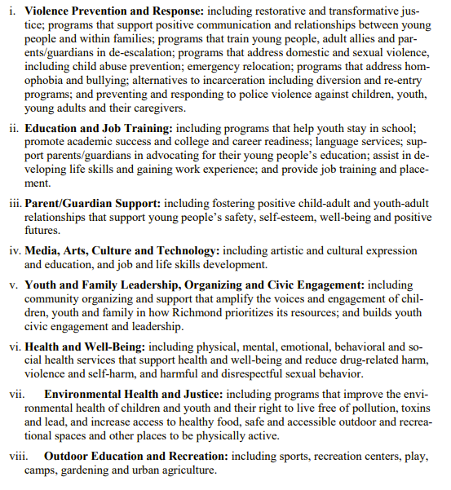
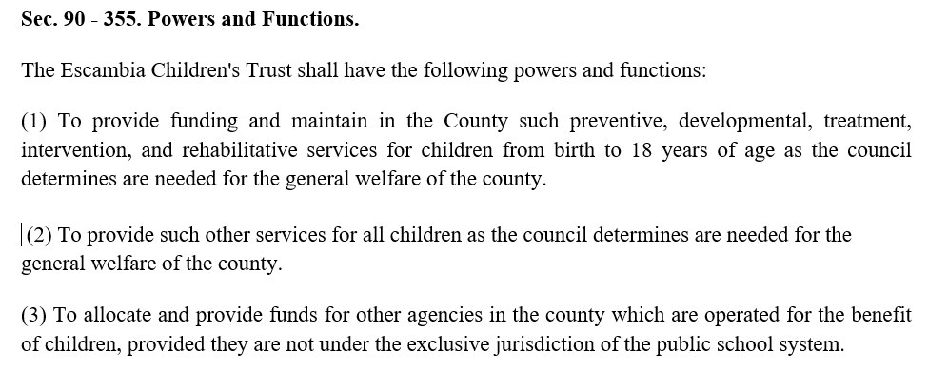
Examples
Richmond, CA
Explicitly lists and eligible program and service types.
Escambia County, FL
Very loosely defines eligible programs and services, which will be based on a mandated annual needs assessment. Escambia has the benefit of a statewide model for CSCs.
Title | Rationale | Purpose | Eligible | Excluded | Oversight | Administration | Accountability | Source | Supplantation
Notes:
Richmond page 4 - Richmond f K ballot language.pdf
Also added Deportation Support

Slide 11
Excluded services
Some examples include:
  Law enforcement (often listed as specific agencies, such as Police or District Attorneys)
  any service that benefits children incidentally or as members of a larger class including adults
  Capital expenses (should be the express purpose of the fund OR be limited or excluded)
  The core functions of local school districts (school districts may still be a fund recipient)
  Basic operations of other special districts or purposes such as zoos or libraries.
  Mandated matches required by state or federal law.
In order to protect the integrity of the Fund, you may wish to list services that CANNOT receive funding. Each community will have something specific that they can foresee taking a chunk out of the fund if not excluded.
Title | Rationale | Purpose | Eligible | Excluded | Oversight | Administration | Accountability | Source | Supplantation

Slide 12
Oversight
Define the composition of the body: Is this a new or existing body? Who has power to appoint members? (legislative body, city or county executive, some combination, others?) What are background requirements for members? How many seats? What is the term length? What specific representation do you want to ensure? (ex. youth voice, geographic representation, provider voice, expertise in certain fields, etc.) Reimbursement & conflict-of-interest requirements of oversight body Will the body have its own staff, which will ensure independence?
Your measure will need to outline an oversight body that will oversee the governance of the fund and ensure that it is implemented in a way that is consistent with the goals stated in the measure.
Your measure should:
clarify the power of the body (on a continuum from advisory to decision-making) and
lay out the oversight body’s functions and responsibilities - such as funding approval, creating a funding plan, reviewing finances of the administering entity, ensuring public engagement, hiring the fund manager, and reporting to the legislative body.
Title | Rationale | Purpose | Eligible | Excluded | Oversight | Administration | Accountability | Source | Supplantation
Notes:
Functions can include

Slide 13
Administering entity
Administrative details you can include in your measure:
Your measure can either identify the entity that will administer the Fund or provide criteria for creating/selecting this entity.
You may choose for this entity to be:
A cap on administrative costs, such as 10%. Pros: The public loves it. Cons: Administrating agency may find it constraining. Contracting, funding cycle, data collection, application and/or reporting processes for grantees of the fund. Financial reporting Reporting to city/county governing body Hiring process and/or characteristics of leader of department/agency
WITHIN GOVERNMENT An office or department responsible for children and youth services
OUTSIDE OF GOVERNMENT
or
An intermediary contracted by government to administer the Fund.
If you will be creating a new office (e.g., an Office of Children and Youth Services) to administer your fund - you may want to establish it either in your measure or before introducing your measure.
Title | Rationale | Purpose | Eligible | Excluded | Oversight | Administration | Accountability | Source | Supplantation

Slide 14
Spending plan & accountability
WHAT CAN YOU INCLUDE?
Require that funding priorities are based on a needs assessment that includes input from the public, recipients of services, service providers, government.
Mandate a public spending plan and an approval process that includes public participation. Require components of the spending plan, such as specific programs, funding amounts, target populations, and measurable objectives.
Mandate that an annual or bi-annual written report on the Fund is approved by the oversight body, presented to the local legislative body, and made public via public forum and online.
There are several mandates you can include in your measure to promote and ensure transparency and accountability.
A major way to do this is to require and define a public planning process that engages all stakeholders. You can state the planning cycle timeline – for instance, every 3 years.
You can also require a regular independent evaluation of the services funded; and allow a percentage of the fund (e.g., up to 5%) to fund the evaluation.
Title | Rationale | Purpose | Eligible | Excluded | Oversight | Administration | Accountability | Source | Supplantation

Slide 15
Funding source
DURATION
Consider using a sunset (a date by which the fund must be reauthorized) as a selling point.
Rule of thumb: make sure the Fund is in place long enough to accomplish something significant, but short enough to convince the public there will be chance to evaluate it and rescind the measure if need be.
A standard sunset is 10 years.
In this section you might note that unspent funds can be carried over from year to year – a very important point.
The measure must describe the source of public revenue for the fund; and may include extensive legal detail. If establishing a new tax, you must include:
a definition of the tax
tax rate
provisions for incorporation of state law & tax collection
exemptions and exclusions
TIP: Give the fund a name, such as Solano Fund for Children and Youth, or simply Children’s Fund. The name will be used many times, including for accounting purposes. Put the words “child” or “youth” in the name.
Title | Rationale | Purpose | Eligible | Excluded | Oversight | Administration | Accountability | Source | Supplantation
Notes:
If possible, put the purpose and services to be funded at the beginning of the measure and the legal mechanisms for funding toward the end. OR, summarize the type of tax and duration early on, and put the details of the tax at the end. For the people who will actually read the measure and must vote on it, it is best to understand the need and what it will accomplish first.

Slide 16
Preventing supplantation
What is a CHILDREN AND YOUTH BASELINE BUDGET?
Maintenance of effort requirement for current level of local spending.
Can be calculated by local fiscal officers after measure passes.
Creates high visibility for children’s spending within each department of government.
Develops ongoing way to measure spending on kids.
This is a critical part of a measure – the assurance that new funds are not used to supplant existing funds. This needs to be stated clearly as an explicit goal in 2 ways:
Creating new or expanded services articulated as goal
Disallowing supplanting funding for existing services
Title | Rationale | Purpose | Eligible | Excluded | Oversight | Administration | Accountability | Source | Supplantation

Slide 17
Translating to the ballot question
Can you spot the stronger question?
Shall the City impose a new gross receipts tax of 1% on revenues a business receives from leasing warehouse space in San Francisco, and 3.5% on revenues a business receives from leasing some commercial spaces in San Francisco, to fund quality early care and education for young children and for other public purposes?
WEAK
The City or County attorney will translate your measure into the ballot question. The framing of this question is crucial, as it is the final (and in many cases only) representation of your measure people will see before they vote.
Before the question is finalized for the ballot, many cities or counties provide a formal hearing to appeal the wording. USE IT
RECEIVED
OF THE VOTE
50%
To expand access to childcare and preschool for low- and middle-income families; help homeless and at-risk children, including help preventing child abuse and neglect; attract and retain quality childcare workers; and add spaces for childcare at locations throughout the county, shall the County of Alameda enact a 30-year ½% sales tax providing approximately 140 million dollars annually with citizens’ oversight, public disclosure of spending, and mandatory annual audits?
STRONG
RECEIVED
OF THE VOTE
65%
Notes:
GREAT: ALAMEDA COUNTY CHILDCARE AND EARLY EDUCATION MEASURE- To expand access to childcare and preschool for low- and middle-income families; help homeless and at-risk children, including help preventing child abuse and neglect; attract and retain quality childcare workers; and add spaces for childcare at locations throughout the county, shall the County of Alameda enact a 30-year ½% sales tax providing approximately 140 million dollars annually with citizens’ oversight, public disclosure of spending, and mandatory annual audits? 65% VOTED YES
OK: CITY OF RICHMOND CHILDREN AND YOUTH FUND MEASURE - Shall the Charter of the City of Richmond be amended to provide that a portion of general fund money shall be set aside for funding youth programs and services? 76% VOTED YES
WEAK: SAN FRANCISCO CHILDCARE MEASURE - Shall the City impose a new gross receipts tax of 1% on revenues a business receives from leasing warehouse space in San Francisco, and 3.5% on revenues a business receives from leasing some commercial spaces in San Francisco, to fund quality early care and education for young children and for other public purposes? 50% VOTED YES
GREAT STRUCTURE: CITY OF MERCED MARIIJAUNA TAX MEASURE - Generating approximately $1,000,000 annually locally to fund Merced Police, Fire, Parks, Recreation services such as 911 emergency response; neighborhood-based policing; fire/gang prevention services; skilled police officers and firefighters; and safe, clean parks; shall the City of Merced adopt an ordinance authorizing an annual commercial cannabis business tax of up to: $25 per square foot of cultivation space, or 10% of gross receipts until ended by voters, with independent citizens oversight? 78% VOTES YES

Slide 18
Links to libraries of measures & questions
1. Ordinances/ballot measure language
2. Ballot questions

