Slide 1

Building a Lasting Coalition
Yes4Kids Tax Measure – Act One
Sonja Koehler
Yes4Kids Cabinet
sonjackoehler@gmail.com

Slide 2


Slide 3
What we did intentionally . . .
  Drafted flexible language, collaboratively
  Engaged community early on
  Neutralized opposition
  Gathered broad endorsements

Slide 4


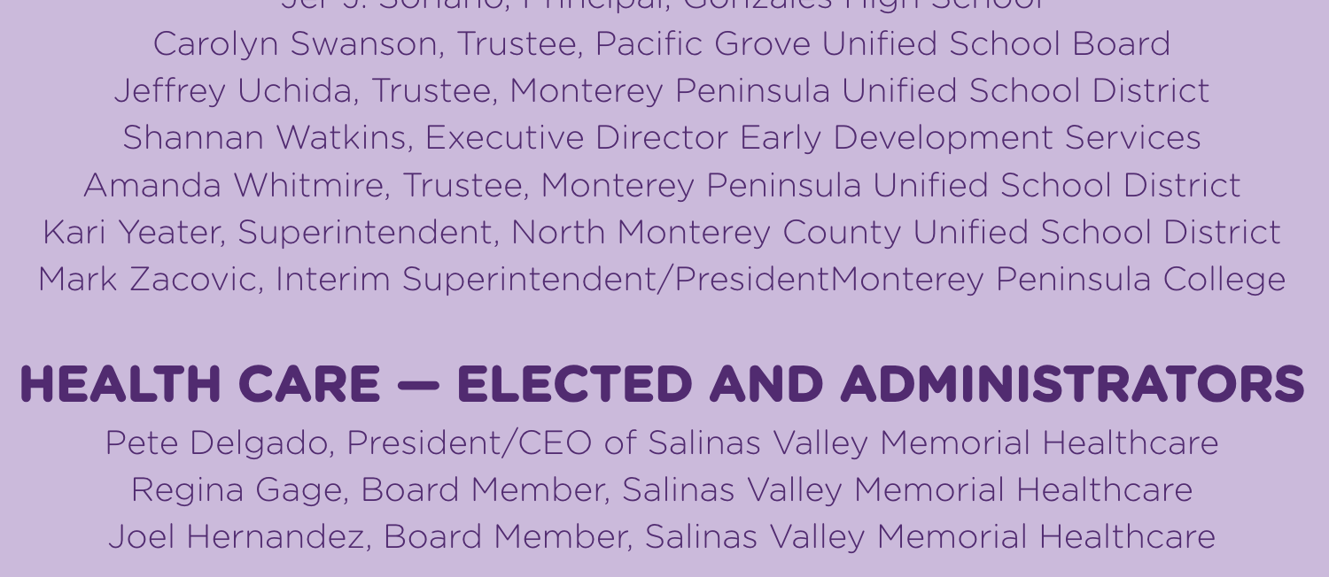
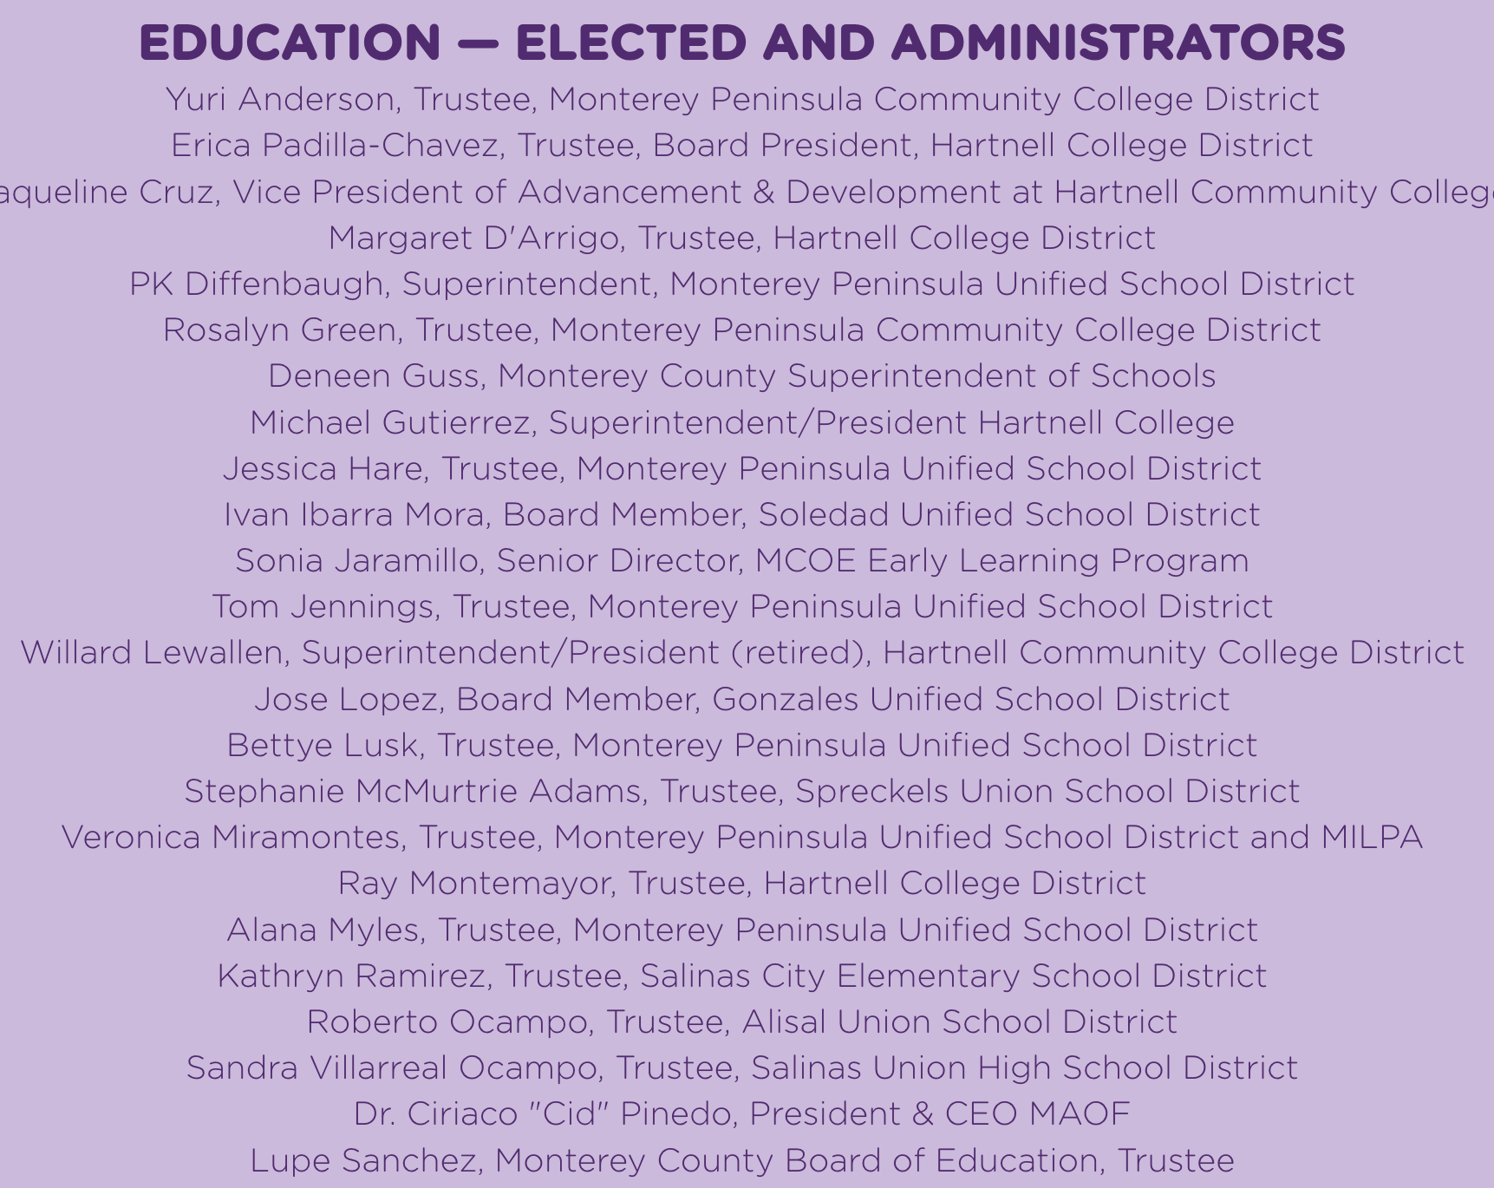
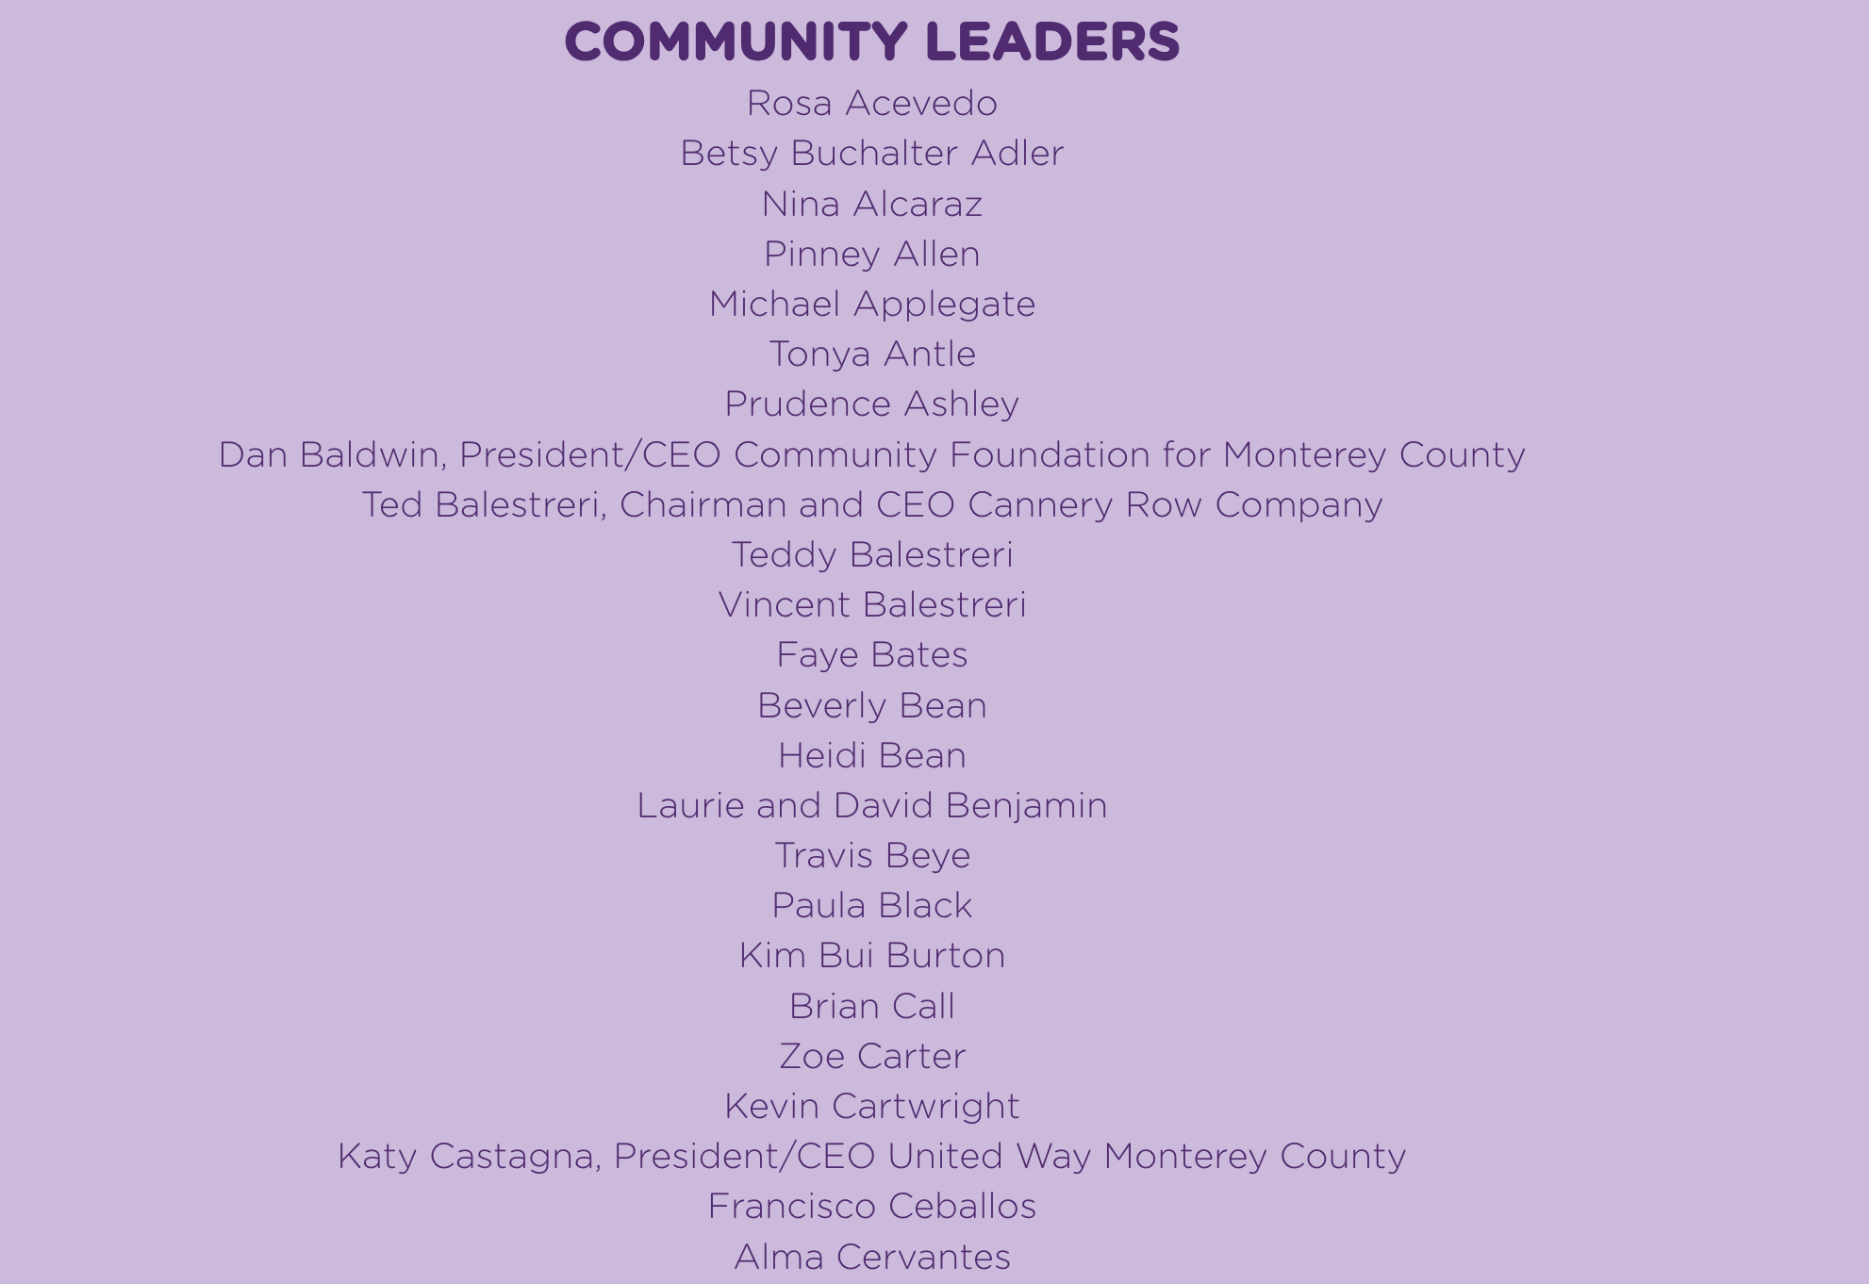
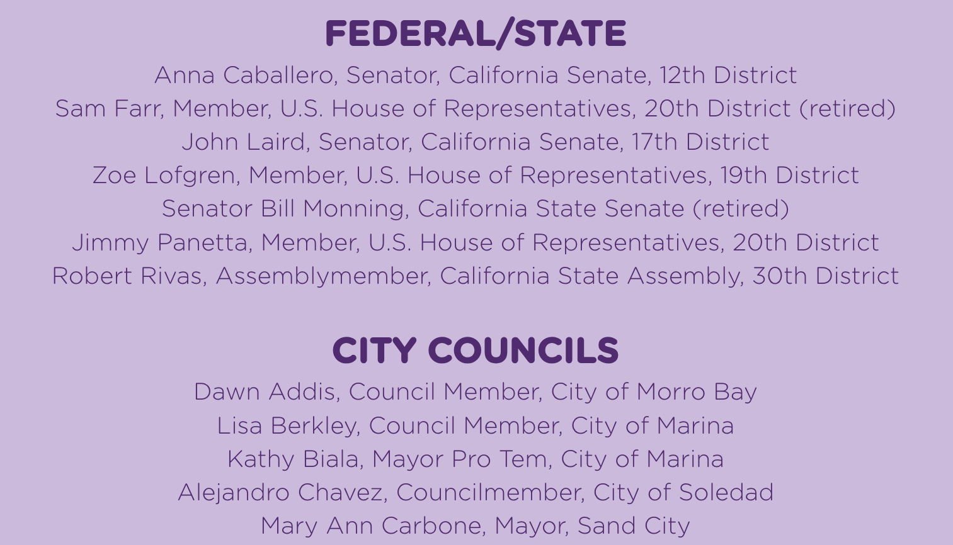

Slide 5
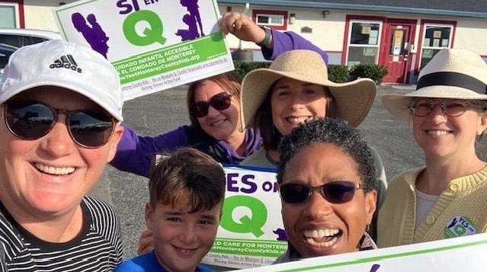

Slide 6
We lost a surprisingly large margin.
  Low voter turn out across the state
  Endorsing = willingness to mobilize
  ?!? It’s still a puzzling plot twist

Slide 7
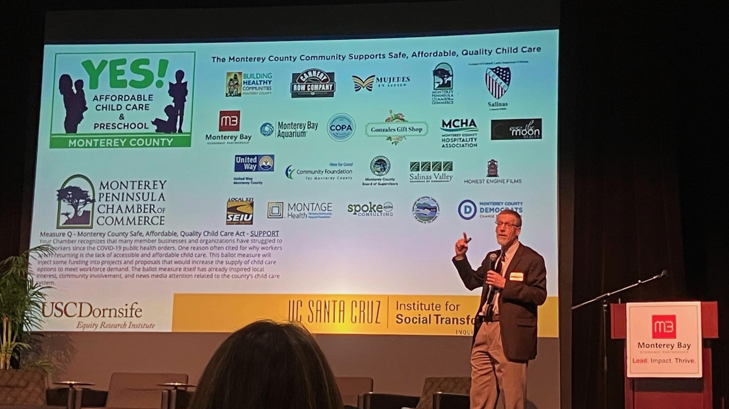

Slide 8
Simply act one of winning.
  We started the conversation
  We now know better what resonates
  We are building a lasting coalition

Slide 9
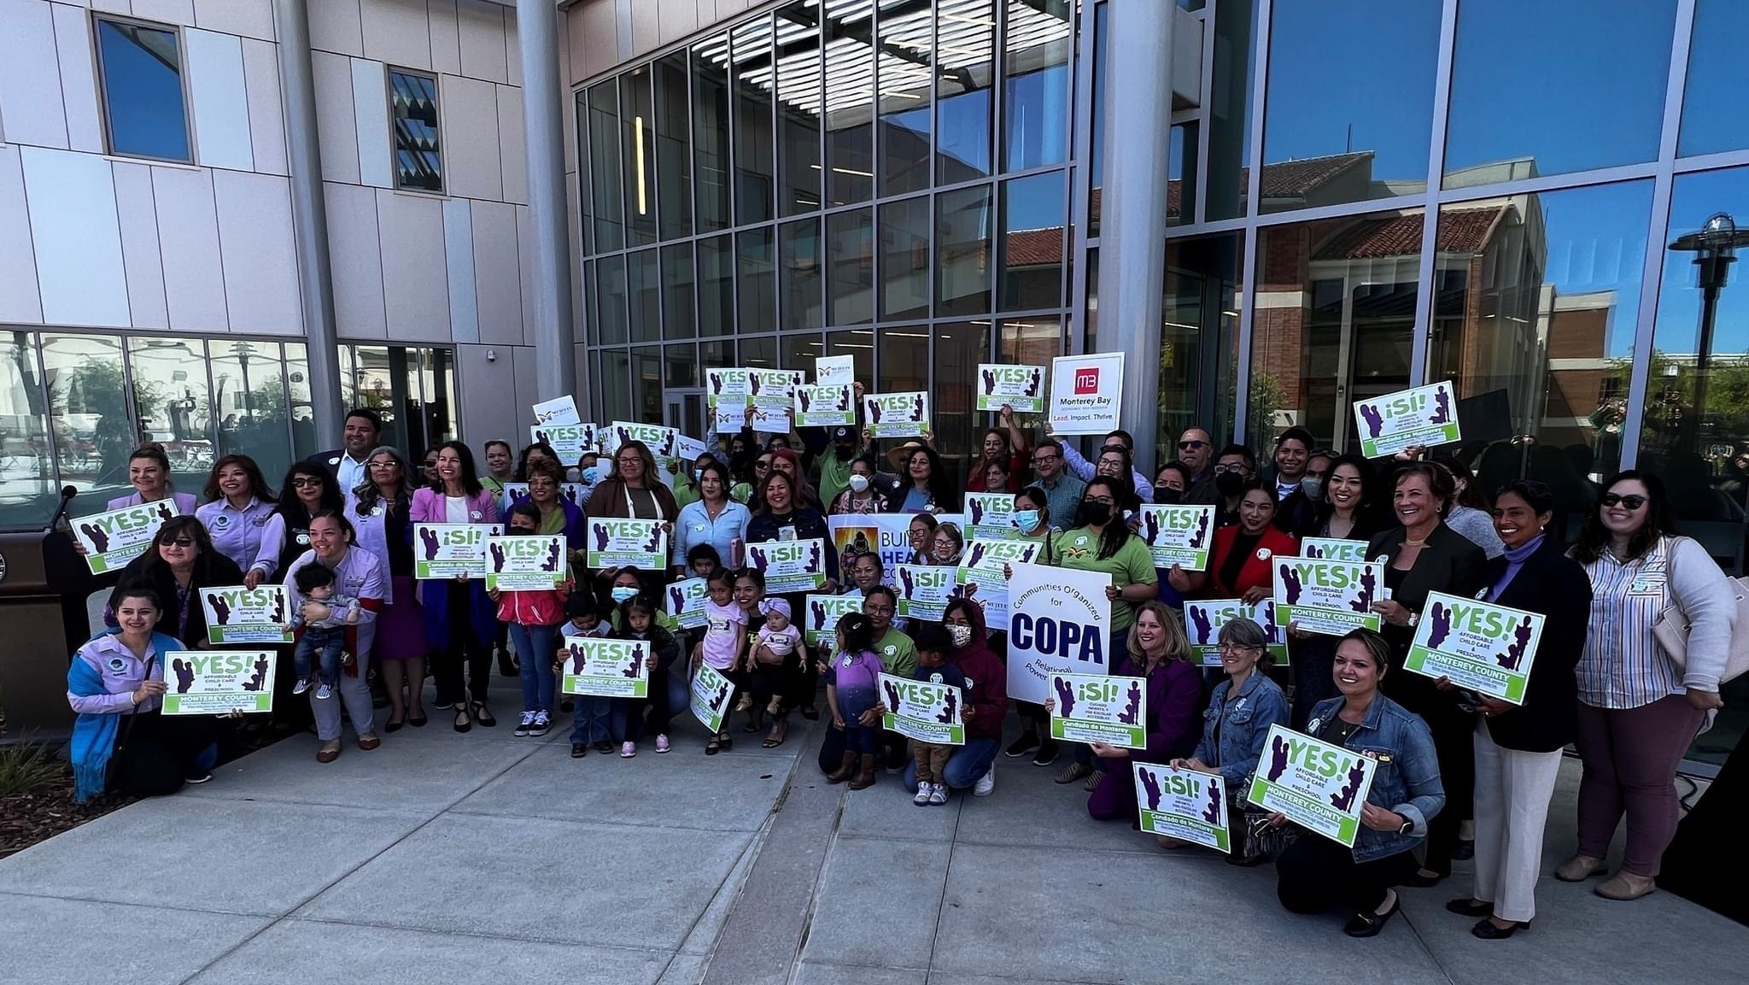
sonjackoehler@gmail.com

