Slide 1

What can city departments do to help facilitate the creation of a voter-approved dedicated fund for children and youth?
    June 27, 2025,
    Meeting of California’s city departments and offices of youth development.
    Long Beach, CA

Slide 2

WHAT NEEDS TO BE IN PLACE?
  Convening organization and dedicated staff
  Diverse network/coalition prepared for political engagement
  Baseline information on community needs
  Agreement about what to fund
  Time and motivation to organize the base
  Resources to lay groundwork, e.g., dedicated staff support
  Political champion(s) - desirable, not necessary
  Passion and willingness to take risks

Slide 3
ELEMENTS OF PRE-CAMPAIGN WORK
Research
Building coalition
Budget advocacy
Developing legislation
Educating the public
Getting on the ballot
NOTE: City departments can play key role in all these strategies

Slide 4
TIMELINE EXAMPLE
RESEARCH
BUILD AND STRENGTHEN THE COALITION
BUDGET ADVOCACY
DEVELOP LEGISLATION
EDUCATE and ENGAGE THE PUBLIC
GET ON BALLOT

Slide 5
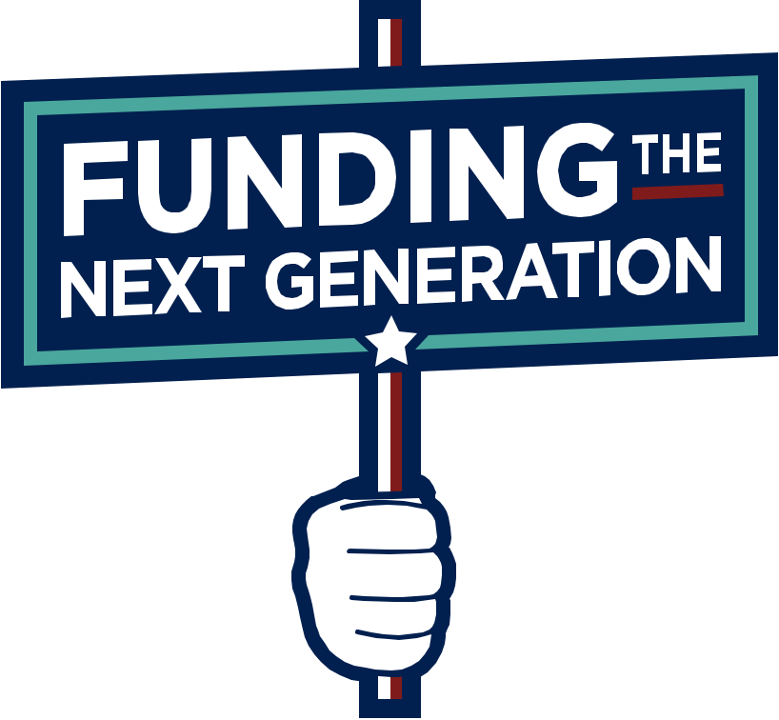
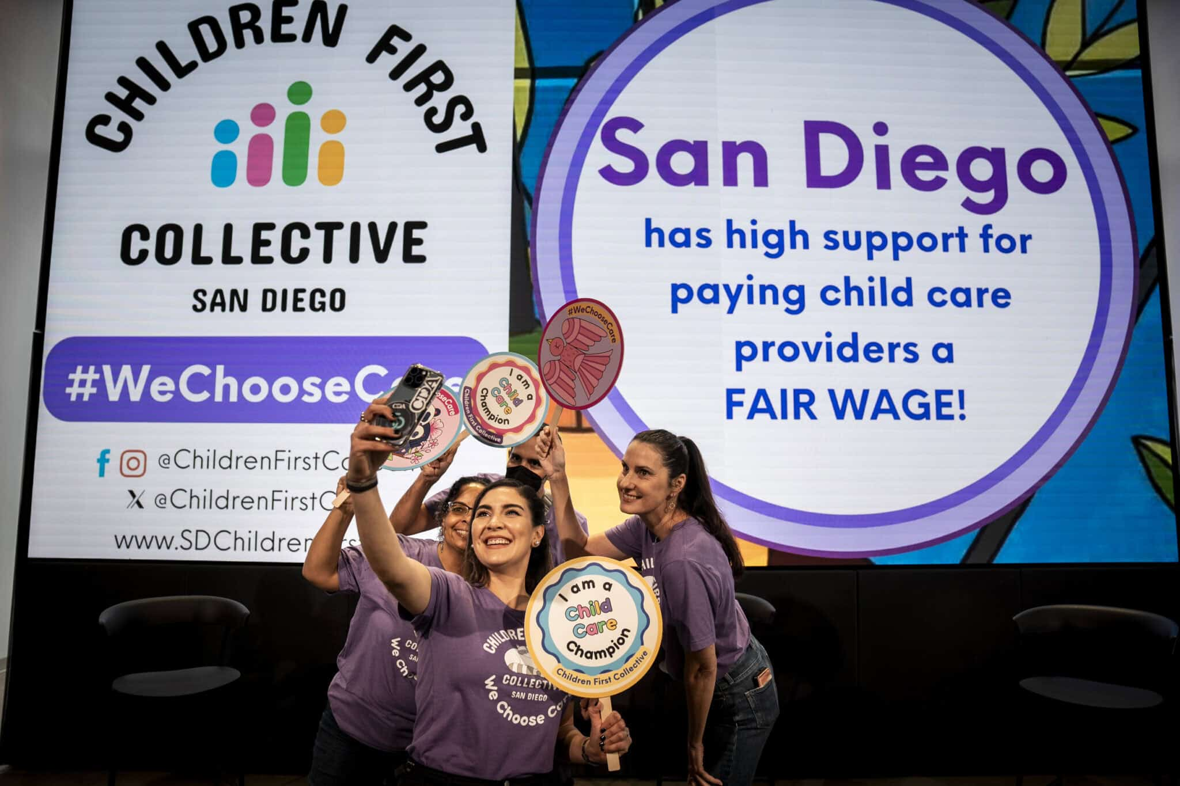
GUIDELINES FOR CITY DEPARTMENTS IN PREPARING FOR A BALLOT MEASURE
Understand what government can and can’t do.
Develop strong partnerships with advocates for an inside/outside strategy.
Do as much background research as possible – document need, design model system, develop costs of care, etc. Share and be transparent.
Educate and cultivate support from local elected officials who can champion an effort – Mayor, City Council, etc.
Educate city departments about unmet needs. Engage them in support. Minimize competition
Understand campaign leadership must ultimately come from a community-based coalition.
Help develop and train community leadership including youth voices
Conduct public education campaigns about child and youth needs and benefits of services.

Slide 6
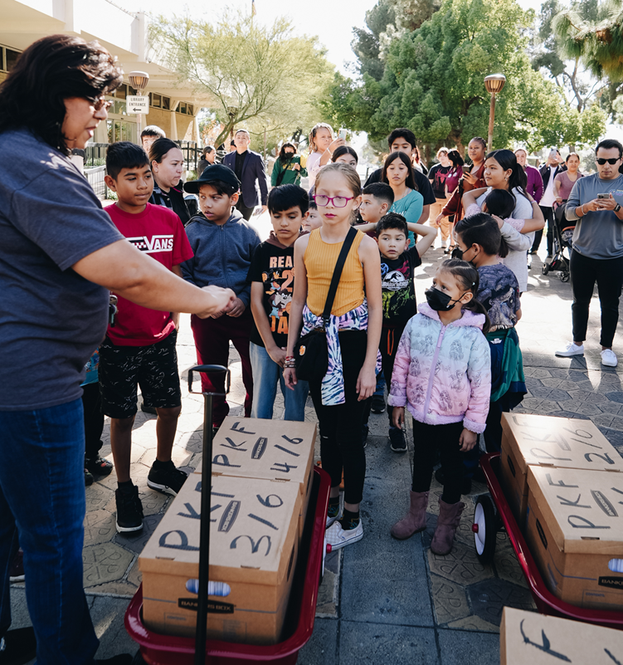
EXAMPLES OF ACTIVITES TO SUPPORT A FUTURE MEASURE
Sponsor events that build community like family picnics, resource fairs, conferences.
Publish and disseminate needs assessments and budget data.
Sponsor a teach-in for community agencies on data about needs and budgets.
Build e-mail and mailing lists to educate community through social media, newsletters, opinion pieces.
Attend community planning and coalition meetings aimed at improving services and generating public support. Volunteer for key pieces of work.
Encourage city to conduct a poll or include opinions about children’s needs in a general poll.
Connect community advocates to key resource people and information in government.
Convene the initial meetings about need for greater revenue and strategy options.

Slide 7
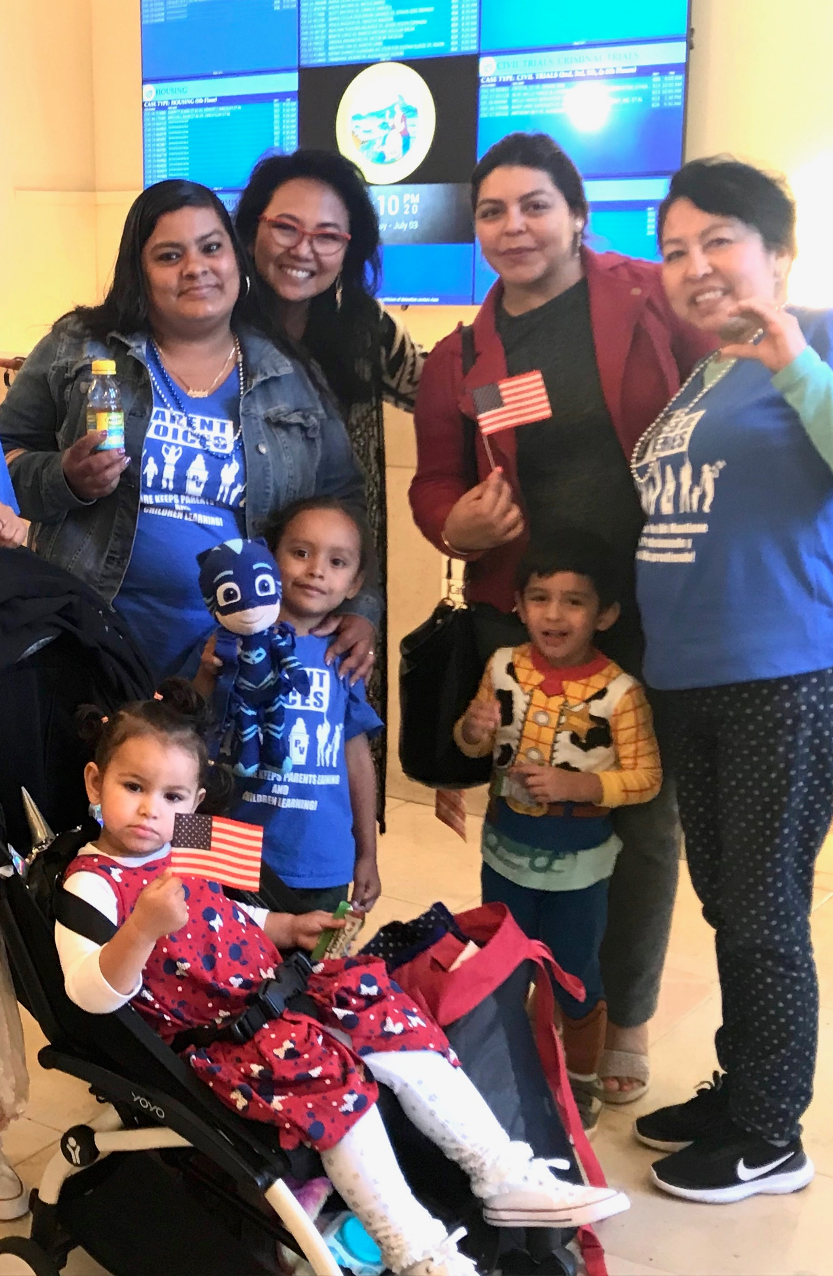
OTHER POTENTIAL SOURCES OF FUNDING FOR CITY DEPARTMENTS
Foundation grants – Focus on system building - coordination, evaluation, experimental projects
State and federal grants – partner with community in applications
Partnerships with other city departments – e.g., youth internships, particularly in departments with resources, such as police and fire and public works
Partnerships with local businesses and corporations, financial institutions and hospitals
Taking lead on community benefits, fees on tickets and other items, voluntary donations on city bills, etc.
Become active part of city-driven tax increase measures. i.e., sales.

